Slide 1
وبائيات وصحة عامة السنة الخامسة د رسمية الزيدان
Epidemiology and public health
Fifth year
Dr Rasmieh Alzeidan

Slide 2
General principles of epidemiology

Slide 3
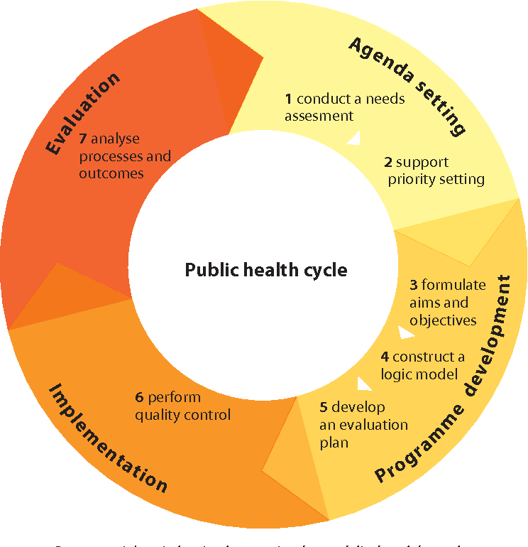
General Principles Of Epidemiology

Slide 4
General principles of epidemiology
Endemic The amount of a particular disease that is usually present in a community. It's also called a baseline.
Epidemic/ out break وباء
outbreak or an epidemic is the occurrence of more cases of disease than expected in a given area or among a specific group of people over a particular period of time.
Pandemic جائحة
epidemic that has spread over several countries or continents and affects many people ( Covid-19)

Slide 5
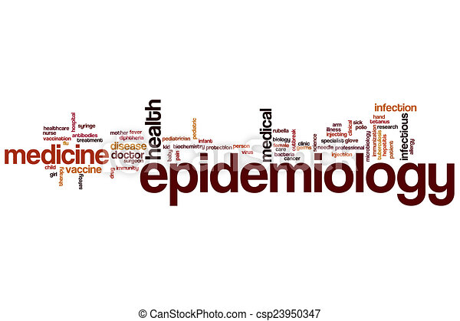
General principles of epidemiology
Definitions
Styles/types of epidemiological studies
Cycle of infection
Genetic concept
Epidemiological variables
Epidemic investigation

Slide 6
Definitions
Epidemilogoy
Epidemiology is the study of the distribution and determinants of health-related states or events in specified populations, and the application of this study to the control of health problems.

Slide 7
Definitions
In summary
pidemiology is the study (scientific, systematic, data-driven) of the distribution (frequency, pattern) and determinants (causes, risk factors) of health-related states and events (not just diseases) in specified populations (patient is community, individuals viewed collectively), and the application of (since epidemiology is a discipline within public health) this study to the control of health problems.

Slide 8
Definitions
public heath
What is public health?
Public health is the science of protecting and improving the health of people and their communities.
This work is achieved by promoting healthy lifestyles, researching disease and injury
prevention, and detecting, preventing and responding to infectious diseases

Slide 9
Cycle of infection
Agent :
Clostridium tetani, It is gram-positive anaerobic bacillus, producing neurotoxin (exotoxin).
The vegetative form of organism is fragile,
Reservoir :
The soil and intestinal tract of animals specially horses and cattle in which the organism is harmless normal inhabitant.
Source of infection: The source of infection is the soil or street dust containing the spores
Exit: The stools of animals specially horses.
Mode of transmission:
Inlet: Wounds, puncture, burns or umbilical cord stump.

Slide 10
Cycle of infection
Reservoir
(Cattle, sheep, horses)
EXIT
Skin, GIT
or
Respiratory system
Mode
of
Transmission
Direct (soil,
animal products)
Common Vehicle
Air Borne
Source
( contaminated animal
products)
Inlet
Skin abrasion, GIT or
respiratory system
AGENT
Bacillus Anthracic

Slide 11
Types Of Epidemiological Studies
What are the 2 types of epidemiology?
Epidemiologic studies fall into two categories: experimental and observational
Cohort studies are best for studying the natural progression of disease or risk factors for disease;
case-control studies are much quicker and less expensive.
Cross-sectional studies provide a snapshot of of a disease or condition at one time, and we must be cautious in inferring disease progression from them.

Slide 12
Genetic concepts
Genetics is the study of genes, genetic variation, and heredity in organisms.
It is an important branch in biology because heredity is vital to organisms' evolution.
Gregor Mendel, a Moravian Augustinian friar working in the 19th century in Brno, was the first to study genetics scientifically.
Mendel studied "trait inheritance", patterns in the way traits are handed down from parents to offspring over time.
He observed that organisms inherit traits by way of discrete

Slide 13
Epidemiological Variables
In epidemiology,
nominal variables with only two categories are very common
alive or dead, ill or well, vaccinated or unvaccinated, or did or did not eat the potato salad.
A nominal variable with two mutually exclusive categories is sometimes called a dichotomous variable.

Slide 14
Genetic concepts
Genetic epidemiology is a discipline closely allied to traditional epidemiology
that deals with the analysis of the familial distribution of traits.
It emerged in the mid-1980s bringing together approaches and techniques developed in mathematical and quantitative genetics, medical and population genetics, statistics and epidemiology.
The purpose of this chapter is to familiarize the reader with key concepts in genetic epidemiology as applied at present to unveil the familial and genetic determinants of disease and the joint effects of genes and environmental exposures.

Slide 15
Epidemic Investigation
The purpose of the epidemiologic investigation is:
to identify a problem,
collect data,
formulate and test hypotheses
. It involves the collection and analysis of more facts
or data to determine the cause of illness and to implement control measures
to prevent additional illness.

Slide 16
Steps of Epidemic Investigation
Securing the Scene.
Separating the Witnesses.
Scanning the Scene.
Seeing the Scene.
Sketching the Scene.
Searching for Evidence.
Securing and Collecting Evidence.

Slide 18
2.Epidemiology and prevention of Some acute diseases
Immunological Bio- factors
Measles and influenzas
Brucellosis and Typhoid fever
Sexual diseases
Viral hepatitis
Tuberculosis

Slide 19
2 Epidemiology Of Prevention Of Some Acute Diseases

Slide 20
2 Epidemiology And Prevention Of Some Acute Diseases

Slide 21
2.Epidemiology and prevention of Some acute diseases
Immunological Bio- factors
Measles and influenzas
Brucellosis and Typhoid fever
Sexual diseases
Viral hepatitis
Tuberculosis

Slide 22
Immunological Bio-factors
There is a role of the immune system in cancer etiology
measuring immune response as part of the host response to exogenous exposures.
elevated cancer risk among solid transplant recipients who receive long-term immunosuppressant medications to prevent organ rejection.
chronic inflammation from infection is related to cancer risk, as demonstrated by H. pylori with gastric cancer and periodontal hygiene with oral and oesophageal cancers.

Slide 23
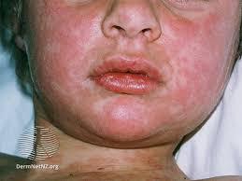
Measles
Measle can now almost always be prevented with a vaccine is schildhood infection caused by a virus. Once quite common
.
Also called rubeola, measles spreads easily and can be serious and even fatal for small children. While death rates have been falling worldwide as more children receive the measles vaccine,
the disease still kills more than 200,000 people a year, mostly children.

Slide 24
Measles symptom
Cconjunctivitis)ough
Signs and symptoms of measles usually appear about 7 to 14 days after a person is infected. Measles usually begins with:
High fever >40
Runny nose (coryza)
Red, watery eyes (

Slide 25
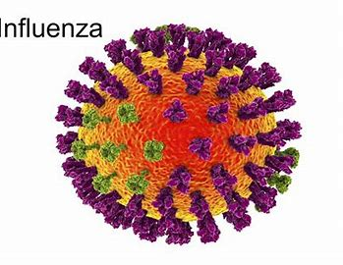
Influenza
Influenza (flu) is a contagious respiratory illness caused by viruses that infect the nose, throat,. and lungs
Some people are at higher risk of serious complications due to influenza.
are two main types of influenza viruses: Types A and B.
The influenza A and B viruses that routinely spread in people (human influenza viruses)
are responsible for seasonal epidemics each year.

Slide 26
Brucellosis
Brucellosis is an infectious disease caused by bacteria.
People can get the disease when they are in contact with infected animals or animal products contaminated with the bacteria
Animals that are most commonly infected include sheep, cattle, goats, pigs, and dogs, among others.
The most common way to be infected is by eating or drinking unpasteurized/raw dairy products. When sheep, goats, cows, or camels are infected,

Slide 27
Symptoms of Brucellosis
After human espoused to the bacteria though eating raw met, or drinking row milk or contact with infected anima got the :e been infected. Signs and symptoms are similar to those of the flu and include:
Fever
Chills
Loss of appetite
Sweats
Weakness
Fatigue
Joint, muscle and back pain
Headache

Slide 28
Typhoid fever
Typhoid fever is a life-threatening infection
by the bacterium Salmonella Typhi.
It is usually spread through contaminated food or water.
Once Salmonella Typhi bacteria are ingested,
they multiply and spread into the bloodstream

Slide 29
Typhoid symptoms
Salmonella Typhi lives only in humans. Persons with typhoid fever carry the bacteria in their bloodstream and intestinal tract.
Symptoms include prolonged high fever, fatigue, headache, nausea, abdominal pain, and constipation or diarrhoea
Some patients may have a rash. Severe cases may lead to serious complications or even death
Typhoid fever can be confirmed through blood testing.

Slide 30
Cycle of infection
Reservoir
(Cattle, sheep, horses)
EXIT
Skin, GIT
or
Respiratory system
Mode
of
Transmission
Direct (soil,
animal products)
Common Vehicle
Air Borne
Source
( contaminated animal
products)
Inlet
Skin abrasion, GIT or
respiratory system
AGENT
Bacillus Anthracic

Slide 31
Sexual Diseases
What is common sexual disease?
Gonorrhoea. Hepatitis.
Herpes. HIV/AIDS & STDs.
Human Papillomavirus (HPV)
Syphilis

Slide 32
Viral Hepatitis
What is Viral Hepatitis?
Viral hepatitis is an infection that causes liver inflammation and damage.
Several different viruses cause hepatitis, including hepatitis A, B, C, D, and E.
The hepatitis A and E viruses typically cause acute infections.
The hepatitis B, C, and D viruses can cause acute and chronic infections

Slide 33
Symptoms of viral hepatitis
Dark urine.
Stomach pain.
Yellow skin or eye whites, called jaundice.
Pale or clay-colored stool.
Low-grade fever.
Loss of appetite.
Fatigue.
Feeling sick to your stomach.
Aching joints

Slide 34
Transition of viral hepatitis
person can get hepatitis B in many ways, including:
Having sex with an infected person.
Sharing dirty needles.
Being in direct contact with infected blood.
Getting needle stick injuries.
Being transferred from a pregnant person to a fetus.
Being in contact with an infected person's body fluids

Slide 35
Tuberculosis
Tuberculosis is a serious bacterial infection that mainly affects your lungs,
but it can also affect virtually every organ including your brain, spine and kidneys.
TB spreads from person to person through coughing or sneezing. It’s also sometimes spread through transplant with a donated organ.
Not everyone infected with TB gets sick with symptoms. Approximately 25% of the world's population has latent tuberculosis infection (LTBI). When you have latent TB, you don't feel sick and can't spread the infection to others

Slide 36
Tuberculosis
A TB test checks to see if you have been infected with tuberculosis (TB).
There are two types of TB tests: a skin test and a blood test. TB skin and blood tests can show if you’ve ever been exposed to the bacterium that causes TB
but they can’t determine if you have a latent (dormant) or active TB infection.

Slide 37
Symptoms Of Tuberculosis
Bad cough lasting longer than two weeks.
Pain in your chest.
Coughing up blood or sputum (mucus).
Fatigue or weakness.
Loss of appetite.
Unexplained weight loss.
Chills and fever.
Night sweats.

