Slide 1


رضا السيدات في فترة ما حول الولادة عن سلوكيات رعاية الممرضات - دراسة في الصين
Perinatal Women's Satisfaction with Nurses’ Caring Behaviours in Teaching Hospitals in China
إعـداد
د. فوزية غازي عثمان
نائب عميد كلية التمريض للشؤون العلمية
(دكتوراه في تمريض الأمومة وصحة المرأة)

Slide 2
BACKGROUND OF THE STUDY
PURPOSE/ SIGNIFICANCE
OUTLINES
LITERATURE REVIEW
RESEARCH METHODOLOGY
RESULTS
DISCUSSION
RECOMMENDATIONS

Slide 3
BACKGROUND
Complications of Pregnancy and Childbirth are the leading causes of disability and death among women of reproductive ages (15-49) years in developing countries
(Glei et al. 2003).
Caring Behaviour is a critical component of nursing practice. Leininger (1986) showed that caring is a universal core of nursing and suggested that perceptions of caring behaviours might vary with cultural background, which contributes to socially learned practices, systems, processes. Thus, Adequate caring behaviours provided by nurses can increase patients’ satisfaction of care.
Many studies on caring were examined throughout oncology units, cardiology sections, surgical wards, and rehabilitation centers, the majority in Western Europe and America. However, caring as a concept has not yet been fully explored in China, for Chinese postpartum patients.

Slide 4
OBJECTIVES
General Objective
To assess the level of women satisfaction towards nurses caring behaviours among postpartum women attending at teaching hospitals, Wuhan, China during the period of 8th December 2017 to 20th March 2018.

Slide 5
Cont.…
Specific Objectives
1
To assess the level of Antenatal, Childbirth, and Postnatal caring satisfaction
2
To determine the Highest and Lowest scores of nurses caring behaviours
3
To determine a comparison of women's satisfaction with the independent variables
To determine a comparison of socio-demographic characteristics with caring behaviours subscales
4

Slide 6
SIGNIFICANCE OF THE STUDY
Theoretical Significance
This study will contribute to increase the knowledge and hands-on experience of nurses. Thus, this leads to achieve better care standards and applications for postpartum patients and families.
This study will contribute to improve the professional status for nurses and provide guidance/ direction for research and education.
Practical Function
The Results of this Study:
Can be used to design an educational program for nursing staff in the obstetric department in order to enhance women satisfaction.
Will provide insight to nurse administrators who are seeking to improve patient satisfaction in the obstetric unit at hospital. This could inform nursing managers to develop strategies to increase service uptake.
Will provide direction for educational development of nursing student and staff members in the obstetric department.
Practical Significance

Slide 7
Figure. 1 Conceptual Framework
Women Satisfaction with Nurses Caring Behaviours
Caritas Process of Watson Theory of Caring | Nurses Caring Behaviours
Cultivating the practice of loving-kindness Sustaining and honoring the faith-hope Cultivation of sensitivity to oneself and others Developing a helping-trusting relationship Expression of feelings Problem-solving Promotion of teaching and learning Creating a healing environment Basic human needs Spirituality | Explain: nurse give adequate information, teaching Comfort: cheerful, touch for comfort Trust: nurses introduce themselves, relationship Monitor: handle equipment, give (shots, I.V.s, etc) Human respect: treat with respect Accessible: medication on time Healing environment: privacy, attentively Affiliation needs:
Obtain a good satisfaction grade towards nurses caring behaviours
Promotes core values of health caring such as:
Self-worth
Respect
Trust
Promoting of:
psychological and basic human physical aspects of care
Determine of satisfaction of antenatal nurse caring
Determine of satisfaction of childbirth nurse caring
Determine of satisfaction of postnatal nurse caring
STRUCTURE
PROCESS
OUTCOME

Slide 8
LITERATURE REVIEW
Studies of Caring Done in The Field of Nursing
He et al. (2013) performed a descriptive, comparative study of five hospitals in mainland China to compare the perceptions of nurses and patients of nurses’ caring behaviours. In the study, the researchers used the CBI-24 instrument. Their findings showed that the ‘Knowledge and skill’ subscale obtained the highest score for both groups (a mean score of 4.73 for patients and 5.25 for nurses). The ‘Assurance’ subscale received the second highest score (4.41 and 5.19, respectively), and the subscale with the third highest score was ‘Respectful’ (4.13 and 4.80, respectively)
A qualitative descriptive study conducted by Liu et al. (2006) concluded that Chinese cancer patients described nurses’ caring as follows: nurses with qualified, professional knowledge, attitudes and skills in oncology who provided information and emotional and practical support.

Slide 9
Cont.…
2) Studies of Caring Done on Perinatal Women
Schultz and Colleagues (1998) performed an exploratory comparative study on perceptions of caring behaviours among antepartum and postpartum women (n=42) using the CBA tool. The results showed that patients ranked the ‘Basic human needs’ subscale as the most important caring behaviour other than needs.
Manogin et al, (2000) conducted a descriptive study of childbearing women’s (n=31) perceptions of nurses’ caring behaviours. The researchers gathered data through a structured questionnaire. The findings concluded that behaviours in the ‘Human needs assistance’ subscale, which included items such as ‘give my medication and treatments on time’, ‘check my status closely’ and ‘help me with my care until I'm able to do it for myself’ were ranked as the most important caring behaviours.

Slide 10
METHODOLOGY

Slide 11
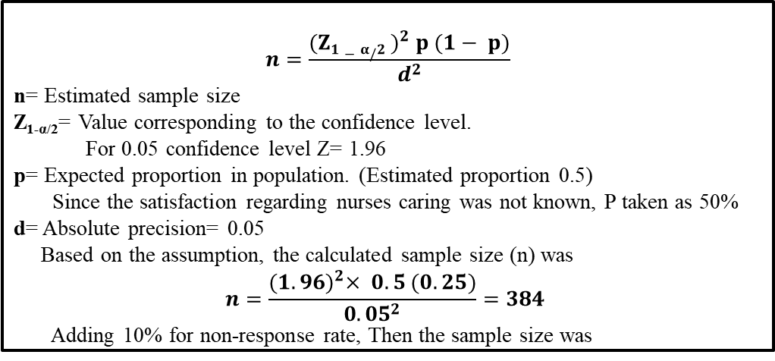
MATERIALS AND METHODS
Research Design
A cross-sectional study was conducted
Setting
The study was conducted in teaching hospitals (Wuhan Union hospital) in Wuhan- China
Sampling Procedures
A nonprobability convenience sampling technique of 422 postpartum women participated in this study
Sample Size
$$n=\frac{{(Z1−α/2 )}^{2} p (1− p)}{d^{2}}$$
n= Estimated sample size
Z_{1-α/2}= Value corresponding to the confidence level.
For 0.05 confidence level Z= 1.96
p= Expected proportion in population. (Estimated proportion 0.5)
Since the satisfaction regarding nurses caring was not known, P taken as 50%
d= Absolute precision= 0.05
Based on the assumption, the calculated sample size (n) was
$$n=\frac{{(1.96)}^{2}× 0.5 (0.25)}{{0.05}^{2}}=384$$
Adding 10% for non-response rate, Then the sample size was
422

Slide 12
Cont.…
Study Subjects
Inclusion Criteria
18-45 years old age
Primipara and multipara
Normal vaginal and cesarean delivery of term infant
Willing to participate in the research
Without any history of infertility problems
Being Chinese
Voluntarily agreed to participate in the study through informed consent
Exclusion Criteria
Women with known complications were excluded from the study

Slide 13
Instrumentation
Design of the Questionnaire
The structured questionnaire was composed of two parts, the demographic forms and the scale for satisfaction of nurses’ caring behaviours. The questionnaire was prepared using previous studies (Larson; 1986, Cronin S, Harrison B;1988, Watson;1988, Wolf;1994, Smith MK, Sullivan JM;1997, Manogin; 2000, Mizuno;2005, Duffy;2007, Zamanzadeh;2010,Chen;2012, Omari et al; 2012, Youssef;2013, Guan;2018)
The type of demographic data recorded included the following: age, educational level, occupation, place of residence, income level, parity, number of antenatal visits, transportation mode, type of delivery and health insurance.
Satisfaction with nurses’ caring behaviours during the antenatal, childbirth and postnatal periods was measured via 60 components of nurses’ caring behaviours as rated on a five-point Likert scale. The scale categorized a specific nursing behaviour according to the degree of satisfaction from 1–5 (where 1 = strongly dissatisfied and 5 = strongly satisfied). The Likert scale was previously developed by Chen et al. (2012) for a sample of patients from general wards at Taiwan Medical University Hospital.

Slide 14
Cont.…
The scale for satisfaction of nurses’ caring behaviours included 17 items for the antenatal, 20 items for the childbirth and 23 items for the postnatal stage.
The items were placed on eight subscales, as follows:
  Explain, which included items ʻ nurses give me adequate information about my situationʼ
  Comfort, which included items ʻnurses are cheerfulʼ
  Trust, which included items ʻnurses introduce themselves and tell me what they
  Monitor, which included items ʻnurses know how to give (shots, I.V.s, etc)ʼ
  Human respect, which included items ʻnurses treat me with respectʼ
  Accessible, which included items ʻnurses give me treatment on timeʼ
  Healing environment, which included items ʻnurses check my condition closelyʼ
  Affiliation needs, which included items ʻnurses allow my family to be involvedʼ
The questionnaire was first developed in English and then translated into Mandarin by a Chinese and English language expert. It was then translated back to English.

Slide 15
Cont.…
Validity
Before processing the data collection, the researcher submitted the questionnaire to the panel of nursing scholars for semantic equivalence and content validity.
The content validity index for the scale items was 0.90. then, the questionnaire was adopted according to the suggestions and comments of thesis advisors and proceeded to pre-test.
Reliability
We conducted a pilot study with a sample of 20 postpartum women from obstetric units hospitals. After the questionnaires have been filled with subjects, they were coded and entered into SPSS version (23.0) program for statistical analysis.
The Cronbach’s alpha coefficients for the overall questionnaire was ‘0.97’.
The Cronbach’s alpha for 7 items related to ‘Explain’ subscale was ‘0.77’, 10 items related to ‘Comfort’ subscale was ‘0.62’, 8 items related to ‘Trust’ subscale was ‘0.73’, 10 items related to ‘Monitor’ subscale was ‘0.91’, 10 items related to ‘Human respect’ subscale was ‘0.87’, 7 items related to ‘Healing environment’ subscale was ‘0.90’, 6 items related to ‘Accessible’ subscale was ‘0.93’ and 2 items related to ‘Affiliation needs’ subscale was ‘0.64’.
The alpha coefficients of the total scale were 0.97, thus indicating good internal consistency.

Slide 16
Data Collection Procedure
Cont.…
The study was conducted between 8th December 2017 and 20th March 2018
Questionnaires were collected from the inpatient department of the obstetrics ward in the hospital.
The purpose of the study was explained to the women who agreed to participate, and consent was taken
A copy of the structured questionnaire, which included questions relevant to the antenatal, childbirth and postnatal periods, was distributed
Women were asked to remember and rate their satisfaction in nurses’ caring behaviours by responding to statements on a five-point scale
The research assistant was present to answer questions if participants encountered any confusion while filling out the questionnaires
The questionnaire took an average of 15–25 minutes for each woman to complete

Slide 17
Cont.…
Ethical Consideration
This study has a granted permit (IORG No: IORG0003571) from Ethics Committee of Tongji Medical College, Huazhong University of Science and Technology and the administrative departments of the hospitals included in the study. All patients provided informed consent via consent forms for the study.

Slide 18
Cont.…
Statistical Analysis
Analysis was conducted using the Statistical Package for the Social Sciences (SPSS) Version 23.0 for Windows (SPSS Inc. Chicago, IL, USA).
Descriptive statistics were used for the quantitative data in the demographic data and for the satisfaction of caring behaviours scale.
Descriptive statistics included: Mean, standard deviation, frequencies, and percentages. The study focused on three variables—antenatal caring, childbirth caring, and postnatal caring. These served as dependent variables.
The Chi-square (χ2) test was used to determine comparison between the three main variables of the study and the independent variables. The level of significance was fixed at 0.05.

Slide 19
RESULTS
.
Socio-Demographic Characteristics
Assess the level of women satisfaction towards nurses caring behaviours for all three periods (antenatal, childbirth, and postnatal periods)
Ranking of Caring Behaviours Subscales for each Stage
Ranking the Highest and Lowest scores of nurses caring behaviours as perceived by participants for all three periods (antenatal, childbirth, and postnatal periods)
Comparison between independent and dependent variables.
Comparison between socio-demographic characteristics and caring behaviours subscales.

Slide 20
Table 1. Demographic Characteristics n=422
Variable | Frequency | Percentage (%)
Age in years Mean= 30.51 SD=5.21
18-24 | 29 | 6.9
25-31 | 208 | 49.3
32-38 | 154 | 36.5
39-45 | 31 | 7.3
Educational status
Primary | 4 | 0.9
Secondary | 109 | 25.8
Bachelor | 269 | 63.7
Higher | 40 | 9.5
Residence
Rural | 70 | 16.6
Urban | 352 | 83.4
Parity
1 Child | 279 | 66.1
2 Children | 140 | 33.2
>2 Children | 3 | 0.7
Times of ANC visits (>4) | 338 | 80.1
Type of delivery
Spontaneous vaginal delivery | 116 | 27.5
Forceps | 6 | 1.4
Cesarean section | 300 | 71.1
Has health insurance | 397 | 94.0

Slide 21
RESULTS
Table 2. Women's satisfaction of nurses caring behaviours
Table 2. Women's satisfaction of nurses caring behaviours (n=422)
Variables | Dissatisfied No. (%) |  | Neutral No. (%) |  | Satisfied No. (%) |  | Strongly satisfied No. (%)
Antenatal caring | 2 (0.5) |  | 58 (13.7) |  | 86 (20.4) |  | 276 (65.4)
Childbirth caring | 4 (0.9) |  | 57 (13.5) |  | 105 (24.9) |  | 256 (60.7)
Postnatal caring | 7 (1.7) |  | 59 (14) |  | 104 (24.6) |  | 252 (59.7)

Slide 22
RESULTS
Table 3 Ranking of caring behaviours subscales for antenatal stage (n=422)
Rank | Subscales | Mean | SD
1 | Human respect | 4.53 | 0.75
2 | Monitor | 4.46 | 0.84
3 | Healing environment | 4.38 | 0.82
4 | Comfort | 4.12 | 0.71
5 | Explain | 4.04 | 0.77
6 | Trust | 3.78 | 0.65
Total antenatal caring |  | 4.22 | 0.60
General mean score of the women satisfaction with nurses caring behaviours during antenatal stage was 4.22 (SD=0.60) out of 5.

Slide 23
RESULTS
Table 4. Ranking of caring behaviours subscales for childbirth stage (n=422)
Rank | Subscales | Mean | SD
1 | Monitor | 4.64 | 0.60
2 | Accessible | 4.51 | 0.67
3 | Healing environment | 4.43 | 0.76
4 | Human respect | 4.27 | 0.71
5 | Comfort | 4.09 | 0.79
6 | Trust | 3.98 | 0.82
7 | Explain | 3.64 | 1.16
 | Total childbirth caring | 4.22 | 0.62
General mean score of the women satisfaction with nurses caring behaviours during childbirth stage was 4.22 (SD=0.62) out of 5.

Slide 24
RESULTS
Table 5. Ranking of caring behaviours subscales for postnatal stage (n=422)
Rank | Subscales | Mean | SD
1 | Human respect | 4.56 | 0.71
2 | Affiliations needs | 4.54 | 0.81
3 | Accessible | 4.48 | 0.71
4 | Healing environment | 4.33 | 0.90
5 | Monitor | 4.31 | 0.73
6 | Explain | 3.84 | 0.80
7 | Comfort | 3.19 | 0.64
Total postnatal caring |  | 4.11 | 0.62
General mean score of the women satisfaction with nurses caring behaviours during postnatal stage was 4.11 (SD=0.62) out of 5.

Slide 25
Figure 2. Average response on women satisfaction of nurses caring subscales

Slide 26
RESULTS
Table 6. Rank order the highest and lowest scores of nurses caring behaviours during antenatal stage (n=422)
Item | Rank | Mean | SD
Highest Scores
Nurses express concern about my overall situation | 1 | 4.54 | 0.87
Nurses treat me with respect | 2 | 4.54 | 1.00
Nurses listen to me attentively during antenatal visits | 3 | 4.52 | 0.84
Nurses give me a good physical care | 4 | 4.52 | 0.83
Nurses give an adequate information about my situation | 5 | 4.50 | 0.73
Lowest Scores
Nurses ask me what name I prefer to be called | 1 | 2.26 | 1.21
Nurses introduce themselves and tell me what they do | 2 | 3.38 | 1.33
Nurses sit down and talk to me | 3 | 3.50 | 1.11
Nurses suggest me questions to be asked for doctor | 4 | 3.58 | 1.25
Privacy is maintained during examination in clinic | 5 | 4.38 | 0.81

Slide 27
RESULTS
Table 7. Rank order the highest and lowest scores of nurses caring behaviours during childbirth stage (n=422)
Item | Rank | Mean | SD
Highest Scores
Nurses know how to give (shots, I.V.s, etc) | 1 | 4.70 | 0.61
Nurses know how to handle equipment | 2 | 4.65 | 0.67
Nurses give me treatment and medication on time | 3 | 4.60 | 0.69
Nurses know what they are doing in the childbirth process | 4 | 4.57 | 0.68
Give me medication to relief labor pain as prescribed by doctors | 5 | 4.54 | 0.72
Lowest Scores
Nurses encourage me to talk about how I feel | 1 | 3.16 | 1.50
Nurses used to comfort me when I feel upset | 2 | 3.53 | 1.43
Nurses consider my spiritual needs | 3 | 3.60 | 1.47
Nurses provide me emotional support during childbirth | 4 | 4.37 | 0.90
Nurses make me feel comfortable during childbirth | 5 | 4.37 | 0.78

Slide 28
RESULTS
Table 8. Rank order the highest and lowest scores of nurses caring behaviours during postnatal stage (n=422)
Item | Rank | Mean | SD
Highest Scores
Nurses are making equipment skillfully | 1 | 4.73 | 0.65
Nurses deal me and my family with respect | 2 | 4.70 | 0.68
Nurses give me treatment on time as prescribed by doctors | 3 | 4.62 | 0.72
Nurses allow my family to be involved | 4 | 4.55 | 0.81
Nurses pay attention to my needs | 5 | 4.53 | 0.83
Lowest Scores
Nurses touch me when I need it for comfort | 1 | 2.26 | 1.23
Nurses talk to me about my life outside the hospital | 2 | 2.27 | 1.07
Allow me the opportunity to clarify doubts about my baby care | 3 | 3.25 | 1.47
Nurses make me sure if my family or I know how to breastfed my child | 4 | 3.60 | 1.49
Nurses help me to formulate questions for doctor about care at home | 5 | 3.77 | 1.39

Slide 29
RESULTS
Table 9. Comparison of different risk factors (based on p-values and Chi-square test) (n=422)
Variable | Satisfaction with Antenatal caring
 | χ2 | P-value
Woman's age | 27.9 | .001**
Occupation | 33.5 | .004**
Residence | 6.0 | .108
Times of ANC visits | 24.8 | .016*
Waiting time | 31.6 | .000***
Note: Significance level: * = p < .05; ** = p < .01. *** = p < .001. - = Not applicable.
There were significance differences between demographic characteristics and satisfaction of antenatal caring

Slide 30
RESULTS
Table 10. Comparison of different risk factors (based on p-values and Chi-square test) (n=422)
Variable | Satisfaction with Childbirth caring
 | χ2 | P-value
Woman's age | 26.2 | .002**
Occupation | 28.8 | .017*
Residence | 10.0 | .018*
Times of ANC visits | 34.7 | .001**
Waiting time | 18.9 | .004**
Note: Significance level: * = p < .05; ** = p < .01. *** = p < .001. - = Not applicable.
There were significance differences between demographic characteristics and satisfaction of childbirth caring

Slide 31
RESULTS
Table 11. Comparison of different risk factors (based on p-values and Chi-square test) (n=422)
Variable | Satisfaction with Postnatal caring
 | χ2 | P-value
Woman's age | 31.2 | .000***
Occupation | 27.7 | .023*
Residence | 3.3 | .345
Times of ANC visits | 30.2 | .003**
Waiting time | 23.2 | .001**
Note: Significance level: * = p < .05; ** = p < .01. *** = p < .001. - = Not applicable.
There were significance differences between demographic characteristics and satisfaction of postnatal caring

Slide 32
RESULTS
Table 12. Comparison of demographic characteristics with antenatal caring subscales (n=422)
Variable | Comfort |  |  | Trust |  | Monitor |  |  | Healing environment
 | χ2 | P |  | χ2 | P | χ2 | P |  | χ2 | P
Woman's age | 30.8 | .000*** |  | 28.3 | .005** | 33.8 | .001** |  | 35.3 | .000***
Education | 21.2 | .012* |  | 8.6 | .736 | 16.3 | .177 |  | 28.0 | .005**
Occupation | 34.1 | .003** |  | 33.8 | .027* | 35.4 | .018* |  | 36.1 | .015*
Waiting time | 32.6 | .000*** |  | 24.1 | .002** | 22.6 | .004** |  | 32.6 | .000***
Note: Significance level: * = p < .05; ** = p < .01. *** = p< .001. - = Not applicable.
There were significance differences between demographic characteristics and four subscales of antenatal caring

Slide 33
DISCUSSION
Antenatal Caring
The highest average scores were obtained by ʻHuman respectʼ and ʻMonitorʼ subscales. In particular, the items ‘nurses express concern about my overall situation’ and ‘nurses treat me with respect’. Given the importance to human respect was supported with previous researches addressing dimensions of caring (Watson 1985, Duffy et al 2007, Wolf et al 2006), which revealed that this factor (Human respect) as the first and most basic one.
While these results are not congruent with a study by He et al. (2013) who found that both nurses and patients rated lower scores to ‘Respectful’ and ‘Connectedness’.
Childbirth Caring
The subscale with the highest score was ʻMonitorʼ. In particular, the items ʻnurses know how to give (shots, I.V.s, etc) ʼ . These results emphasis that the fulfillment of basic needs is as important to maternity patients as it is to patients with other medical or surgical diagnosis.
This results congruent with research by Manogin et al. (2000) and Schultz et al. (1998) which showed that women in intrapartum and postpartum periods ranked the ʻHumanistic need assistanceʼ and ʻMonitorʼ subscales as highest important caring behaviours by nurses.

Slide 34
Cont.…
Postnatal Caring
The ʻAffiliation needs ’ subscale was obtained the highest scores in particular the item ʻnurses allow my family to be involvedʼ. These results emphasis that in the Chinese culture, family members provide support and visit their loves ones regularly. Therefore, patients may not need these caring behaviours from health care providers.
However, these findings were not congruent with the study of Omari et al. (2012) that showed that patients in coronary care units perceived the item ʻlets my family visit me as much as possible’ within the 10 least important caring behaviours. In this case, excessive family visits may have caused discomfort to patients in coronary care units; the critical nature of coronary artery diseases have a high need for extensive time for rest and privacy and little time for family visits.
However, in this current study, the participants perceived family visits as an essential need, and postpartum women might need psychological support from their loved ones. Hence, family members could provide reassurance and comfort to the postpartum women.

Slide 35
CONCLUSION
This study provided evidence of the applicability of Watson's theory in Eastern Asia cultures.
THE FINDINGS CONCLUDED :
The participants reported a high satisfaction score towards nurses caring behaviours including all three periods.
The participants perceived psychological and basic physical aspects of care as ranking higher than any other caring behaviours.
The /Monitor/ subscale received the highest score for the antenatal, childbirth and postnatal periods
The /Human respect/subscale received the second highest score.
The /Trust/ subscale obtained the lowest scores during the antenatal and childbirth periods.
There were significance differences between demographic characteristics and caring satisfaction (woman's age, occupation, times of ANC visits, and waiting time to receive ANC).

Slide 36
Limitations
1
The use of a convenience sample, which limited the generalizability of the findings
2
The length of the questionnaire that required prolonged time to be filled out by the women
3
The refusal of some women to complete the questionnaire due to postpartum fatigue, especially by those who underwent caesarean section
4
Survey errors in measurement that could have occurred as a result of the different methods of administering the nurses’ caring behaviours scale

Slide 37
Recommendations
The best implication for clinical practice from this survey was that nurses should be aware of the effect that intended caring behaviours might have on the patient.
Nurses in practice should play a significant role and assert the importance of the physical and technical caring behaviours as perceived by Chinese perinatal women in obstetrics unites.
Nursing administrators still need to develop projects that focus on caring and integration of all its aspects, including physical, emotional, psychological and cognitive aspects.
A shorter and more comprehensive scale should be utilized in future studies.
More research that reflects Watson theory of human caring should be conducted on the maternity population with a larger sample size.
The results of such studies should be presented to nursing students through curriculum

Slide 38


Slide 39
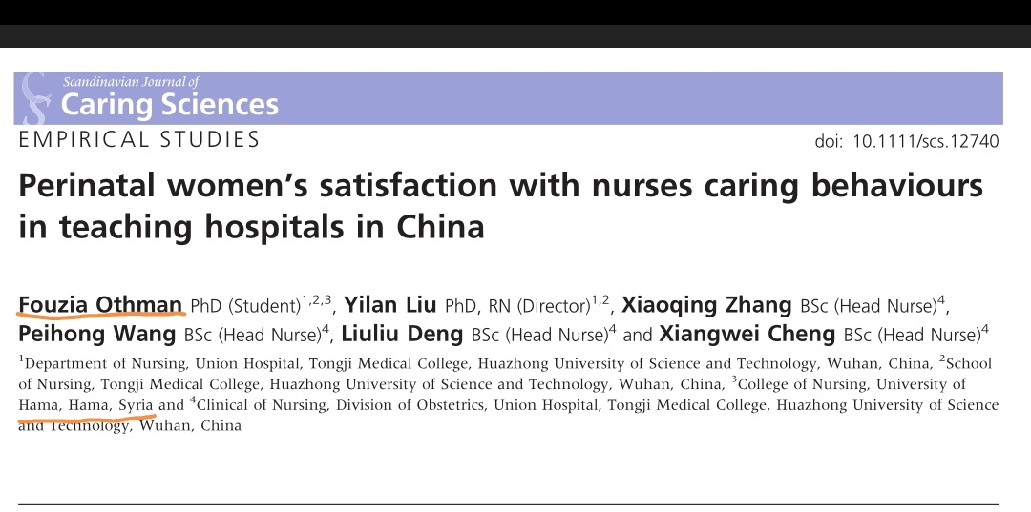

Slide 40


