Slide 1
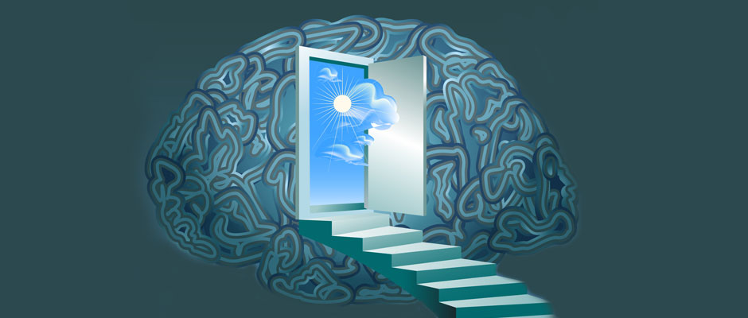


New Perspectives on Health
Can the mind heal the body?
Dr. Roula Alio
Dean of the faculty of nursing

Slide 2
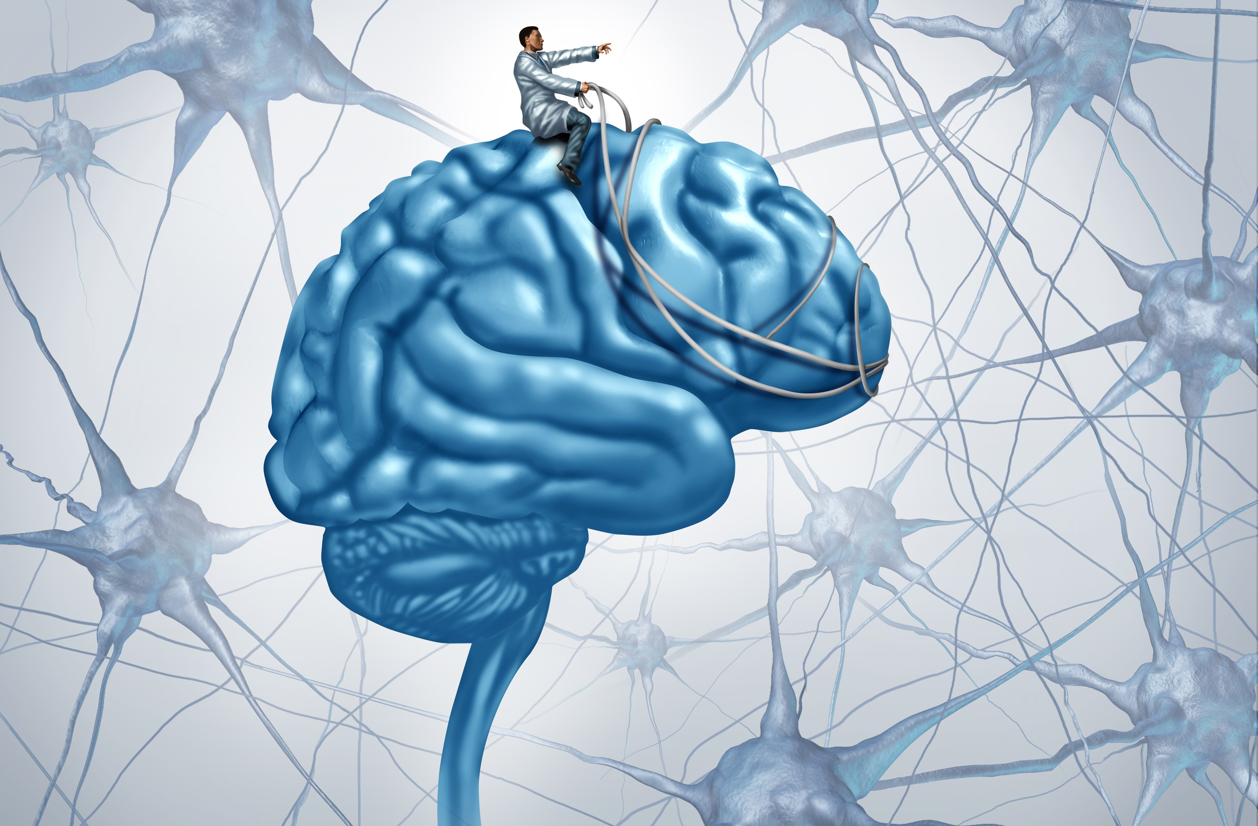
Brain vs Mind
Brain is the machine or instrument.
Mind is what the brain does (i.e. the brain in action)
e.g. fMRI study mind
Consciousness manipulates the brain to produce mind (perceptions, thoughts, emotions, intentions, memories)
Notes:
The mind is a set of cognitive faculties including consciousness, perception, thinking, judgement, language and memory. It is usually defined as the faculty of an entity's thoughts and consciousness.^{[3]} It holds the power of imagination, recognition, and appreciation, and is responsible for processing feelings and emotions, resulting in attitudes and actions.
Mental contents are those items that are thought of as being "in" the mind, and capable of being formed and manipulated by mental processes and faculties. Examples include thoughts, concepts, memories, emotions, percepts and intentions.

Slide 3
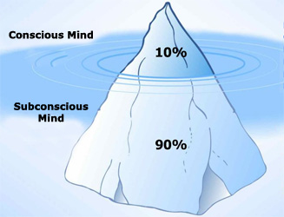
Composition of the mind
Brain processes 400 billion bit of information.
2000 bit (Body, environment, and Time)
Notes:
The brain is wired to conserve energy and resources, look for patterns and automate them. Our behaviors, emotional memories, physical reactions become part of our subconscious brain maps, which are automatic and not easy to change. Your Brain on Autopilot

Slide 4
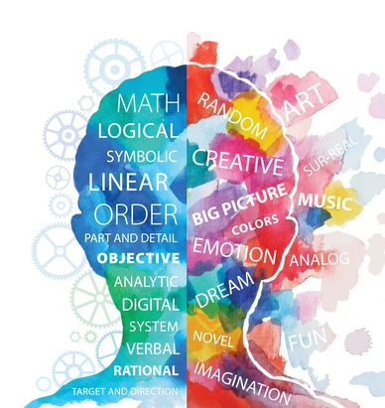
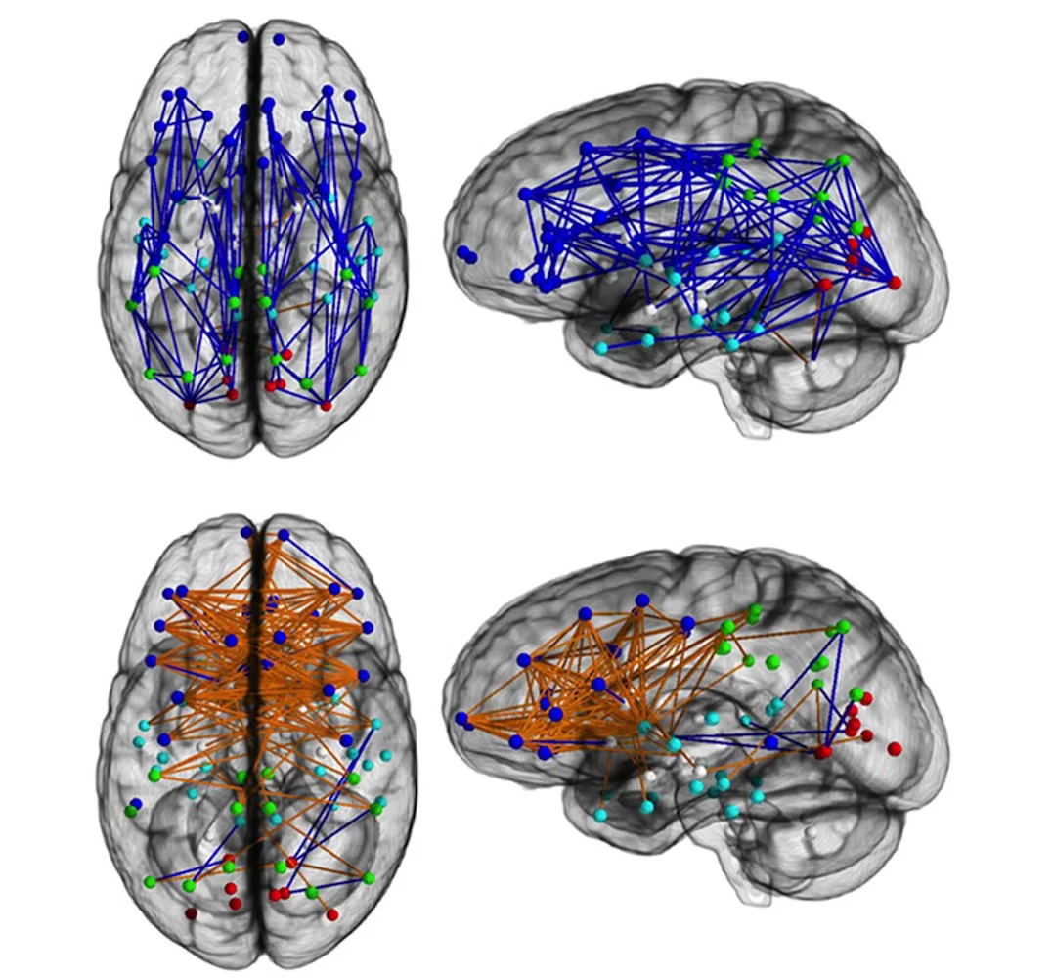
Emotional vs rational thinking

Slide 5
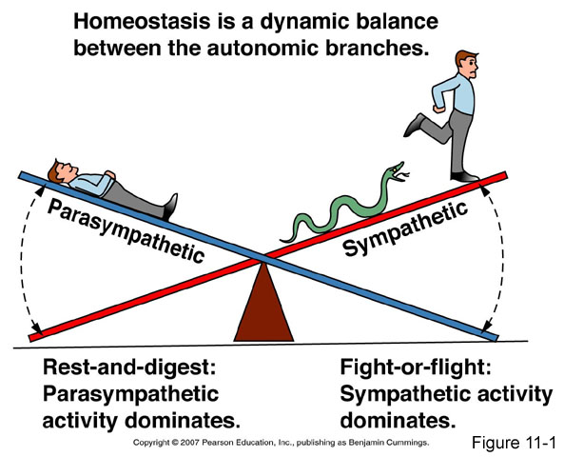
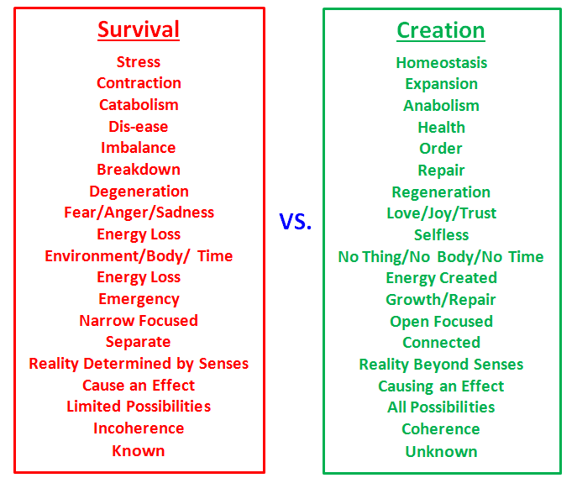
The two states of mind & body
Notes:
50 stress response per day, Turn on your relaxation response, you can meditate, social,
Brain communicate with te rest f the body via neurotransmitters if you fell lonely or depressed these negative emotions are percieved by the body as a threat so stress hormon kicks in cortisol, no epinephren (fight or flight mode) rest and digest mode explains placebo effect
The body is so busy trying to fight or flee..if you are unhappy, miserable, pesmistic the number could be doubled
Scientist believe that the relaxation response could explain placebo effect (you feel positive about new drug and don’t know whether you’ll get placebo or real) positive belief and the caring of a health cre provider relaxes the nervous system
Every facor in our life can turn on the stress response or relaxation response

Slide 6
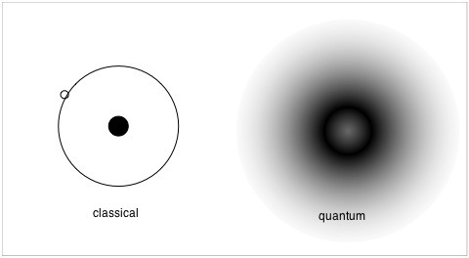
Quantum atom
  Old school Newtonian version of the atom (material)
  New school quantum version of the atom
  99.9999999999999 energy
  0.00000000000001 material

Slide 7
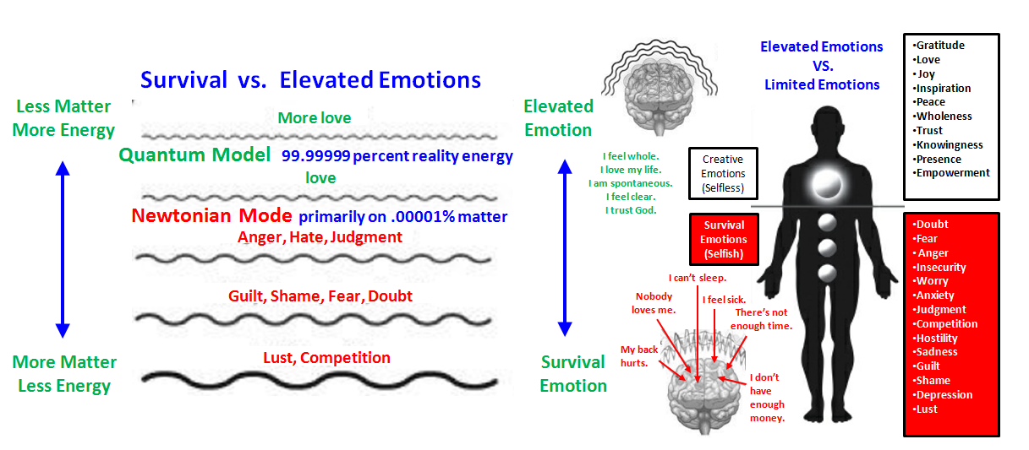

Slide 8
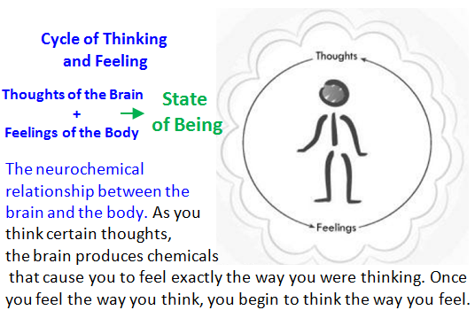
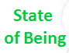
My thoughts create my reality
  Thinking produce chemicals which makes us feel exactly the way we think
  once that happened we begin to feel the way we think

Slide 9
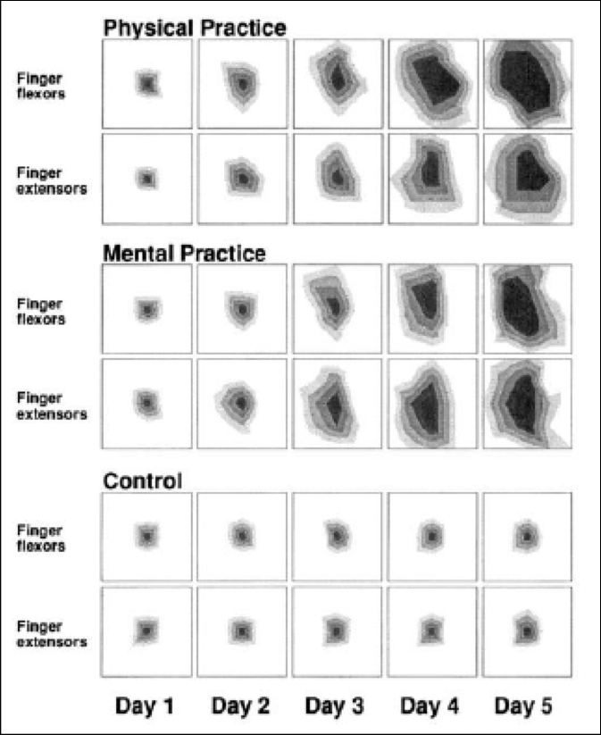
The piano experiment
  Harvard Medical school
  TMS test (how much of the motor cortex controlled the fingers movement)
  Thought can alter the physical structure and function of gray matter

Slide 10
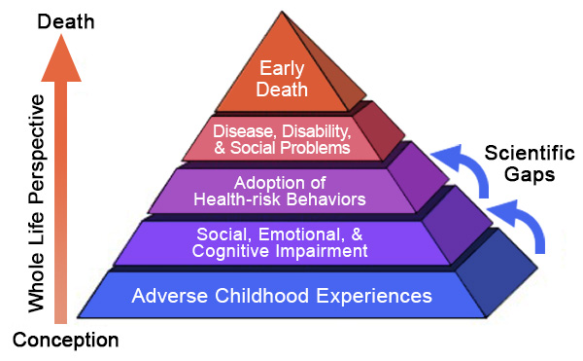
Scientific data
Strong social networks, 50% less heart diseases
Married people are twice as likely to live longer
Religious people live 14 years longer
Happy people live longer
Optimists have 77% less heart disease

Slide 11
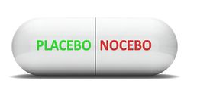

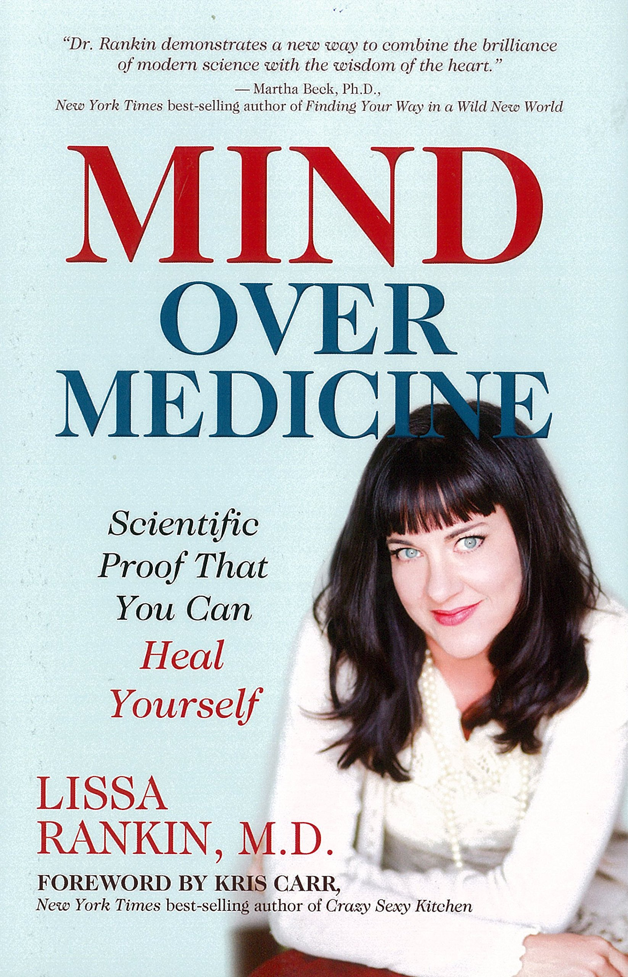
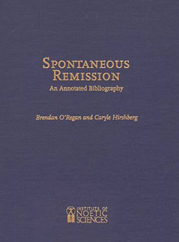
Can the mind heal the body
Innate self-repair mechanism
Database (350 cases: cancer, HIV, etc)
Mr Right case study

Slide 12
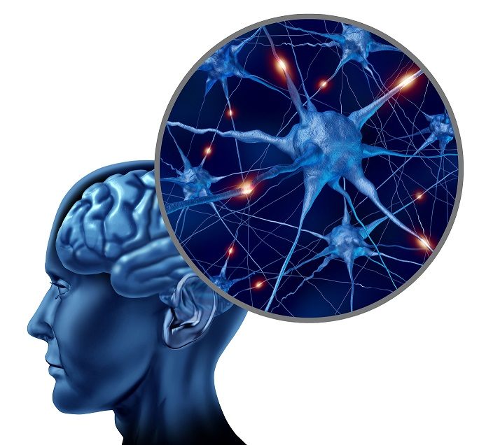
Neuroplasticity
we are continuously producing new brain cells and create new pathways in our brain throughout life.
The brain's ability to rewire itself as a result of experience
Notes:
Positive Outcomes of Neuroplasticity, New skills
Better cognition
More efficient communication between sensory and motor pathways
Improved function of the aging brain
Slowing down pathological processes
Promoting recovery of sensory losses
Improved motor control
Improved memory

Slide 13
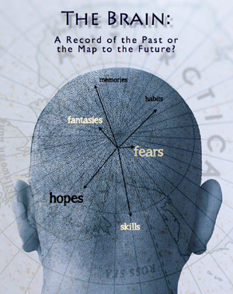
“Use Your Brain To Heal Your Brain”
Dr Joe Dispenza

Slide 14
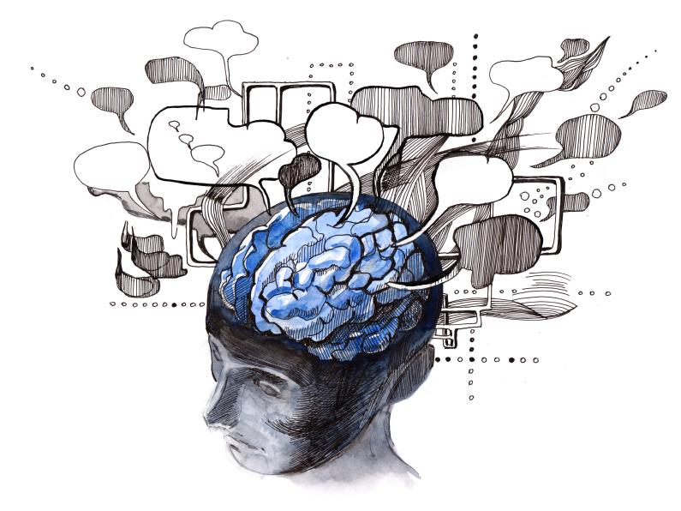
Brain training

Slide 15
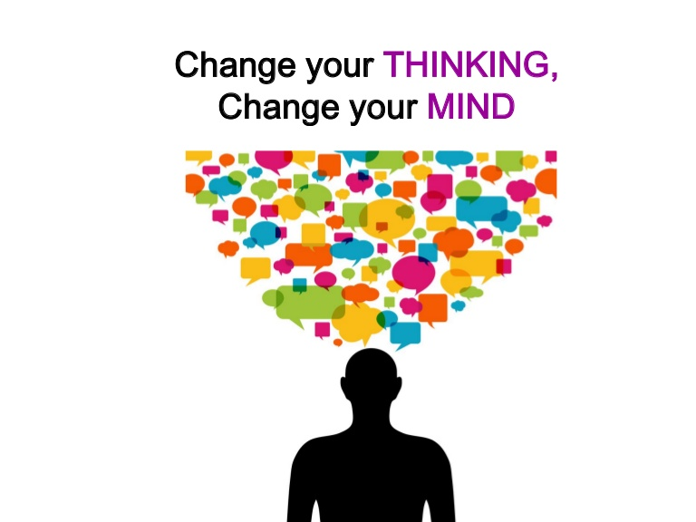
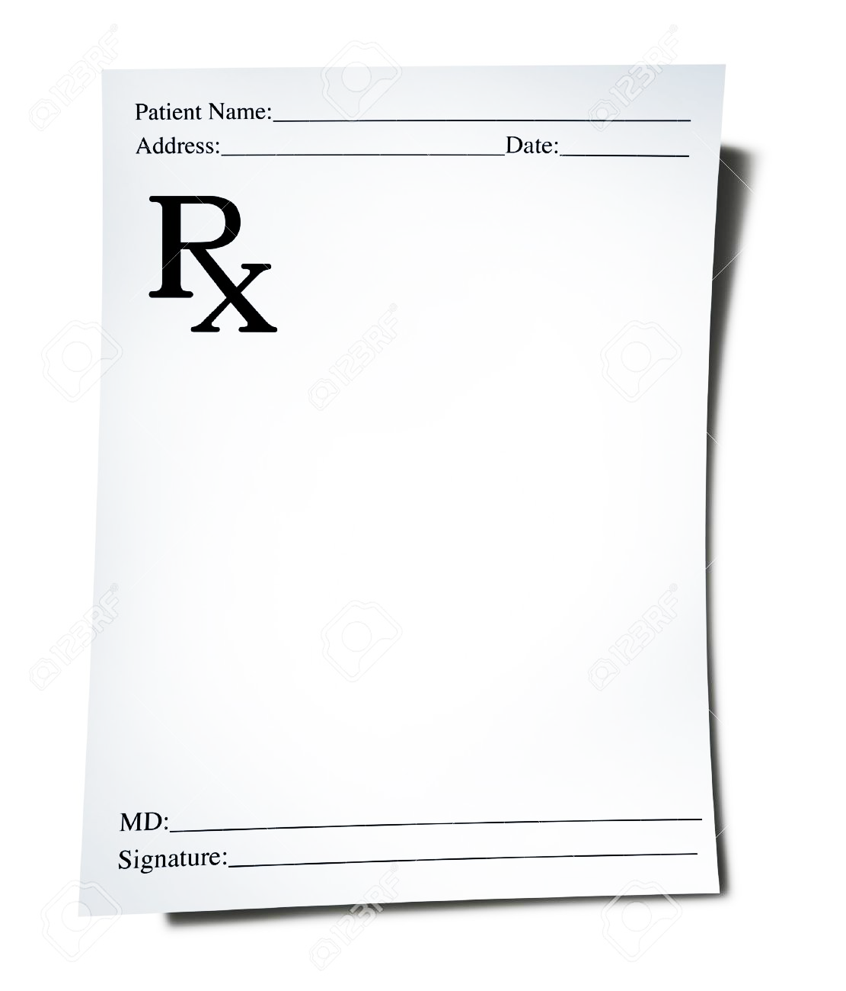
Write your own prescription

Slide 16
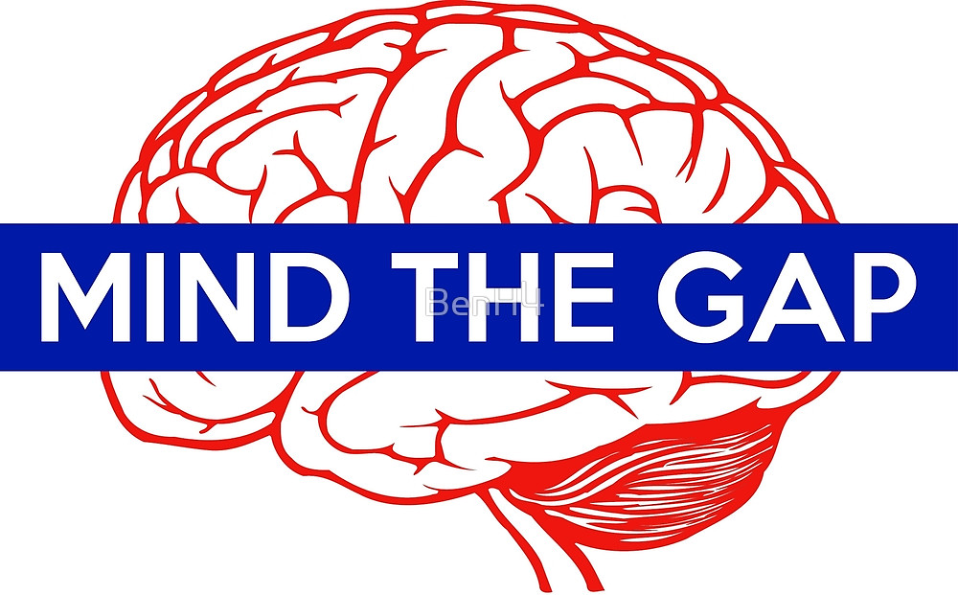
Thank you

