Slide 1


Management of Trigeminal Neuralgia – Comparison of two techniques
Maxillofacial Surgery Department, College of Dentistry,
Arab University for Science & Technology,
Hama, Syrian Arab Republic
Mouetaz Kheirallah, Sameer Ozzo

Slide 2
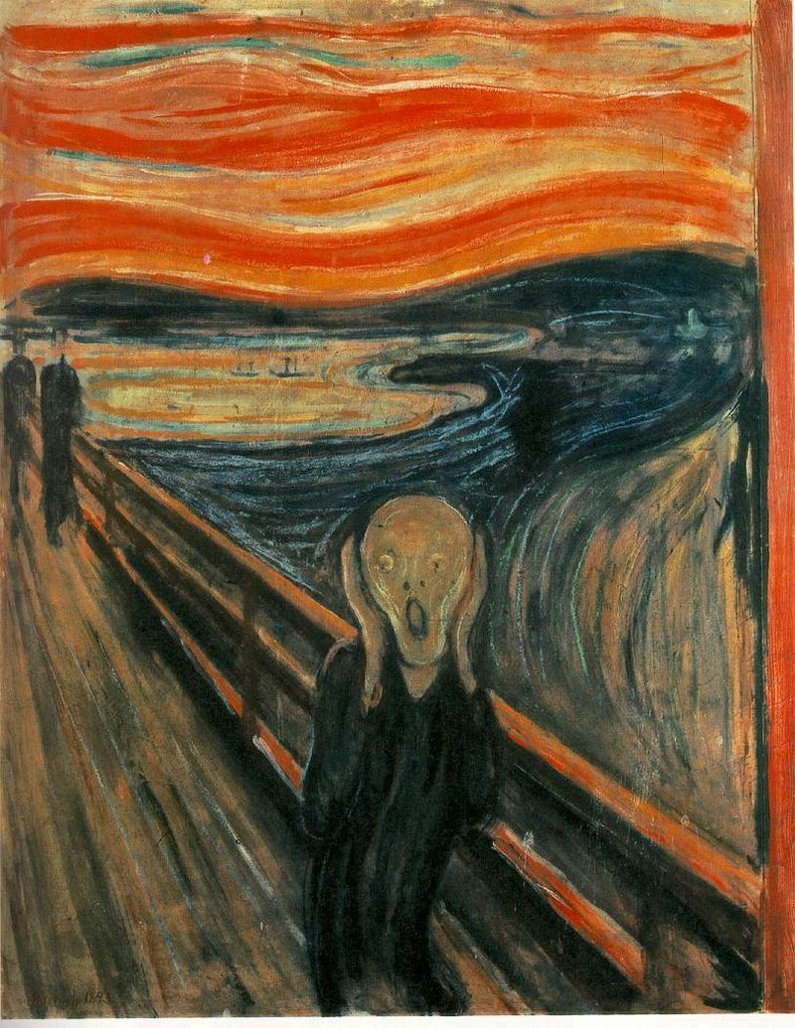
DEFINITION
Sudden, usually unilateral, severe brief stabbing pain in the distribution of one of more branches of the V nerve. About 13 people out of every 100,000 suffer from trigeminal neuralgia every year.
Trigeminal neuralgia also affects women more than men, and most of the patients are retired. 1% of people with trigeminal neuralgia have multiple sclerosis

Slide 3
PATHOGENESIS
Superior cerebellar artery pressing on or grooving the root of the nerve causes pressure which results in
focal demyelinization and hyperexcitability of nerve fibres
which fire in response to light touch resulting in brief episodes of intense pain.

Slide 4
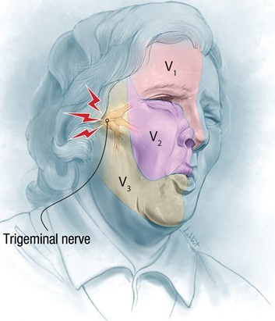
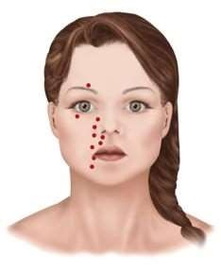
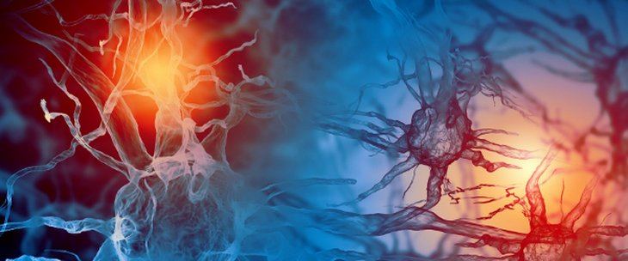
Confusion and misdiagnosis during routine dentistry
Electric shock-like
Recurrent unilateral
Intraoral or extraoral trigger zone
Pain
Lasts for a few seconds to a minute
intense, sharpshooting
Sudden in onset
One or more divisions of the trigeminal nerve
The zone provokes pain by a mechanical stimulus (chewing, drinking, shaving, applying makeup).

Slide 5
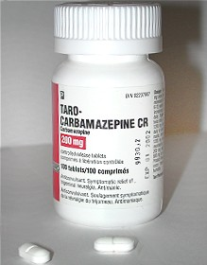
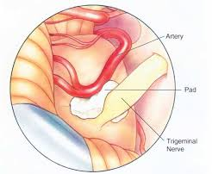
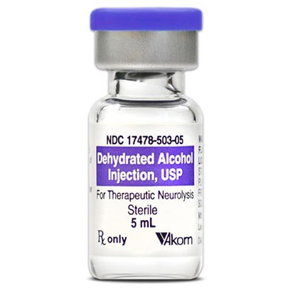
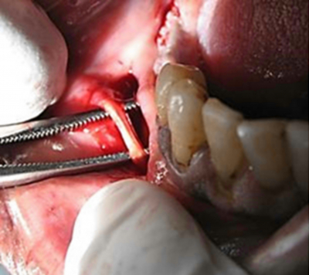
There is no definite treatment protocol for trigeminal neuralgia has been established because of its unclear etiology
although, the assumption that sclerotic superior cerebellar artery may press on the roots of the trigeminal nerve, causing neuronal discharge
balloon compression of the root entry zone
alcohol, phenol or glycerol injections
peripheral neurectomy of trigeminal nerve branches
cryotherapy
gamma-knife radiosurgery
drug therapy

Slide 6
Study Design
The present study has compared the efficacy of two treatment modalities
Alcohol
Cryosurgery
A study has been conducted on 108, who were treated with neurolysis therapy using peripheral ethyl alcohol injections and cryosurgery.

Slide 7
Study Participants
The patients were selected with the features of trigeminal neuralgia and had been followed up for at least five years
Inclusion Criteria
All the patients were unresponsive to treatment with anticonvulsants or carbamazepine (up to 1200 mg per day) for a period of at least 3 months or the patients could not tolerate the drugs.
sharp shooting, shock-like excruciating pain, intermittent pain distributed in the division of trigeminal nerve, abrupt initiation, and abrupt termination.
None of the patients was a subject to neurolytic injections or any neurosurgical treatment.
Pain could be triggered by innocent stimuli such as touch or light and local anaesthesia cancelled the pain.
Alcohol nerve block group that included 45 (41.7%) patients
The patients suffering from any chronic or threatening disease were not included in the study.
Cryosurgery group that included 63 (58.3 %) patients
Each group divided into two subgroups according to the trigeminal nerve branch.

Slide 8
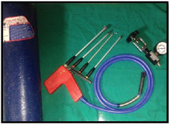
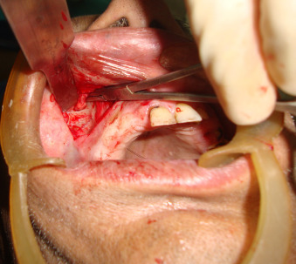
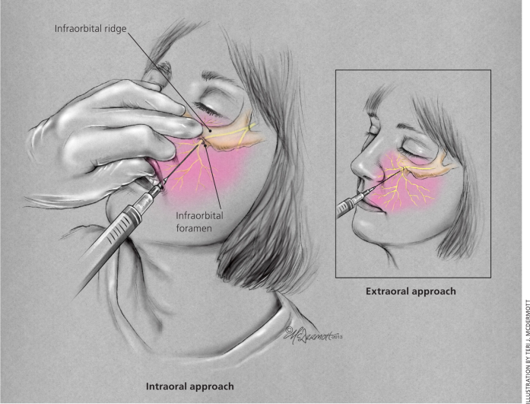
Study Procedure
Lignocaine blocks were given to the patients for three consecutive days to confirm the branch of trigeminal nerve involved. The target area was disinfected and 1 ml lignocaine hydrochloride was injected, after a gap of 5 minutes, 1cc of 70% ethyl alcohol was injected slowly. After observation of 30 minutes, the patient was discharged and informed that the significant effect of injection will be after 1-2 weeks. The medications, which inhibit alcohol dehydrogenase (metronidazole, oral hypoglycemic agents, beta-lactam antibiotics, etc.) were stopped.
Liquid nitrogen was used. The target nerve was blocked first then surgically exposed. The cryoprobe meets the nerve for two minutes with the application of three cycles. The surgically exposed nerve was frozen to -120 Cº by using a thermostatically controlled temperature system. Care was taken so that the probe does not come into contact of adjacent soft tissue during the procedure.

Slide 9
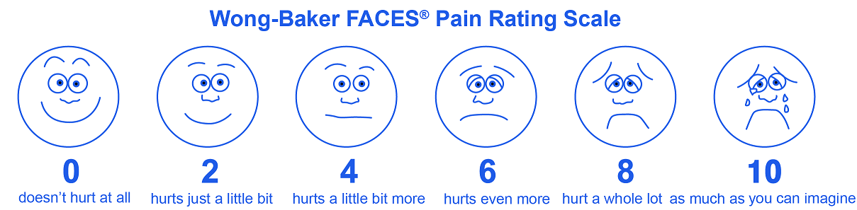
Face-to-face questionnaire or a telephone interview was used to follow-up patients regarding current pain, outcome, and overall satisfaction.
Duration of pain relief, patient’s satisfaction level, and the patient’s perception level of paresthesia were observed for each patient.
Data Collection

Slide 10
Duration of pain relief category and Patient’s satisfaction level
Duration of pain relief variables had three ordinal categories and patient’s satisfaction level variable had three ordinal categories
Not satisfied
0 – 1 year
Satisfied
1 – 2 years
Very satisfied
2 – 3 years

Slide 11
Duration of pain relief as well as three levels of a patient’s perception of paresthesia.
Each category for each variable assigned to a distinct numerical value, which reflects the strength of the according to the variable.
The material was analyzed to evaluate if there is a relationship between patient satisfaction and his perception of paresthesia.
Very disturbing
1
0 – 1 year
Some what disturbing
Statistical Analysis
2
1 – 2 years
Disturbing but better than pain
3
2 – 3 years

Slide 12
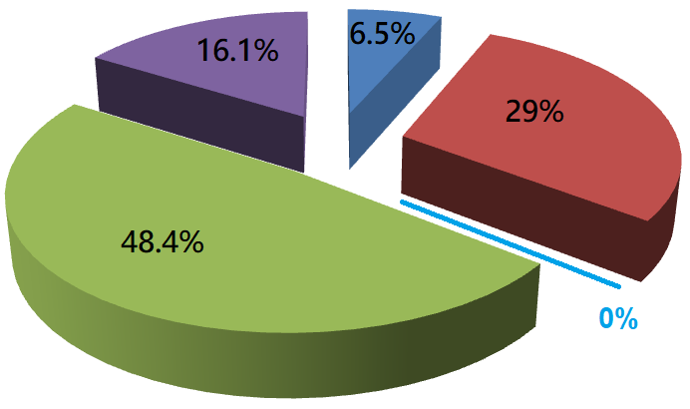
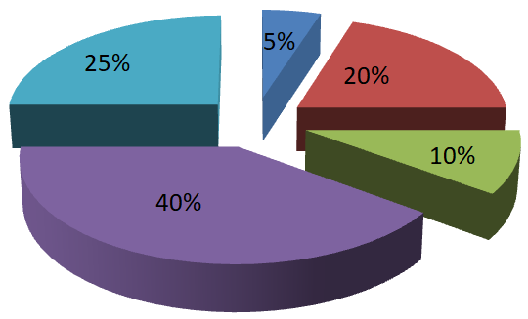
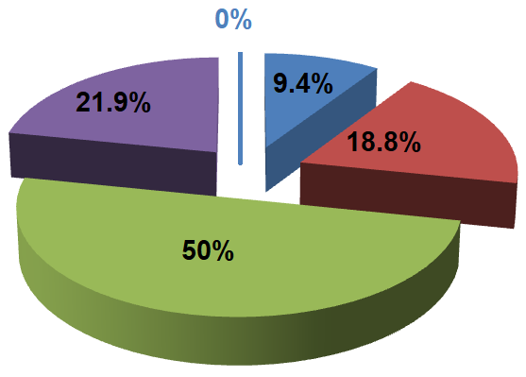
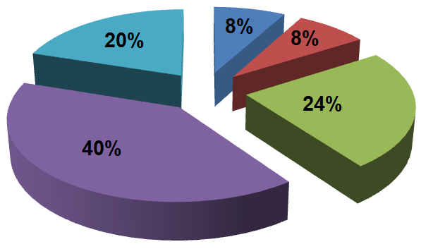

Duration of pain relief categories versus the treatment techniques and trigeminal nerve branch involved
ION branch
IAN branch
Duration of pain relief
Cryosurgery
Alcohol nerve block

Slide 13
Percentage of patient’s satisfaction level versus the treatment techniques and trigeminal nerve branch
Trigeminal n. branch | Treatment technique | % of patient’s satisfaction level
 |  | Not satisfied | Satisfied | Very satisfied | Total
ION | Alcohol nerve block | 15.0 | 5.0 | 80.0 | 100
 | Cryosurgery | 12.9 | 9.7 | 77.4 | 100
IAN | Alcohol nerve block | 0 | 16.0 | 84.0 | 100
 | Cryosurgery | 12.5 | 18.8 | 68.8 | 100
All | Alcohol nerve block | 6.7 | 11.1 | 82.2 | 100
 | Cryosurgery | 12.7 | 14.3 | 73.0 | 100

Slide 14
Conclusion
Recurrences rates have been reported to be high in the majority of peripheral techniques
Also have been shown to bear the lowest morbidity in refractory patients to medical therapy or in patients who are unable to undergo neurosurgical treatment
The present study has shown that peripheral alcohol injections are still useful in the management of trigeminal neuralgia, particularly in nonresponsive cases to drug therapy or in patients with severe side effects or unwilling to go for neurosurgical procedures.
the study results are limited because it lacks knowledge about drug use after the procedure and the perception of patients was not evaluated
The study has also not measured the level of pre-operative pain.
Cryosurgery of trigeminal nerve produces a reliable, prolonged pain relief with no aggravation of symptoms. It is a simple procedure for those patients who want to avoid major surgery

Slide 15
THANK YOU
THANK YOU

