Slide 1
Hypothyroidism in Infants & Children
الدكتور جهاد الخطيب
اختصاصي بالأمراض الداخلية
اختصاصي بأمراض الغدد الصم
محاضر في كلية الطب جامعة حماة

Slide 2
Unlike the adult, thyroid disease in the child is associate with important effects on growth and development.
Although thyroid disorders often are subtle in presentation, the delirious consequences of late or inappropriate diagnosis and treatment may be irreversible.
Thyroid hormone is important for regulating the body metabolism throughout life, it is crucial for growth and development of the fetal central nervous system during the 1st three years.
Lack of sufficient thyroid hormone during this period results in mental retardation.

Slide 3
Neonatal (congenital) Hypothyroidism
Causes of Neonatal Hypothyroidism
And Their Approximate Incidences
Causes | Incidence
Permanent (90%)
Thyroid dysgenesis | 1 in 4500
Inborn errors of thyroid hormonogenesis | 1 in 30,000
Hypothalamic/ pituitary | 1 in 100,000
Thyroid hormone resistance | Rare
Transient (10%)
Parental or postnatal iodine exposure | Unknown
Maternal TSH receptor blocking antibodies | 1 in 180,000
Maternal antithyroid drugs | Unknown

Slide 4
The clinical manifestations are subtle , nonspecific , or absent in the majority of infants.
Less than 5% of the infants detected by screening programs are suspected of having Hypothyroidism on clinical grounds prior to notification by the screening laboratory .
Newborn screening for hypothyroidism is now performed in all infants in most industrialized nations.
At present only 30% of the world birth population
(approximately 127 million) undergoes screening for this disorder.
The screening program may not identify CH in pre­mature infants with an immature thyroid axis. all infants born <32 weeks of gestation with a nor­mal TSH screen in the first week of life have a second screening after 4 weeks.

Slide 5
Clinical features
The following features are late sequelae of congenital hypothyroidism and, with routine screening now available, should never be seen nowadays.
Physiological jaundice.
Goitre.
Hoarse cry, feeding problems, constipation, somnolence.
Delay in reaching normal milestones of development; short stature.
Coarse features with protruding tongue, broad flat nose, widely-set eyes.
Sparse hair and dry skin, protuberant abdomen with umbilical hernia.

Slide 6
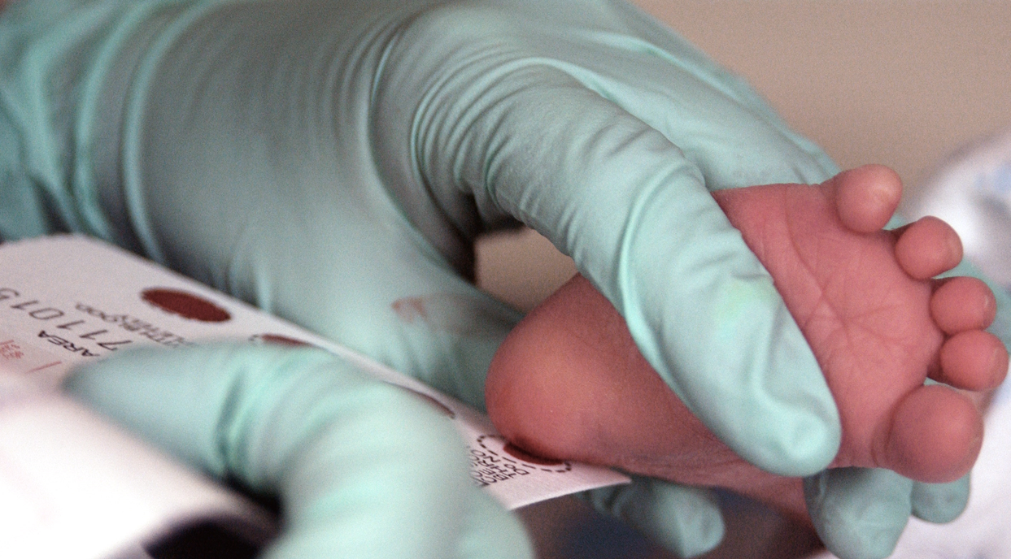

Slide 7
TSH
>40 mU/L (Treatment)
>20 mU/L
Treatment
6-20 mU/L Followup
<20 mU/L
(No treatment)
20-40 mU/L
Rpt after 2 wk
<6 mU/L
No treatment

Slide 8
Hyperthyrotropinemia at neonatal screening
≥40μIU/L
<40μIU/L
Venous Thyroid function tests
Ft4 below normal for age
TSH>20μIU/L
(even with N T4)
TSH
6-20 μIU/L
Start treatment + imaging
Re-testing after 2
weeks + imaging
Thyroid scan is a mandatory if non-visualized
thyroid gland by Ultrasound to exclude ectopia

Slide 9
Neonates with subclinical Hyperthyrotropinemia
In infants with mild SH (TSH: 6-10 μIU/L)
72% resolve spontaneously
Decision of treatment is controversial
“Grey Zone”
Indications of treatment of in infants with SL
Persistent TSH>10 μIU/L for >3-4 weeks
Symptoms strongly suggestive of hypothyroidism
Thyroid dysgenesis (e.g. Ectopia)
TSH
6-20 μIU/L
Concerns about
Neurodevelopment and growth
Re-treating after 2 weeks +imaging
Thyroid ultrasound &/or Scan

Slide 10
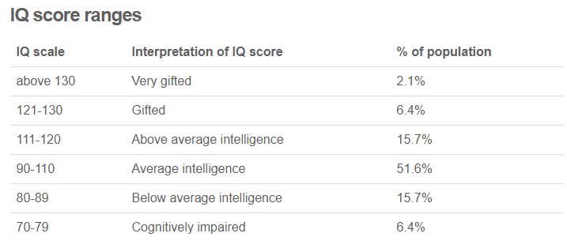
Age treatment for congenital hypothyroidism started and intellectual outcome prior to newborn screening
Age (Mo) | IQ (X) Mean | Range
0-3 | 89 | 64-107
3-6 | 71 | 35-96
>6 | 54 | 25-80
Adapted from Klein AH, et al. Improved prognosis in congenital hypothyroidism treated before age 3 months. (1972)

Slide 11
Prognosis
Early treatment critical for normal neurological outcome
  Start treatment within the first 2 weeks if possible
  Most will have normal development , growth and IQ of 109 -similar to those in control groups.
Those inadequately treated:
  Lower IQs
  Gross and fine motor impairment
  Language deficits
  Poor visual-spatial abilities

Slide 12
Hypothyroidism in Children & Adolescents
The most frequent cause of Hypothyroidism is Chronic Lymphocytic Thyroiditis (CLT).
The onset of Hypothyroidism in childhood is insidious.
Children are usually recognized because of the detection of a goiter on routine examination or because of poor interval growth.
These children are relatively overweight for their height.
The classical clinical manifestation include: Lethargy, cold intolerance, constipation, dry skin, periorbital edema.
Variable but usually declining school performance.

Slide 13
The presentation of hypothyroidism may be of slow onset, delaying diagnosis. Children may be noted to sleep more than expected and complain of a lack of energy; school work and cognition may be impaired but the children are generally quiet and non‐disruptive in school so this is rarely a cause for complaint.
In contrast to neonatal hypothyroidism, rapid replacement is not essential in the older children.
Rapid normalization may result in unwanted side effects (deterioration in school performance, short attention span, hyperactivity, insomnia, and behavior difficulties.

Slide 14
