Slide 1
COVID –19 Management principles for Hospitalized patients
M. Safwan Badr, MD, MBA
Professor and Chair, Department of Internal Medicine
Wayne State University School of Medicine.

Slide 2
Pathophysiology of COVID
Coronaviruses
Large, enveloped, single-stranded RNA viruses found in humans and other mammals
Cause a variety of Respiratory, Gastrointestinal, and Neurological diseases
Common Cold Viruses
229E,OC43,NL63,and HKU1
Epidemics & Pandemics
Severe Acute Respiratory Syndrome (SARS-CoV)
Middle East Respiratory Syndrome (MERS)
COVID-19 (SARS-CoV-2)
Notes:
individuals. SARS-CoV-2 is the third coronavirus that has caused severe
disease inhumansto spread globally in the past 2 decades.1The
first coronavirus that caused severe disease was severe acute respiratory
syndrome (SARS), which was thought to originate in
Foshan, China,andresulted in the2002-2003SARS-CoVpandemic.2
The secondwas the coronavirus-caused MiddleEast respiratory syndrome(
MERS),whichoriginatedfromtheArabian penins
distinctive
spikes, ranging from 9 nm to 12 nm, giving the virions the appearance
of a solar corona (Figure 2).4 Through genetic recombination
and variation, coronaviruses can adapt to and infect new
hosts. Bats are thought to be a natural reservoir for SARS-CoV-2, but
it has been suggested that humans became infected with SARSCoV-
2 via an intermediate host, such as the pangolin.5,6ula in2012.3
SARS-CoV-2 has a diameter of 60 nm to 140 nm and distinctive
spikes, ranging from 9 nm to 12 nm, giving the virions the appearance
of a solar corona (Figure 2).4 Through genetic recombination
and variation, coronaviruses can adapt to and infect new
hosts. Bats are thought to be a natural reservoir for SARS-CoV-2, but
it has been suggested that humans became infected with SARSCoV-
2 via an intermediate host, such as the pangolin

Slide 3
COVID Basics 2 - Presentation
Fever (43%)
Cough (50.3%)
Anorexia (40–84%) ess of breath (29%)
Sore Throat (20%)
Myalgia (36%)
Headache (34%)
Diarrhea (19%)
Nausea/vomiting 12%)
Anosmia, ageusia, sore throat, , rhinorrhea, abdominal pain (<10%)
Stokes, E. K., et al. (2020). "Coronavirus Disease 2019 Case Surveillance - United States, January 22-May 30, 2020." MMWR Morb Mortal Wkly Rep 69(24): 759-765.
https://www.cdc.gov/coronavirus/2019-ncov/hcp/clinical-guidance-management-patients.html
Notes:
Atypical presentations have been described, and older adults and persons with medical comorbidities may have delayed presentation of fever and respiratory symptoms.10,11 In one study of 1,099 hospitalized patients, fever was present in only 44% at hospital admission but later developed in 89% during hospitalization.1 Headache, confusion, rhinorrhea, sore throat, hemoptysis, vomiting, and diarrhea have been reported but are less common (<10%).1,4-6 Some persons with COVID-19 have experienced gastrointestinal symptoms such as diarrhea and nausea prior to developing fever and lower respiratory tract signs and symptoms.9 Anosmia or ageusia preceding the onset of respiratory symptoms has been anecdotally reported12, but more information is needed to understand its role in identifying COVID-19.
Atypical presentations occur often, and older adults and persons with medical comorbidities may have delayed presentation of fever and respiratory symptoms.10,14 In one study of 1,099 hospitalized patients, fever was present in only 44% at hospital admission but eventually developed in 89% during hospitalization.¹
Fatigue, headache, and muscle aches (myalgia) are among the most commonly reported symptoms in people who are not hospitalized, and sore throat and nasal congestion or runny nose (rhinorrhea) also may be prominent symptoms.
Loss of smell (anosmia) or taste (ageusia) preceding the onset of respiratory symptoms has been commonly reported in COVID-19 especially among women and young or middle-aged patients who do not require hospitalization.^{11,12} While many of the symptoms of COVID-19 are common to other respiratory or viral illnesses, anosmia appears to be more specific to COVID-19.¹²

Slide 4
COVID Basics 3 – Illness Severity
Mild disease (no or mild pneumonia) was reported in 81 percent.
Severe disease (eg, with dyspnea, hypoxia, or >50 % lung involvement on CXR) : 14 percent.
Critical disease (eg, with respiratory failure, shock, or multiorgan dysfunction): 5%
The overall case fatality rate : 2.3 %
Higher among hospitalized patients: 24
Higher if mechanical ventilation is required: 60%
Mortality rates among hospitalized patients : five times higher than influenza
Notes:
The largest cohort of >44,000 persons with COVID-19 from China showed that illness severity can range from mild to critical:³⁸

Slide 5
COVID Basics – Clinical Progression
Among patients who developed severe disease:
Medium time to dyspnea ranged from 5 to 8 days
Median time to acute respiratory distress syndrome (ARDS) ranged from 8 to 12 days
Median time to ICU admission ranged from 10 to 12 days
Among all hospitalized patients, a range of 26% to 32% of patients were admitted to the ICU
Mortality among patients admitted to the ICU ranges from 39% to 72% depending on the study
The median length of hospitalization among survivors was 10 to 13 days
Notes:
Clinicians should be aware of the potential for some patients to rapidly deteriorate one week after illness onset

Slide 6
Epidemiologic Risk Factors for Severe COVID -19 Disease
Age > 65 years
Preexisting Pulmonary Disease
Chronic Kidney Disease
Diabetes Mellitus
Hypertension
Cardiovascular Disease
Obesity (BMI ≥ 30)
Smoking
Immunocompromising Conditions
Liver Disease

Slide 7
Comorbidities Associated with a Risk for Mortality Due to COVID - 19
Variable | OR for Mortality (95% CI) | P value
Male Sex | 1.78 (1.30-2.42) | P=0.0003
Hypertension | 2.53 (2.07- 3.09] | P<0.00001
CHD/CVD | 3.81 (2.11-6.85) | P<0.00001
Cerebrovascular Disease | 4.92 (1.54-15.68) | P=0.007
Diabetes | 1.97 (1.67- 2.31) | P<0.00001
Smoking | 1.77 (0.83-3.81) | P=0.14
Chronic Renal Disease | 9.41 (3.23- 27.40) | P<0.0001
COPD | 2.09 (0.49- 8.90) | P=0.32
14 studies with 4659 patients
Tian, W., et al. (2020). "Predictors of mortality in hospitalized COVID-19 patients: A systematic review and meta-analysis." J Med Virol.
Notes:
Mortality rates of coronavirus disease 2019 (COVID-19) continue to rise across the
world. Information regarding the predictors of mortality in COVID-19 patients remains
scarce.
Herein, we performed a systematic review of published articles, from January 1 to April
24, 2020, to evaluate the risk factors associated with mortality in COVID-19. Two
investigators independently searched the articles and collected the data, in accordance
with PRISMA guidelines. We looked for associations between mortality and patient
characteristics, comorbidities, and laboratory abnormalities. A total of 14 studies
documenting the outcomes of 4659 patients were included. The presence of comorbidities
such as hypertension (OR 2.5; 95% CI 2.1-3.1; P<0.00001), coronary heart disease (OR 3.8; 95% CI 2.1-6.9; P<0.00001) and diabetes (OR 2.0; 95% CI 1.7-2.3; P<0.00001) were
associated with significantly higher risk of death amongst COVID-19 patients. Those
who died, compared to those who survived, differed on multiple biomarker levels on
admission including elevated levels of cardiac troponin (+44.2 ng/L, 95% CI 19.0-69.4;
P=0.0006); C-reactive protein (+66.3 µg/mL, 95% CI 46.7-85.9; P<0.00001); interleukin-
6 (+4.6 ng/mL, 95% CI 3.6-5.6; P<0.00001); D-dimer (+4.6 µg/mL, 95% CI 2.8-6.4;
P<0.00001); creatinine (+15.3 µmol/L, 95% CI 6.2-24.3; P=0.001) and alanine
transaminase (+5.7 U/L, 95% CI 2.6-8.8; P=0.0003); as well as decreased levels of
albumin (-3.7 g/L, 95% CI -5.3 to -2.1; P<0.00001). Individuals with underlying
cardiometabolic disease and that present with evidence for acute inflammation and end-
organ damage are at higher risk of mortality due to COVID-19 infection and should be
managed with greater intensity.

Slide 8
Lab Features Associated with Severe COVID19
Abnormality | Threshold
Elevations in:
D Dimer | >1000 ng/mL (normal range: <500 ng/mL)
CRP | >100 mg/L (normal range: <8.0 mg/L)
LDH | >245 units/L (normal range: 110 to 210 units/L)
Troponin | >2× the upper limit of normal
Ferritin | >500 mcg/L (normal range: females 10 to 200 mcg/L; males 30 to 300 mcg/L)
CPK | >2× the upper limit of normal (normal range: 40 to 150 units/L)
Reduction in:
Absolute lymphocyte count | <800/microL (normal range for age ≥21 years: 1800 to 7700/microL)
1.Guan WY, Ni ZY, Hu Y, et al. Clinical characteristics of coronavirus disease 2019 in China. N Engl J Med 2020.
2.Huang C, Wang Y, Li X, et al. Clinical features of patients infected with 2019 novel coronavirus in Wuhan, China. Lancet 2020; 395:497.
3.Zhou F, Yu T, Du R, et al. Clinical course and risk factors for mortality of adult inpatients with COVID-19 in Wuhan, China: a retrospective cohort study. Lancet 2020; 395:1054.
4.Wang D, Hu B, Hu C, et al. Clinical characteristics of 138 hospitalized patients with 2019 novel coronavirus-infected pneumonia in Wuhan, China. JAMA 2020.
5.Wu Z, McGoogan JM. Characteristics of and important lessons from the coronavirus disease 2019 (COVID-19) outbreak in China: Summary of a report of 72,314 cases from the Chinese Center for Disease Control and Prevention. JAMA 2020.
6.Ruan Q, Yang K, Wang W, et al. Clinical predictors of mortality due to COVID-19 based on an analysis of data of 150 patients from Wuhan, China. Intensive Care Med 2020
Notes:
Lymphopenia is the most common laboratory finding in COVID-19, and is found in as many as 83% of hospitalized patients

Slide 9
Lab Results that Are Associated with an Increased Risk of Mortality
Lab Test | Mean Difference (95% CI) Non-survivor - Survivor | Meta- Analysis P Value
Albumin | -3.7 (-5.3 to -2.1) | P<0.00001
ALT | 5.7 (2.6-8.8) | P=0.0003
APTT | 1.3 (-1.3 to 4.0) | P=0.32
AST | 15.2 (7.7-22.7) | P<0.0001
BUN | 3.0 (1.6-4.4) | P <0.0001
CD4+ T Cell count | -50.0 (-82.6 to -17.4) | P=0.003
CD8+ T Cell count | -82.9 (-151.3 to -14.4) | P=0.02
Creatine Kinase | 87 (21-153) | P=0.010
Creatinine | 15.3 (6.2-24.3) | P=0.001
CRP | 66.3 (46.7-85.9) | P<0.00001
D-Dimer | 4.6 (2.8-6.4) | P<0.00001
Tian, W., et al. (2020). "Predictors of mortality in hospitalized COVID-19 patients: A systematic review and meta-analysis." J Med Virol.

Slide 10
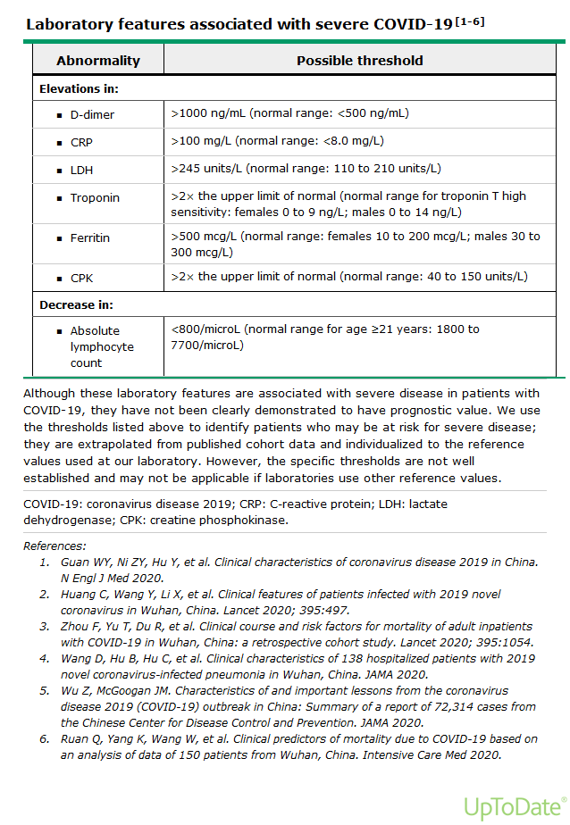

Slide 11
Lab Results that Are Associated with an Increased Risk of Mortality
Lab Test | Mean Difference (95% CI) Non-survivor - Survivor | Meta- Analysis P Value
ESR | 6.9 (3.4-10.4) | P=0.0001
Hemoglobin | -1.2 (-3.9 to 1.4) | P=0.35
IL-6 | 4.6 (3.6-5.6) | P<0.00001
Lactate dehydrogenase | 290 (256-325) | P<0.00001
Lymphocyte count | -0.34 (-0.41 to -0.27) | P<0.00001
NT-proBNP | 903 (718-1089) | P<0.00001
Platelet count | -35.9 (-53.3 to -18.5) | P<0.00001
Procalcitonin | 0.21 (0.11-0.31) | P<0.00001
PT | 1.15 (0.43-1.87) | P=0.002
Total Bilirubin | 4.8 (3.4-6.1) | P<0.00001
Troponin I | 44.2 (19.0-69.4) | P=0.0006
WBC count | 3.8 (3.1-4.5) | P<0.00001
Tian, W., et al. (2020). "Predictors of mortality in hospitalized COVID-19 patients: A systematic review and meta-analysis." J Med Virol.

Slide 12
Laboratory Testing
Daily tests
CBC and diff, CK, CRP
PT, PTT, and fibrinogen
D-dimer
Initial and as needed
Portable CXR
No need for chest CT scan or echocardiography routinely
LDH
Troponin
EKG

Slide 13
Defining disease severity
Mild disease
Fever, malaise, cough, upper respiratory symptoms, and/or less common features of COVID-19 – No dyspnea
Moderate disease
Dyspnea
Infiltrates on chest imaging
Severe disease
Hypoxia (oxygen saturation ≤94 percent on room air)
Need for oxygenation or ventilatory support

Slide 14
General Care Considerations
Empiric treatment for influenza during influenza season
Empiric treatment for bacterial pneumonia in select patients
Prevention of and evaluation for venous thromboembolism
Uncertainty about NSAID use
Avoiding nebulized medications
Continue chronic ACE inhibitors/ARBs, Statins and aspirin
Individualized decision regarding Immunomodulatory agents:

Slide 15
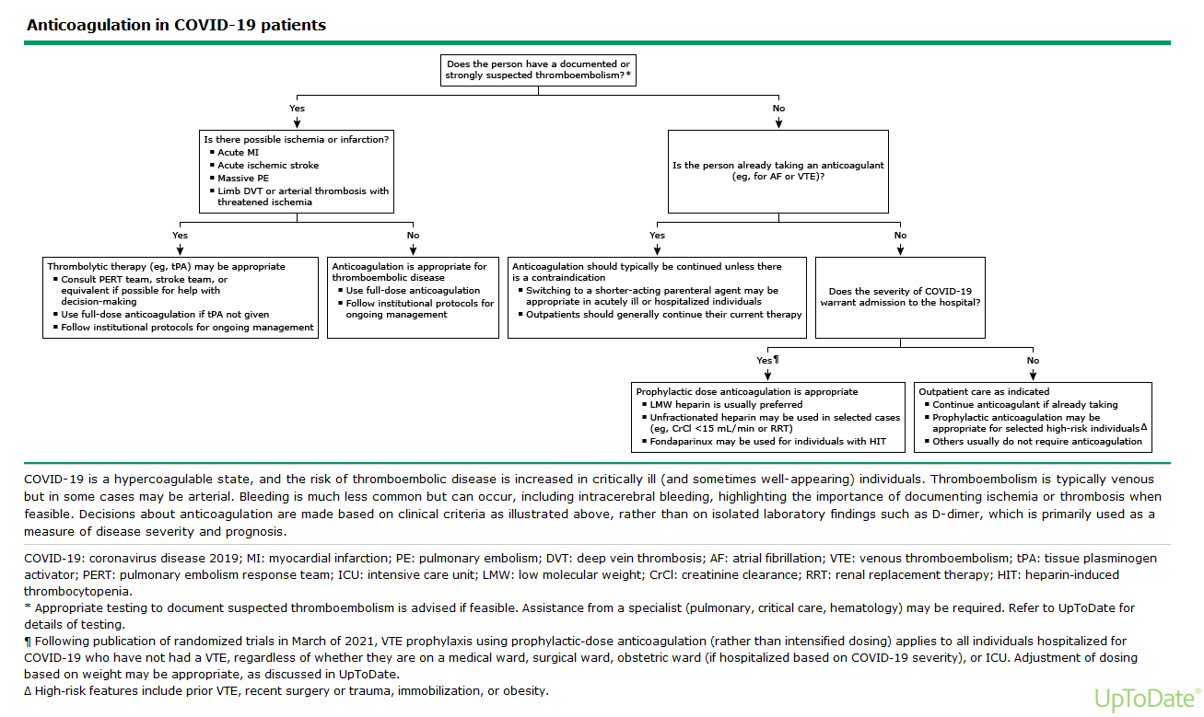

Slide 16
Specific Treatments
Limited and emerging evidence
Variable protocols
In the US, several are under Emergency Use Authorization by the FDA
Guidelines are rapidly changing.
Dexamethasone and other glucocorticoids
Remdesevir
IL-6 pathway inhibitors (eg, tocilizumab)

Slide 17
Approach
The optimal approach to treatment of COVID-19 is uncertain.
There is evidence of mortality benefit with dexamethasone as well as with adjunctive tocilizumab and a possible clinical benefit with remdesevir
No grade A recommendations
No other therapies have clearly proven effective.
Enrollment in clinical trials is recommended.

Slide 18
Hospitalized patients
Remdesivir for hospitalized patients not on O2.
Remdesivir + dexamethasone for those receiving low-flow O2.
Add tocilizumab for those with elevated inflammatory markers (CRP) and continuously increasing oxygen requirements
Prioritize it for more severely ill patients on higher levels of oxygen support.

Slide 19
Hospitalized patients with severe disease who require mechanical ventilation
Low -dose dexamethasone (Grade 1B).
If within 24 to 48 hours of admission to an ICU : tocilizumab
Remdesivir : questionable value at this point.

Slide 20
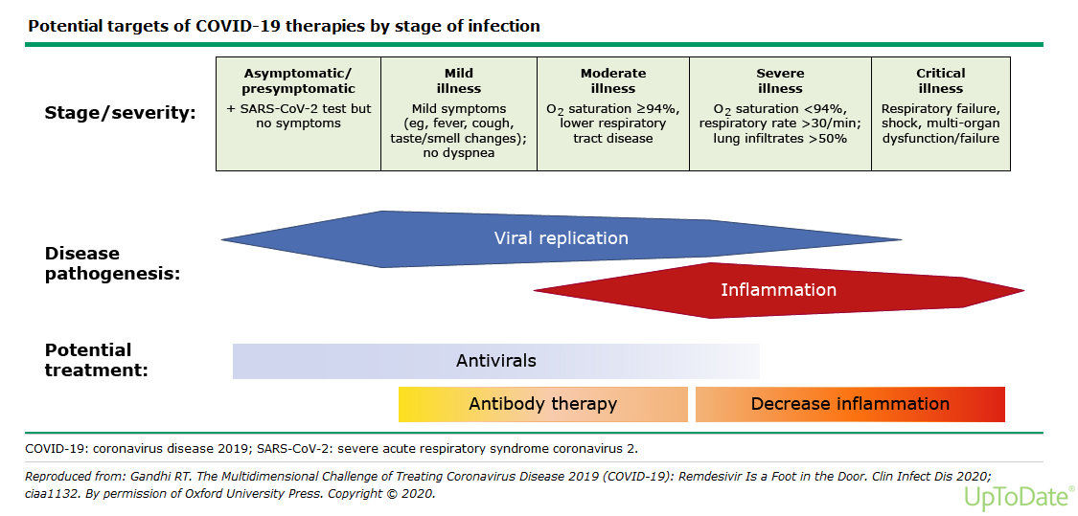

Slide 21
https://www.who.int/publications/i/item/WHO-2019-nCoV-clinical-2021-1

