Slide 1


Diabetec Older Adults
Standards of Medical Care in
Diabetes—2021
Dr. Rana Shannat
Endocrinologist & Diabetologist
Hama 1l6l2021

Slide 2


Slide 3
Diabetes is a highly prevalent health condition in the aging population.
Over one-quarter of people over the age of 65 years have diabetes and one-half of older adults have prediabetes
and the number of older adults living with these conditions is expected to increase rapidly in the coming decades

Slide 4
Older adults with diabetes have higher rates of premature death, functional disability, accelerated muscle loss, and coexisting illnesses, such as hypertension, coronary heart disease, and stroke, than those without diabetes.
Screening for diabetes complications in older adults should be individualized and periodically revisited, as the results of screening tests may impact targets and therapeutic approaches

Slide 5
At the same time, older adults with diabetes are also at greater risk than other older adults for several common geriatric syndromes, such as
polypharmacy, cognitive impairment, depression, urinary incontinence, injurious falls, and persistent pain .
These conditions may impact older adults' diabetes self-management abilities and quality of life if left unaddressed

Slide 6
الإمراضيات الشائعة عند المسنين
سيطرة معتقدات إجتماعية
ضمور الكتلة العضلية
سوء واضطراب التغذية
تراجع القدرة على إفراز الإنسولين
تزايد النسيج الشحمي في الأحشاء
دور الجينات الوراثية
تناقص النشاط الفيزيائي الرياضي
تأثيرات جانبية لبعض الأدوية
وجود أمراض أخرى

Slide 7
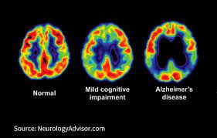
Recommendations
Neurocognitive Function
Screening for early detection of mild cognitive impairment or dementia should be performed for adults 65 years of age or older at the initial visit and annually as appropriate

Slide 8
The presentation of cognitive impairment ranges from subtle executive dysfunction to memory loss and overt dementia.
People with diabetes have higher incidences of all-cause dementia, Alzheimer disease, and vascular dementia than people with normal glucose tolerance.
Poor glycemic control is associated with a decline in cognitive function , and longer duration of diabetes is associated with worsening cognitive function.

Slide 9
Cognitive dysfunction makes it difficult for patients to perform complex self-care tasks , such as monitoring glucose and adjusting insulin doses.
It also hinders their ability to appropriately maintain the timing of meals and content of diet.
When clinicians are managing patients with cognitive dysfunction, it is critical to simplify drug regimens and to facilitate and engage the appropriate support structure to assist the patient in all aspects of care.
Screening for cognitive impairment should additionally be considered when a patient presents with a significant decline in clinical status due to increased problems with self-care activities, such as errors in calculating insulin dose, difficulty counting carbohydrates, skipped meals, skipped insulin doses, and difficulty recognizing, preventing, or treating hypoglycemia.
People who screen positive for cognitive impairment should receive diagnostic assessment as appropriate, including referral to a behavioral health provider for formal cognitive/neuropsychological evaluation

Slide 10
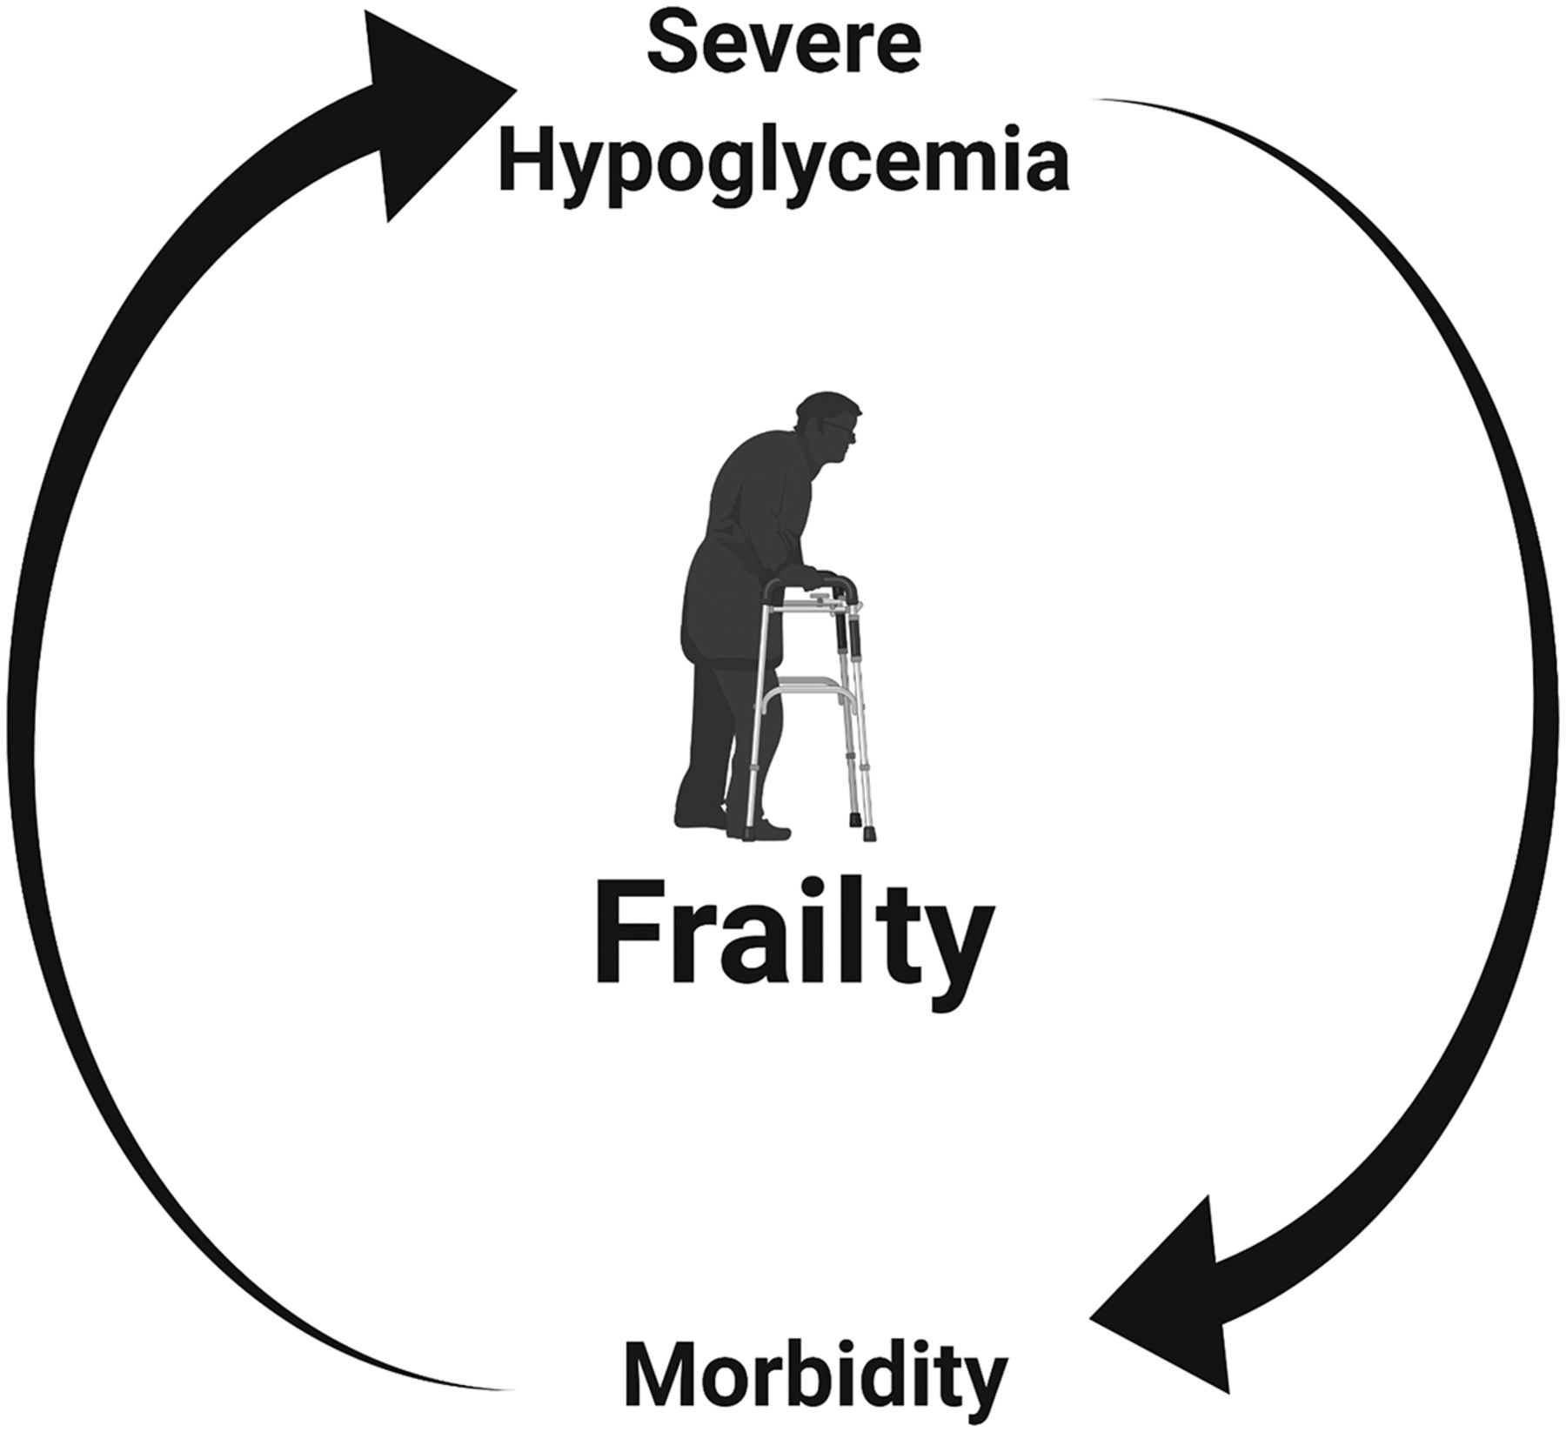

Slide 11

Hypoglycemia
Recommendations
Because older adults with diabetes have a greater risk of hypoglycemia than younger adults, episodes of hypoglycemia should be ascertained and addressed at routine visits.

Slide 12
For older adults with type 1 diabetes, continuous glucose monitoring should be considered to reduce hypoglycemia.
Older adults are at higher risk of hypoglycemia for many reasons.
Cognitive decline has been associated with increased risk of hypoglycemia, and conversely, severe hypoglycemia has been linked to increased risk of dementia.
Patients and their caregivers should be routinely queried about hypoglycemia (e.g., selected questions from the Diabetes Care Profile) and hypoglycemia unawareness .

Slide 13
An important step to mitigating hypoglycemia risk is to determine whether the patient is skipping meals or inadvertently repeating doses of their medications.
Glycemic targets and pharmacologic regimens may need to be adjusted to minimize the occurrence of hypoglycemic events .
This recommendation is supported by observations from multiple randomized controlled trials, such as the Action to Control Cardiovascular Risk in Diabetes (ACCORD) study and the Veterans Affairs Diabetes Trial (VADT), which showed that intensive treatment protocols targeting A1C <6.0% with complex drug regimens significantly increased the risk for hypoglycemia requiring assistance compared with standard treatment .

Slide 14

For older patients with type 1 diabetes, continuous glucose monitoring (CGM) may be another approach to reducing the risk of hypoglycemia.
Over 6 months, use of CGM resulted in a small but statistically significant reduction in time spent with hypoglycemia (glucose level <70 mg/dL) compared with routine finger-stick monitoring using standard BGM.
- CGM may be an option for older patients with type 2 diabetes using multiple daily injections of insulin

Slide 15

Treatment Goals
Recommendations
Older adults who are otherwise healthy with few coexisting chronic illnesses and intact cognitive function and functional status should have lower glycemic goals (such as A1C <7.0–7.5%
[while those with multiple coexisting chronic illnesses, cognitive impairment, or functional dependence should have less stringent glycemic goals (such as A1C <8.0–8.5%
Glycemic goals for some older adults might reasonably be relaxed as part of individualized care, but hyperglycemia leading to symptoms or risk of acute hyperglycemia complications should be avoided in all patients.

Slide 16


Treatment of hypertension to individualized target levels is indicated in most older adults.
Treatment of other cardiovascular risk factors should be individualized in older adults considering the time frame of benefit.
Lipid-lowering therapy and aspirin therapy may benefit those with life expectancies at least equal to the time frame of primary prevention or secondary intervention trials.

Slide 17
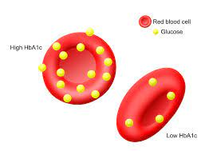
A1C is used as the standard biomarker for glycemic control in all patients with diabetes but may have limitations in patients who have medical conditions that impact red blood cell turnover
Many conditions associated with increased red blood cell turnover, such as hemodialysis, recent blood loss or transfusion, or erythropoietin therapy, are commonly seen in older adults and can falsely increase or decrease A1C. In these instances, plasma blood glucose fingerstick and sensor glucose readings should be used for goal setting

Slide 18

Healthy Patients With Good Functional Status
There are few long-term studies in older adults demonstrating the benefits of intensive glycemic, blood pressure, and lipid control.
Patients who can be expected to live long enough to reap the benefits of long-term intensive diabetes management, who have good cognitive and physical function, and who choose to do so via shared decision-making may be treated using therapeutic interventions and goals similar to those for younger adults with diabetes

Slide 19
Patients With Complications and Reduced Functionality
For patients with advanced diabetes complications, life-limiting comorbid illnesses, or substantial cognitive or functional impairments, it is reasonable to set less-intensive glycemic goals .
These patients are less likely to benefit from reducing the risk of microvascular complications and more likely to suffer serious adverse effects from hypoglycemia. However, patients with poorly controlled diabetes may be subject to acute complications of diabetes, including dehydration, poor wound healing, and hyperglycemic hyperosmolar coma.

Slide 20

Vulnerable Patients at the End of Life
For patients receiving palliative care and end-of-life care, the focus should be to avoid hypoglycemia and symptomatic hyperglycemia while reducing the burdens of glycemic management. Thus, when organ failure develops, several agents will have to be deintensified or discontinued.
For the dying patient, most agents for type 2 diabetes may be removed .

Slide 21
Beyond Glycemic Control
greater reductions in morbidity and mortality are likely to result from control of other cardiovascular risk factors rather than from tight glycemic control alone.
There is strong evidence from clinical trials of the value of treating hypertension in older adults
with treatment of hypertension to individualized target levels indicated in most.
There is less evidence for lipid-lowering therapy and aspirin therapy, although the benefits of these interventions for primary prevention and secondary intervention are likely to apply to older adults whose life expectancies equal or exceed the time frames of the clinical trials.

Slide 22
Lifestyle Management
Recommendations
Optimal nutrition and protein intake is recommended for older adults; regular exercise, including aerobic activity, weight-bearing exercise, and/or resistance training, should be encouraged in all older adults who can safely engage in such activities.
For older adults with type 2 diabetes, overweight/obesity, and capacity to safely exercise, an intensive lifestyle intervention focused on dietary changes, physical activity, and modest weight loss (e.g., 5–7%) should be considered for its benefits on quality of life, mobility and physical functioning, and cardiometabolic risk factor control.
Diabetes in the aging population is associated with reduced muscle strength, poor muscle quality, and accelerated loss of muscle mass, which may result in sarcopenia and/or osteopenia

Slide 23

. Diabetes is also recognized as an independent risk factor for frailty.
Frailty is characterized by decline in physical performance and an increased risk of poor health outcomes due to physiologic vulnerability and functional or psychosocial stressors.
Inadequate nutritional intake, particularly inadequate protein intake, can increase the risk of sarcopenia and frailty in older adults.

Slide 24

Pharmacologic Therapy

Slide 25

Pharmacologic Therapy
Recommendations
In older adults with type 2 diabetes at increased risk of hypoglycemia, medication classes with low risk of hypoglycemia are preferred. B
Overtreatment of diabetes is common in older adults and should be avoided. B
Deintensification (or simplification) of complex regimens is recommended to reduce the risk of hypoglycemia and polypharmacy, if it can be achieved within the individualized A1C target. B
Consider costs of care and insurance coverage rules when developing treatment plans in order to reduce risk of cost-related nonadherence. B

Slide 26
insulin
Simplification of the insulin regimen to match an individual's self-management abilities and their available social and medical support in these situations has been shown to reduce hypoglycemia and disease-related distress without worsening glycemic control

Slide 27
insulin regimen simplification may be appropriate in older adults.
Algorithm to simplify insulin regimen for older patients with type 2 diabetes. eGFR, estimated glomerular filtration rate. *Basal insulins: glargine U-100 and U-300, detemir, degludec, and human NPH. ¥Mealtime insulins: short-acting (regular human insulin) or rapid-acting (lispro, aspart, and glulisine). §Premixed insulins: 70/30, 75/25, and 50/50 products. Adapted with permission from Munshi and colleagues

Slide 28

Metformin
Metformin is the first-line agent for older adults with type 2 diabetes.
Recent studies have indicated that it may be used safely in patients with estimated glomerular filtration rate ≥30 mL/min/1.73 m²
However, it is contraindicated in patients with advanced renal insufficiency and should be used with caution in patients with impaired hepatic function or congestive heart failure because of the increased risk of lactic acidosis.
Metformin may be temporarily discontinued before procedures, during hospitalizations, and when acute illness may compromise renal or liver function.
Additionally, metformin can cause gastrointestinal side effects and a reduction in appetite that can be problematic for some older adults.
Reduction or elimination of metformin may be necessary for patients experiencing persistent gastrointestinal side effects.

Slide 29
Thiazolidinediones
Thiazolidinediones, if used at all, should be used very cautiously in those patients on insulin therapy as well as those patients with or at risk for congestive heart failure, osteoporosis, falls or fractures, and/or macular edema

Slide 30
Insulin Secretagogues
Sulfonylureas and other insulin secretagogues are associated with hypoglycemia and should be used with caution.
If used, sulfonylureas with a shorter duration of action, such as glipizide or glimepiride, are preferred.
Glyburide is a longer-acting sulfonylurea and should be avoided in older adults .

Slide 31
Incretin-Based Therapies
Oral dipeptidyl peptidase 4 (DPP-4) inhibitors have few side effects and minimal risk of hypoglycemia, but their cost may be a barrier to some older patients
Across the trials of this drug class, there appears to be no interaction by age-group

Slide 32
GLP-1 receptor agonists
have demonstrated cardiovascular benefits among patients with established atherosclerotic cardiovascular disease (CVD.
Liraglutide
These drugs are injectable agents (with the exception of oral semaglutide) which require visual, motor, and cognitive skills for appropriate administration.
They may also be associated with nausea, vomiting, and diarrhea.
Given the gastrointestinal side-effects of this class, GLP-1 receptor agonists may not be preferred in older patients who are experiencing unexplained weight loss.

Slide 33


Slide 34
Sodium–Glucose Cotransporter 2 Inhibitors
SGLT2 inhibitors are administered orally, which may be convenient for older adults with diabetes.
In patients with established atherosclerotic CVD, these agents have shown cardiovascular benefits
This class of agents has also been found to be beneficial for patients with heart failure and to slow the progression of chronic kidney disease.. The stratified analyses of the trials of this drug class indicate that older patients have similar or greater benefits than younger patients.
While understanding of the clinical benefits of this class is evolving, side effects such as volume depletion may be more common among older patients.

Slide 35

Insulin Therapy
The use of insulin therapy requires that patients or their caregivers have good visual and motor skills and cognitive ability.
Once-daily basal insulin injection therapy is associated with minimal side effects and may be a reasonable option in many older patients. Multiple daily injections of insulin may be too complex for the older patient with advanced diabetes complications, life-limiting coexisting chronic illnesses, or limited functional status.

Slide 36
Special Considerations for Older Adults With Type 1 Diabetes
Due in part to the success of modern diabetes management, patients with type 1 diabetes are living longer, and the population of these patients over 65 years of age is growing
Insulin is an essential life-preserving therapy for patients with type 1 diabetes, unlike for those with type 2 diabetes.
To avoid diabetic ketoacidosis, older adults with type 1 diabetes need some form of basal insulin even when they are unable to ingest meals.

Slide 37
In the older patient with type 1 diabetes, administration of insulin may become more difficult as complications, cognitive impairment, and functional impairment arise.
This increases the importance of caregivers in the lives of these patients.
Many older patients with type 1 diabetes require placement in long-term care (LTC) settings (i.e., nursing homes and skilled nursing facilities), and unfortunately these patients encounter providers that are unfamiliar with insulin pumps or CGM.
Some providers may be unaware of the distinction between type 1 and type 2 diabetes.
In these instances, the patient or the patient's family may be more familiar with diabetes management than the providers.
Education of relevant support staff and providers in rehabilitation and LTC settings regarding insulin dosing and use of pumps and CGM is recommended as part of general diabetes education

Slide 38
Resources
Staff of LTC facilities should receive appropriate diabetes education to improve the management of older adults with diabetes.
Treatments for each patient should be individualized. Special management considerations include the need to avoid both hypoglycemia and the complications of hyperglycemia

Slide 39

Nutritional Considerations

Slide 40
Nutritional Considerations
An older adult residing in an LTC facility may have irregular and unpredictable meal consumption, undernutrition, anorexia, and impaired swallowing.
Furthermore, therapeutic diets may inadvertently lead to decreased food intake and contribute to unintentional weight loss and undernutrition.
Diets tailored to a patient's culture, preferences, and personal goals may increase quality of life, satisfaction with meals, and nutrition status).
It may be helpful to give insulin after meals to ensure that the dose is appropriate for the amount of carbohydrate the patient consumed in the meal.

Slide 41
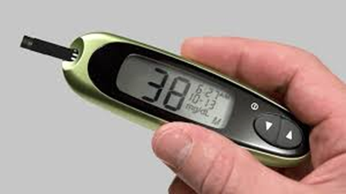
Hypoglycemia
Older adults with diabetes in LTC are especially vulnerable to hypoglycemia. impaired cognitive and renal function, slowed hormonal regulation and counterregulation, suboptimal hydration, variable appetite and nutritional intake, polypharmacy, and slowed intestinal absorption.
Oral agents may achieve glycemic outcomes in LTC populations similar to basal insulin.

Slide 42
The following alert strategy could be considered:
Call provider immediately in cases of low blood glucose levels (<70 mg/dL [3.9 mmol/L]).
Call as soon as possible when
  a) glucose values are 70–100 mg/dL (3.9–5.6 mmol/L) (regimen may need to be adjusted),
  b) glucose values are >250 mg/dL (13.9 mmol/L) within a 24-h period,
  c) glucose values are >300 mg/dL (16.7 mmol/L) over 2 consecutive days,
  d) any reading is too high for the glucometer, or
  e) the patient is sick, with vomiting, symptomatic hyperglycemia, or poor oral intake.
basal insulin may maintain glucose levels and prevent acute hyperglycemic complications.

Slide 43

End-Of-Life Care
Recommendations
When palliative care is needed in older adults with diabetes, providers should initiate conversations regarding the goals and intensity of care.
Strict glucose and blood pressure control may not be necessary E, and reduction of therapy may be appropriate.
Similarly, the intensity of lipid management can be relaxed, and
withdrawal of lipid-lowering therapy may be appropriate. A
Overall comfort, prevention of distressing symptoms, and preservation of quality of life and dignity are primary goals for diabetes management at the end of life. C

Slide 44
. Overall, palliative medicine promotes comfort, symptom control and prevention (pain, hypoglycemia, hyperglycemia, and dehydration), and preservation of dignity and quality of life in patients with limited life expectancy.
. In a multicenter trial, withdrawal of statins among patients in palliative care was found to improve quality of life, while similar evidence for glucose and blood pressure control are not yet available
A patient has the right to refuse testing and treatment, whereas providers may consider withdrawing treatment and limiting diagnostic testing, including a reduction in the frequency of blood glucose monitoring.
Glucose targets should aim to prevent hypoglycemia and hyperglycemia. Treatment interventions need to be mindful of quality of life.
Careful monitoring of oral intake is warranted.
The pharmacologic therapy may include oral agents as first line, followed by a simplified insulin regimen. If needed, basal insulin can be implemented, accompanied by oral agents and without rapid-acting insulin. Agents that can cause gastrointestinal symptoms such as nausea or excess weight loss may not be good choices in this setting. As symptoms progress, some agents may be slowly tapered and discontinued

Slide 45
1. A stable patient: Continue with the patient's previous regimen, with a focus on the prevention of hypoglycemia and the management of hyperglycemia using blood glucose testing, keeping levels below the renal threshold of glucose. There is very little role for A1C monitoring and lowering.
2. A patient with organ failure: Preventing hypoglycemia is of greater significance.
Dehydration must be prevented and treated.
In people with type 1 diabetes, insulin administration may be reduced as the oral intake of food decreases but should not be stopped.
For those with type 2 diabetes, agents that may cause hypoglycemia should be reduced in dose. The main goal is to avoid hypoglycemia, allowing for glucose values in the upper level of the desired target range.
3. A dying patient: For patients with type 2 diabetes, the discontinuation of all medications may be a reasonable approach, as patients are unlikely to have any oral intake.
In patients with type 1 diabetes, there is no consensus, but a small amount of insulin

Slide 46

شكرا لإصغائكم

