Slide 1
Classes of Drugs Used to Treat Arrhythmias
Antiarrhythmic drug classes:
Class I - Sodium-channel blockers
Class II - Beta-blockers
Class III - Potassium-channel blockers
Class IV - Calcium-channel blockers
Miscellaneous - adenosine - electrolyte supplement (magnesium and potassium salts) - digitalis compounds (cardiac glycosides) - atropine (muscarinic receptor antagonist)

Slide 2
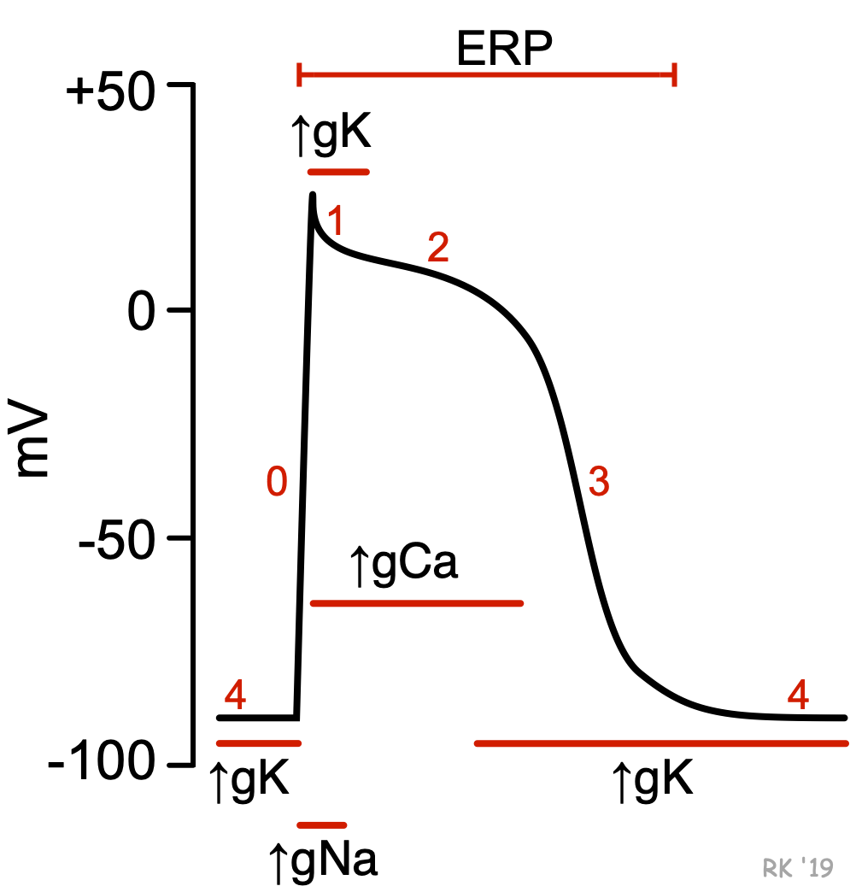
(Sodium-Channel Blockers)
Effects on depolarization
Sodium-channel blockers comprise the Class I antiarrhythmic compounds according to the Vaughan-Williams classification scheme. These drugs bind to and block fast sodium channels that are responsible for rapid depolarization (phase 0) of fast-response cardiac action potentials. This type of action potential is found in non-nodal cardiomyocytes (e.g., atrial and ventricular myocytes; Purkinje fibers). Because the slope of phase 0 depends on the activation of fast sodium-channels and the rapid entry of sodium ions into the cell (Figure: ↑gNa⁺), blocking these channels decreases the slope of phase 0, which also leads to a decrease in the amplitude of the action potential. In contrast, nodal tissue action potentials (sinoatrial and atrioventricular nodes) do not depend on fast sodium channels for depolarization; instead, phase 0 depolarization is carried by calcium currents. Therefore, blocking sodium channels has no direct effect on nodal tissue action potentials.

Slide 3
The principal effect of reducing the rate and magnitude of depolarization by blocking sodium channels is a decrease in conduction velocity in non-nodal tissue (atrial and ventricular muscle, Purkinje conducting system). The faster a cell depolarizes, the more rapidly adjacent cells become depolarized, leading to a more rapid regeneration and transmission of action potentials between cells. Therefore, blocking sodium channels reduces the velocity of action potential transmission within the heart (reduced conduction velocity; negative dromotropy). This can serve as an important mechanism for suppressing tachycardias that are caused by abnormal conduction (e.g., reentry mechanisms). By depressing abnormal conduction, reentry mechanisms can be interrupted.

Slide 4
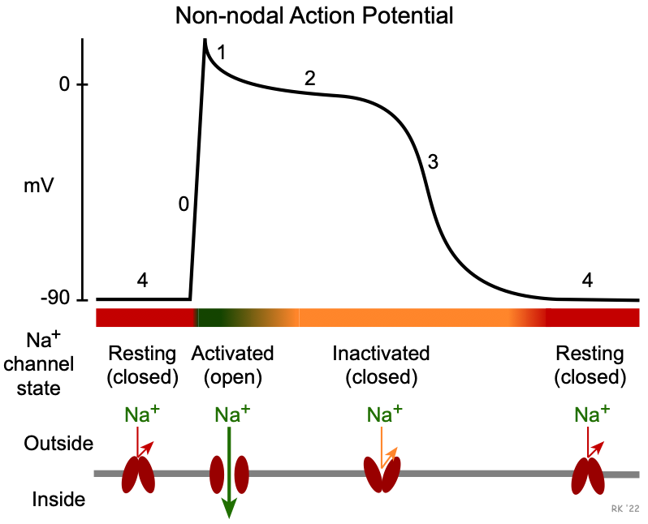
The three subclasses of sodium-channel blockers differ in how they bind to fast sodium channel. To understand this, it is important to note that these channels have different states: resting (closed), activated (open), and inactivated (closed). These states are regulated by voltage and time-dependent mechanisms that alter conformational states of the channel structure. As shown in the figure to the right, the resting state occurs during phase 4 when the membrane potential is repolarized to its resting potential of -80 to -90 mV. When these channels are closed, inward sodium currents through these channels do not contribute to the membrane potential. When the membrane potential is rapidly depolarized to about -70 mV by an adjacent cell that becomes depolarized, these channels undergo a rapid change to the activated (open) state, which increases sodium conductance (gNa⁺) thereby permitting a rapid influx of sodium that further depolarizes the cell (phase 0). Once the cell depolarizes, this leads to inactivation and the closing of these channels

Slide 5
The many sodium channels in a single cell respond at slightly different voltages and times, so the process of inactivation, while rapid, is not instantaneous but is still occurring in early phase 2. Some of these more slowly inactivated channels produce late sodium currents. When the channels are in the inactivated (closed) state, inward sodium currents through these channels cease. As the membrane potential repolarizes during phase 3, the inactivated state prevents reactivation of action potentials (i.e., the cell is refractory). As the cell potential reaches its resting value at the end of phase 3, the sodium channels transition back into their resting (close) state, and the cell can once again be stimulated to produce a new action potential

Slide 6
Class IA and IC drugs bind to (and therefore block) sodium channels in both activated and inactivated states, which makes them particularly effective in treating tachyarrhythmias. This is referred to as a use-dependence or state-dependence attribute of these drugs. At higher rates of cell depolarizations, the relative time the channels spend in a rested (closed) state is reduced; therefore, there is a higher probability that the drug will bind to the activated and inactivated states at higher heart rates. In contrast, Class IB drugs bind primarily to channels in the inactivated state. This characteristic of IB drugs is important because these drugs are very useful for arrhythmias in ischemic myocardium. The reason for this is that ischemia leads to slow cellular depolarization that inactivates sodium channels, and therefore enhanced binding of IB drugs.

Slide 7
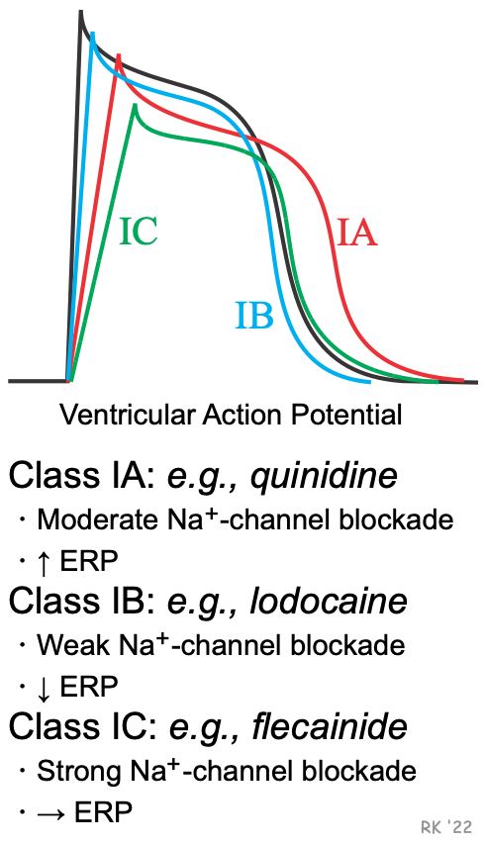
Effects on repolarization
Besides affecting phase 0 of action potentials, sodium-channel blockers may also alter the action potential duration (APD) and the effective refractory period (ERP). Because some sodium-channel blockers increase the ERP (Class IA), while others decrease the ERP (Class IB) or have no effect on ERP (Class IC), the Vaughan-Williams classification recognizes these differences as subclasses of Class I antiarrhythmic drugs. These effects on ERP are not directly related to sodium channel blockade, but are related to drug actions on potassium channels involved in phase 3 repolarization of action potentials. These channels regulate potassium efflux from the cell (gK), and therefore repolarization. For example, delaying and inhibiting the activation of these outward K⁺ currents increase APD and ERP.

Slide 8
The drugs in these subclasses also differ in their efficacy for reducing the slope of phase 0, with IC drugs having the greatest and IB drugs having the smallest effect on phase 0 (IA drugs are intermediate in their effect on phase 0). The following summarizes these differences:
Sodium-channel blockade: IC > IA > IB Increasing the ERP: IA > IC > IB (decreases)
Increasing or decreasing the APD and ERP can either increase or decrease arrhythmogenesis, depending on the underlying cause of the arrhythmia. Increasing the ERP, for example, can interrupt tachycardia caused by reentry mechanisms by prolonging the duration that normal tissue is unexcitable (its refractory period). This can prevent reentry currents from re-exciting the tissue. Increasing the APD can precipitate torsades de pointes, a type of ventricular tachycardia caused by afterdepolarizations.
Ranolazine is classified as a Class ID compound because, unlike the Class I drugs it blocks late sodium currents found during phase 2, which leads to a delay in the activation of repolarizing potassium channels in phase 3. Therefore, ranolazine increases the APD and ERP

Slide 9
Effects on automaticity
By mechanisms not understood and unrelated to blocking fast sodium channels, Class I antiarrhythmics can suppress abnormal automaticity by decreasing the slope of phase 4, which is generated by pacemaker currents.
Indirect vagal effects
The direct effect of Class IA antiarrhythmic drugs on action potentials is significantly modified by their anticholinergic actions. Inhibiting vagal activity can lead to both an increase in sinoatrial rate and atrioventricular conduction, which can offset the direct effects of the drugs on these tissues. Although a IA drug may effectively depress atrial rate during flutter, it can lead to an increase in ventricular rate because of an increase in the number of impulses conducted through the atrioventricular node (anticholinergic effect), requiring concomitant treatment with a beta-blocker or calcium-channel blocker to slow AV nodal conduction. These anticholinergic actions are most prominent at the sinoatrial and atrioventricular nodes because these sites are extensively innervated by vagal efferent nerves. Different drugs within the IA subclass differ in their anticholinergic actions

Slide 10
Specific Drugs and Therapeutic Indications
Class IA: atrial fibrillation, flutter; supraventricular & ventricular tachyarrhythmias
quinidine* | anticholinergic (moderate) | cinchonism (blurred vision, tinnitus, headache, psychosis); cramping and nausea; enhances digitalis toxicity
procainamide | anticholinergic (weak); relatively short half-life | lupus-like syndrome in 25-30% of patients
disopryamide | anticholinergic (strong) | negative inotropic effec

Slide 11
Class IB: ventricular tachyarrhythmias (VT)
lidocaine* | IV only; VT and PVCs | good efficacy in ischemic myocardium; binds primarily to inactivated Na⁺-channels in ischemic cells; therefore, little effect in normal cardiac cells
tocainide | orally active lidocaine analog | can cause pulmonary fibrosis
mexiletine | orally active lidocaine analog | good efficacy in ischemic myocardium

Slide 12
Class IC: life-threatening supraventricular tachyarrhythmias (SVT) and ventricular tachyarrhythmias (VT)
flecainide* | SVT | can induce life-threatening VT
propafenone | SVT & VT; | β-blocking and Ca⁺⁺-channel blocking activity can worsen heart failure
moricizine | VT; IB activity
Class ID: ventricular arrhythmias (premature ventricular complexes, PVC)
ranolazine | PVC | also classified and used as an antianginal
* prototypical drug Abbreviations: IV, intravenous; PVC, premature ventricular complex

Slide 13
Side Effects and Contraindications
The anticholinergic effects of IA drugs can produce tachycardia, dry mouth, urinary retention, blurred vision, and constipation. Diarrhea, nausea, headache and dizziness are also common side effects of many Class I drugs. Quinidine enhances digitalis toxicity, especially if hypokalemia is present. Quinidine, by delaying repolarization, can precipitate torsades de pointes (especially in patients with long-QT syndrome), a ventricular tachyarrhythmia caused by afterdepolarizations. Disopyramide is contraindicated for patients with uncompensated heart failure because of its negative inotropic actions; propafenone can also depress inotropy. IC compounds can cause increased risk of sudden death in patients with a prior history of myocardial infarction or sustained ventricular arrhythmias

Slide 14
Late Sodium Current Blocker (Ranolazine)
Mechanism of Action
Ranolazine represents a new class of antianginal drugs. Although the antianginal mechanism is not well understood, ranolazine clearly blocks late inward sodium currents occurring during phase 2 of ventricular action potenials. This mechanism is now included in the Vaughan-Williams classification as a Class ID sodium-channel blocker. In the ischemic myocardium, late inward sodium currents contribute to an elevation in intracellular sodium, which leads to an increase in intracellular calcium through the sodium-calcium exchanger. Calcium overload in ischemic cells leads to impaired relaxation, which increases ventricular diastolic wall stress and end-diastolic pressure. This causes mechanical compression of the microcirculation within the wall of the ventricle, which impairs coronary blood flow during diastole and therefore worsens ischemia, particularly in the subendocardial regions. By blocking late inward sodium currents, calcium overload and diastolic wall stress are reduced, leading to improved coronary blood flow. Additionally, ranolazine prolongs the QT-interval (action potential duration) by inhibiting outward potassium (delayed rectifying) currents (Kr currents) during phase 3 of the cardiac action potential. It is possible that other mechanisms may contribute to the antianginal effects of ranolazine. Unlike other antianginal drugs, such as beta-blockers and calcium-channel blockers, ranolazine has no clinically significant effect on heart rate or arterial pressure

Slide 15
Therapeutic Indication and Administration
Ranolazine is approved by the FDA as a treatment for chronic angina. It is available as an extended-release oral compound and is dosed twice daily. Ranolazine may be used along with other antianginal drugs such as nitrates, beta-blockers and calcium-channel blockers.
Because ranolazine increases the action potential duration and effective refractory period, it has been shown to be effective (off-label) in the treatment of premature ventricular complexes.
Side Effects and Contraindications
Because ranolazine prolongs the QT-interval, it is contraindicated in patients with preexisting prolonged QT-intervals because this can lead to torsade de pointes and ventricular tachyarrhythmia. Constipation, nausea, dizziness and headaches are among the more common side-effects

Slide 16
(Potassium Channel Blockers)
All class III antiarrhythmic drugs share a common electrophysiological mechanism in that they prolong the action potential duration, and most of the drugs in this class do so primarily by inhibiting repolarizing potassium currents. Therefore, these compounds are often referred to as "potassium channel blockers." To understand this mechanism of these compounds, the following provides a brief review of cardiac action potential generation

Slide 17
In non-nodal cardiac tissue, such as ventricular cardiomyocytes action potentials are initiated when a cell is depolarized to a threshold potential by an adjacent cell. This leads to rapid opening of fast sodium channels and a slower opening of L-type calcium channels (increased sodium and calcium conductance; gNa and gCa, respectively) that permit sodium and calcium to enter the cell during phases 0 - 2. As these channels become inactivated, potassium channels open (increased gK) permitting potassium ions to leave the cell, which causes repolarization of the membrane potential (phases 3 and 4). Potassium channels remain open until the next action potential is triggered. A different type of potassium channel is responsible for the initial repolarization (phase 1). Potassium channels are also responsible for repolarizing slow-response action potentials in the sinoatrial and atrioventricular nodes.

Slide 18
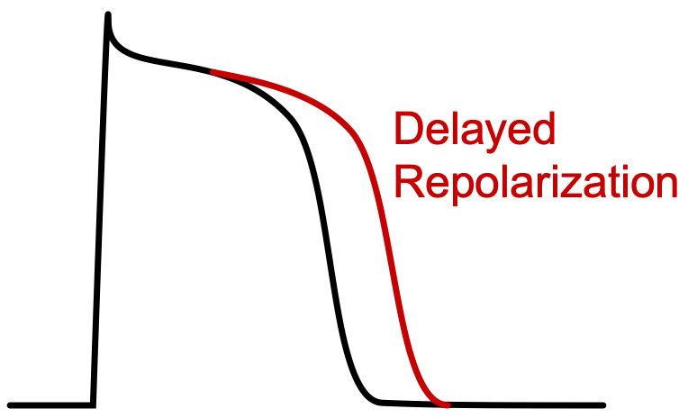
Class III antiarrhythmic compounds (Vaughan-Williams classification) bind to and block potassium channels that are responsible for phase 3 repolarization. By blocking these channels, action potential repolarization is delayed, which leads to an increase in action potential duration and an increase in the effective refractory period (ERP). Most of the class III drugs,however, have additional mechanisms of action that may contribute to their electrophysiological actions.
Prolongation of ventricular action potentials increases the QT interval in the electrocardiogram. This is a common effect of all Class III antiarrhythmic drugs. The electrophysiological changes prolong the length of time that the cell is unexcitable (refractory) and therefore make the cell less excitable.
By increasing the ERP, these drugs are very useful in suppressing tachyarrhythmias caused by reentry mechanisms. Reentry occurs when an action potential reemerges into normal tissue that is no longer refractory. When this happens, a new action potential is generated prematurely (before normal activation) and a circular, repeating pattern of early and rapid activation can develop, which leads to tachycardia. If the ERP of the normal tissue is lengthened, then the reemerging action potential may find the normal tissue refractory and premature activation will not occur

Slide 19
Specific Drugs and Therapeutic Indications
Drug | Therapeutic Uses | Comments
amiodarone | ventricular tachycardia, including ventricular fibrillation; atrial fibrillation and flutter (off-label use) | very long half-life (25-60 days); Class I, II, III & IV actions and therefore decreases phase 4 slope and conduction velocity; side effects include (some serious): pulmonary fibrosis; hypothyroidism; hepatotoxicity; corneal micro-deposits, skin discoloration
dronedarone | atrial fibrillation (non-permanent) and flutter | structurally related (but non-iodinated) to amiodarone, but has a much smaller volume of distribution and shorter elimination half-life (~24 hr); Class I, II, III & IV actions; contraindicated in severe or recently decompensated, symptomatic heart failure; although less toxic than amiodarone, it is less efficacious in atrial fibrillation
bretylium | life-threatening ventricular tachycardia and fibrillation | IV only; initial sympathomimetic effect (norepinephrine release) followed by inhibition, which can lead to hypotension
sotalol | ventricular tachycardia; atrial flutter and fibrillation | inhibits opening of repolarizing K⁺ channels and increases ERP; also has Class II (beta-blocker) activity and therefore slows sinus rate
ibutilide | atrial flutter and fibrillation (acute termination) | activates slow inward Na⁺ currents during early phase 3 and inhibits opening of repolarizing K⁺ channels, which delays repolarization and increases ERP; IV only; can cause life-threatening ventricular arrhythmias; infrequent non-cardiac side effects
dofetilide | atrial flutter and fibrillation; paroxysmal supraventricular tachycardia (off-label) | approved for acute atrial flutter and fibrillation; very selective K⁺-channel blocker; can cause life-threatening ventricular arrhythmias

Slide 20
Cardiac Side Effects and Contraindications
These drugs, like Class I drugs, are proarrhythmic as well as being antiarrhythmic. For example, the increase in action potential duration can produce torsades de pointes (a type of ventricular tachycardia), especially in patients with long-QT syndrome. Amiodarone, because of its Class IV effects, can cause bradycardia and atrioventricular block, and therefore is contraindicated in patients with heart block or sinoatrial node dysfunction

Slide 21
Adenosine
General Pharmacology
Adenosine is a naturally occurring purine nucleoside that forms from the breakdown of adenosine triphosphate (ATP). ATP is the primary energy source in cells for transport systems and many enzymes. Most ATP is hydrolyzed to ADP, which can be further dephosphorylated to AMP. Most ADP and AMP that form in the cell are rephosphorylated by the mitochondria through enzymatic reactions requiring oxygen. If large amounts of ATP are hydrolyzed, and especially if there is insufficient oxygen available (i.e., hypoxia), then some of the AMP can be further dephosphorylated to adenosine by the cell membrane associated enzyme, 5'-nucleotidase.
Adenosine has a short half-life. In human blood, its half-life is less than 10 seconds. There are two important metabolic fates for adenosine

Slide 22
Adenosine is rapidly transported into red blood cells (and other cell types) where it is rapidly deaminated by adenosine deaminase to inosine, which is further broken down to hypoxanthine, xanthine, and uric acid which is excreted by the kidneys. Adenosine deamination also occurs in plasma, but at a lower rate than that which occurs within cells. Dipyridamole is a vasodilator drug that blocks adenosine uptake by cells, reducing the metabolism of adenosine. Therefore, one important mechanism for dipyridamole-induced vasodilation is its potentiation of extracellular adenosine.
Adenosine can be acted on by adenosine kinase and rephosphorylated to AMP. This salvage pathway helps maintain the adenine nucleotide pool in cells

Slide 23
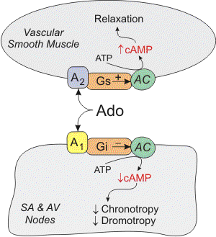
Cardiac electrical effects
In cardiac nodal tissue, adenosine binds to type 1 (A₁) receptors, which are coupled to Gi-proteins. Activation of this pathway opens potassium channels, which hyperpolarizes the cell. Activation of the Gi-protein also decreases cAMP, which inhibits L-type calcium channels and therefore calcium entry into the cell. In cardiac pacemaker cells in the sinoatrial node, adenosine acting through A₁ receptors inhibits the pacemaker current (I_{f}), which decreases the slope of phase 4 of the pacemaker action potential and decreasing its spontaneous firing rate (negative chronotropy). Inhibition of L-type calcium channels by adenosine also decreases conduction velocity (negative dromotropic effect) at the atrioventricular (AV) node. Finally, adenosine, by acting on presynaptic purinergic receptors on sympathetic nerve terminals, inhibits the release of norepinephrine. In terms of its electrical effects in the heart, adenosine decreases the heart rate at the SA node and reduces conduction velocity at the AV node. The latter effect can produce atrioventricular block. Note, however, that when adenosine is infused systemically into humans, the heart rate can increase because of baroreceptor reflexes activated by systemic vasodilation and hypotension

Slide 24
Vasodilator actions
Adenosine binds to purinergic receptors in different cell types, where it has several actions. One important action is vascular smooth muscle relaxation, which leads to vasodilation. This is an important mechanism for matching coronary blood flow to the metabolic needs of the heart. In coronary vascular smooth muscle, adenosine binds to adenosine type 2A (A_{2A}) receptors, which are coupled to the Gs-protein. Activation of this G-protein stimulates adenylyl cyclase (AC in figure), increases cAMP, and causes protein kinase activation. This activates K_{ATP} channels, which hyperpolarizes the smooth muscle, causing relaxation. Increased cAMP also causes smooth muscle relaxation by inhibiting myosin light chain kinase, which leads to decreased myosin phosphorylation and a decrease in contractile force. There is also evidence that adenosine inhibits calcium entry into the cell through L-type calcium channels. Since calcium regulates smooth muscle contraction, reduced intracellular calcium causes relaxation. In some types of blood vessels, there is evidence that adenosine produces vasodilation through increases in cGMP, which leads to inhibition of calcium entry into the cells, opening of potassium channels, and activation of myosin light chain phosphatase

Slide 25
Therapeutic and Diagnostic Use
The major therapeutic use of adenosine is as an antiarrhythmic drug for the rapid treatment of supraventricular tachycardia caused by AV nodal reentry by suppressing AV nodal conduction. For these indications, adenosine is administered either as bolus intravenous injection or as an intravenous infusion. Adenosine is not effective for atrial flutter or fibrillation.
Although adenosine is a powerful vasodilator, especially in coronary circulation, it is not used as a vasodilator to treat coronary artery disease. The reason is that it is short-acting, limited to intravascular administration, and can produce coronary vascular steal. When administered by intravenous infusion, it can produce hypotension and atrioventricular block.
Adenosine's unique vasodilator properties, however, are utilized in cardiac imaging during stress tests to determine coronary fractional flow reserve (a measure of severity of coronary stenosis), and to assess pulmonary vasodilator responses in patients with pulmonary hypertension.

Slide 26
Side-effects
Most of adenosine's side effects are related to its vasodilator properties. Patients can experience flushing and headaches, both of which are related to vasodilation. Adenosine can produce rapid arterial hypotension; however, this is reversed shortly after stopping the infusion of adenosine because of its short half-life. Coronary vascular steal is of theoretical concern in some patients with coronary artery disease, although there is no clinical evidence supporting this adverse effect. Methylxanthines such as caffeine and theophylline competitively antagonize the binding of adenosine at its purinergic receptor. Finally, adenosine may produce undesirable AV block; however, this is usually rapidly corrected by stopping adenosine administration. Therefore, adenosine is contraindicated in patients with preexisting second or third degree AV block

Slide 27
The Pharmacologic Treatment of Myocardial Infarction
Classes of Drugs Used to Treat Myocardial Infarction
Vasodilators (dilate arteries and veins) - nitrodilators - angiotensin converting enzyme inhibitors (ACEIs) - angiotensin receptor blockers (ARBs) - aldosterone (mineralocorticoid receptor) antagonists
Cardiac depressant drugs (reduce heart rate and contractility) - beta-blockers
Antiarrhythmics (if necessary)
Anti-thrombotics (prevent thrombus formation) - anticoagulant - anti-platelet drugs
Thrombolytics (dissolve clots - i.e., "clot busters") - plasminogen activators
Analgesics (reduce pain) - morphine

Slide 28
The Pharmacologic Treatment of Heart Failure
Causes of Heart Failure
INTRINSIC
Coronary artery disease
Myocardial infarction
Valve disease
Congenital heart defects
Cardiomyopathy (dilated, hypertrophic, or restrictive)
Myocarditis
EXTRINSIC
Chronic hypertension
Arrhythmias
Pericarditis
Thyroid disease; diabetes; anemia
Arterial-venous shunts
Lung disease; pulmonary embolism
Pregnancy
Septic shock

Slide 29
Heart failure can be defined as the inability of the heart to provide adequate cardiac output and oxygen delivery to meet the metabolic demands of the body, or can do so only under conditions of increased cardiac preload. Heart failure can be caused by factors originating from within the heart (i.e., intrinsic disease or pathology) or from external factors that place excessive demands upon the heart, as shown in the list of causes.

Slide 30
The number one cause of heart failure is coronary artery disease (CAD). CAD reduces coronary blood flow and oxygen delivery to the myocardium. This leads to myocardial hypoxia and impaired function. Another common cause of heart failure is myocardial infarction, which is the final and often fatal culmination of CAD. Infarcted tissue does not contribute to the generation of mechanical activity, so overall cardiac performance is diminished. Furthermore, non-infarcted regions must compensate for the loss of function and this extra burden can precipitate changes that lead to failure of the non-infarcted myocardium. Valvular disease and congenital defects place increased demands upon the heart that can precipitate failure. Cardiomyopathies of known origin (e.g., bacterial or viral) or idiopathic (unknown origin) can lead to failure. Myocarditis damages the heart and can lead to abnormal function. Arrhythmias, such as severe bradycardia or tachycardia, can also precipitate failure.

Slide 31
Acute heart failure develops rapidly and can be immediately life threatening because the heart does not have time to undergo compensatory adaptations. Acute failure (hours/days) may result from acute infection (sepsis), reperfusion injury and stunning, acute myocardial infarction, valve chordae tendineae rupture, severe arrhythmias, etc. Acute heart failure can often be managed successfully by pharmacological or surgical interventions.
Chronic heart failure is a long-term condition (months/years) that is associated with the heart undergoing adaptive responses (e.g., dilation, hypertrophy) to a precipitating condition or pathology. These adaptive responses, however, can be deleterious in the long-term and lead to a worsening condition

Slide 32
Classes of Drugs Used to Treat Heart Failure
Because heart failure is a complex condition that affects other systems of the body, multiple drugs are often administered. Treatment may include diuretic drugs to reduce blood volume and venous pressures, vasodilator drugs to reduce arterial afterload and venous pressures, and drugs that stimulate or inhibit cardiac function. Ancillary drugs may also be given to suppress arrhythmias, inhibit clotting mechanisms, or alter glucose handling.
Diuretics - thiazide diuretics - loop diuretics - aldosterone antagonists
Vasodilators (dilate arteries and veins) - angiotensin converting enzyme (ACE) inhibitors - angiotensin receptor blockers (ARBs) - direct acting arterial dilators - nitrodilators - neprilysin inhibitors - phosphodiesterase inhibitors
Cardiostimulatory or inotropic drugs (stimulate contractility) - digitalis - beta-agonists (sympathomimetic drugs) - phosphodiesterase inhibitors
Cardioinhibitory - beta-blockers - funny current blocker - calcium-channel blockers (for diastolic dysfunction)

Slide 33
Besides the above drug classes, recent clinical trials support the use of a sodium-glucose cotransporter 2 inhibitors (SGLT2I) such as empagliflozin. Although this drug class is used in the treatment of diabetes, it has also been found to improve outcomes in HFpEF patients (both diabetic and non-diabetic), and in patients with mildly reduced ejection fractions (HFmrEF; 41-49%). Besides lowering plasma glucose, SGLT2I drugs act on the kidneys to promote natriuresis and diuresis, both of which are beneficial in heart failure. Arterial stiffness is reduced and diastolic function is improved.

Slide 34
The Pharmacologic Treatment of Pulmonary Hypertension
Rationale for Pharmacologic Treatment
If pulmonary arterial hypertension (PAH) has an identifiable cause, then measures can be taken to correct the underlying problem. If the diagnosis is primary PAH, or treating the cause of the secondary PAH does not restore normal pulmonary artery pressure, then pharmacologic intervention is required to reduce the pressure. This is done by using vasodilator drugs to decrease pulmonary vascular resistance and lower the pressure. Adjunctive therapy may include diuretics to reduce blood volume, which decreases central venous pressure and right ventricular stroke volume, as well as reduce some signs and symptoms of edema and shortness of breath associated with PAH. Anticoagulants are administered to prevent the formation of pulmonary thrombi.

Slide 35
Drugs Used to Treat Pulmonary Hypertension
Classes of drugs used in the treatment of pulmonary arterial hypertension (PAH) are listed below.
Diuretics - thiazide diuretics - loop diuretics
Vasodilators - calcium-channel blockers - prostacyclin agonists - endothelin receptor antagonists - inhaled nitric oxide - soluble guanylyl cyclase stimulators - cGMP phosphodiesterase (PDE5) inhibitors

Slide 36
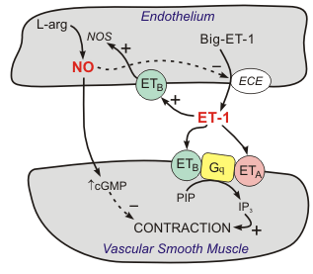
Endothelin Receptor Antagonists
General Pharmacology
Endothelin-1 (ET-1) is a 21 amino acid peptide that is produced by the vascular endothelium It is a very potent vasoconstrictor that binds to smooth muscle endothelin receptors, of which there are two subtypes: ET_{A} and ET_{B} receptors. These receptors are coupled to a Gq-protein and receptor activation leads to the formation of IP₃, which causes the release of calcium by the sarcoplasmic reticulum (SR) and increased smooth muscle contraction and vasoconstriction. There are also ET_{B} receptors on the endothelium that stimulate the formation of nitric oxide, which produces vasodilation in the absence of smooth muscle ET_{A} and ET_{B} receptor activation. This receptor distribution helps to explain the phenomenon that ET-1 administration causes transient vasodilation (initial endothelial ET_{B} activation) and hypotension, followed by prolong vasoconstriction (smooth muscle ET_{A} and ET_{B} activation) and hypertension.
ET-1 receptors in the heart are also linked to the Gq-protein and IP₃ signal transduction pathway Therefore, ET-1 in the heart causes the SR to release calcium, which increases contractility. ET-1 also increases the heart rate

Slide 37
Therapeutic Indications
Because of its powerful vasoconstrictor properties, and its effects on intracellular calcium, ET-1 has been implicated in the pathogenesis of hypertension, coronary vasospasm, and heart failure. Many studies suggest a role for ET-1 in idiopathic pulmonary hypertension, as well as in systemic hypertension. ET-1 is released by the failing myocardium, where it may contribute to cardiac calcium overload and hypertrophy.
Endothelin receptor antagonists, by blocking the vasoconstrictor and cardiotonic effects of ET-1, produce vasodilation and cardiac inhibition. Endothelin receptor antagonists have been shown to decrease mortality and improve hemodynamics in experimental models of heart failure.
At present, the one approved indication for endothelin antagonists is pulmonary hypertension

Slide 38
Specific Drugs
Bosentan, a non-selective ET-1 receptor antagonist (blocks ET_{A} and ET_{B} receptors) is currently used in the treatment of pulmonary hypertension.
Macitentan is a similar non-selective antagonist, but with a longer half-life than bosentan.
Another drug also used for pulmonary hypertension is
ambrisentan, which is a selective ET_{A} receptor antagonist.
Side Effects and Contraindications
Some of the endothelin antagonist side effects are common to most vasodilators; namely, headache, cutaneous flushing, and peripheral edema. This class of drug may cause birth defects and therefore is contraindicated in pregnancy. These drugs can also can cause liver injury

Slide 39
The Pharmacologic Treatment of Systemic Hypertension - Antihypertensive Drugs
Rationale for Pharmacologic Treatment of Hypertension
Patients with primary hypertension are treated with drugs that 1) reduce blood volume (which reduces central venous pressure and cardiac output), 2) reduce systemic vascular resistance, or 3) reduce cardiac output by depressing heart rate and stroke volume. Patients with secondary hypertension are best treated by controlling or removing the underlying disease or pathology, although they may still require antihypertensive drugs.

Slide 40
Rationale for Reducing Arterial Pressure
Reduce Cardiac Output
Reduce blood volume
Reduce heart rate
Reduce stroke volume
Reduce Systemic Vascular Resistance
Dilate systemic vasculature

Slide 41
Arterial pressure can be reduced by decreasing cardiac output, systemic vascular resistance, or central venous pressure. Venous pressure and cardiac output can be decreased by using drugs that reduce blood volume. These drugs (diuretics) act on the kidneys to enhance sodium and water excretion. Reducing blood volume not only reduces central venous pressure, but reduces cardiac output by the Frank-Starling mechanism because of the reduction in ventricular preload. An added benefit of these drugs is that they also reduce systemic vascular resistance with long-term use by mechanisms that are not fully understood.

Slide 42
Many antihypertensive drugs have their primary action on systemic vascular resistance. Some of these drugs produce vasodilation by interfering with sympathetic adrenergic vascular tone (sympatholytics) or by blocking the formation of angiotensin II or its vascular receptors. Other drugs are direct arterial dilators, and some are mixed arterial and venous dilators. Some drugs that act on regions in the brain ("centrally acting") or on autonomic ganglia that inhibit sympathetic efferent activity. However, these drugs are less commonly used because of a high incidence of side effects. By reducing sympathetic output, centrally acting drugs and ganglionic blockers decrease arterial pressure by decreasing systemic vascular resistance and cardiac output.

Slide 43
Some antihypertensive drugs, most notably beta-blockers, depress heart rate and contractility (this decreases stroke volume) by blocking the influence of sympathetic nerves on the heart. Calcium-channel blockers, especially non-dihydropyridines that are more cardioselective, also reduce cardiac output by decreasing heart rate and contractility. Some calcium-channel blockers (most notably the dihydropyridines) are more selective for systemic vasculature and therefore reduce systemic vascular resistance.

Slide 44
Drugs Used to Treat Hypertension
Classes of drugs used in the treatment of hypertension are listed below. It is important to note that listing all these classes of drugs does not imply that all are equally effective and safe in all patients. In fact, for most patients with essential hypertension, the most commonly used drug classes ("first-line therapy") are thiazide diuretics, angiotensin converting enzyme inhibitors or angiotensin receptor blockers, and calcium-channel blockers. Co-morbidities (e.g., stroke, heart failure, valvular disease, renal disease) also play a role in deciding which class of drug to use for treating hypertension. Clicking on the drug class will link you to the page describing the pharmacology of that drug class.

Slide 45
Diuretics - thiazide diuretics - loop diuretics - potassium-sparing diuretics
Vasodilators - alpha-adrenoceptor antagonists (alpha-blockers) - angiotensin converting enzyme inhibitors (ACE inhibitors) - angiotensin receptor blockers (ARBs) - calcium-channel blockers - direct acting arterial dilators - ganglionic blockers - nitrodilators - potassium-channel openers - renin inhibitors
Cardioinhibitory drugs - beta-blockers - calcium-channel blockers
Centrally acting sympatholytics

Slide 46
The Pharmacologic Treatment of Hypotension
Causes of Hypotension:
Reduced Cardiac Output
Hypovolemia
Impaired venous return
Reduced cardiac contractility
Arrhythmias
Autonomic dysfunction
Reduced Systemic Vascular Resistance
Systemic vasodilation
Autonomic dysfunction

Slide 47
Hypotension is a physiologic state in which the arterial blood pressure is abnormally low. For an adult, hypotension exists when the systolic pressure is less than 90 mmHg and the diastolic pressure is less than 60 mmHg. Because arterial pressure is determined by cardiac output, venous pressure and systemic vascular , a reduction in any of these variables can lead to hypotension.

Slide 48
Causes of hypotension include:
Hypovolemia caused by hemorrhage or dehydration (reduces venous pressure and cardiac output).
Impaired venous return caused by postural changes, gravitational forces, or venous obstruction (reduces venous pressure and cardiac output).
Reduced cardiac contractility caused by heart failure, myocardial ischemia, or autonomic dysfunction (reduces cardiac output).
Arrhythmias that reduce heart rate or impair ventricular filling (reduce cardiac output)
Reduced systemic vascular resistance because of loss of sympathetic tone caused by drugs, autonomic dysfunction, or vasodilation caused by sepsis (septic shock) or anaphylaxis

Slide 49
The Pharmacologic Treatment of Edema
Edema is the swelling of tissues that occurs when excessive fluid accumulates within the tissue. Fluid comprising water and electrolytes, with a very small amount of protein and other macromolecules, normally leaves capillaries and small postcapillary venules by a process called filtration. Filtration is primarily driven by the capillary hydrostatic pressure, and the capillary plasma oncotic pressure (osmotic pressure exerted by plasma proteins) counteracts capillary filtration. The amount filtered per unit time is additionally influenced by the permeability of the vessel wall (endothelium and basement membrane). for more details on the physical forces involved in filtration). The fluid that filters into the tissue flows within the intercellular space (the interstitium) and most of it is reabsorbed at the venular end of capillaries where the hydrostatic pressure is lower than the plasma oncotic pressure. The filtered fluid that is not reabsorbed is taken up by lymphatic vessels and returned to the circulation.

Slide 50
Edema (interstitial fluid accumulation) may be caused by:
Increased capillary hydrostatic pressure (as occurs when venous pressures become elevated by gravitational forces, volume expanded states, in heart failure or with venous obstruction)
Decreased plasma oncotic pressure (as occurs with hypoproteinemia)
Increased capillary permeability caused by proinflammatory mediators (e.g., histamine, bradykinin) or by damage to the structural integrity of capillaries so that they become more "leaky" (as occurs in tissue trauma, burns, and severe inflammation)
Lymphatic obstruction (as occurs in filariasis) that results in a condition termed lymphedema

Slide 51
The most common cause of edema in patients with cardiovascular disorders is heart failure. In left ventricular failure, blood backs up into the pulmonary circuit. This increase in pulmonary blood volume (i.e., pulmonary congestion) leads to increased pulmonary capillary hydrostatic pressures and fluid filtration into the lungs. This is termed pulmonary edema and can be life-threatening. As left ventricular failure becomes more severe, or during isolated right ventricular failure, blood backs up into the systemic venous circulation. This elevates venous pressures and capillary hydrostatic pressures, which can lead to edema, especially in the feet and legs. Sometimes fluid will accumulate in the abdominal cavity, causing ascites. It is important to note that heart failure patients, because of activation of the renin-angiotensin-aldosterone system, retain sodium and water. This increases circulating blood volume and further increases venous and capillary hydrostatic pressures, which enhance edema formation.

Slide 52
Sometimes patients with severe hypertension will also present with systemic edema because of elevated capillary pressures, although it is important to note that capillary pressure is far more sensitive to elevations in venous pressure than to elevations in arterial pressure.
Finally, edema can be a side effect of vasodilator drugs that are used to treat hypertension. Vasodilation of precapillary resistance vessels increases downstream capillary hydrostatic pressure and fluid filtration.

Slide 53
Drug Treatment for Edema
Edema is treated by manipulating the physical factors that cause edema. Most commonly, this is done by giving diuretics to stimulate renal excretion of sodium and water, which reduces blood volume and venous and capillary pressures. Improving cardiac function in heart failure patients will also contribute to reducing venous pressures and edema. If other mechanisms are involved in causing the edema, such as lymphatic blockage, varicose veins, venous thrombosis, tissue damage or inflammation, these conditions can be corrected by other interventions

Slide 54
Cardioinhibitory Drugs
Therapeutic Uses of Cardioinhibitory Drugs
Hypertension
Angina
Arrhythmias
Heart failure (β-blockers only)

Slide 55
Cardioinhibitory drugs depress cardiac function by decreasing heart rate (chronotropy), myocardial contractility (inotropy), or both, which decreases cardiac output and arterial pressure. These cardiac changes reduce the work of the heart and therefore decrease myocardial oxygen consumption. The mechanisms of action of these drugs also lead to depressed electrical conduction (dromotropy) within the heart. Some of these drugs may also impair relaxation (lusitropy).
The mechanical and metabolic effects of these drugs make them very suitable for treating hypertension, angina caused by coronary artery disease, and myocardial infarction. Their effects on electrical activity make them good candidates for treating cardiac arrhythmias. Finally, some cardioinhibitory drugs, notably certain beta-blockers and ivabradine, are used in the treatment of heart failure.

Slide 56
Hypertension
Hypertension is defined as an arterial systolic pressure greater than 140 mmHg and/or a diastolic pressure greater than 90 mmHg. Hypertension can be caused by either an increase in cardiac output or by an increase in systemic vascular resistance. It is not uncommon for hypertension to be caused by elevations in both. Since cardiac output is the product of heart rate and stroke volume, cardioinhibitory drugs that reduce either or both will decrease cardiac output and decrease arterial pressure.

Slide 57
Angina and myocardial infarction
Cardioinhibitory drugs, by reducing heart rate, contractility, and arterial pressure, reduce the work of the heart and the oxygen demand of the heart. By reducing oxygen demand, the oxygen supply/demand ratio is improved, which can relieve a patient of anginal pain that is caused by a reduction in the oxygen supply/demand ratio because of coronary artery disease. Furthermore, cardioinhibitory drugs that block beta-adrenoceptors are very important in treating myocardial infarction. Their benefit is derived not only from improving the oxygen supply/demand ratio but also from their ability to inhibit subsequent cardiac remodeling.

Slide 58
Arrhythmias
Because cardioinhibitory drugs alter pacemaker activity and electrical conduction within the heart, they are useful for treating arrhythmias caused by both abnormal automaticity and abnormal conduction.

Slide 59
Heart failure
Although it seems counterintuitive that cardioinhibitory drugs would be used in heart failure, clinical studies have shown conclusively that beta-blockers improve cardiac function in certain types of heart failure. Furthermore, they have been shown to reduce deleterious cardiac remodeling that occurs in chronic heart failure. The benefit of beta-blockers may be derived from their blockade of excessive sympathetic stimulation of the heart, which is known to be harmful to the failing heart.
Another drug used in some heart failure patients is ivabradine. This relatively new drug blocks sinoatrial "funny" currents that are responsible for generating pacemaker currents controlling heart rate. By blocking these currents, ivabradine reduces heart rate and myocardial oxygen demand, which is beneficial in heart failure patients. Although beta-blockers also reduce heart rate, their actions on beta-adrenoceptors can also depress inotropy. Therefore, ivabradine acts as a "pure" heart rate reducing drug.

Slide 60
Drug Classes and General Mechanisms
Beta-blockers
Calcium-channel blockers
Centrally-acting sympatholytics
Cardioinhibitory drugs can be divided into three mechanistic classes: beta-adrenoceptor antagonists (beta-blockers), calcium-channel blockers, and centrally acting sympatholytics.

Slide 61
Beta-blockers
Beta-blockers bind to beta-adrenoceptors in cardiac nodal tissue, the conducting system, and contracting myocytes. The heart has both beta₁ (β₁) and beta₂ (β₂) adrenoceptors, although the predominant receptor type in number and function is β₁. These receptors primarily bind norepinephrine that is released from sympathetic adrenergic nerves. Additionally, they bind norepinephrine and epinephrine that circulate in the blood. Beta-blockers prevent the normal ligand (norepinephrine or epinephrine) from binding to the beta-adrenoceptor by competing for the binding site. Because there is some level of sympathetic tone on the heart, beta-blockers can reduce sympathetic influences that normally stimulate chronotropy, inotropy, dromotropy and lusitropy. These drugs have an even greater effect when there is elevated sympathetic activity. Beta-blockers that are used clinically are either non-selective (β₁/β₂) blockers, or relatively selective β₁ blockers. Some beta-blockers have additional mechanisms of action besides beta-blockade. Beta-blockers are used for treating hypertension, angina, myocardial infarction, and arrhythmias.

Slide 62
Calcium-channel blockers
Calcium-channel blockers (CCBs) bind to L-type calcium channels on cardiac myocytes and cardiac nodal tissue (sinoatrial and atrioventricular nodes). These channels regulate the influx of calcium into cardiomyocytes, which stimulates cardiac myocyte contraction. In cardiac nodal tissue, L-type calcium channels play an important role in pacemaker currents and in phase 0 of the action potentials. Therefore, by blocking calcium entry into the cell, CCBs decrease myocardial force generation (negative inotropy), decrease heart rate (negative chronotropy), and decrease conduction velocity within the heart (negative dromotropy) particularly at the atrioventricular node. CCBs are used in treating hypertension, angina, and arrhythmias.

Slide 63
Centrally acting sympatholytics
Centrally acting sympatholytics block sympathetic activity by binding to and activating alpha₂ (α₂)-adrenoceptors on cardioregulatory cells within the medulla of the brain. This reduces sympathetic outflow to the heart, decreasing cardiac output by decreasing heart rate and contractility. These drugs are only used for treating hypertension.

Slide 64
Vasoconstrictor Drugs
Therapeutic Use and Rationale
As the name implies, vasoconstrictor drugs contract the smooth muscle in blood vessels, which causes the vessels to constrict. Constriction of arterial (resistance) vessels increases systemic vascular resistance, which leads to an increase in arterial blood pressure because mean arterial pressure is determined by the product of systemic vascular resistance and cardiac output. Constriction of venous (capacitance) vessels increases venous blood pressure and increases cardiac preload and cardiac output by the Frank-Starling mechanism, which increases arterial pressure. Because vasoconstrictor drugs increase arterial pressure, they comprise a functional group of drugs known as pressor drugs.

Slide 65
Hypotension, which is a systolic pressure of less than 90 mmHg or a diastolic pressure less than 60 mmHg, needs to be aggressively treated because blood flow to critical organs, particularly the brain, heart and kidneys may become compromised to an extent that organ failure and death occur. Although vasoconstrictors can elevate arterial pressure, there is a drawback to their use. Unless cardiac output is increased at the same time systemic vascular resistance is increased, blood flow to some organs may actually decrease. The reason for this is that if the vascular resistance of an organ increases, for example, by 30% and mean arterial pressure increases by 30%, the organ blood flow will not change. If resistance is increased in some organs by 50%, and in others by only 10%, yet the arterial pressure is increased by 30%, blood flow will be increased to those organs that had the smaller increase in resistance because arterial pressure increased more than their resistance. This is precisely how pressor drugs can have a benefit in treating hypotension. Although blood flow may be reduced in some organs (e.g., to the splanchnic and muscle circulations), blood flow to critical organs (e.g., brain, heart and kidneys) may actually increase. Part of this benefit may be lost if systemic vascular resistance is increased too much with a pressor drug, especially if the hypotension is caused by cardiogenic shock, because the increase in ventricular afterload will reduce cardiac output. For a greater understanding of the hemodynamics associated with regional vasoconstriction, the reader is encouraged to read about the significance of the parallel arrangement of vascular beds in the body.

Slide 66
Drug Classes, General Mechanisms of Action, and Contraindications
There are two general functional classes of vasoconstrictors based on their mechanism of action. The first class is sympathomimetic drugs that have alpha-adrenoceptor agonist (alpha-agonist) properties. Although many sympathomimetics possess other mechanisms that contribute to their pressor effects (e.g., beta-adrenoceptor agonist activity), a common property of several of these drugs is that they bind to alpha-adrenoceptors on vascular smooth muscle, promoting smooth muscle contraction. Non-sympathomimetics represent a second class of vasoconstrictor drugs. These drugs produce vascular smooth muscle contraction by binding to non-adrenergic receptors. For example, vasopressin is a powerful vasoconstrictor that binds to non-adrenergic receptors.

Slide 67
Although vasoconstrictor drugs can effectively increase arterial pressure, their vasoconstrictor actions may have adverse effects on some patients. For example, alpha-agonists produce systemic vasoconstriction, which increases the work and oxygen requirements of the heart. If the coronary circulation is impaired, as in patients with coronary artery disease, the resulting decrease in myocardial oxygen supply/demand ratio can precipitate angina. Likewise, vasopressin can produce a powerful vasoconstrictor response, and therefore should be administered cautiously to patients with coronary artery disease because it constricts coronary arteries (reducing oxygen delivery) while simultaneously increasing myocardial oxygen demand by increasing arterial pressure

Slide 68
Vasopressin Analogs
Vasopressin (arginine vasopressin, AVP; antidiuretic hormone, ADH) is a nonapeptide hormone formed in the hypothalamus and released from the posterior pituitary. Its primary function in the body is to regulate extracellular fluid volume by affecting renal handling of water; however, it also is a potent vasoconstrictor.
There are several mechanisms regulating the release of AVP. Hypovolemia, as occurs during hemorrhage, results in a decrease in atrial pressure. Specialized stretch receptors within the atrial walls and large veins entering the atria decrease their firing rate when there is a fall in atrial pressure. Afferent nerve fibers from these receptors synapse within the nucleus tractus solitarius of the medulla, which sends fibers to the hypothalamus, a region of the brain that controls AVP release by the pituitary. Atrial receptor firing normally inhibits the release of AVP by the posterior pituitary. With hypovolemia or decreased central venous pressure, the decreased firing of atrial stretch receptors leads to an increase in AVP release. Hypothalamic osmoreceptors sense extracellular osmolarity and stimulate AVP release when osmolarity rises, as occurs with dehydration. Finally, angiotensin II receptors in a region of the hypothalamus regulate AVP release – an increase in angiotensin II simulates AVP release.

Slide 69
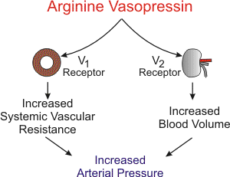
AVP has two principal sites of action: the kidney and blood vessels. The most important physiological action of AVP is to increase water reabsorption in the kidneys by increasing water permeability in the collecting duct, permitting the formation of more concentrated urine. This is the antidiuretic effect of AVP and it acts through vasopressin type 2 (V₂) receptors coupled to adenylyl cyclase. AVP also constricts arterial blood vessels by binding to V₁ receptors, which are coupled to the Gq-protein and the IP₃ signal transduction pathway. The Rho-kinase pathway is also activated and contributes to the smooth muscle contraction. Normal physiological concentrations of AVP are below its vasoactive range; however, in hypovolemic shock when AVP release is very high, AVP contributes to the compensatory increase in systemic vascular resistance.

Slide 70
Specific Drugs
Arginine vasopressin (AVP) is used in the treatment of patients in shock. Terlipressin (triglycyl lysine vasopressin) is a long-acting vasopressin analog that is under clinical investigation. In contrast to AVP, this analog has a relatively higher affinity for vascular V₁ receptors than for renal V₂ receptors.

Slide 71
Therapeutic Uses
The main uses of AVP are for treating excessive water loss caused by diabetes insipidus, for treating bleeding caused by esophageal varices, and as a pressor agent in treating septic shock, which is a vasodilated, hypotensive condition that can be caused by infection and inflammation. Infusion of AVP in septic shock increases systemic vascular resistance and elevates arterial pressure. AVP should be considered when fluids and other vasopressor agents (e.g., vasoconstrictor catecholamines) cannot restore arterial pressure to an adequate level. Some studies have shown that low-dose infusions AVP (which are used in septic shock) also cause cerebral, pulmonary and renal dilation (mediated by endothelial release of nitric oxide). The overall effect is an increase in systemic vascular resistance. AVP is also being investigated for other forms of shock, such as cardiogenic and hypovolemic (hemorrhagic) shock, but its benefit is less clear than for septic shock.

Slide 72
Side Effects and Contraindications
Side effects include headache, nausea, bronchoconstriction and abdominal cramps. Its antidiuretic effects can lead to water intoxication and hyponatremia. Because of AVP's powerful constrictor response, it should be administered cautiously to patients with coronary artery disease because it constricts coronary arteries (reducing oxygen delivery) and increases myocardial oxygen demand by increasing afterload on the heart.

Slide 73
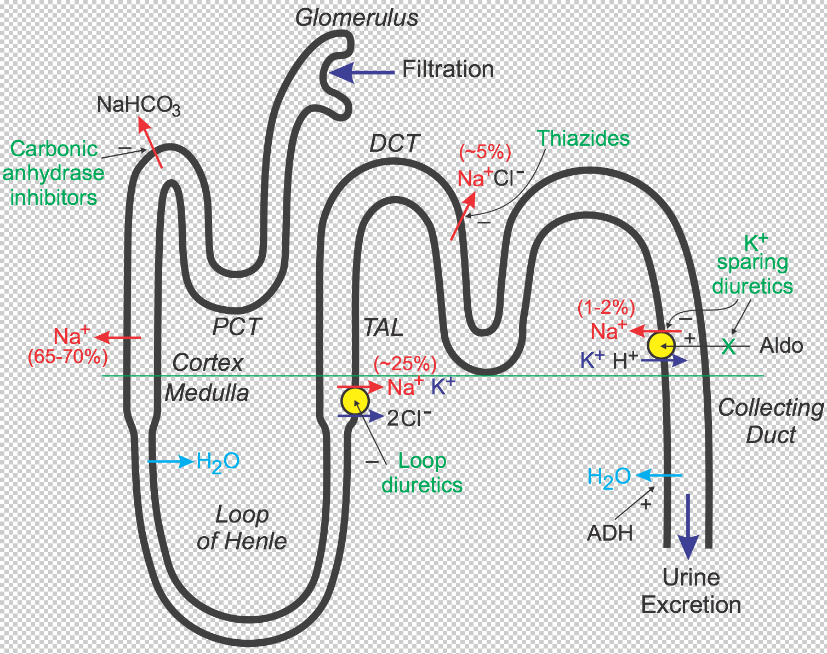
Diuretics
General Pharmacology
Renal handling of sodium and water
To understand the action of diuretics, it is first necessary to review how the kidney filters fluid and forms urine. The following discussion and accompanying illustration provide a simple overview of how the kidney handles water and electrolytes. For more detailed explanation, particularly related to ion and fluid movement across the renal tubular cells, the reader should consult a physiology textbook.

Slide 74
As blood flows through the kidney, it passes into glomerular capillaries located within the cortex (outer zone of the kidney). These glomerular capillaries are highly permeable to water and electrolytes. Glomerular capillary hydrostatic pressure drives (filters) water and electrolytes into Bowman's space and into the proximal convoluting tubule (PCT). About 20% of the plasma that enters the glomerular capillaries is filtered (termed filtration fraction). The PCT, which lies within the cortex, is the site of sodium, water, and bicarbonate transport from the filtrate (urine), across the tubule wall, and into the interstitium of the cortex. About 65-70% of the filtered sodium is removed from the urine found within the PCT (this is termed sodium reabsorption). This sodium is reabsorbed isosmotically, meaning that every molecule of sodium that is reabsorbed is accompanied by a molecule of water. As the tubule dives into the medulla, or middle zone of the kidney, the tubule becomes narrower and forms a loop (Loop of Henle) that reenters the cortex as the thick ascending limb (TAL) that travels back to near the glomerulus. Because the interstitium of the medulla is very hyperosmotic and the Loop of Henle is permeable to water, water is reabsorbed from the Loop of Henle and into the medullary interstitium. This loss of water concentrates the urine within the Loop of Henle.

Slide 75
The TAL, which is impermeable to water, has a cotransport system that reabsorbs sodium, potassium, and chloride at a ratio of 1:1:2. Approximately 25% of the sodium load of the original filtrate is reabsorbed at the TAL. From the TAL, the urine flows into the distal convoluting tubule (DCT), which is another site of sodium transport (~5% via a sodium-chloride cotransporter) into the cortical interstitium (the DCT is also impermeable to water). Finally, the tubule dives back into the medulla as the collecting duct and then into the renal pelvis where it joins with other collecting ducts to exit the kidney as the ureter. The distal segment of the DCT and the upper collecting duct has a transporter that reabsorbs sodium (about 1-2% of filtered load) in exchange for potassium and hydrogen ion, which are excreted into the urine. It is important to note two things about this transporter. First, its activity is dependent on the tubular concentration of sodium, so that when sodium is high, more sodium is reabsorbed, and more potassium and hydrogen ion are excreted

Slide 76
Second, this transporter is regulated by aldosterone, which is a mineralocorticoid hormone secreted by the adrenal cortex. Increased aldosterone stimulates the reabsorption of sodium, which also increases the loss of potassium and hydrogen ion to the urine. Finally, water is reabsorbed in the collected duct through special pores that are regulated by antidiuretic hormone, which is released by the posterior pituitary. ADH increases the permeability of the collecting duct to water, which leads to increased water reabsorption, a more concentrated urine and reduced urine outflow (antidiuresis). Most of the sodium originally filtered is reabsorbed by the kidney, so that less than 1% of originally filtered sodium remains in the final urine.

Slide 77
Mechanisms of diuretic drugs
Diuretic drugs increase urine output by the kidney (i.e., promote diuresis). This is accomplished by altering how the kidney handles sodium. If the kidney excretes more sodium, then water excretion will also increase. Most diuretics produce diuresis by inhibiting the reabsorption of sodium at different segments of the renal tubular system. Sometimes a combination of two diuretics is given because this can be significantly more effective than either compound alone (synergistic effect). The reason for this is that one nephron segment can compensate for altered sodium reabsorption at another nephron segment; therefore, blocking multiple nephron sites significantly enhances efficacy.

Slide 78
Loop diuretics inhibit the sodium-potassium-chloride cotransporter in the thick ascending limb . This transporter normally reabsorbs about 25% of the sodium load; therefore, inhibition of this pump can lead to a significant increase in the distal tubular concentration of sodium, reduced hypertonicity of the surrounding interstitium, and less water reabsorption in the collecting duct. This altered handling of sodium and water leads to both diuresis (increased water loss) and natriuresis (increased sodium loss). By acting on the thick ascending limb, which handles a significant fraction of sodium reabsorption, loop diuretics are powerful diuretics. These drugs also induce renal synthesis of prostaglandins, which contributes to their renal action including the increase in renal blood flow and redistribution of renal cortical blood flow. Loop diuretics are the most effective diuretic class because their site of action has a high capacity for sodium reabsorption. Note that efficacy is inversely related to renal function, which can be impaired in heart failure.

Slide 79
Thiazide diuretics, which are the most prescribed diuretic, inhibit the sodium-chloride transporter in the distal tubule. Because this transporter normally only reabsorbs about 5% of filtered sodium, these diuretics are less efficacious than loop diuretics in producing diuresis and natriuresis. Nevertheless, they are sufficiently powerful to satisfy many therapeutic needs requiring a diuretic. Their mechanism depends on renal prostaglandin production.
Because loop and thiazide diuretics increase sodium delivery to the distal segment of the distal tubule, this increases potassium loss (potentially causing hypokalemia) because the increase in distal tubular sodium concentration stimulates the aldosterone-sensitive sodium pump to increase sodium reabsorption in exchange for potassium and hydrogen ion, which are lost to the urine. The increased hydrogen ion loss can lead to metabolic alkalosis. Part of the loss of potassium and hydrogen ion by loop and thiazide diuretics results from activation of the renin-angiotensin-aldosterone system that occurs because of reduced blood volume and arterial pressure. Increased aldosterone stimulates sodium reabsorption and increases potassium and hydrogen ion excretion into the urine.

Slide 80
There is a third class of diuretic that is functionally referred to as potassium-sparing diuretics. Unlike loop and thiazide diuretics, some of these drugs do not act directly on sodium transport. Some drugs in this class antagonize the actions of aldosterone (aldosterone receptor antagonists; (mineralocorticoid receptor antagonists; MRAs) at the distal segment of the distal tubule. This causes more sodium (and water) to pass into the collecting duct and be excreted in the urine. They are called K⁺-sparing diuretics because they do not produce hypokalemia like the loop and thiazide diuretics. The reason for this is that by inhibiting aldosterone-sensitive sodium reabsorption, less potassium and hydrogen ion are exchanged for sodium by this transporter and therefore less potassium and hydrogen are lost to the urine. Other potassium-sparing diuretics directly inhibit sodium channels associated with the aldosterone-sensitive sodium pump, and therefore have similar effects on potassium and hydrogen ion as the aldosterone antagonists. Their mechanism depends on renal prostaglandin production. Because this class of diuretic has weak effects on overall sodium balance, they are often used in conjunction with thiazide or loop diuretics to help prevent hypokalemia.

Slide 81
Carbonic anhydrase inhibitors inhibit the transport of bicarbonate out of the proximal convoluted tubule into the interstitium, which leads to less sodium reabsorption at this site and therefore greater sodium, bicarbonate, and water loss in the urine. These are the weakest of the diuretics and seldom if ever used in cardiovascular disease.

Slide 82
Cardiovascular effects of diuretics
Through their effects on sodium and water balance, diuretics decrease blood volume and venous pressure. This decreases cardiac filling (preload) and, by the Frank-Starling mechanism, decreases ventricular stroke volume and cardiac output, which leads to a fall in arterial pressure. The decrease in venous pressure reduces capillary hydrostatic pressure, which decreases capillary fluid filtration and promotes capillary fluid reabsorption, thereby reducing edema if present. There is some evidence that loop diuretics cause venodilation, which can contribute to the lowering of venous pressure. Long-term use of diuretics results in a fall in systemic vascular resistance (by unknown mechanisms) that helps to sustain the reduction in arterial pressure.

Slide 83
Therapeutic Uses
Hypertension
Most patients with hypertension, of which 90-95% have hypertension of unknown origin (primary or essential hypertension), are effectively treated with diuretics. Antihypertensive therapy with diuretics is particularly effective when coupled with reduced dietary sodium intake. The efficacy of these drugs is derived from their ability to reduce blood volume, cardiac output, and with long-term therapy, systemic vascular resistance. Thiazide diuretics, particularly chlorthalidone, are considered "first-line therapy" for stage 1 hypertension. Potassium-sparing, aldosterone-blocking diuretics (e.g., spironolactone or eplerenone) are used in secondary hypertension caused by primary hyperaldosteronism, and sometimes as an adjunct to thiazide treatment in primary hypertension to prevent hypokalemia.

Slide 84
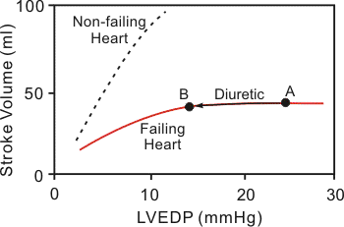
Heart failure
Heart failure leads to activation of the renin-angiotensin-aldosterone system, which causes increased sodium and water retention by the kidneys. This in turn increases blood volume and contributes to the elevated venous pressures associated with heart failure, which can lead to pulmonary and systemic edema. The primary use for diuretics in heart failure is to reduce pulmonary and/or systemic congestion and edema, and associated clinical symptoms (e.g., shortness of breath - dyspnea). Long-term treatment with diuretics may also reduce the afterload on the heart by promoting systemic vasodilation, which can lead to improved ventricular ejection.

Slide 85
When treating heart failure with diuretics, care must be taken to not unload too much volume because this can depress cardiac output. For example, if pulmonary capillary wedge pressure is 25 mmHg (point A in figure) and pulmonary congestion is present, a diuretic can safely reduce that elevated pressure to a level (e.g., 14 mmHg; point B in figure) that will reduce pulmonary pressures without compromising ventricular stroke volume. The reason for this is that heart failure caused by systolic dysfunction is associated with a depressed, flattened Frank-Starling curve. However, if the volume is reduced too much, stroke volume will fall because the heart will now be operating on the ascending limb of the Frank-Starling relationship. If the heart failure is caused by diastolic dysfunction, diuretics must be used very carefully so as to not impair ventricular filling. In diastolic dysfunction, ventricular filling requires elevated filling pressures because of the reduced ventricular compliance.
Most patients in heart failure are prescribed a loop diuretic because they are more effective in unloading sodium and water than thiazide diuretics. In mild heart failure, a thiazide diuretic may be used. Potassium-sparing, aldosterone-blocking diuretics (e.g., spironolactone) are being used increasingly in heart failure.

Slide 86
Pulmonary and systemic edema
Capillary hydrostatic pressure and therefore capillary fluid filtration is strongly influenced by venous pressure Therefore, diuretics, by reducing blood volume and venous pressure, lower capillary hydrostatic pressure, which reduces net capillary fluid filtration and tissue edema. Because left ventricular failure can cause life-threatening pulmonary edema, most heart failure patients are treated with a loop diuretic to prevent or reduce pulmonary edema. Diuretics may also be used to treat leg edema caused by right-sided heart failure or venous insufficiency in the limb.

Slide 87
Specific Drugs
Class | Specific Drugs | Comments
Thiazide | chlorothiazide | primarily used for treating edema
 | chlorthalidone | thiazide-like in action, not structure; long half-life; more effective than hydrochlorothiazide in hypertension
 | hydrochlorothiazide | prototypical drug
 | indapamide | thiazide-like in action, not structure; long half-life; more effective than hydrochlorothiazide in hypertension
 | methyclothiazide | thiazide-like in action, not structure; not available in U.S.
 | metolazone | thiazide-like in action, not structure; primarily used for treating edema

Slide 88
Loop | bumetanide | short half-life (~ 1.5 hr); oral and I.V.
 | ethacrynic acid | non-sulfonamide used in patients with sulfa allergy; highest incidence of ototoxicity
 | furosemide | short half-life (~ 1 hr) with normal kidney function; relatively low bioavailability (~50%) with high intra- and interpatient variability
 | torsemide | slower onset but longer half-life (3-4 hr); oral and I.V.

Slide 89
K⁺-sparing | amiloride | distal tubule Na⁺-channel inhibitor
 | eplerenone | aldosterone receptor antagonist; fewer side effects than spironolactone
 | spironolactone | aldosterone receptor antagonist; side effect: gynecomastia
 | triamterene | distal tubule Na⁺-channel inhibitor

Slide 90
Adverse Side Effects and Contraindications
Class | Adverse Side Effects | Drug Interactions
Thiazide | hypokalemia metabolic alkalosis dehydration (hypovolemia), leading to hypotension hyponatremia hyperglycemia in diabetics hypercholesterolemia; hypertriglyceridemia increased low-density lipoproteins hyperuricemia (at low doses) azotemia (in renal disease patients) | hypokalemia potentiates digitalis toxicity non-steroidal anti-inflammatory drugs: reduced diuretic efficacy beta-blockers: potentiate hyperglycemia, hyperlipidemias corticosteroids: enhance hypokalemia

Slide 91
Loop | hypokalemia metabolic alkalosis hypomagnesemia hyperuricemia dehydration (hypovolemia), leading to hypotension dose-related hearing loss (ototoxicity) | hypokalemia potentiates digitalis toxicity non-steroidal anti-inflammatory drugs: reduced diuretic efficacy corticosteroids: enhance hypokalemia aminoglycosides: enhance ototoxicity, nephrotoxicity

Slide 92
K⁺-sparing | hyperkalemia metabolic acidosis gynecomastia (aldosterone antagonists) gastric problems including peptic ulcer | ACE inhibitors: potentiate hyperkalemia non-steroidal anti-inflammatory drugs: reduced diuretic efficacy

Slide 94
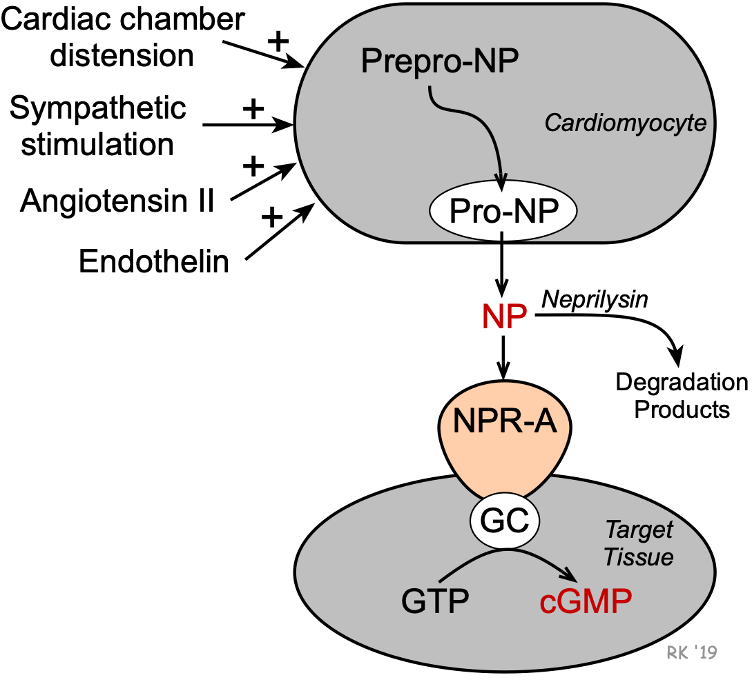
Natriuretic Peptides and Neprilysin Inhibitors
Natriuretic Peptide Formation and Metabolism

Slide 95
Natriuretic peptides (NPs) are peptide hormones that are synthesized by the heart, brain,
and other organs. Their formation in the heart is stimulated by cardiac chamber distension, angiotensin II, endothelin, and sympathetic nerve activity (beta-adrenoceptor mediated). Formation occurs in cardiomyocytes from larger peptide precursors (prepro-NP and pro-NP). After release by the cells, these NPs circulate to their target tissues where they bind to NPR-A receptors that are linked to guanylyl cyclase and the formation of cGMP.
Atrial natriuretic peptide (ANP) is a 28 amino acid peptide that is synthesized, stored, and released by atrial myocytes. Therefore, elevated levels of ANP are found during hypervolemic states (elevated blood volume) and congestive heart failure. Brain-type natriuretic peptide (BNP; 32 amino acids), although first identified in the brain, is primarily produced by ventricular tissue in the heart, and like ANP, there is enhanced synthesis and release of BNP during heart failure. Neutral endopeptidase (neprilysin) is a circulating enzyme that degrades natriuretic peptides. Therefore, inhibition of this enzyme increases circulating levels of NPs and enhances their effects.

Slide 96
Cardiovascular and Renal Actions of Natriuretic Peptides
Natriuresis
Diuresis
Improve glomerular filtration rate & filtration fraction
Inhibit renin release - ↓ circulating angiotensin II - ↓ circulating aldosterone
Systemic vasodilation
Arterial hypotension
Reduced venous pressure
Reduced pulmonary capillary wedge pressure

Slide 97
Natriuretic peptides are involved in the long-term regulation of sodium and water balance, blood volume and arterial pressure. These peptide hormones decrease aldosterone release by the adrenal cortex, increase glomerular filtration rate (GFR) and filtration fraction, produce natriuresis and diuresis (potassium sparing), and decrease renin release, decreasing circulating levels of angiotensin II. These actions contribute to a reduction in blood volume and therefore central venous pressure (CVP), pulmonary capillary wedge pressure, cardiac output, and arterial blood pressure. Chronic elevations of ANP appear to decrease arterial blood pressure primarily by decreasing systemic vascular resistance. The mechanism of systemic vasodilation involves ANP receptor-mediated elevations in vascular smooth muscle cGMP and by attenuating sympathetic vascular tone. This latter mechanism may involve ANP acting upon sites within the central nervous system, as well as through inhibition of norepinephrine release by sympathetic nerve terminals. To summarize, natriuretic peptides serve as a counter-regulatory system for the renin-angiotensin-aldosterone system

Slide 98
Therapeutic Use of Natriuretic Peptides in Heart Failure
Heart failure leads to activation of the renin-angiotensin-aldosterone system, which causes increased sodium and water retention by the kidneys. This renal action increases blood volume and contributes to the elevated venous pressures associated with heart failure, which can lead to pulmonary and systemic edema. Increased angiotensin II also causes systemic vasoconstriction, which increases the afterload on the left ventricle.
The rationale for using a NP in heart failure is that it should reduce pulmonary and/or systemic congestion and edema, and associated clinical symptoms (e.g., shortness of breath - dyspnea). NPs may also reduce the afterload on the heart by promoting systemic vasodilation, which can lead to improved ventricular ejection. A recombinant human BNP (nesiritide) was developed and evaluated to treat acute, decompensated congestive heart failure caused by systolic dysfunction. However, this drug is no longer used in the treatment of this condition because a large clinical trial failed to show improved clinical outcomes. This compound produced long-lasting hypotension among its adverse effects.

Slide 99
Neprilysin Inhibitors in Heart Failure
Instead of infusing natriuretic peptides, a more successful approach was found in the development of neprilysin inhibitors (e.g., sacubitril). This new drug class increases the concentration of circulating, naturally produced NPs by inhibiting their degradation. Sacubitril, when combined with an angiotensin receptor blocker (valsartan), is effective in treating acute, decompensated heart failure, and has some benefit in patients with mildly reduced ejection fractions (HFmrEF; 41 - 49%). This combined therapy enhances the inhibitory effects of naturally produced NPs on the renin-angiotensin-aldosterone system, besides blocking AT₁ receptors. The combination of valsartan and sacubitril is referred to as an ARNI (angiotensin receptor neprilysin inhibitor).

Slide 101
Potassium-Channel Openers
General Pharmacology
Potassium-channel openers are drugs that activate (open) ATP-sensitive K⁺-channels in vascular smooth muscle. Opening these channels hyperpolarizes the smooth muscle, which closes voltage-gated calcium channels and decreases intracellular calcium. With less calcium available to combine with calmodulin, there is less activation of myosin light chain kinase and phosphorylation of myosin light chains (click here for details). This leads to relaxation and vasodilation. Because small arteries and arterioles normally have a high degree of smooth muscle tone, these drugs are effective in dilating these resistance vessels, decreasing systemic vascular resistance, and lowering arterial pressure. The fall in arterial pressure leads to reflex cardiac stimulation (baroreceptor-mediated tachycardia).

Slide 102
Therapeutic Indications
Being effective arterial dilators, potassium-channel openers are used in the treatment of hypertension. These drugs are not first-line therapy for hypertension because of their side effects, and therefore they are relegated to treating refractory, severe hypertension. They are used with a beta-blocker and diuretic to attenuate the reflex tachycardia and retention of sodium and fluid, respectively.

Slide 103
Specific Drugs
Although several potassium-channel openers have been used in research for many years, only one, minoxidil, is approved for humans to treat hypertension.
Side Effects and Contraindications
Common side effects to minoxidil include headaches, flushing and reflex tachycardia. The potent vasodilator actions of minoxidil can lead to fluid retention and edema formation. Reflex cardiac stimulation can precipitate angina in patients with coronary artery disease. Minoxidil produces T wave changes in a high percentage (~60%) of patients under chronic treatment. One of the most noted side effects of minoxidil is hypertrichosis, a thickening and enhanced pigmentation of body hair, and therefore this drug is more commonly used for treating baldness

Slide 104
Thrombolytic (Fibrinolytic) Drugs
Thrombolytic drugs are used to dissolve (lyse) blood clots (thrombi). Blood clots can occur in any vascular bed; however, when they occur in coronary, cerebral or pulmonary vessels, they can be immediately life-threatening. Coronary thrombi cause myocardial infarctions, cerebrovascular thrombi produce strokes, and pulmonary thrombi can lead to respiratory and cardiac failure. Therefore, rapid diagnosis and treatment of blood clots is important.

Slide 105
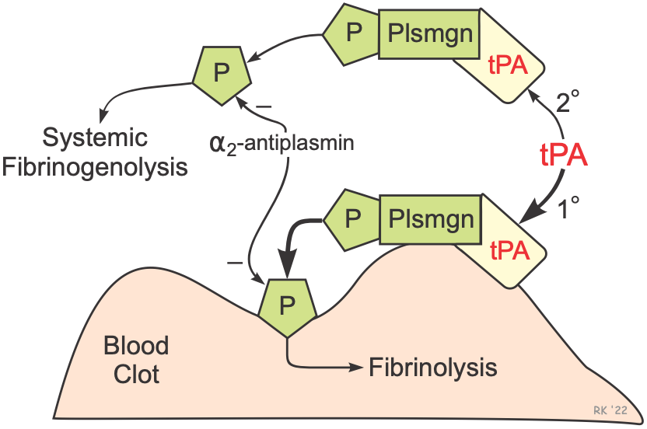
Mechanisms of Thrombolysis
Thrombolytic drugs dissolve blood clots by activating plasminogen, which forms a cleaved product called plasmin. Plasmin is a proteolytic enzyme that breaks cross-links between fibrin molecules, which provide the structural integrity of blood clots. Because of these actions, thrombolytic drugs are also called "plasminogen activators" and "fibrinolytic drugs."
There are three major classes of fibrinolytic drugs: tissue plasminogen activator (tPA), streptokinase (SK), and urokinase (UK). While drugs in these three classes all effectively dissolve blood clots, they differ in their mechanisms, which alter their selectivity for fibrin clots.

Slide 106
The figure illustrates the fibrinolytic mechanisms for tPA. Derivatives of tPA are the most used thrombolytic drugs because of their relative selectivity for activating fibrin-bound plasminogen. Tissue plasminogen activator produces clot lysis through the following sequence:
tPA binds to fibrin on the surface of the clot
Activates fibrin-bound plasminogen
Plasmin is cleaved from the plasminogen associated with the fibrin
Fibrin molecules are broken apart by the plasmin and the clot dissolves
Plasmin is a protease that can break apart fibrin molecules, dissolving the clot. However, it is important to note that plasmin also breaks down other circulating proteins, including fibrinogen. But because of the relative fibrin specificity of tPA, clot dissolution occurs with a less breakdown of circulating fibrinogen than occurs with SK and UK. Although tPA is relatively selective for clot-bound plasminogen, it still activates circulating plasminogen and releasing plasmin, which can lead to the breakdown of circulating fibrinogen and cause an unwanted systemic fibrinolytic state. Normally, circulating α₂-antiplasmin inactivates plasmin, but therapeutic doses of tPA (and SK) lead to sufficient plasmin formation to overwhelm the limited circulating concentrations α₂-antiplasmin. In summary, although tPA is relatively selective for clot-associated fibrin, it can produce systemic lytic state and undesirable bleeding.

Slide 107
SK is not a protease and has no enzymatic activity; however, it forms a complex with plasminogen that releases plasmin. Unlike tPA, it does not bind preferentially to clot-associated fibrin and therefore binds equally to circulating and non-circulating plasminogen. Therefore, SK produces significant fibrinogenolysis along with clot fibrinolysis. Because SK is derived from streptococci, patients who have had recent streptococci infections can require significantly higher doses of SK to produce thrombolysis.
It is important to note that the efficacy of thrombolytic drugs depends on the age of the clot. Older clots have more fibrin cross-linking and are more compacted; therefore, older clots are more difficult to dissolve. For treating acute myocardial infarction, the thrombolytic drugs should ideally be given within the first 2 hours. Beyond that time, the efficacy diminishes, and higher doses are required to achieve desired lysis.

Slide 108
Thrombolytic agents are used for the following therapeutic indications:
Acute myocardial infarctions (ST-elevated; STEMI)
Acute pulmonary embolism
Acute ischemic stroke (non-hemorrhagic)
Acute limb ischemia (arterial thrombosis)
Deep vein thrombosis (DVT)

Slide 109
Specific Thrombolytic Drugs
Tissue Plasminogen Activators
This family of thrombolytic drugs is used for all the above indications.
Alteplase (Activase®; rtPA) is a recombinant form of human tPA. It has a short half-life (~5 min) and therefore is usually administered as an intravenous bolus followed by an infusion.
Retaplase (Retavase®) is a genetically engineered, smaller derivative of recombinant tPA that has increased potency and is faster acting than rtPA. Having a longer half-life than rtPA, it is often administered as IV bolus injections.
Tenecteplase (TNK-tPA) has a longer half-life and greater binding affinity for fibrin than rtPA. Because of its longer half-life, it can be administered by IV bolus.

Slide 110
Streptokinase (SK) and Urokinase (UK)
The use of these drugs has been superseded by the use of tPA-compounds because of issues related to specificity of action, systemic fibrinolysis, and ease of administration. Neither SK nor UK are available for use in the U.S.
Natural streptokinase (SK) is isolated and purified from streptococci bacteria. Its lack of fibrin specificity makes it a less desirable thrombolytic drug than tPA compounds because it produces more fibrinogenolysis. SK is antigenic because it is derived from streptococci bacteria and, therefore, neutralizing antibodies can decrease its effectiveness.

Slide 111
Anistreplase (Eminase®) is a complex of SK and plasminogen and therefore is antigenic, like SK alone. It has more fibrin specificity and has a longer activity than natural SK; however, it causes considerable fibrinogenolysis.
Urokinase (Abbokinase®; UK) is sometimes referred to as urinary-type plasminogen activator (uPA) because it is formed by kidneys and is found in urine. It has limited clinical use because, like SK, it produces considerable fibrinogenolysis although it is non-antigenic.

Slide 112
Adverse Effects and Contraindications
A common adverse effect of all the thrombolytic drugs is bleeding complications related to systemic fibrinogenolysis and lysis of normal hemostatic plugs. The bleeding is often noted at a catheterization site, although gastrointestinal and cerebral hemorrhages may occur. Intracranial bleeding is a significant concern (5-7%) in using I.V. rtPA for acute ischemic stroke. Therefore, patients who have experienced trauma injury or who have a history of cerebral hemorrhagic stroke are not usually administered thrombolytics. Re-thrombosis can occur following thrombolysis, and therefore anticoagulants such as heparin are usually co-administered and continued after thrombolytic therapy

Slide 113
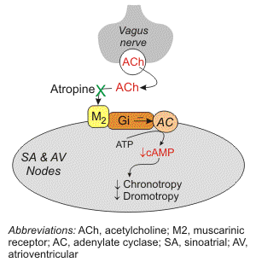
Atropine (Muscarinic Receptor Antagonist)
General Pharmacology

Slide 114
The vagus (parasympathetic) nerves that innervate the heart release acetylcholine (ACh) as their primary neurotransmitter. ACh binds to muscarinic receptors (M₂) that are found principally on cells comprising the sinoatrial (SA) and atrioventricular (AV) nodes. Muscarinic receptors are coupled to the Gi-protein; therefore, vagal activation decreases cAMP. Gi-protein activation also leads to the activation of K_{ACh} channels that increase potassium efflux and hyperpolarizes the cells.

Slide 115
Increases in vagal activity at the SA node decreases the firing rate of the pacemaker cells by decreasing the slope of the pacemaker potential (phase 4 of the action potential); this decreases the heart rate (negative chronotropy). The change in phase 4 slope results from alterations in potassium and calcium currents, as well as the slow-inward sodium current that is thought to be responsible for the pacemaker current (I_{f}). By hyperpolarizing the cells, vagal activation increases the cell's threshold for firing, which contributes to the reduction in firing rate. Similar electrophysiological effects also occur at the AV node; however, in this tissue, these changes are manifested as a reduction in the velocity impulse conduction through the AV node (negative dromotropy). In the resting state, there is a large degree of vagal tone acting on the heart, which is responsible for low resting heart rates.
There is also some vagal innervation of the atrial muscle, and to a much lesser extent, the ventricular muscle. Vagal activation, therefore, results in modest reductions in atrial contractility (inotropy) and even smaller decreases in ventricular contractility.

Slide 116
Alpha-Adrenoceptor Antagonists (Alpha-Blockers)
General Pharmacology
These drugs block the effect of sympathetic nerves on blood vessels by binding to alpha-adrenoceptors on the vascular smooth muscle. Most of these drugs act as competitive antagonists to the binding of norepinephrine that is released by sympathetic nerves synapsing on smooth muscle. Therefore, sometimes these drugs are referred to as sympatholytics because they antagonize sympathetic activity. Some alpha-blockers are non-competitive (e.g., phenoxybenzamine), which prolongs their action because of their strong binding to the receptor.

Slide 117
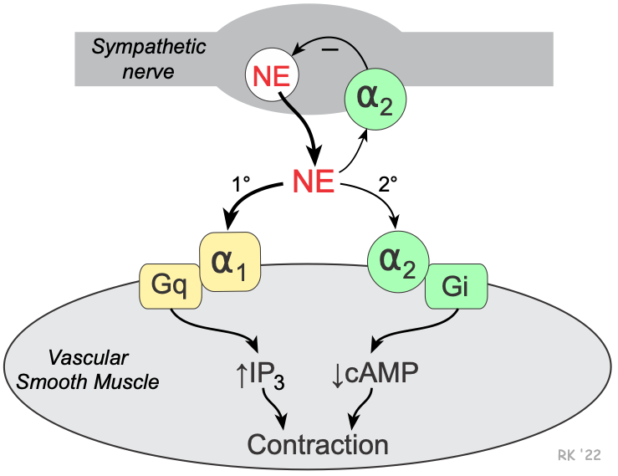
Vascular smooth muscle has two types of alpha-adrenoceptors: alpha₁ (α₁) and alpha₂ (α₂). The α₁-adrenoceptors are the predominant α-receptors on vascular smooth muscle. These receptors are linked to Gq-proteins that activate smooth muscle contraction through the IP₃ signal transduction pathway. Depending on the tissue and type of vessel, there are also α₂-adrenoceptors found on the smooth muscle. These receptors are linked to Gi-proteins, and binding of an alpha-agonist to these receptors decreases intracellular cAMP, which causes smooth muscle contraction. There are also α₂-adrenoceptors on the sympathetic nerve terminals that inhibit the release of norepinephrine and therefore act as a negative feedback mechanism for modulating the release of norepinephrine.

Slide 118
Alpha₁-adrenoceptor antagonists cause vasodilation by blocking the binding of norepinephrine to the smooth muscle receptors. Non-selective α₁ and α₂-adrenoceptor antagonists block postjunctional α₁ and α₂-adrenoceptors, which causes vasodilation; however, the blocking of prejunctional α₂-adrenoceptors leads to increased release of norepinephrine, which attenuates the effectiveness of the α₁ and α₂-postjunctional adrenoceptor blockade. Blocking α₂-prejunctional adrenoceptors in the heart can lead to increases in heart rate and contractility because of the enhanced release of norepinephrine that binds to beta₁-adrenoceptors.
Alpha-blockers dilate both arteries and veins because both vessel types are innervated by sympathetic adrenergic nerves; however, the vasodilator effect is more pronounced in the arterial resistance vessels. Because most blood vessels have some sympathetic tone under basal conditions, these drugs are effective dilators. They are even more effective under conditions of elevated sympathetic activity (e.g., during stress) or during pathologic increases in circulating catecholamines caused by an adrenal gland tumor (pheochromocytoma)

Slide 119
Therapeutic Uses
Selective α₁-blockers are used in the treatment of primary hypertension, although their use is not as widespread as other antihypertensive drugs. Alpha₁-blockers are not recommended as monotherapy and therefore are used with other antihypertensive drugs. Non-selective antagonists are usually reserved for hypertensive emergencies caused by a pheochromocytoma. This hypertensive condition, which is most commonly caused by an adrenal gland tumor that secretes large amounts of catecholamines, is commonly managed by a non-selective alpha-blocker with a beta-blocker (to blunt the reflex tachycardia) until the tumor can be surgically removed

Slide 120
Specific Drugs
.
Alpha-blocker type | Specific Drugs | Comments
Selective | prazosin | prototypical drug; essential hypertension; T_{1/2} ~ 3h
 | terazosin | essential hypertension; T_{1/2} ~ 12h
 | doxazosin | essential hypertension; T_{1/2} ~ 20h
Non-selective | phenoxybenzamine | long-lasting non-competitive blockade; T_{1/2} ~24h; used for hypertension caused by pheochromocytoma
 | phentolamine | used occasionally for hypertension caused by pheochromocytoma

Slide 121
Side Effects and Contraindications
The most common side effects are related directly to alpha-adrenoceptor blockade. These side effects include dizziness, orthostatic hypotension (because of loss of reflex vasoconstriction upon standing), nasal congestion (because of dilation of nasal mucosal arterioles), headache, and reflex tachycardia (especially with non-selective alpha-blockers). Fluid retention is also a problem that can be rectified by the use of a diuretic with the alpha-blocker. Alpha blockers have not been proven to be beneficial in heart failure or angina, and should not be used in these conditions

Slide 122
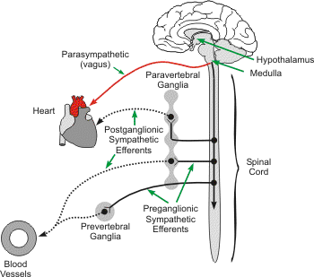
Centrally Acting Sympatholytics
General Pharmacology
The sympathetic adrenergic nervous system plays a major role in regulating arterial pressure. Activation of these nerves to the heart increases the heart rate (positive chronotropy), contractility (positive inotropy) and velocity of electrical impulse conduction (positive dromotropy). The norepinephrine-releasing, sympathetic adrenergic nerves that innervate the heart and blood vessels are postganglionic efferent nerves whose cell bodies originate in prevertebral and paravertebral sympathetic ganglia. Preganglionic sympathetic fibers, which travel from the spinal cord to the ganglia, originate in the medulla of the brainstem. Within the medulla are located sympathetic excitatory neurons that have significant basal activity, which generates a level of sympathetic tone to the heart and vasculature, even under basal conditions. The sympathetic neurons within the medulla receive input from other neurons within the medulla (e.g., vagal neurons), from the nucleus tractus solitarius (receives input from peripheral baroreceptors and chemoreceptors), and from neurons in the hypothalamus. Together, these neuronal systems regulate sympathetic (and parasympathetic) outflow to the heart and vasculature.

Slide 123
Sympatholytic drugs can block this sympathetic adrenergic system are three different levels. First, peripheral sympatholytic drugs such as alpha-adrenoceptor and beta-adrenoceptor antagonists block the influence of norepinephrine at the effector organ (heart or blood vessel). Second, there are ganglionic blockers that block impulse transmission at the sympathetic ganglia. Third, there are drugs that block sympathetic activity within the brain. These are called centrally acting sympatholytic drugs.
Centrally acting sympatholytic drugs block sympathetic activity by binding to and activating alpha₂ (α₂)-adrenoceptors in the central nervous system. This reduces sympathetic outflow to the heart, decreasing cardiac output by decreasing heart rate and contractility. Reduced sympathetic output to the vasculature decreases sympathetic vascular tone, which causes vasodilation and reduced systemic vascular resistance, which decreases arterial pressure.

Slide 124
Therapeutic Indications
Centrally acting α₂-adrenoceptor agonists are used in the treatment of hypertension. However, they are not considered first-line therapy because of side effects that are associated with their actions within the brain. They are usually administered in combination with a diuretic to prevent fluid accumulation, which increases blood volume and compromises the blood pressure lowering effect of the drugs. Fluid accumulation can also lead to edema. Centrally acting α₂-adrenoceptor agonists are effective in hypertensive patients with renal disease because they do not compromise renal function.

Slide 125
Specific Drugs
Several centrally acting α₂-adrenoceptor agonists are available for clinical use:
clonidine
guanabenz
guanfacine
methyldopa
Clonidine, guanabenz and guanfacine are structurally related compounds and have similar antihypertensive profiles. α-methyldopa is a structural analog of dopa and functions as a prodrug. After administration, α-methyldopa is converted to α-methylnorepinephrine, which then serves as the α₂-adrenoceptor agonist in the medulla to decrease sympathetic outflow.

Slide 126
Clonidine, when given intravenously, causes initial vasoconstriction via vascular α₂-adrenoceptors; however, this changes to vasodilation as the clonidine binds to α₂-adrenoceptors in the central nervous system, which decreases sympathetic efferent activity and lowers blood pressure. The oral form does not display initial vasoconstriction. Clonidine may also inhibit norepinephrine release by sympathetic nerves that innervate blood vessels, thus offsetting the constrictor effects on vascular smooth muscle postjunctional receptors. Central stimulation by clonidine also increases parasympathetic outflow, which can reduce heart rate. Guanabenz, guanfacine and methyldopa have actions that are like clonidine.

Slide 127
Side Effects and Contraindications
Side effects of centrally acting α₂-adrenoceptor agonists include sedation, dry mouth and nasal mucosa, bradycardia (because of increased vagal stimulation of the SA node and sympathetic withdrawal), orthostatic hypotension, and impotence. Constipation, nausea and gastric upset are also associated with the sympatholytic effects of these drugs. Fluid retention and edema are also a problem with chronic therapy; therefore, concurrent therapy with a diuretic is necessary. Sudden discontinuation of clonidine can lead to rebound hypertension, which results from excessive sympathetic activity.

Slide 128
Direct Acting Vasodilators
General Pharmacology
The one drug in this group, hydralazine, does not fit neatly into the other mechanistic classes, in part, because its mechanism of action is not entirely clear and it appears to have multiple, direct effects on the vascular smooth muscle. First, hydralazine causes smooth muscle hyperpolarization, likely through the opening of K⁺-channels. It also may inhibit IP₃-induced release of calcium from the smooth muscle sarcoplasmic reticulum. This calcium combines with calmodulin to activate myosin light chain kinase, which induces contraction. There is also evidence that hydralazine stimulates prostacyclin production to cause cAMP-mediated vasodilation. Finally, hydralazine may increase the bioavailability of nitric oxide produced by the vascular endothelium, leading to cGMP-mediated vasodilation.
Hydralazine, which is highly specific for arterial vessels, reduces systemic vascular resistance and arterial pressure. Indirect cardiac stimulation (e.g., tachycardia) occurs with hydralazine administration because of the activation of the baroreceptor reflex.

Slide 129
Therapeutic Indications for Hydralazine
Hypertension
Hydralazine is used occasionally (although rarely alone) in the treatment of arterial hypertension. It is not first-line therapy for arterial hypertension. Its relatively short half-life, which requires frequent dosing, and its precipitation of reflex tachycardia make it undesirable for treating chronic hypertension. However, it is used in treating acute hypertensive emergencies, secondary hypertension caused by preeclampsia, and pulmonary hypertension. It is often used with a beta-blocker and diuretic to attenuate the baroreceptor-mediated reflex tachycardia and renal sodium retention, respectively.

Slide 130
Heart failure
Hydralazine has a role in the management of heart failure with reduced ejection fraction (HFrEF) because of its ability to reduce afterload and enhance stroke volume and ejection fraction. When used in heart failure, it is given along with a diuretic and often with isosorbide dinitrate, a nitrodilator.
Side Effects and Contraindications
Common side effects of hydralazine include headaches, flushing and tachycardia. Reflex cardiac stimulation can precipitate angina in patients with coronary artery disease. Some patients (~10%) experience a lupus-like syndrome.

Slide 131
Alpha-Adrenoceptor Agonists (α-agonists)
General Pharmacology
Most alpha-adrenoceptor agonists (α-agonists) that are used clinically bind to α-receptors on vascular smooth muscle and induce smooth contraction and vasoconstriction, thus mimicking the effects of sympathetic adrenergic nerve activation to the blood vessels. Some α-agonists bind to prejunctional receptors on sympathetic nerves, which inhibits norepinephrine release both peripherally and centrally in the brain

Slide 132
Vascular smooth muscle has two types of alpha-adrenoceptors - alpha₁ (α₁) and alpha₂ (α₂). The α₁-adrenoceptors are the predominant α-receptors on vascular smooth muscle. These receptors are linked to Gq-proteins that activate smooth muscle contraction through the IP₃ signal transduction pathway and Rho-kinase pathway. Depending on the tissue and type of vessel, there are also α₂-adrenoceptors found on the smooth muscle. These receptors are linked to Gi-proteins, and binding of an α₂-agonist to these receptors decreases intracellular cAMP, which causes smooth muscle contraction. There are also α₂-adrenoceptors located on the sympathetic nerve terminals that inhibit the release of norepinephrine and therefore act as a feedback mechanism for modulating the release of norepinephrine. Therefore, an α₂-agonist inhibits norepinephrine release from sympathetic nerves.
Alpha-agonists constrict both arteries and veins; however, the vasoconstrictor effect is more pronounced in the arterial resistance vessels. Constriction of the resistance vessels (small arteries and arterioles) increases systemic vascular resistance, whereas constriction of venous capacitance vessels increases venous pressure.

Slide 133
Specific Drugs and Therapeutic Uses
Alpha-agonists used therapeutically are relatively selective or non-selective for α₁ or α₂-adrenoceptors. Besides the drugs listed below, there are sympathomimetic drugs that have α-agonist and β-adrenoceptor agonist properties. These drugs include the naturally occurring catecholamines, dopamine, epinephrine and norepinephrine, as well as catecholamine analogs such as dobutamine
α₁-adrenoceptor agonists (systemic vasoconstrictors)
midodrine (prodrug converted to desglymidodrine)
phenylephrine
Phenylephrine (I.V. form) is used as a pressor agent in treating hypotension and shock. Midodrine (oral form) is used in patients with autonomic insufficiency and symptomatic postural hypotension.
Oxymetazoline, tetrahydrozoline, xylometazoline and some preparations of phenylephrine are used as nasal decongestants primarily because of their α₁ vasoconstrictor properties.

Slide 134
α₂-adrenoceptor agonists (centrally-acting vasodilators;
clonidine
guanabenz
guanfacine
methyldopa

Slide 135
Side Effects and Contraindications - α₁-agonists
Alpha₁-agonists can cause headache, reflex bradycardia, excitability, and restlessness. Because alpha₁-agonists produce systemic vasoconstriction, the work and oxygen requirements of the heart increase. If the coronary circulation is impaired, as in patients with coronary artery disease, the decrease in myocardial oxygen supply/demand ratio can precipitate angina. Preparations used as nasal decongestants can cause a rebound effect (increased congestion) after a few days of use

Slide 136
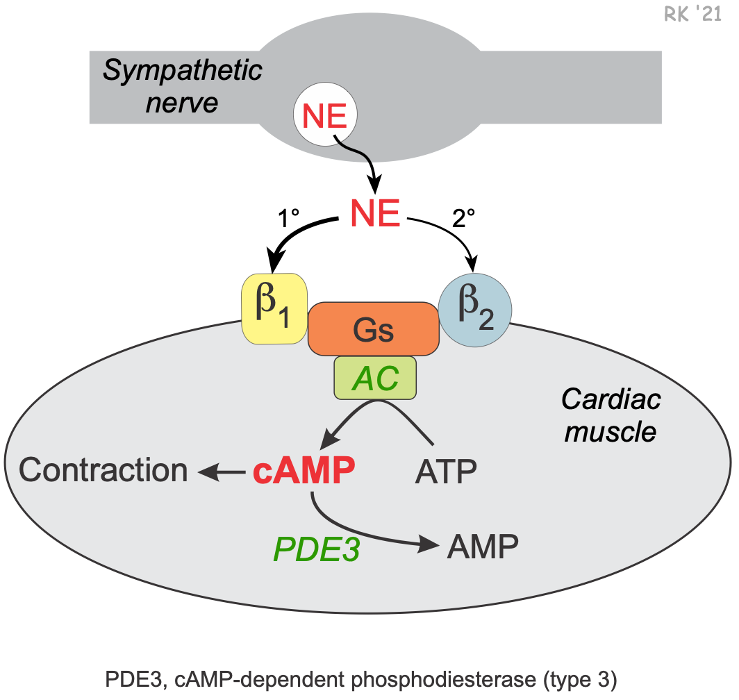
Phosphodiesterase Inhibitors
General Pharmacology of cAMP-Dependent Phosphodiesterase Inhibitors (PDE3)
Intracellular concentrations of cAMP play an important second messenger role in regulating cardiac muscle contraction. Activation of the sympathetic nervous system releases the neurotransmitter norepinephrine and increases circulating catecholamines (epinephrine and norepinephrine).

Slide 137
These catecholamines bind primarily to beta₁-adrenoceptors in the heart that are coupled to Gs-proteins. This activates adenylyl cyclase to form cAMP from ATP. Increased cAMP, through its coupling with other intracellular messengers, increases contractility (inotropy), heart rate (chronotropy) and conduction velocity (dromotropy). Cyclic-AMP is broken down by an enzyme called cAMP-dependent phosphodiesterase (PDE). The isoform of this enzyme that is targeted by currently used clinical drugs is the type 3 form (PDE3). Inhibition of this enzyme prevents cAMP breakdown and increases its intracellular concentration. This increases cardiac inotropy, chronotropy and dromotropy. PDE3 inhibitors can be thought of as a backdoor approach to cardiac stimulation, whereas β-agonists go through the front door to produce the same cardiac effects.

Slide 138
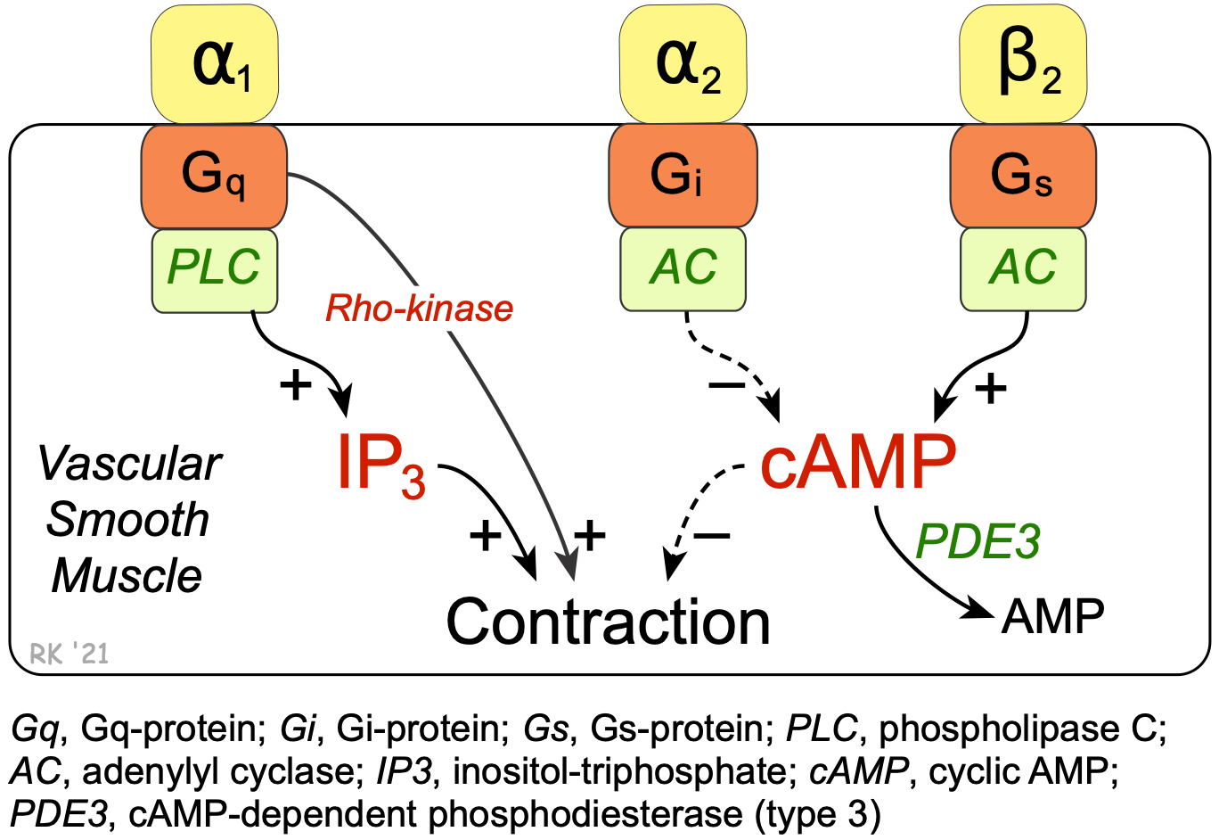
Cyclic-AMP also plays an important role in regulating the contraction of vascular smooth muscle. Beta₂-adrenoceptor agonists such as epinephrine stimulate the Gs-protein and the formation of cAMP (click here for details). Unlike cardiac muscle, increased cAMP in smooth muscle causes relaxation. The reason for this is that cAMP normally inhibits myosin light chain kinase, the enzyme that phosphorylates smooth muscle myosin, causing contraction. Like the heart, the cAMP is broken down by a cAMP-dependent PDE (PDE3). Therefore, inhibition of this enzyme increases intracellular cAMP, which further inhibits myosin light chain kinase, producing less contractile force (i.e., promoting relaxation).

Slide 139
Cardiovascular Actions of cAMP-dependent PDE (type3) Inhibitors
Systemic Circulation
Vasodilation
Increased organ perfusion
Decreased systemic vascular resistance
Decreased arterial pressure
Cardiopulmonary
Increased contractility and heart rate
Increased stroke volume and ejection fraction
Decreased ventricular preload (secondary to increased output)
Decreased pulmonary capillary wedge pressure

Slide 140
Overall cardiovascular effects
The cardiac and vascular effects of cAMP-dependent PDE inhibitors cause cardiac stimulation, which increases cardiac output, and reduced systemic vascular resistance, which lowers arterial pressure. Because cardiac output increases and systemic vascular resistance decreases, the change in arterial pressure depends on the relative effects of the PDE inhibitor on the heart versus the vasculature. At normal therapeutic doses, PDE3 inhibitors such as milrinone have a greater vascular than cardiac effect, so that arterial pressure is lowered in the presence of augmented cardiac output. Because of the dual cardiac and vascular effects of these compounds, they are sometimes referred to as "inodilators."
Other actions
PDE3 inhibitors also decrease platelet aggregation by increasing platelet cAMP. However, only cilostazol is used for this purpose in the treatment of intermittant claudication (ischemic leg pain associated with leg movement).

Slide 141
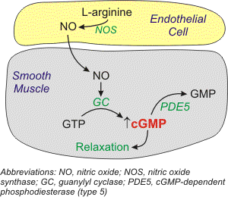
General Pharmacology of cGMP-Dependent Phosphodiesterase Inhibitors (PDE5)
There is a second isoenyme form of PDE in vascular smooth muscle that is a cGMP-dependent phosphodiesterase. The type 5 isoform of this enzyme (PDE5) is found in the corpus cavernosum of the penis and in vascular smooth muscle. This enzyme breaks down cGMP that forms in response to increased nitric oxide (NO). Increased intracellular cGMP inhibits calcium entry into the cell, decreasing intracellular calcium concentrations and causing smooth muscle relaxation

Slide 142
NO also activates K⁺ channels, which leads to hyperpolarization and relaxation. Finally, NO acting through cGMP can stimulate a cGMP-dependent protein kinase that activates myosin light chain phosphatase, the enzyme that dephosphorylates myosin light chains, which leads to relaxation. Therefore, inhibitors cGMP-dependent phosphodiesterase, by increasing intracellular cGMP, enhance smooth muscle relaxation and vasodilation, and cause penile erection.

Slide 143
Therapeutic Indications
The cardiostimulatory and vasodilatory actions of PDE3 inhibitors make them suitable for treating heart failure. Arterial dilation reduces afterload on the failing ventricle and leads to an increase in stroke volume and ejection fraction, as well as increases organ perfusion. Reducing the afterload leads to a secondary decrease in preload on the heart that helps to improve the mechanical efficiency of dilated hearts and to reduce ventricular wall stress and the oxygen demands placed on the failing heart. The cardiostimulatory effects of these drugs increase inotropy, which further enhances stroke volume and ejection fraction. Tachycardia, however, also results, and this is not beneficial; therefore, doses are used that minimize the positive chronotropic actions of the drug.

Slide 144
A baroreceptor reflex, which occurs in response to hypotension, may contribute to tachycardia. Clinical trials have shown that long-term therapy with PDE3 inhibitors increases mortality in heart failure patients; therefore, these drugs are not used for long-term, chronic therapy. They are very useful, however, in treating acute, decompensated heart failure or temporary bouts of decompensated chronic failure. They are not used as monotherapy. Instead, they are used with other treatment modalities such as diuretics, ACE inhibitors, beta-blockers or digitalis.
The somewhat selective vasodilatory actions of PDE5 inhibitors have made these compounds very useful in the treatment of male erectile dysfunction. The PDE5 inhibitor sildenafil is also approved to treat pulmonary hypertension.

Slide 145
Specific Drugs
Several PDE inhibitors are available for clinical use:
PDE3 inhibitors
milrinone
inamrinone (formerly amrinone)
cilostazol
PDE5 inhibitors
sildenafil
tadalafil

Slide 146
The PDE3 inhibitors (except cilostazol) are used for treating acute, decompensated heart failure,
whereas the PDE5 inhibitors are used for treating male erectile dysfunction and pulmonary hypertension.
Note that the PDE3 inhibitors used in acute heart failure end in "one,“
whereas the PDE5 inhibitors end in "fil".
Inhibition of platelet aggregation, along with vasodilation, is an important mechanism of action for cilostazol, which is used in the treatment of intermittent claudication in peripheral arterial disease. Cilostazol appears to have less cardiostimulatory effects than milrinone.

Slide 147
Side Effects and Contraindications
PDE3 inhibitors
Milrinone and inamrinone are not used in the treatment of chronic heart failure because clinical trials have shown that long-term use of these drugs worsen patient outcomes. The most common and severe side effect of PDE3 inhibitors is ventricular arrhythmias in about 12% of patients, some of which may be life-threatening. Headaches and hypotension occur in about 3% of patients. These side effects are not uncommon for drugs that increase cAMP in cardiac and vascular tissues, other examples being β-agonists
PDE5 inhibitors
The most common side effects for PDE5 inhibitors include headache and cutaneous flushing, both of which are related to vascular dilation caused by increased vascular cGMP. There is clinical evidence that nitrodilators may interact adversely with PDE5 inhibitors. The reason for this adverse reaction is that nitrodilators stimulate cGMP production while PDE5 inhibitors inhibit cGMP degradation. When combined, these two drug classes potentiate cGMP levels, which can lead to hypotension and impaired coronary perfusion.

Slide 148
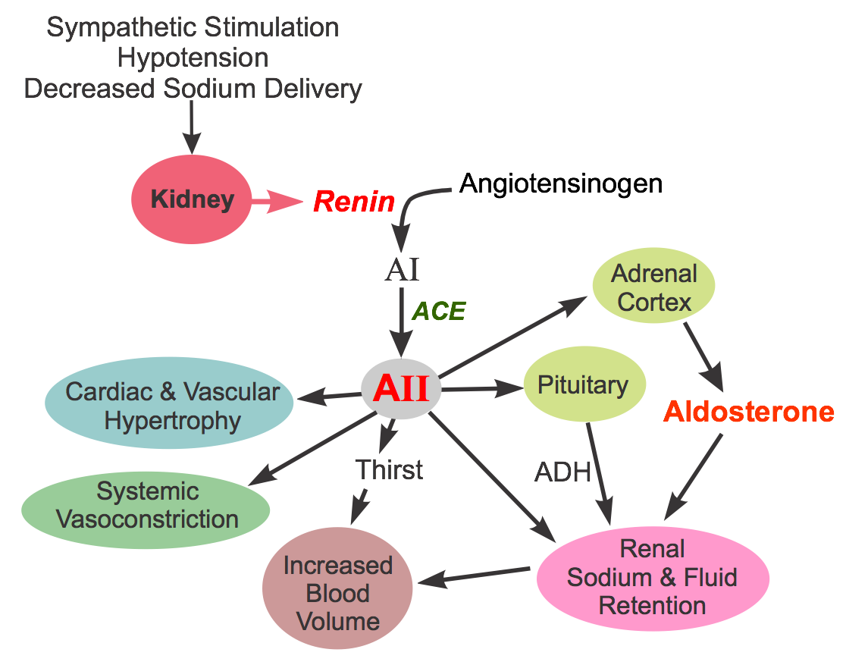
Angiotensin Converting Enzyme (ACE) Inhibitors
General Pharmacology

Slide 149
ACE inhibitors produce vasodilation by inhibiting the formation of angiotensin II. This
vasoconstrictor is formed by the proteolytic action of renin (released by the kidneys) acting on circulating angiotensinogen to form angiotensin I. Angiotensin I is then converted to angiotensin II by angiotensin converting enzyme (ACE).
ACE also breaks down bradykinin (a vasodilator substance). Therefore, ACE inhibitors, by blocking the breakdown of bradykinin, increase bradykinin levels, which can contribute to the vasodilator action of ACE inhibitors. The increase in bradykinin is also believed to be responsible for a troublesome side effect of ACE inhibitors, a dry cough.

Slide 150
Angiotensin II constricts arteries and veins by binding to AT₁ receptors on the smooth muscle, which are coupled to a Gq-protein and the IP₃ signal transduction pathway. Angiotensin II also facilitates the release of norepinephrine from sympathetic adrenergic nerves and inhibits norepinephrine reuptake by these nerves. This action of angiotensin II augments sympathetic activity on the heart and blood vessels, promoting cardiac stimulation and vasoconstriction. Angiotensin II stimulates the adrenal cortex to release aldosterone, which acts on the kidneys to increase sodium and water reabsorption, leading to increased blood volume and arterial pressure. By stimulating pituitary release of antidiuretic hormone (ADH; vasopressin), water renal reabsorption is increased, which increases blood volume and arterial pressure. ADH can also directly constrict blood vessels.

Slide 151
Cardiorenal Effects of ACE Inhibitors
Vasodilation (arterial & venous) - reduce arterial & venous pressure - reduce ventricular afterload & preload
Decrease blood volume - natriuretic - diuretic
Depress sympathetic activity
Inhibit cardiac and vascular hypertrophy

Slide 152
ACE inhibitors have the following actions:
Dilate arteries and veins by blocking angiotensin II formation and inhibiting bradykinin metabolism. This vasodilation reduces arterial pressure, preload and afterload on the heart.
Down regulate sympathetic adrenergic activity by blocking the facilitating effects of angiotensin II on sympathetic nerve release and reuptake of norepinephrine.
Promote renal excretion of sodium and water (natriuretic and diuretic effects) by blocking the effects of angiotensin II in the kidney, blocking angiotensin II stimulation of aldosterone secretion, and by blocking angiotensin II stimulated ADH release. These actions blood volume, venous pressure and arterial pressure.
Inhibit cardiac and vascular remodeling associated with chronic hypertension, heart failure, and myocardial infarction.
Elevated plasma renin is not required for the actions of ACE inhibitors, although ACE inhibitors are more efficacious when circulating levels of renin are elevated. We know that the renin-angiotensin system is found in many tissues, including heart, brain, vascular and renal tissues. Therefore, ACE inhibitors may act at these sites besides blocking the conversion of angiotensin in the circulating plasma.

Slide 153
Therapeutic Use of ACE Inhibitors
Hypertension
Heart failure
Post-myocardial infarction

Slide 154
Hypertension
ACE inhibitors are considered "first-line therapy" in the treatment of stage 1 hypertension. They may also be used in hypertension caused by renal artery stenosis, which causes renin-dependent hypertension owing to the increased release of renin by the kidneys. Reducing angiotensin II formation leads to arterial and venous dilation, which reduces arterial and venous pressures. By reducing the effects of angiotensin II on the kidney, ACE inhibitors cause natriuresis and diuresis, which decreases blood volume and cardiac output, lowering arterial pressure.
African Americans do not respond as well as other races to monotherapy with ACE inhibitors or angiotensin receptor blockers (ARBs); however, differences in blood pressure lowering efficacy are eliminated with adequate diuretic dosing. Therefore, current recommendations are that ACE inhibitors and ARBs are appropriate for African Americans, but not as monotherapy. A diuretic or calcium-channel blocker should be used with an ACE inhibitor or ARB to achieve the target reduction in blood pressure in these patient populations.

Slide 155
Heart Failure
ACE inhibitors have proven to be very effective in the treatment of heart failure caused by systolic dysfunction (i.e., heart failure with reduced ejection fraction; HFrEF)). Beneficial effects of ACE inhibition in HFrEF include:
Reduced afterload, which enhances ventricular stroke volume and improves ejection fraction.
Reduced preload, which decreases pulmonary and systemic congestion and edema.
Reduced sympathetic activation, which is deleterious in chronic heart failure.
Improving the oxygen supply/demand ratio primarily by decreasing demand through the reductions in afterload and preload.
Prevents angiotensin II from triggering deleterious cardiac remodeling.
Finally, ACE inhibitors are effective in patients following myocardial infarction because they help to reduce deleterious remodeling that occurs post-infarction.
Note that ACE inhibitors are often used with a diuretic in treating hypertension and heart failure.

Slide 156
Specific Drugs
The first ACE inhibitor marketed, captopril, is still in widespread use today, although its short half-life requires dosing 2-3 times per day. Newer ACE inhibitors differ from captopril in terms of pharmacokinetics (e.g., longer half-life) and metabolism; however, all ACE inhibitors have similar overall effects on blocking the formation of angiotensin II. Many of the drugs are converted to a more active form after absorption. The following is a list of ACE inhibitors available for clinical use:
benazepril
captopril
cilazapril
enalapril (prodrug that forms enalaprilat)
enalaprilat (I.V. only)
fosinopril
lisinopril
moexipril
perindopril
quinapril
ramipril
tradolapril
Note that each of the ACE inhibitors named above ends with "pril."

Slide 157
Side Effects and Contraindications
As a drug class, ACE inhibitors have a relatively low incidence of side effects and are well-tolerated. A common, annoying side effect of ACE inhibitors is a dry cough appearing in about 10% of patients. It appears to be related to the elevation in bradykinin. Hypotension can also be a problem, especially in heart failure patients. Angioedema (life-threatening airway swelling and obstruction; 0.1-0.2% of patients) and hyperkalemia (occurs because aldosterone formation is reduced) are also adverse effects of ACE inhibition. The incidence of angioedema is 2 to 4-times higher in African Americans compared to Caucasians. ACE inhibitors are contraindicated in pregnancy.
Hypertensive patients caused by bilateral renal artery stenosis may experience renal failure if ACE inhibitors are administered. The reason is that elevated circulating and intrarenal angiotensin II in this condition constricts the efferent arteriole more than the afferent arteriole within the kidney, which helps to maintain glomerular capillary pressure and filtration. Removing this constriction by blocking circulating and intrarenal angiotensin II formation can cause an abrupt fall in glomerular filtration rate. This is not generally a problem with unilateral renal artery stenosis because the unaffected kidney can usually maintain sufficient filtration after ACE inhibition; however, with bilateral renal artery stenosis, it is especially important to ensure that renal function is not compromised

Slide 158
Angiotensin Receptor Blockers (ARBs)
General Pharmacology
These drugs have very similar effects to angiotensin converting enzyme (ACE) inhibitors and are used for the same indications (hypertension, heart failure, post-myocardial infarction). Their mechanism of action, however, differs from ACE inhibitors, which inhibit the formation of angiotensin II. ARBs are receptor antagonists that block type 1 angiotensin II (AT₁) receptors on blood vessels and other tissues, such as the heart. These receptors are coupled to the Gq-protein and IP₃ signal transduction pathway that stimulates vascular smooth muscle contraction. Because ARBs do not inhibit ACE, they do not cause an increase in bradykinin, which contributes to the vasodilation produced by ACE inhibitors and also some of the side effects of ACE inhibitors (cough and angioedema).

Slide 159
Similar to ACE inhibitors, ARBs have the following actions:
Dilate arteries and veins and thereby reduce arterial pressure and preload and afterload on the heart.
Down regulate sympathetic adrenergic activity by blocking the effects of angiotensin II on sympathetic nerve release and reuptake of norepinephrine.
Decrease blood volume by 1) promoting renal excretion of sodium and water (natriuretic and diuretic effects) by blocking the effects of angiotensin II in the kidney; 2) blocking angiotensin II stimulation of aldosterone secretion; 3) inhibiting antidiuretic hormone (vasopressin) release; and 4) by decreasing thirst-stimulating mechanisms.
Inhibit cardiac and vascular remodeling associated with chronic hypertension, heart failure, and myocardial infarction.

Slide 160
Therapeutic Uses
ARBs are used in the treatment of hypertension and heart failure, similarly to ACE inhibitors (see ACE inhibitors for details). Valsartan is the only ARB approved for post-myocardial infarction.
Specific Drugs
ARBs include the following drugs:
azilsartan
candesartan
eprosartan
irbesartan
losartan
olmesartan
telmisartan
valsartan
Note that each of the ARBs named above ends with "sartan."

Slide 161
Side Effects and Contraindications
As a drug class, ARBs have a relatively low incidence of side effects and are well-tolerated. Because they do not increase bradykinin levels like ACE inhibitors, the incidence of dry cough and angioedema is lower than with ACE inhibitors. Using ARBs may lead to hyperkalemia, as occurs with ACE inhibitors, especially in patients taking a potassium-sparing diuretic. ARBs are contraindicated in pregnancy. Patients with bilateral renal artery stenosis may experience renal failure if ARBs are administered. The reason is that the elevated circulating and intrarenal angiotensin II in this condition constricts the efferent arteriole more than the afferent arteriole within the kidney, which helps to maintain glomerular capillary pressure and filtration. Removing this constriction by blocking angiotensin II receptors on the efferent arteriole can cause an abrupt fall in glomerular filtration rate. This is not usually a problem with unilateral renal artery stenosis because the unaffected kidney can maintain sufficient filtration after AT₁ receptors are blocked; however, with bilateral renal artery stenosis, it is especially important to ensure that renal function is not compromised.

Slide 162
Renin Inhibitors

Slide 163
Cardiorenal Effects of Renin Inhibitors
Vasodilation (arterial & venous) - reduce arterial & venous pressures - reduce ventricular afterload & preload
Decrease blood volume - natriuretic - diuretic
Depress sympathetic activity
Inhibit cardiac and vascular hypertrophy
Dilate arteries and veins by blocking angiotensin II formation. This vasodilation reduces arterial pressure, preload and afterload on the heart.
Downregulate sympathetic adrenergic activity by blocking the facilitating effects of angiotensin II on sympathetic nerve release and reuptake of norepinephrine.
Promote renal excretion of sodium and water (natriuretic and diuretic effects) by blocking the effects of angiotensin II in the kidney and by blocking angiotensin II stimulation of aldosterone secretion. This reduces blood volume, venous pressure, and arterial pressure.
Inhibit cardiac and vascular remodeling associated with chronic hypertension, heart failure, and myocardial infarction.

Slide 164
Specific Drugs and Therapeutic Uses
Aliskiren is a renin inhibitor that was approved to treat hypertension by the U.S. FDA in 2007. Aliskiren is orally active, has a half-life of about 24 hours, and is dosed once per day. Because of its relatively long half-life, it takes about 1 week of dosing to achieve a near maximal antihypertensive effect. It is metabolized by the liver and excreted by the kidneys. Normal therapeutic concentrations of aliskiren reduce plasma renin activity by 50-80%. It is effective in monotherapy. When used with thiazide diuretics or ARBs, the antihypertensive effects are additive.

Slide 165
Side Effects and Contraindications
Aliskiren alone, like ACEIs and ARBs, has a relatively low incidence of side effects and is well-tolerated. Aliskiren has dose-related gastrointestinal adverse effects in some patients; diarrhea is observed in less the 3% of patients. The incidence of cough is much lower in patients taking aliskiren than those taking ACEIs. Angioedema (life-threatening airway swelling and obstruction) can occur in patients taking aliskiren (as can occur with ACEI and ARB treatment), although fewer than 1% of patients develop this condition. When administered with an ACEI, aliskiren can produce hyperkalemia, especially in diabetic patients. The ALTITUDE trial noted increased adverse events (non-fatal stroke, renal complications, hyperkalemia, hypotension) with no apparent additional benefits when added to treatment with an ACEI or ARB in diabetic patients.
As with ACEIs, aliskiren should not be administered anytime during pregnancy, particularly in second and third trimesters because of fetal and neonatal injury, and risk of birth defects.

Slide 166
Cardiac Glycosides (Digoxin)
Cardiac glycosides represent a family of compounds that are derived from the foxglove plant (Digitalis purpurea). The therapeutic benefits of digitalis were first described by William Withering in 1785. Initially, digitalis was used to treat dropsy, which is an old term for edema. Subsequent investigations found that digitalis was most useful for edema that was caused by a weakened heart (i.e., heart failure).

Slide 167
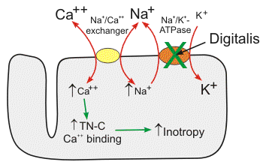
Mechanism of action
Digitalis compounds are potent inhibitors of cellular Na⁺/K⁺-ATPase. This ion transport system moves sodium ions out of the cell and brings potassium ions into the cell. This transport function is necessary for cell survival because sodium diffusion into the cell and potassium diffusion out of the cell down their concentration gradients would reduce their concentration differences (gradients) across the cell membrane over time. Loss of these ion gradients would lead to cellular depolarization and loss of the negative membrane potential that is required for normal cell function. The Na⁺/K⁺-ATPase also plays an active role in membrane potential generation. This pump generates electrogenic hyperpolarizing currents because it transports 3 sodium ions out of the cell for every two potassium ions that enter the cell. This can add several negative millivolts to the membrane potential depending on the activity of the pump.

Slide 168
Cardiac myocytes, as well as many other cells, have a Na⁺-Ca⁺⁺ exchanger (not an active energy-requiring pump) that is essential for maintaining sodium and calcium homeostasis. The exact mechanism by which this exchanger works is unclear. It is known that calcium and sodium can move in either direction across the sarcolemma. Furthermore, three sodium ions are exchanged for each calcium, therefore an electrogenic potential is generated by this exchanger. The direction of movement of these ions (either inward or outward) depends upon the membrane potential and the chemical gradient for the ions. At rest, the exchanger contributes a few millivolts of depolarizing current because 3 Na⁺ ions enter the cell for each Ca⁺⁺ ion that leaves the cell. We also know that an increase in intracellular sodium concentration competes for calcium through this exchange mechanism leading to an increase in intracellular calcium concentration. As intracellular sodium increases, the concentration gradient driving sodium into the cell across the exchanger is reduced, thereby reducing the activity of the exchanger, which decreases the movement of calcium out of the cell. Therefore, mechanisms that lead to an accumulation of intracellular sodium cause a subsequent accumulation of intracellular calcium because of decreased exchange pump activity.

Slide 169
By inhibiting the Na⁺/K⁺- ATPase, cardiac glycosides cause intracellular sodium concentration to increase. This then leads to an accumulation of intracellular calcium via the Na⁺- Ca⁺⁺ exchanger. In the heart, increased intracellular calcium causes more calcium to be taken up and subsequently released by the sarcoplasmic reticulum, thereby making more calcium available to bind to troponin-C, which increases contractility (inotropy). Inhibition of the Na⁺/K⁺- ATPase in vascular smooth muscle causes depolarization, which causes smooth muscle contraction and vasoconstriction.
By mechanisms that are not fully understood, digitalis compounds also increase vagal efferent activity to the heart. This parasympathomimetic action of digitalis reduces sinoatrial firing rate (decreases heart rate; negative chronotropy) and reduces conduction velocity of electrical impulses through the atrioventricular node (negative dromotropy).

Slide 170
Pharmacokinetics and toxicity
The long half-life of digoxin distinguishes this drug from most other cardiovascular acting drugs. With a half-life of 40 hours, digoxin requires several days of constant dosing to reach steady-state plasma level. Therefore, when initiating treatment, a special dosing regimen involving either oral or intravenous "loading doses" is used to rapidly increase digoxin plasma levels. This process is termed "digitalization." Digoxin is eliminated by the kidneys.
The therapeutic plasma concentration range for digoxin is 0.5 - 1.5 ng/ml. It is important that therapeutic plasma levels are not exceeded because digitalis compounds have a narrow therapeutic safety window, meaning that small increases in plasma concentration within the upper therapeutic range and above can have significant adverse side effects. Plasma concentrations above 2.0 ng/ml can lead to digitalis toxicity, which is frequently manifested as arrhythmias, some of which may be life-threatening. If toxicity occurs with digoxin, it may take several days for the plasma concentrations to fall to safe levels because of the long half-life. There is available for digoxin toxicity an immune Fab (Digibind) that can be used to rapidly reduce plasma digoxin levels. Potassium supplementation can also reverse the toxic effects of digoxin if the toxicity is related to hypokalemia

Slide 171
Drug Interactions
Many commonly used drugs interact with digoxin. The Class IA antiarrhythmic, quinidine, competes with digoxin for binding sites and depresses renal clearance of digoxin. These effects increase digoxin levels and can produce toxicity. Similar interactions occur with calcium-channel blockers and nonsteroidal anti-inflammatory drugs. Other drugs that interact with digoxin are amiodarone (Class III antiarrhythmic) and beta-blockers. Diuretics can indirectly interact with digoxin because of their potential for decreasing plasma potassium levels (i.e., producing hypokalemia). Hypokalemia results in increased digoxin binding to the Na⁺/K⁺-ATPase and thereby enhances digoxin's therapeutic and toxic effects. Hypercalcemia enhances digitalis-induced increases in intracellular calcium, which can lead to calcium overload and increased susceptibility to digoxin-induced arrhythmias. Hypomagnesemia also sensitizes the heart to digoxin-induced arrhythmias.

Slide 172
Therapeutic Uses of Digitalis Compounds
Heart Failure
↑ inotropy
↑ ejection fraction
↓ preload
↓ pulmonary congestion/edema
Arrhythmias
↓ AV nodal conduction (parasympathomimetic effect)
↓ ventricular rate in atrial flutter and fibrillation

Slide 173
Heart failure
Digoxin has historically been used in the treatment of chronic heart failure owing to its cardiotonic effect. Although newer and more efficacious treatments for heart failure are available, digoxin is still used. Clinical studies in heart failure patients with reduced ejection fraction (HFrEF) have shown that digoxin, when used in conjunction with diuretics and vasodilators, improves cardiac output and ejection fraction, and reduces filling pressures and pulmonary capillary wedge pressures (this reduces pulmonary congestion and edema), heart rate changes little. These effects are to be expected for a drug that increases inotropy. Although the direct effect of digoxin on blood vessels is vasoconstriction, when given to patients in heart failure, the systemic vascular resistance falls. This may result from the improvement in cardiac output, which leads to withdrawal of compensatory vasoconstrictor mechanisms (e.g., sympathetic adrenergic activity and angiotensin II influences).

Slide 174
Atrial fibrillation and flutter
Atrial fibrillation and flutter lead to a rapid ventricular rate that can impair ventricular filling (due to decreased filling time) and reduce cardiac output. Furthermore, chronic ventricular tachycardia can lead to heart failure. Digoxin, although not a first-line drug for rate control, can be used to reduce ventricular rate when a high atrial rate or atrial fibrillation is driving it. The mechanism of this beneficial effect of digoxin is its ability to activate vagal efferent nerves to the heart (parasympathomimetic effect). Vagal activation can reduce the conduction of electrical impulses within the atrioventricular node to the point where some of the impulses will be blocked. When this occurs, fewer impulses reach the ventricles and ventricular rate falls. Digoxin also increases the effective refractory period within the atrioventricular node.

Slide 175
Side Effects, Contraindications and Warnings
The major side effect of digoxin is cardiac arrhythmia, especially atrial tachycardias and atrioventricular block. Digoxin is contraindicated in patients who are hypokalemic, or who have atrioventricular block or Wolff-Parkinson-White (WPW) syndrome. Impaired renal function leads to enhanced plasma levels of digoxin because digoxin is eliminated by the kidneys. Lean, elderly patients are more susceptible to digoxin toxicity because they often have reduced renal function, and their reduced muscle mass increases plasma digoxin levels at a given dose because muscle Na⁺/K⁺-ATPase acts as a large binding reservoir for digoxin. A 2018 analysis of the AFFIRM trial determined that digoxin significantly increased all-cause mortality in patients with atrial fibrillation. This calls into question the practice of using digoxin for lowering ventricular rate in patients with atrial fibrillation

Slide 176
Sympathomimetics
General Pharmacology
Sympathomimetic drugs mimic the effects of sympathetic activation on the heart and circulation. Like the sympathetic nerves innervating the heart, sympathomimetics stimulate the heart through activation of beta-adrenoceptors, and sympathomimetics cause vascular smooth muscle contraction and vasoconstriction through activation of alpha-adrenoceptors. Included in the list of sympathomimetic drugs are beta-adrenoceptor agonists and alpha-adrenoceptor agonists. Some sympathomimetics stimulate the release of norepinephrine from sympathetic nerves, in addition to their receptor agonist activities.

Slide 177
Therapeutic Use of Sympathomimetic Drugs
Heart failure (acute, decompensated)
Shock - cardiogenic - hypovolemic - septic
Therapeutic Use and Rationale
Sympathomimetics are used in conditions where it is appropriate to raise blood pressure by stimulating the heart and inducing vasoconstriction. Because long-term use of sympathomimetics is deleterious (see Side Effects and Contraindications), they are used for short-term treatment of refractory heart failure, cardiogenic shock, and hypotension caused by hemorrhage or sepsis.

Slide 178
Drug Classes and General Mechanisms of Action
Many sympathomimetics are catecholamines or analogs of catecholamines that can be divided into two mechanistic classes: 1) alpha-adrenoceptor agonists (α-agonists), and 2) beta-adrenoceptor agonists (β-agonists). It is not uncommon because of their catecholamine structure for there to be both α-agonist and β-agonist properties. A third class of sympathomimetics that affects norepinephrine storage, release and uptake by sympathetic nerves is not used in cardiovascular drug therapy; however, they are used as research tools (e.g., tyramine, guanethidine) and are also used illicitly (e.g., amphetamine, methamphetamine, cocaine).
alpha-adrenoceptor agonists
beta-adrenoceptor agonists

Slide 179
Side Effects and Contraindications
Because these drugs mimic sympathetic adrenergic stimulation, they can produce hypertension, excessive cardiac stimulation, and cardiac arrhythmias. For these reasons, most of these drugs are only used for short-term cardiovascular therapy with clinical supervision and monitoring. Long-term use increases mortality in heart failure patients. These drugs are contraindicated in patients with coronary artery disease because of the risk of precipitating myocardial ischemia and angina due to decreased myocardial oxygen supply/demand ratio. These drugs can also precipitate myocardial infarction and cerebrovascular stroke

