Slide 1
الادوية الخافضة للشحوم
Antihyperlipidemic Agent
يعتبر نمط الحياة الصحي أول خط دفاع ضد ارتفاع الكوليسترول في الدم . غير أنه أحياناً لا يكفي النظام الغذائي والتمارين الرياضية. وقد تحتاج كذلك إلى تناول أدوية للكوليسترول للمساعدة على ما يلي :
الحد من نسبة كوليسترول البروتين الدهني منخفض الكثافة LDL، وهو الكوليسترول
"الضار" الذي يزيد من خطر الإصابة بأمراض القلب
الحد من الدهون الثلاثية، وهو نوع من الدهون في الدم يزيد أيضًا من خطر الإصابة
بأمراض القلب
زيادة نسبة كوليسترول البروتين الدهني مرتفع الكثافة HDL، وهو الكوليسترول
"النافع" الذي يقي من أمراض القلب

Slide 2
Lipoprotein levels
The optimal level for LDL cholesterol is < 100 mg/dL.
It is considered high when it is ≥ 160 mg/dL.
HDL cholesterol should ideally be < 40 mg/dL.
It is considered high if it is > 60 mg/dL.
Total cholesterol should be < 200 mg/dL.
It is considered high if it is > 240 mg/dL.

Slide 4
Dyslipidemia and Related Diseases
Dyslipidemia is a general term used to describe high levels of LDL cholesterol (LDL-C) or triglycerides, or low levels of HDL cholesterol (HDL-C).
Dyslipidemias are major contributors to atherosclerosis and atherosclerosis-related conditions, such as coronary heart disease (CHD), ischemic cerebrovascular disease, and peripheral vascular disease.
Genetic disorders and life-style may contribute to the dyslipidemias.
Therapy for dyslipidemias is based on the blood levels of LDL-C, HDL-C, and triglycerides (found mainly in VLDL cholesterol)

Slide 5
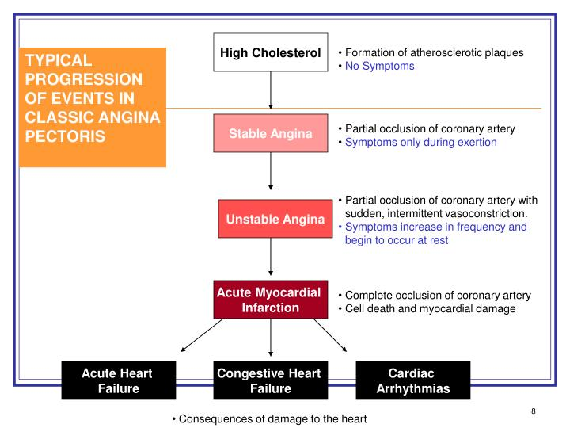

Slide 7
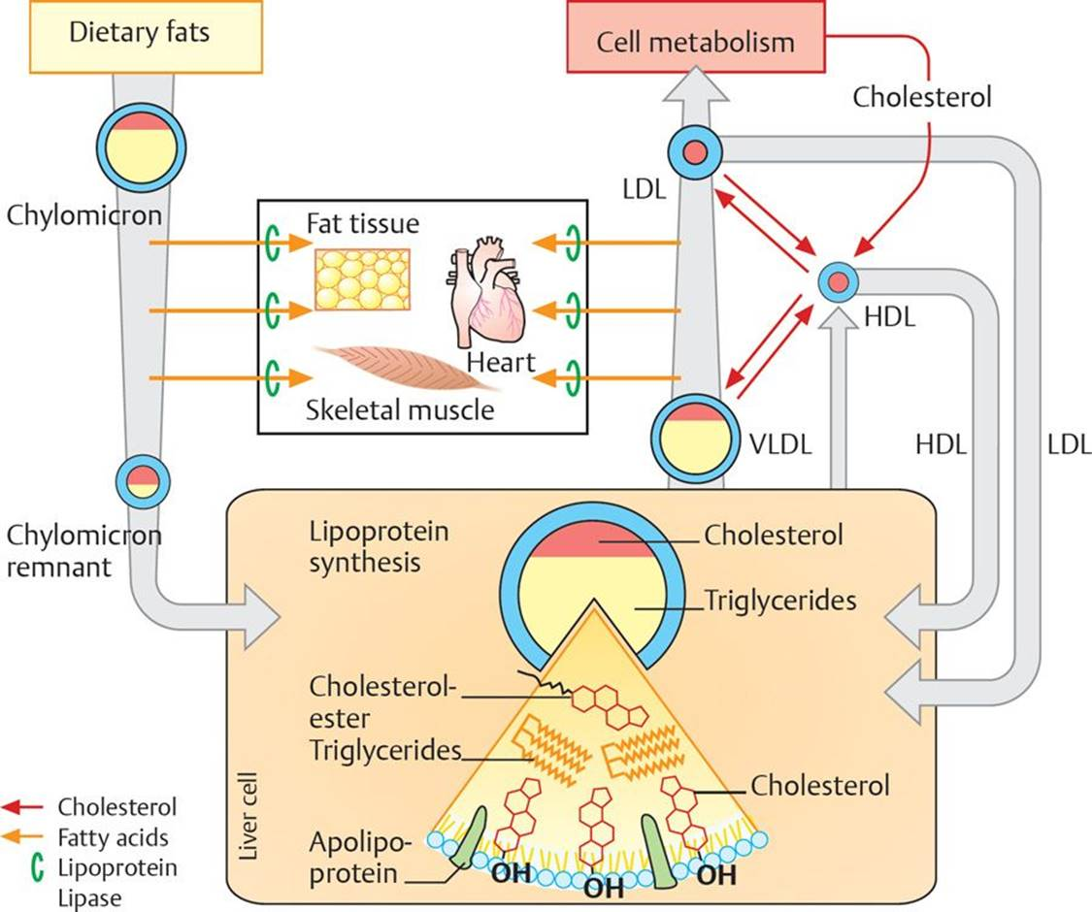
Lipoprotein metabolism.
Enterocytes release absorbed lipids in the form of triglyceride-rich chylomicrons. These are acted upon by lipoprotein lipases in endothelial cells, producing fatty acids, which are stored in tissues. The remnants of chylomicrons are transported to liver cells, where they are a source of dietary cholesterol. The liver uses this and hepatically produced cholesterol to synthesize very-low-density lipoproteins (VLDLs) and bile acids. VLDLs are released into the blood and supply tissues with fatty acids. The low-density lipoprotein (LDL) remnants either return to the liver or supply cells with cholesterol. (HDL, high-density lipoprotein.)

Slide 8
Antihyperlipidemic Therapy
Initial therapy is to institute lifestyle changes,
including reduction of dietary intake of cholesterol and saturated fats
increased intake of soluble fiber and plant sterols.
In addition, weight management and increased physical activity should be initiated.
If these are insufficient to lower LDL-C to the desired level, drug therapy is indicated.
The National Cholesterol Education Program has established guidelines for initiation of drug therapy in dyslipidemias based on the blood levels of the lipoproteins after an overnight fast. The presence of other major risk factors, such as cigarette smoking, hypertension, low HDL-C (< 40 mg/dL), family history of premature CHD, and age, determine the level to which cholesterol should be lowered

Slide 9
Antihyperlipidemic Drugs
Antihyperlipidemic drugs are used to hyperlipidemias or hyperlipoproteinemias and conditions characterized by elevated plasma levels of cholesterol or triglycerides, for example, type 2 diabetes, metabolic syndrome, and hypertriglyceridemia. Diabetics usually have high
triglycerides, moderate elevations of total cholesterol and LDL-C, and low HDL-C.

Slide 10
Metabolic syndrome
Metabolic syndrome is a combination of medical disorders that increases the risk of developing atherosclerotic disease, for example, coronary heart disease, peripheral vascular disease, and stroke. It also increases the risk of developing type 2 diabetes. Its etiology is unknown, but weight, advancing age, lifestyle factors, and genetics are all known to be involved. Signs of metabolic syndrome include fasting hyperglycemia, hypertension, abdominal obesity, high levels of triglycerides, and low levels of HDL-C. Treatment primarily involves weight management and increasing exercise, then drug management for hypertension, diabetes, and to correct lipid levels as appropriate.

Slide 11
تصنيف خافضات الشحوم :
تصنف حسب آلية التاثير الى عدة مجموعات :
1 – مجموعة الفيبرات : تزيد من تحطم الليبوبروتين
2 – مجموعة الستاتينات : تمنع الاصطناع الحيوي للكولسترول في الكبد
3 – الراتنجيات الرابطة للحموض الصفراوية : تمنع اعادة امتصاص
الحموض الصفراوية
4 – ايزيتيميب : يمنع امتصاص الكولسترول من الغذاء
5 – متفرقات

Slide 12
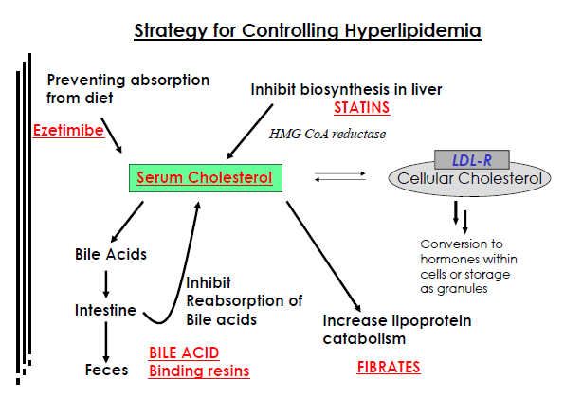

Slide 13
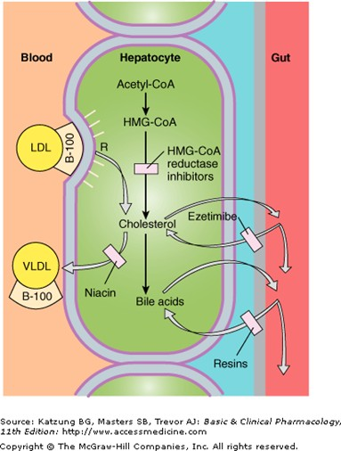

Slide 15
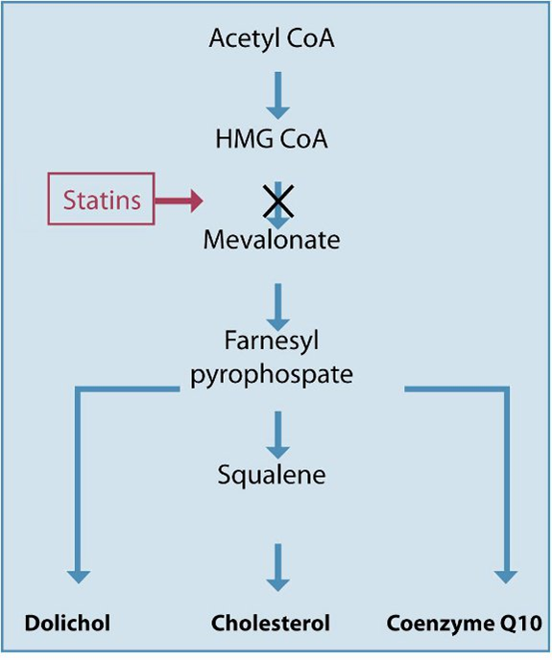
الستاتينات STATINS
( HMG-COA Reductase Inhibitors )
ادوية هذه المجموعة تثبط انزيم HMG-COA Reductase المسؤول عن تحويل HMG-COA الى الميفالونات في طريق التصنيع الحيوي للكولسترول و بذلك تخفض تركيز الكولسترول .
Statins
The statins (3-hydroxy-3-methylglutaryl [HMG]−coenzyme A [CoA] inhibitors) have become the most widely prescribed drugs for lowering plasma cholesterol levels.

Slide 16
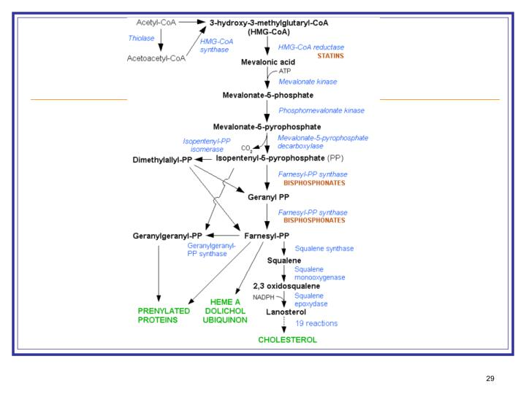

Slide 17
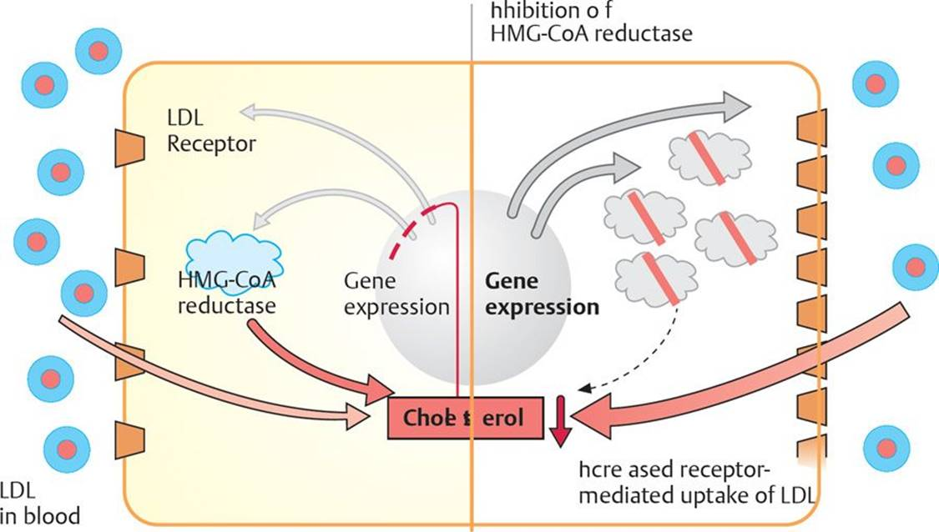
Mechanism of action.
The major mechanism of these agents is to competitively inhibit HMG-CoA reductase, the rate-limiting enzyme in cholesterol synthesis This causes significant reductions in LDL-C by causing an increased expression of LDL receptors on hepatocytes and increased removal of LDL from the blood Statins also reduce blood triglyceride levels.
In the presence of HMG-CoA reductase inhibitors, hepatocytes increase the production of LDL-receptor proteins. This allows LDL uptake from the blood to increase to provide the liver with its only source of cholesterol

Slide 19
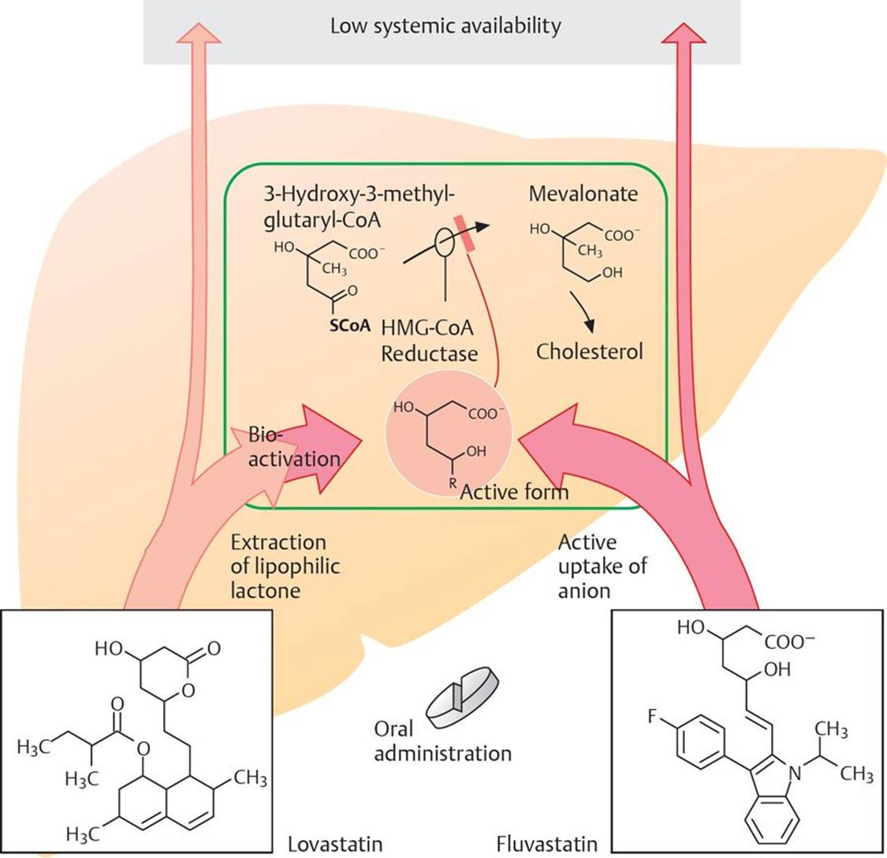

Slide 20
Effects
– Lowers LDL and triglyceride levels
– Increases HDL levels
Uses
– First-line treatment for hypercholesterolemia
– Used prophylactically to prevent adverse vascular events in patients with diabetes mellitus or cardiovascular disease

Slide 21
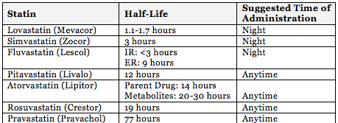

Slide 22
فئة الدواء | الفوائد | الآثار الجانبية المحتملة
أتورفاستاتين فلوفاستاتين لوفاستاتين بيتافاستاتين برافاستاتين روزوفاستاتين سيمفاستاتين | تقليل كوليسترول البروتين الدهني منخفض الكثافة والدهون الثلاثية، مع زيادة كوليسترول البروتين الدهني مرتفع الكثافة قليلاً | ألم العضلات، وزيادة مستويات السكر في الدم، والإمساك، والغثيان، والإسهال، وألم المعدة، والتقلصات، وارتفاع إنزيمات الكبد

Slide 24
Side effects
These include gastrointestinal (GI) upset in < 10% of patients, muscle weakness in combination with fibrates, and altered liver enzymes.
Contraindications
– Liver disease
Drug Interactions
The HMG-CoA reductase inhibitors increase warfarin levels so prothrombin times (expressed as International Normalized Ratio should be monitored.

Slide 25
Accumulation and effect of HMG-CoA reductase inhibitors in the liver.
The HMG-CoA reductase inhibitors mimic the normal enzyme substrate, which renders it unavailable for cholesterol synthesis in the liver. These drugs accumulate in the liver, as they have a high rate of presystemic elimination. This accumulation is advantageous because it concentrates the actions of these drugs where they are needed. The liver maintains its requirement for cholesterol by the uptake of LDL from the blood, thus lowering plasma cholesterol levels.

Slide 26
Rhabdomyolysis
Rhabdomyolysis is the rapid breakdown of skeletal muscle due to injury to muscle tissue. The muscle breakdown product, myoglobin, is harmful to the kidney and can precipitate acute kidney failure. Signs and symptoms include
pain, tenderness, and swelling of the affected muscle, as well as nausea, vomiting, confusion, arrhythmias, coma, anuria, and later disseminated intravascular coagulation (DIC). This is a rare complication of treatment with statins and fibrates.

Slide 27
Bile Acid Sequestrants
Cholestyramine and Colestipol
Mechanism of action
These agents are insoluble resins that are not absorbed by the body, but that bind bile acids in the gut, thus preventing bile acids from being absorbed. This necessitates an increase in the hepatic conversion of cholesterol to bile acids, thereby reducing the cholesterol available through the enterohepatic circulation for production of plasma lipids. They also lower LDL and plasma cholesterol. illustrates the effect of cholesterol-lowering drugs like cholestyramine on cholesterol metabolism in the liver.
الراتنجيات الرابطة للحموض الصفراوية
راتنج الكوليستيرامين Cholestyramine Resin
بعد تناول هذا المركب عن طريق الفم فان الراتنج يبقى في السبيل الهضمي ثم يحدث تبادل بين شوارد الكلورايد من جهة و الحموض الصفراوية في المعي الدقيق و هذا يؤدي الى الاقلال من اعادة امتصاص الحموض الصفراوية مما يؤدي الى استقلاب الكولسترول في الكبد الى حموض صفراوية .
هذا الراتنج لا يرتبط مع الادوية المعتدلة او الاملاح الامينية و لكن الادوية الحمضية بشكلها المتشرد يمكن ان ترتبط .
كوليستيرامين هو الاختيار في ارتفاع شحوم الدم من النمط Type IIa و ذلك مع الحمية الغذائية

Slide 28
الكولسترامين كوليسفيلام كوليستيبول | تقليل كوليسترول البروتين الدهني منخفض الكثافة، مع احتمال زيادة كوليسترول البروتين الدهني مرتفع الكثافة قليلاً | الإمساك، والانتفاخ، والغثيان، والغازات، وحرقة المعدة

Slide 30
Pharmacokinetics
Given orally, these drugs bind with bile acids in the intestine and produce an insoluble complex that is excreted in the feces
Effects
– Decreases LDL levels
– May increase triglycerides, or they may remain unchanged
– Increases HDL levels
Uses
These agents are used alone for the treatment of hypercholesterolemia in patients 11 to 20 years of age. However, they are most often used as secondary agents if statin therapy does not reach its desired goal.
Side effects
– Nausea, constipation, steatorrhea (the presence of excess fat in feces), and deficiency of fat-soluble vitamins (A, D, E, K)
Note: Compliance may be a problem due to the unpleasant taste of the drug.

Slide 31
Drug interactions
These agents may interfere with the absorption of other drugs given concurrently (e.g., warfarin); therefore, drugs should be taken ~1 to 2 hours before or several hours after taking bile acid sequestrants.

Slide 32
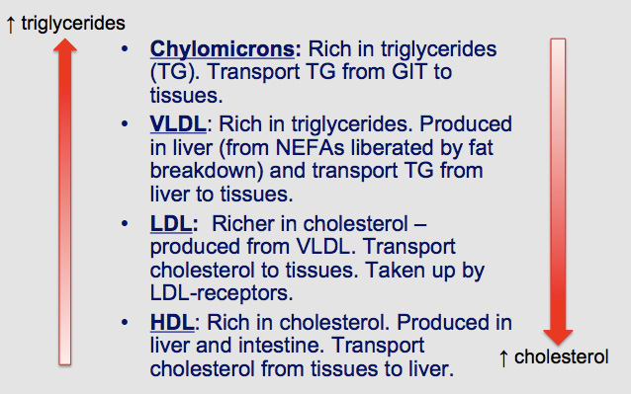

Slide 33
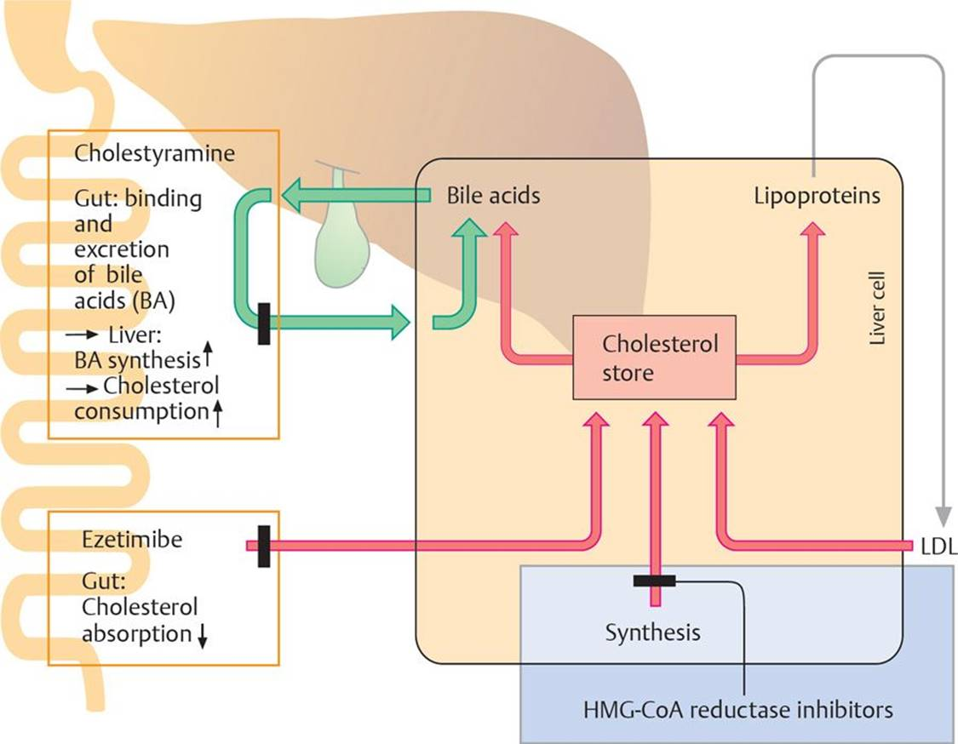
Cholesterol metabolism in liver cell and cholesterol-lowering drugs
Cholesterol-lowering drugs may act in the gut to reduce the absorption of dietary cholesterol, they may inhibit cholesterol synthesis in the liver, or they may act to increase the consumption of cholesterol.

Slide 34
Ezetimibe
Mechanism of action
Ezetimibe inhibits cholesterol absorption in the small intestine.
مثبط امتصاص الكوليسترول إزيتمايب | تقليل كوليسترول البروتين الدهني منخفض الكثافة؛ تقليل الدهون الثلاثية قليلاً، مع زيادة كوليسترول البروتين الدهني مرتفع الكثافة قليلاً | ألم المعدة، والإسهال، والإرهاق، وتقرح العضلات؛ يجب تجنبه أثناء فترة الحمل والرضاعة
Effects
– Lowers LDL-C levels by ~18%
Uses
It is used primarily as adjunctive therapy with statins.
Side effects
– May increase the hepatotoxicity and myopathy of statins

Slide 35
المزج بين أدوية تثبيط امتصاص الكوليسترول والأدوية الخافِضة للكوليسترول إزيتمايب- سيمفاستاتين | تقليل كوليسترول البروتين الدهني منخفض الكثافة والدهون الثلاثية، وزيادة كوليسترول البروتين الدهني مرتفع الكثافة | ألم المعدة، والإرهاق، والغازات، والإمساك، وألم البطن، والتقلصات، وتقرح العضلات، والألم، والضعف

Slide 36
Nicotinic Acid (Niacin)
Mechanisms of action
– Inhibition of hepatocyte diacylglycerol acyltransferase-2, a key enzyme for triacylglycerol synthesis, decreasing secretion of VLDL and LDL-C
– Decreased hepatic catabolism of apolipoprotein A-I increases the half-life and concentrations of HDL-C.
– Niacin also reduces vascular inflammatory genes involved in atherosclerosis.
Effects
– Decreases levels of LDL and triglycerides
– Increases HDL levels
Uses
Niacin is used to treat hypertriglyceridemias and hypercholesterolemia. It is especially useful in patients with both hypertriglyceridemia and low HDL-C levels.

Slide 37
Note: Nicotinamide is not effective in lowering lipids, although it acts interchangeably with nicotinic acid as a vitamin
Side effects
– Cutaneous flushing, burning, and itching are common, as is GI irritation, nausea, and vomiting. The niacin flush results from the stimulation of prostaglandins D₂ and E₂ from subcutaneous Langerhans cells by a G protein–coupled niacin receptor.
– Activation of peptic ulcers, abnormal elevation of liver enzyme levels, hyperglycemia, and hyperuricemia occur infrequently.
Contraindications
– Chronic liver disease
– Gout
– May be inappropriate for use in peptic ulcer disease, hyperuricemia, and diabetes

Slide 38
النياسين | تقليل كوليسترول البروتين الدهني منخفض الكثافة والدهون الثلاثية، وزيادة كوليسترول البروتين الدهني مرتفع الكثافة | هبات ساخنة بالوجه والعنق، والحكة، واضطراب المعدة، وزيادة السكر في الدم

Slide 40
مجموعة الفيبرات : Fibrate
كيميائيا هي مشتقات Fibric acid
هذه الادوية تنشط اكسدة الحموض الدسمة β-oxidation في الميتاكوندريا
لذلك تستعمل في خفض مستويات الحموض الدسمة و الشحوم الثلاثية في البلاسما
هي عوامل خافضة للشحوم تستعمل بشكل واسع في معالجة الاشكال المختلفة من
ارتفاع الشحوم و الكولسترول
تمتص بسرعة مع الوجبات
ترتبط مع البروتين بنسبة 99%
عمر النصف يتراوح من 1 ساعة ( جيمفيبروزيل ) الى 20 ساعة ( فينوفيبرات )
تتوزع بشكل واسع
تطرح عن طريق البول 90% بشكل مقترنات غلوكورونية

Slide 42
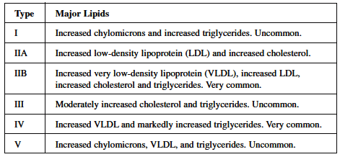
الجيل الأول :
كلوفيبرات Clofibrate
الكلوفيبرات هو الدواء المفضل في علاج النوع الثالث من ارتفاع الليبوبروتين typ III hyperlipoproteinemia و يمكن ان يكون مفيد في typ IIb و typ IV و لكنه غير فعال في typ I و typ IIa
الكلوفيبرات يمكن ان يخفض التراكيز الدموية للشحوم الثلاثية و الكولسترول و لكن تاثيره اكبر على الشحوم الثلاثية
كما انه يخفض مستويات الحموض الدسمة الحرة و الشحوم الفوسفورية .

Slide 43
الجيل الثاني :
فينوفيبرات Fenofibrate
يخفض الشحوم الثلاثية و الكولسترول
جيمفيبروزيل Gemfibrozil
يخفض تركيز VLDL و ينشط اطراحها من البلاسما له تاثير ضعيف على الكولسترول
و لكنه يسبب ارتفاع مستوى HDL
فينوفايبرات جمفبروزيل | تقليل الدهون الثلاثية؛ تقليل كوليسترول البروتين الدهني منخفض الكثافة إلى حد ما، وزيادة كوليسترول البروتين الدهني مرتفع الكثافة | الغثيان، وألم المعدة، والم العضلات

Slide 44
Fibrates
Gemfibrozil and Clofibrate
Mechanism of action
These drugs lower VLDLs and plasma triglycerides by stimulating lipoprotein lipase. They also lower cholesterol by inhibiting its synthesis and enhancing excretion in the bile.
Effects
– Decreases LDL and triglyceride levels
– Increases HDL levels
Uses
– Hypertriglyceridemia and hypercholesterolemia
Side effects
Side effects include GI disturbances (nausea, diarrhea, and cramps), muscle weakness, and rash. Long-term use may increase the incidence of thromboembolism, angina, arrhythmias, or gallstones
Contraindications
– Pregnancy
– Impaired renal or hepatic function
Drug interactions
These agents displace acidic drugs (e.g., warfarin and phenytoin) from plasma proteins; thus a reduced dose of anticoagulant (or other drug) is required.

Slide 45
عوامل اخرى خافضة للشحوم :
LDL Oxidation Inhibitor ( بروبوكول Probucol )
عند الانسان يسبب انخفاض مستويات الكولسترول في الكبد و البلاسما عن طريق زيادة تقويض LDL و يمكن ان يمنع اصطناع الكولسترول و لكنه لا يؤثر على الشحوم الثلاثية في البلاسما
ينقص LDL و بشكل اقل HDL ( الآلية غير معروفة تماما و لكن انخفاض HDL يمكن ان تعزى الى قدرة البروبوكول في منع اصطناع Apoprotein AI البروتين الرئيسي في HDL )

Slide 46
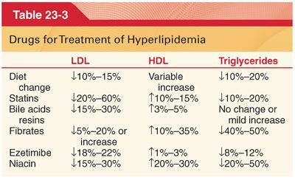

Slide 50
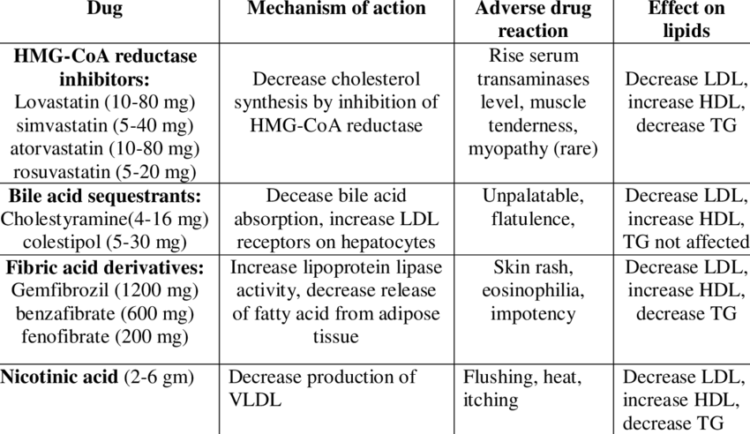

Slide 51
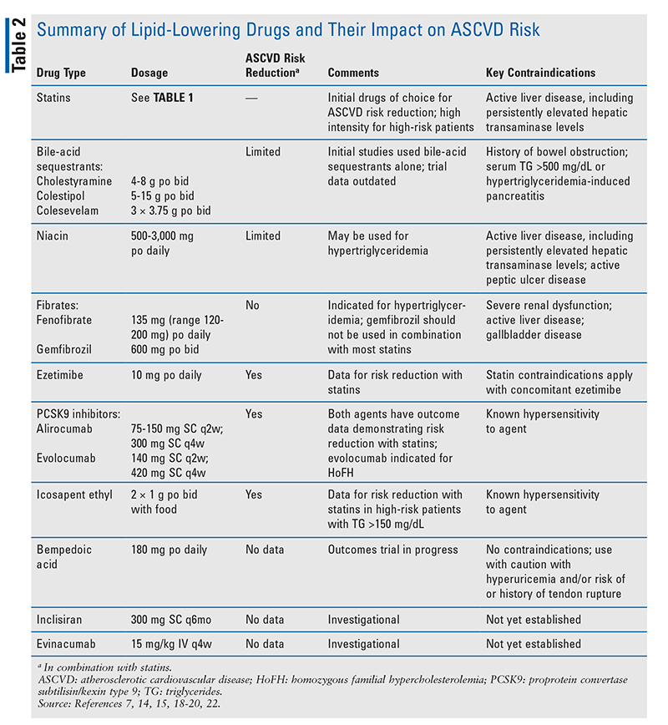

Slide 52
PCSK9 Inhibitors
Proprotein convertase subtilisin/kexin type 9 (PCSK9) is an enzyme responsible for degradation of LDL-C receptors in hepatocytes. LDL receptors are responsible for removing LDL-C from the blood. Greater PCSK9 activity leads to fewer LDL receptors and higher plasma LDL-C levels. The first drugs to target PCSK9 were the monoclonal antibodies (Mabs) alirocumab and evolocumab, which bind to and inhibit PCSK9 (PCSK9 inhibitors). These drugs have similar therapeutic profiles, producing a 45% to 60% reduction in LDL-C when used alone or in combination with statins. Both drugs are given SC at 2- or 4-week intervals. The most common adverse effect of these drugs is injection-site reactions. Since both alirocumab and evolocumab are fully human Mabs, immunologic responses, including allergic reactions and the development of antidrug neutralizing antibodies, are rare

Slide 53
Both PCSK9 inhibitors have been evaluated in combination with statin therapy in morbidity and mortality studies. Evolocumab was studied in 27,564 patients with established CVD and a baseline LDL-C of 70 mg/dL or greater on maximally tolerated statin. Evolocumab produced a significant relative RR of 15% for CVEs. This occurred primarily because of reductions in myocardial infarction (MI), stroke, and coronary revascularization; there was not a decrease in CV death. Alirocumab was studied in 18,924 patients with a recent hospital admission for ACS who had a baseline LDL-C of 70 mg/dL or greater on maximally tolerated statin. Similar to evolocumab, alirocumab produced a significant relative RR of 15% for CVEs.

Slide 54
The benefit of alirocumab was due to a decrease in MI and stroke, but not CV death. The results of these trials support the addition of PCSK9 inhibitors to statins in patients not achieving LDL-C levels below 70 mg/dL, but data in patients not taking a statin are lacking. Cost-effectiveness concerns continue to limit PCSK9 inhibitor therapy. Although manufacturers recently reduced the cost of these drugs by 60% to approximately $5,800 per year, insurance barriers remain, including unaffordable copayments for some patients

Slide 55
Icosapent Ethyl
Prescription omega-3 fatty acids (eicosapentaenoic acid [EPA] and/or docosahexaenoic acid [DHA]) are indicated to treat severe hypertriglyceridemia (TG levels of 500 mg/dL or higher). A number of trials investigating various formulations of omega-3 fatty acids demonstrated inconsistent effects on ASCVD risk. These results were most likely related to the use of low doses of omega-3 fatty acids, differences in baseline ASCVD risk in study subjects, and possibly the use of products containing both EPA and DHA. However, a prescription EPA-only omega-3 fatty acid (icosapent ethyl) has been found to significantly reduce ASCVD risk in patients with established CVD or DM who had at least one other CV risk factor, elevated TG (>135 mg/dL-499 mg/dL), and an LDL-C level between 41 g/dL and 100 mg/dL on statin therapy.

Slide 56
The Reduction of Cardiovascular Events with Icosapent Ethyl-Intervention Trial (REDUCE-IT), which enrolled more than 8,000 subjects and lasted nearly 5 years, demonstrated that patients receiving icosapent ethyl (2 g bid with food) were 25% less likely than placebo patients (P <.001) to experience CV death, nonfatal MI, stroke, coronary revascularization, or unstable angina. Safety issues with icosapent ethyl included increased risk of atrial fibrillation (AF; 5.3% vs. 3.9%; P = .003), greater risk of hospitalization for AF (3.1% vs. 2.1%; P = .004), and higher—though nonsignificant—risk of serious bleeding events (2.6% vs. 2.1%; P = .06). Icosapent ethyl’s benefit in reducing ASCVD risk was unexpected given the previously inconsistent effect of these drugs and the premature discontinuation of a similar mortality study using a high-dose combination (EPA and DHA) prescription omega-3 fatty acid.

Slide 57
The specific mechanism of icosapent ethyl in CV risk reduction is unknown but most likely results from the use of an EPA-only omega-3 fatty acid. Based on the findings from REDUCE-IT, the FDA recently approved icosapent ethyl for use in patients taking maximally tolerated statin therapy with baseline TG of 150 mg/dL or higher who have established CVD or DM and two or more additional ASCVD risk factors

Slide 58
Bempedoic Acid
This oral nonstatin agent reduces LDL-C by inhibiting ATP-citrate lyase, an enzyme in the cholesterol biosynthesis pathway, upstream from the site where statins reduce cholesterol synthesis. Bempedoic acid, a prodrug, requires coenzyme A activation by very-long-chain acyl-CoA synthetase-1. This activity occurs solely in the liver and not in the muscle, potentially limiting musculoskeletal complaints. Bempedoic acid does not have substantial effects on lipid fractions other than LDL-C. This agent was approved in early 2020 as an adjunct to diet and maximally tolerated statin therapy in the treatment of adults with heterozygous familial hypercholesterolemia (HeFH) or established ASCVD who require additional LDL-C–lowering
Bempedoic acid is available as a single dosage of 180 mg daily and as a fixed-dose combination with ezetimibe 10 mg daily

Slide 59
It is metabolized primarily in the liver via glucuronidation. Although less than 5% of the drug is cleared unchanged, few data exist on patients with severe renal disease (creatinine clearance <30 mL/minute), and there are no data on patients with end-stage renal disease or on hemodialysis. Bempedoic acid is a weak inhibitor of the organic anion transport-2 membrane transporter, which is the most likely mechanism for the increases in serum creatinine and uric acid that can occur during therapy. The drug should be used cautiously in patients with gout. Rare instances of tendon rupture have been reported, but the mechanism and risk factors are unknown

Slide 60
Owing to its metabolism by uridine glucuronosyltransferase, bempedoic acid is associated with an approximately twofold increase in blood levels of simvastatin and pravastatin. Maximal dosages of simvastatin and pravastatin with bempedoic acid are 20 mg daily and 40 mg daily, respectively.
Bempedoic acid has been found to decrease LDL-C by approximately 18% in patients with ASCVD or HeFH who are on maximally tolerated statin therapy.¹⁹ In patients with statin intolerance, bempedoic acid was found to decrease LDL-C by 21% (17%-25%) when used alone and by 28% (22%-34%) when used in combination with ezetimibe

Slide 61
Currently, no outcomes data are available for bempedoic acid, but an outcomes trial is in progress in patients with statin intolerance (only low-intensity statin therapy allowed) who are at very high risk for or have established ASCVD.

Slide 62
Inclisiran
Inclisiran is a small interfering RNA (siRNA) agent that inhibits production of the PCSK9 protein in hepatocytes. Inclisiran was previously known as ALN-PCS, an siRNA conjugated with triantennary N-acetylgalactosamine (GalNAc) carbohydrates. This compound was relatively unstable and had to be given IV. The addition of another GalNAc carbohydrate to ALN-PCS improved its stability, allowing the compound (ALN-PCSsc) to be administered by SC injection. The addition of the GalNAc carbohydrate was also clinically important, as it has specific affinity for binding to asialoglycoprotein receptors in the liver. This leads to specific uptake and binding of inclisiran in the liver, with no activity in peripheral tissues.

Slide 63
Inclisiran is a double-stranded RNA molecule that, after uptake in the hepatocyte, binds to a multiprotein complex known as RNA-induced silencing complex (RISC). This RISC combines with messenger RNA (mRNA) specific to PCSK9, which induces activation of an enzyme that promotes degradation of the mRNA-RISC complex. The mRNA is degraded, but the active siRNA within the RISC remains active, producing a long-lasting silencing of mRNA targeting PCSK9. Because of its unique mechanism of action, inclisiran reduces intracellular PCSK9 synthesis and has a prolonged duration of action

Slide 64
ANGPTL3 Inhibitor
Angiopoietin-like protein 3 (ANGPTL3) is a hepatically secreted protein that inhibits lipoprotein and endothelial lipase, resulting in decreased levels of TG-rich lipoprotein and HDL-C. Inhibition of ANGPTL3 reduces LDL-C levels through an unknown mechanism. Evinacumab, an Mab that inhibits ANGPTL3, was studied in 65 patients with homozygous familial hypercholesterolemia (HoFH). Patients had to have genetic mutations in LDL receptors, PCSK9, or apoB with a baseline untreated TC greater than 500 mg/dL and a TG level less than 300 mg/dL.

Slide 65
In addition, patients had to be older than age 12 years with an LDL-C greater than 70 mg/dL on maximally tolerated lipid-lowering therapy. Patients were randomized 2:1 to evinacumab 15 mg/kg IV or placebo every 4 weeks for 24 weeks. Evinacumab decreased LDL-C by 49% ± 8% at 24 weeks. LDL-C was decreased by 50% or greater in 56% of evinacumab patients compared with 4.5% of placebo patients. Genetic mutations in the LDL receptor did not appear to affect response to evinacumab. The overall rate of adverse reactions was less with evinacumab than with placebo, but more serious adverse reactions occurred with evinacumab (4.5%) than with placebo (0%). Evinacumab’s unique mechanism of action appears to be independent of LDL-receptor function, which may be particularly valuable in patients with HoFH

Slide 66
Conclusion
Statins remain the agents of choice for the treatment of dyslipidemia in patients who have or are at substantial risk for established coronary heart disease.
Despite statin use, the risk of adverse CVEs persists. The use of other types of lipid-lowering drugs (e.g., ezetimibe, PCSK9 inhibitors, icosapent ethyl) in combination with statins has been shown to further reduce CV risk.
Lipid-lowering drugs with novel mechanisms of action are being evaluated for their ability to further reduce CV risk.

