Slide 2
Drug Mechanism Classes
There are different ways to group or classify drugs.
One way is by grouping drugs based on their therapeutic use or class, such as antiarrhythmic or diuretic drugs.
A second way to group drugs is by their dominant mechanism of action. Because many drugs have multiple mechanisms of action, it is sometimes difficult to agree on how to classify a particular drug.
The following list attempts to classify drugs based on their dominant mechanism of action, or by the mechanism that is the most therapeutically relevant for cardiovascular disease. Clicking on the drug class will open a new window providing detailed information on that class and links to specific drugs.

Slide 3
Adenosine receptor agonists
Aldosterone-receptor antagonists (mineralocorticoid receptor antagonists)
Alpha-adrenoceptor agonists (alpha-agonists)
Alpha-adrenoceptor blockers (alpha-blockers)
Angiotensin-converting enzyme (ACE) inhibitors
Angiotensin receptor blockers (ARBs)
Beta-adrenoceptor agonists (beta-agonists)
Beta-adrenoceptor blockers (beta-blockers)
Calcium-channel blockers (CCBs)
Centrally-acting sympatholytics
Direct-acting vasodilators
Diuretics (loop, thiazide, potassium-sparing)
Endothelin receptor antagonists
Fibrinolytic (thrombolytic)
Funny current blockers

Slide 4
Ganglionic blockers
Mineralocorticoid receptor antagonists
Muscarinic receptor antagonists
Na⁺-K⁺- ATPase pump inhibitors (cardiac glycosides)
Neprilysin inhibitors
Nitrodilators
Phosphodiesterase inhibitors
Potassium-channel blockers
Potassium-channel openers
Renin inhibitors
Sodium-channel blockers
Sodium-channel blocker (late sodium currents)
Sodium-glucose cotransporter 2 inhibitors
Sympathomimetics
Thrombolytic (fibrinolytic)
Vasopressin analogs

Slide 5
Cardiovascular Diseases
Angina
Arrhythmias
Edema
Heart Failure
Systemic Hypertension
Pulmonary Hypertension
Hypotension
Myocardial Infarction
Therapeutic Classes:
Antianginal
Antiarrhythmic
Antihypertensive
Cardioinhibitory
Cardiostimulatory
Diuretic
Pressor
Thrombolytic
Vasoconstrictor
Vasodilator

Slide 6
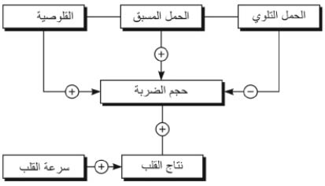
يعتمد النتاج القلبي CO (Cardiac output) على سرعة قلوصية القلب وسرعة القلب وحجم الدم المقذوف مع كل ضربة، ويُعبَّر عن حجم الضربة SV (Stroke Volume) بالعلاقة :
النتاج القلبي = حجم الضربة × سرعة القلب.
العوامل الثلاثة المنظمة لحجم الضربة هي : الحمل المسبّق والحمل التلوي (البَعدي) والقلوصية.

Slide 7
١- الحمل المسبق (القبلي) Preload:
هو الحمل على القلب الناجم عن حجم الدم الذي يُستقبَل في البطين الأيسر من الأذين الأيسر (في نهاية انبساط البطين الأيسر) وهو ما يجب أن يُقذَف مع كل انقباض. أي إنه توتر جدار البطين في نهاية الانبساط، من الناحية السريرية هو مقدار تمدد ألياف البطين قبل الانقباض، وغالباً ما يُقدَّر من خلال حجم نهاية الانبساط أو ضغط نهاية الانبساط.
وعندما يزداد الحمل المسبّق فإن درجة تمدد ألياف عضلة القلب وطولها تزداد كذلك؛ وبالتالي فإن الحمل المسبّق هو الحمل الحجمي، والذي يمكن أن يكون مفرطاً على سبيل المثال، كما في القصور الصمامي.
٢- الحمل التلوي (البَعْدي) Afterload:
يشير الحمل التلوي إلى الحمل على البطين المنقبض الناجم عن مقاومة الدم المقذوف من البطين في الجهاز الشرياني، مثلاً المقاومة المحيطية الإجمالية.
أي إنه توتر جدار البطين في أثناء الانقباض؛ أي القوة التي يجب على البطين التغلب عليها لإخراج محتواه. وغالباً ما يُقدَّر بضغط البطين الانقباضي.
إذاً الحمل التلوي هو الحمل الضغطي، وقد يزداد كما في فرط الضغط الشرياني.
٣- القلوصية Contractility:
تشير القلوصية إلى قدرة عضلة القلب على توليد القوة اللازمة للاستجابة للحمل المسبّق، والتغلب على الحمل التلوي. وهي خاصية في عضلة القلب تفسر التغيرات في قوة الانقباض بغض النظر عن الحمل المسبّق والتلوي، وتنعكس التأثيرات الكيميائية والهرمونية على قوة التقلص

Slide 8
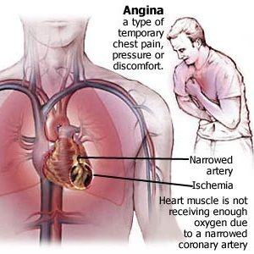
الذبحة الصدرية Angina Pectoris
الذبحة الصدرية او الذبحة (Angina) هي نوع من الأوجاع في الصدر، أو من الشعور بعدم الراحة، الناجم عن انخفاض في تدفق الدم إلى عضلة القلب. والذبحة هي عَرَض لمرض في الشريان التاجيّ (Coronary artery) فعندما لا تحصل عضلة القلب (Myocardium) على كمية كافية من الدم الغني بالاكسيجين من الممكن حدوث الم في الصدر و الشعور بالم عاصر و ضغط وثقل في الصدر و شعور بخنقة و غثيان و تعرق و يمكن ان ينتقل الالم الى الكتف و العضد الايسر .
السبب هو تضيق الاوعية الدموية الاكليلية ( تصبح شرايين القلب التاجية اكثر ضيقا نتيجة لتراكم الشحوم بشكل صفيحات Plaque و تسمى هذه الحالة التصلب العصيدي Atherosclerosis ) مما يؤدي الى اقفار او نقص تروية Ischemia جزء من العضلة القلبية و بالتالي نقص اكسجة و يتحول الاستقلاب من هوائي الى لا هوائي و يتشكل حمض اللبن و يتراكم و يسبب الالم .

Slide 9
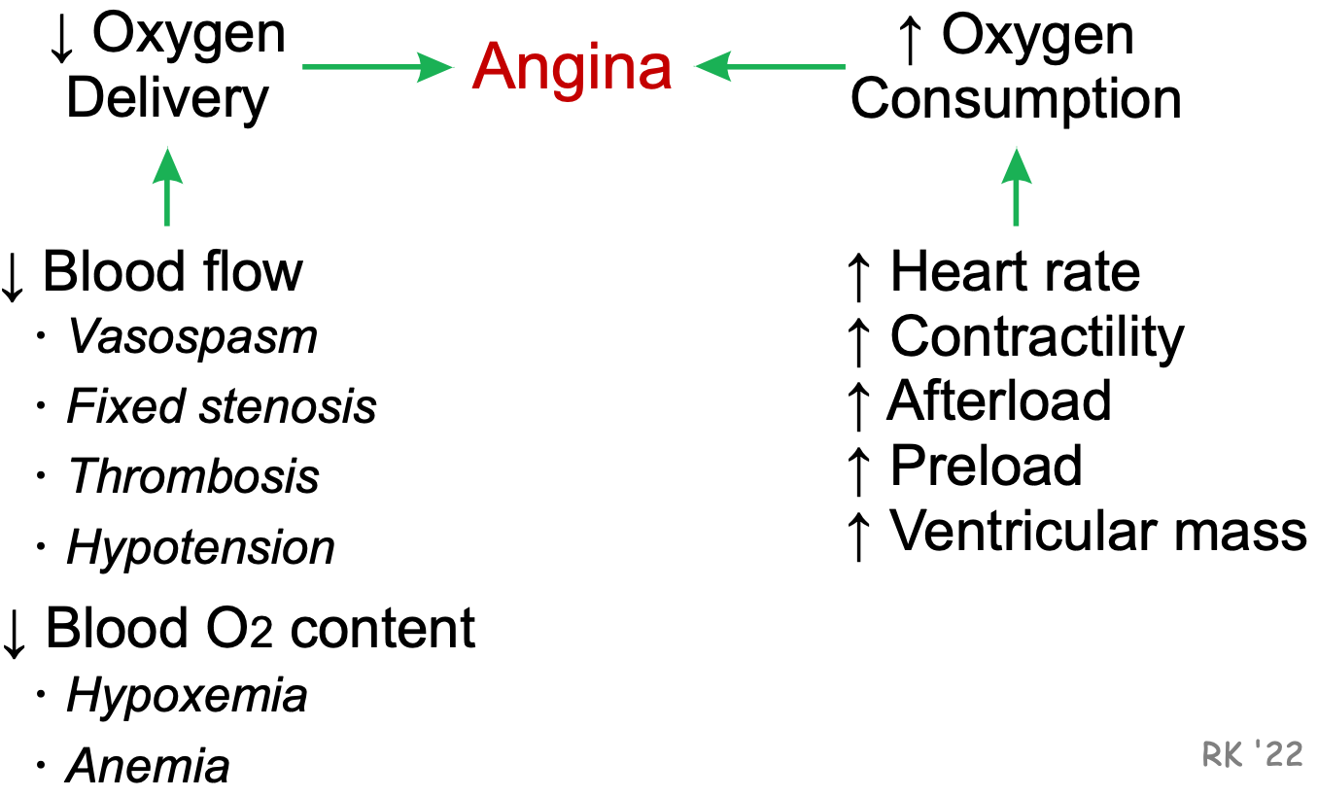
أسباب الذبحة الصدرية

Slide 10
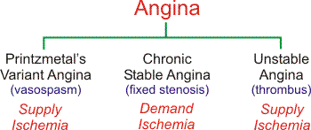
Types of Angina
الذبحة الصدرية المتنوعة
الذبحة الصدرية المستقرة المزمنة
الذبحة الصدرية غير المستقرة

Slide 11
Variant (Printzmetal's) Angina
Variant (Printzmetal's) angina results from coronary vasospasm, which temporarily reduces coronary blood flow (i.e., produces ischemia by reducing oxygen supply; "supply ischemia"), decreasing the oxygen supply/demand ratio. Enhanced sympathetic activity (e.g., during emotional stress), especially when coupled with a dysfunctional coronary vascular endothelium (i.e., reduced endothelial production of
the vasodilators nitric oxide and prostacyclin) can precipitate vasospastic angina
.
Chronic Stable Angina
Chronic Stable angina is caused by a chronic narrowing of coronary arteries because of atherosclerosis. When a coronary artery is narrowed beyond a critical value (critical stenosis), the myocardial tissue perfused by the artery will not receive adequate blood flow (i.e., the tissue becomes ischemic and hypoxic), particularly during times of increased oxygen demand (e.g., during physical exertion). Because the relative ischemia occurs when the oxygen demand increases, this is referred to as "demand ischemia." This will lead to anginal pain or chest discomfort during physical exertion. The pain usually is associated with a predictable threshold of physical activity. Other conditions that cause myocardial oxygen demand to increase, such as a large meal or emotional stress, can also precipitate pain
.

Slide 12
Unstable Angina
Unstable angina is caused by transient formation and dissolution of a blood clot (thrombosis) within a coronary artery. The clots often form in response to plaque rupture in atherosclerotic coronary arteries; however, the clot may also form because diseased coronary artery endothelium produces less nitric oxide and prostacyclin that inhibit platelet aggregation and clot formation. When the clot forms, coronary flow is reduced, leading to a reduction in the oxygen supply/demand ratio ("supply ischemia"). If the clot completely occludes the coronary artery for a sufficient length of time, the myocardium supplied by the vessel may become infarcted (acute myocardial infarction) and become irreversibly damaged

Slide 13
Rationale for Treating Angina
Increase Oxygen Delivery:
Coronary vasodilators
Anti-thrombotic drugs
Decrease Oxygen Demand:
Vasodilators (reduce afterload and preload)
Cardiac depressants (reduce heart rate and contractility)
Angina results from a reduction in the oxygen supply/demand ratio. Therefore, in order to alleviate anginal discomfort, it is necessary to improve this ratio. This can be done either by increasing blood flow (which increases oxygen delivery or supply), or by decreasing oxygen demand (i.e., by decreasing myocardial oxygen consumption).

Slide 14
Pharmacologic interventions that block coronary vasospasm (coronary vasodilators) or inhibit clot formation are used to treat variant and unstable angina, respectively.
These drugs act by :
increasing coronary blood flow and oxygen supply,
or by preventing vasospasm and clot formation, and associated decreases in blood flow.
Drugs that reduce myocardial oxygen demand are also given to patients with
these two forms of angina to reduce oxygen demand and help to alleviate angina
.

Slide 15
Drugs that reduce myocardial oxygen demand are commonly used to prevent and treat episodes of ischemic pain associated with fixed stenotic lesions (i.e., chronic stable angina). Some of these drugs reduce oxygen demand by :
decreasing heart rate (decreased chronotropy)
and contractility (decreased inotropy),
while other drugs reduce afterload and or preload on the heart. Afterload and preload reducing drugs act by dilating peripheral arteries and veins.
Direct vasodilation of the coronary arteries is ineffective as a therapeutic approach and may actually worsen the ischemia by producing coronary vascular steal.

Slide 16
Classes of Drugs Used to Treat Angina
Vasodilators (dilate arteries and veins) - calcium-channel blockers - nitrodilators
Cardioinhibitory drugs (reduce heart rate and contractility) - beta-blockers - calcium-channel blockers
Ranolazine (blocks late sodium currents)
Anti-thrombotic drugs (prevent thrombus formation) - anticoagulants - anti-platelet drugs

Slide 17
Calcium-Channel Blockers (CCBs)
Cardiac effects
Decrease contractility (negative inotropy)
Decrease heart rate (negative chronotropy)
Decrease conduction velocity (negative dromotropy)
Vascular effects
Smooth muscle relaxation (vasodilation)

Slide 18
calcium-channel blockers (CCBs) bind to L-type calcium channels on vascular smooth muscle, cardiac myocytes, and cardiac nodal tissue (sinoatrial and atrioventricular nodes). These channels regulate the influx of calcium into cells. In vascular smooth muscle and cardiac myocytes, calcium influx stimulates muscle contraction; in nodal tissue calcium influx plays an important role in pacemaker currents and in phase 0 of action potentials. Therefore, by blocking calcium entry into the cell, CCBs cause vascular smooth muscle relaxation (vasodilation), decreased myocardial force generation (negative inotropy; decreased contractility), decreased heart rate (negative chronotropy), and decreased conduction velocity (negative dromotropy), particularly at the atrioventricular node.

Slide 19
Therapeutic Use of Calcium-Channel Blockers
Hypertension (systemic & pulmonary)
Angina
Arrhythmias

Slide 20
By causing vascular smooth muscle relaxation, CCBs decrease systemic vascular resistance, which lowers arterial blood pressure. These drugs primarily affect arterial resistance vessels, with only minimal effects on venous capacitance vessels. Some CCBs also reduce heart rate and contractility, which can lead to a fall in cardiac output and lower arterial pressure.

Slide 21
Angina
The anti-anginal effects of CCBs are derived from :
their vasodilator and cardiodepressant actions.
Systemic vasodilation reduces arterial pressure, which reduces ventricular afterload (wall stress) thereby decreasing oxygen demand by the heart. The more cardioselective CCBs (verapamil and diltiazem) decrease heart rate and contractility, which leads to a reduction in myocardial oxygen demand. CCBs can also dilate coronary arteries and prevent or reverse coronary vasospasm (as occurs in Printzmetal's variant angina), increasing oxygen supply to the myocardium.

Slide 22
Arrhythmias
The antiarrhythmic properties (Class IV antiarrhythmics) of CCBs are related to their ability to suppress firing of aberrant pacemaker sites within the heart and their ability to decrease conduction velocity and prolong repolarization, especially at the atrioventricular node. This latter action at the atrioventricular node helps to block reentry mechanisms, which can cause supraventricular tachycardia.

Slide 23
Classes of Calcium-Channel Blockers
There are three chemical classes of CCBs. They differ not only in their basic chemical structure, but also in their relative selectivity for cardiac versus vascular L-type calcium channels. The most smooth muscle selective class of CCBs are the dihydropyridines. Because of their high vascular selectivity,
these drugs are primarily used to reduce systemic vascular resistance and arterial pressure,
and therefore are used to treat hypertension.
Extended release formulations or long-acting compounds are used to treat angina and are particularly effecting for vasospastic angina; however, their powerful systemic vasodilator and pressure lowering effects can lead to baroreflex cardiac stimulation (tachycardia and increased inotropy), which can offset the beneficial effects of afterload reduction on myocardial oxygen demand. Note that dihydropyridines are easy to recognize because the drug name ends in "pine."

Slide 24
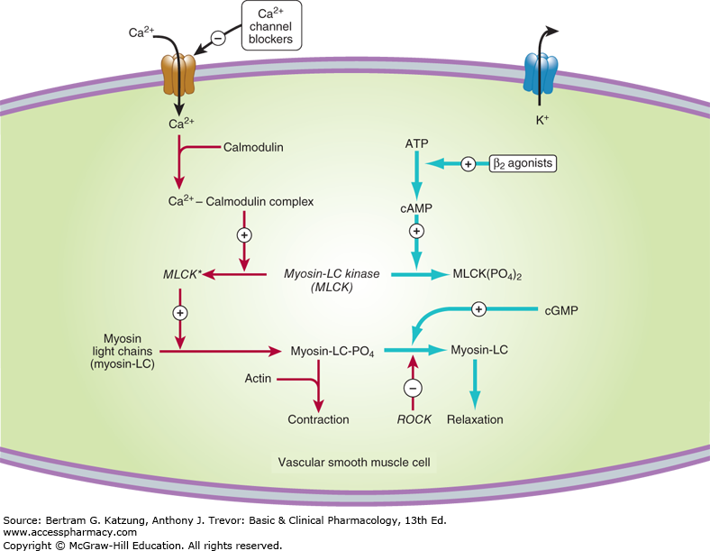

Slide 25
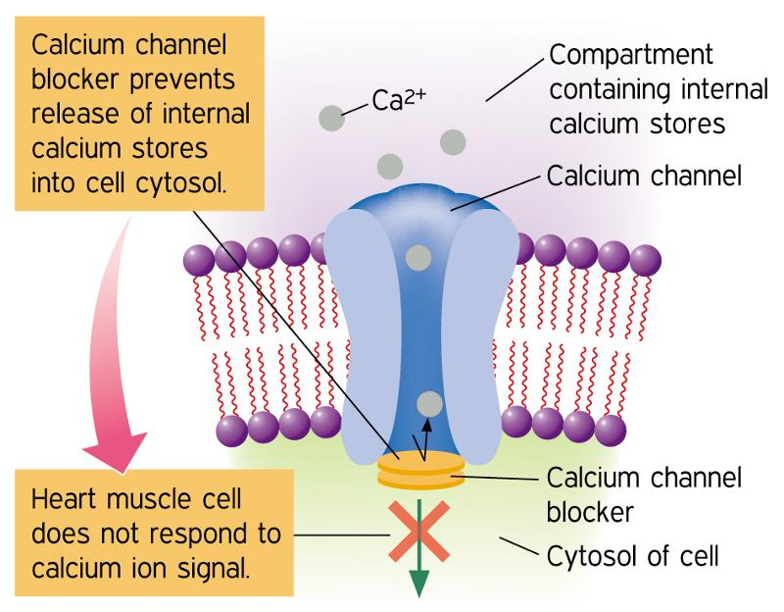

Slide 27
Dihydropyridines include the following specific drugs that are approved in the USA:
amlodipine
felodipine
isradipine
nicardipine
nifedipine
nimodipine (only used for subarachnoid hemorrhage)
nitrendipine

Slide 28
Non-dihydropyridines, of which there are only two currently used clinically, comprise the other two classes of CCBs. Verapamil (phenylalkylamine class), is relatively selective for the myocardium, and is less effective as a systemic vasodilator drug. This drug has a very important role in treating angina (by reducing myocardial oxygen demand and reversing coronary vasospasm) and arrhythmias. Diltiazem (benzothiazepine class) is intermediate between verapamil and dihydropyridines in its selectivity for vascular calcium channels. By having both cardiac depressant and vasodilator actions, diltiazem can reduce arterial pressure without producing as much reflex cardiac stimulation as dihydropyridines.

Slide 29
Side Effects and Contraindications
Dihydropyridine CCBs can cause flushing, headache, excessive hypotension, peripheral edema and reflex tachycardia. Baroreceptor reflex activation of sympathetic nerves and lack of direct negative cardiac effects can make dihydropyridines a less desirable choice for stable angina than diltiazem, verapamil or beta-blockers. Long-acting dihydropyridines (e.g., extended release nifedipine, amlodipine) are safer anti-hypertensive drugs, in part, because of reduced reflex responses. This characteristic also makes them more suitable for angina than short-acting dihydropyridines.

Slide 30
The cardiac selective, non-dihydropyridine CCBs can cause excessive bradycardia, constipation, impaired electrical conduction (e.g., atrioventricular nodal block), and depressed cardiac contractility. Therefore, patients having preexistent bradycardia, conduction defects, or heart failure caused by systolic dysfunction (HFrEF) should not be given CCBs, especially the cardiac selective, non-dihydropyridines. CCBs, especially non-dihydropyridines, should not be administered to patients being treated with a beta-blocker because beta-blockers also depress cardiac electrical and mechanical activity and therefore the addition of a CCB augments the effects of beta-blockade

Slide 31
Nitrodilators and Soluble Guanylyl Cyclase Activators
Nitric oxide (NO), a molecule produced by many cells in the body, and has several important actions
In the cardiovascular system, NO is primarily produced by vascular endothelial cells. This endothelial-derived NO has several important functions, including
relaxing vascular smooth muscle (vasodilation),
inhibiting platelet aggregation (anti-thrombotic),
inhibiting leukocyte-endothelial interactions (anti-inflammatory). These actions involve NO-stimulated formation of cGMP.
Nitrodilators are drugs that mimic the actions of endogenous NO by releasing NO or forming NO within tissues. These drugs act directly on the vascular smooth muscle to cause relaxation and therefore serve as endothelial-independent vasodilators.

Slide 32
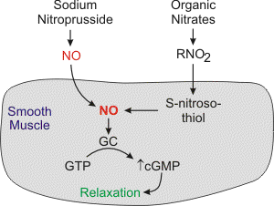

Slide 33
There are two basic types of nitrodilators:
- those that release NO spontaneously (e.g., sodium nitroprusside)
- organic nitrates that require an enzymatic process to form NO. Organic nitrates do not directly release NO, however, their nitrate groups interact with enzymes and intracellular sulfhydryl groups that reduce the nitrate groups to NO or to S-nitrosothiol, which then is reduced to NO. Nitric oxide activates smooth muscle soluble guanylyl cyclase (GC) to form cGMP. Increased intracellular cGMP inhibits calcium entry into the cell, decreasing intracellular calcium concentrations and causing smooth muscle relaxation NO also activates K⁺ channels, which leads to hyperpolarization and relaxation. Finally, NO acting through cGMP can stimulate a cGMP-dependent protein kinase that activates myosin light chain phosphatase, the enzyme that dephosphorylates myosin light chains, which leads to relaxation.

Slide 34
Tolerance to organic nitrates occurs with frequent dosing, which decreases their efficacy. The problem is partially circumvented by using the smallest effective dose of the compound, coupled with infrequent or irregular dosing. The mechanism for tolerance is not fully understood, but it may involve depletion of tissue sulfhydryl groups, or scavenging of NO by superoxide anion and the subsequent production of peroxynitrite that may inhibit guanylyl cyclase.

Slide 35
Primary Cardiovascular Actions of Nitrodilators
Systemic vasculature
vasodilation (venous dilation > arterial dilation)
decreased venous pressure
decreased arterial pressure (small effect)
Cardiac
reduced preload and afterload (decreased wall stress)
decreased oxygen demand
Coronary
prevents/reverses vasospasm
vasodilation (primarily epicardial vessels)
improves subendocardial perfusion
increased oxygen delivery

Slide 36
Although organic nitrates can dilate both arteries and veins, venous dilation predominates when these drugs are given at normal therapeutic doses. Venous dilation reduces venous pressure and decreases ventricular preload. This reduces ventricular wall stress and oxygen demand by the heart, enhancing the oxygen supply/demand ratio. A reduction in preload (reduced diastolic wall stress) also helps to improve subendocardial blood flow, which is often compromised in coronary artery disease. Mild coronary dilation or reversal of coronary vasospasm will further enhance the oxygen supply/demand ratio and diminish the anginal pain. Coronary dilation occurs primarily in the large epicardial vessels, which diminishes the likelihood of coronary vascular steal. Systemic arterial dilation reduces afterload, which can enhance cardiac output while reducing ventricular wall stress and oxygen demand. At high concentrations, excessive systemic vasodilation may lead to hypotension and a baroreceptor reflex that produces tachycardia. When this occurs, the beneficial effects on the oxygen supply/demand ratio are partially offset. Tachycardia, by reducing the duration of diastole, decreases the time available for coronary perfusion, most of which occurs during diastole

Slide 37
Therapeutic Indications
The primary pharmacologic action of nitrodilators,
arterial and venous dilation, makes these compounds useful in the treatment of hypertension, heart failure, angina and myocardial infarction. Another beneficial action of nitrodilators is their ability to inhibit platelet aggregation.

Slide 38
Hypertension
Nitrodilators are not used to treat chronic primary or secondary hypertension; however, sodium nitroprusside and nitroglycerine are used to lower blood pressure in acute hypertensive emergencies that may result from a pheochromocytoma, renal artery stenosis, aortic dissection, etc. Nitrodilators may also be used during surgery to control arterial pressure within desired limits.

Slide 39
Heart failure
Nitrodilators are used in acute heart failure and in severe chronic heart failure. Arterial dilation reduces afterload on the failing ventricle and leads to an increase in stroke volume and ejection fraction. Venous dilation reduces venous pressure, which helps to reduce edema. Reducing both afterload and preload on the heart also helps to improve the mechanical efficiency of dilated hearts and to reduce wall stress and the oxygen demands placed on the failing heart.

Slide 40
Angina and myocardial infarction
Organic nitrates are used extensively to treat angina and myocardial infarction. They are useful in Printzmetal's variant angina because they improve coronary blood flow (i.e., increase oxygen supply) by reversing and inhibiting coronary vasospasm. They are important in other forms of angina because they reduce preload on the heart by producing venous dilation, which decreases myocardial oxygen demand. It is unclear if direct dilation of epicardial coronary arteries plays a role in the antianginal effects of nitrodilators in chronic stable or unstable angina. These drugs also reduce systemic vascular resistance (depending on dose) and arterial pressure, which further reduces myocardial oxygen demand. Taken together, these two actions dramatically improve the oxygen supply/demand ratio and reduce anginal pain.

Slide 41
The following nitrodilators are commonly used in the USA:
nitroglycerin
isosorbide dinitrate
isosorbide mononitrate
sodium nitroprusside

Slide 42
The nitrodilators listed above differ in the route of administration, onset of action, and duration of action. Nitroglycerin, which has been used since the 19th century, is commonly used in the treatment of angina because it is fast acting (within 2 to 5 minutes) when administered sublingually. Its effects usually wear off within 30 minutes. Therefore, nitroglycerin is useful for preventing or ending an acute anginal attack. Longer-acting preparations of nitroglycerin (e.g., transdermal patches) have a longer onset of action (30 to 60 minutes), but are effective for 12 to 24 hours. Intravenous nitroglycerin is used in the hospital setting for unstable angina and acute heart failure.

Slide 43
Isosorbide dinitrate and mononitrate, and tetranitrate compounds have a longer onset of action and duration of action than nitroglycerin. This makes these compounds more useful than short-acting nitroglycerin for the long-term prophylaxis and management of coronary artery disease. Oral bioavailability of many organic nitrates is low because of first-pass metabolism by the liver. Isosorbide mononitrate, which has nearly 100% bioavailability, is the exception. Therefore, oral administration of these compounds requires much higher doses than sublingual administration, which is not subject to first-pass hepatic metabolism.
The metabolites of organic nitrates are biologically active and have a longer half-life than the parent compound. Therefore, the metabolites contribute significantly to the therapeutic activity of the compound.

Slide 44
Sodium nitroprusside, unlike organic nitrates, dilates arterial resistance vessels more than venous vessels. Because of its rapid onset of action, it is used to treat severe hypertensive emergencies and severe heart failure. It is only available as an intravenous preparation, and because of its short half-life, continuous infusion is required.

Slide 45
Pharmacology of Soluble Guanylyl Cyclase Stimulators
A new class of drugs, soluble guanylyl cyclase (sGC) stimulators, directly activates sGC to produce cGMP. As described above, sGC is the enzyme that is activated by nitric oxide and nitrodilators to form cGMP, which produces vasodilation. By directly activating sGC, sGC stimulators mimic the effects of nitrodilators. Riociguat is approved for treatment of pulmonary arterial hypertension by functioning as a pulmonary arterial vasodilator. This drug is orally active and can be administered up to three-times daily.

Slide 46
Side Effects and Contraindications
The most common side effects of nitrodilators are headache (caused by cerebral vasodilation) and cutaneous flushing. Other side effects include postural hypotension and reflex tachycardia. Excessive hypotension and tachycardia can worsen the angina by increasing oxygen demand. Prolonged use of sodium nitroprusside carries the risk of thiocyanate toxicity because nitroprusside releases cyanide along with NO. The thiocyanate is formed in the liver from the reduction of cyanide by a sulfhydryl donor. There is clinical evidence that nitrodilators may interact adversely with cGMP-dependent phosphodiesterase inhibitors that are used to treat erectile dysfunction (e.g., sildenafil [Viagra®]). The reason for this adverse reaction is that nitrodilators stimulate cGMP production and drugs like sildenafil inhibit cGMP degradation. When combined, these two drug classes potentiate cGMP levels, which can lead to hypotension and impaired coronary perfusion. Because riociguat activates sGC, it should not be administered along with nitroglycerin or PDE5 inhibitors because significant hypotension can occur related to excessive formation of cGMP.

Slide 47
Antiarrhythmic Drugs
Therapeutic Use and Rationale
The goal of antiarrhythmic drug therapy is to restore normal rhythm and conduction.They are also used to prevent more serious and lethal arrhythmias from occurring.
Antiarrhythmic drugs are used to :
decrease or increase conduction velocity
alter the excitability of cardiac cells by changing the duration of the effective refractory period
suppress abnormal automaticity

Slide 48
All antiarrhythmic drugs directly or indirectly alter membrane ion conductances, which alters the physical characteristics of cardiac action potentials. For example, some drugs are used to block fast sodium channels. These channels determine how fast the membrane depolarizes (phase 0) during an action potential. Since conduction velocity is related to how fast the membrane depolarizes, sodium channel blockers reduce conduction velocity. Decreasing conduction velocity can help to abolish tachyarrhythmias caused by reentry circuits. Other types of antiarrhythmic drugs affect the duration of action potentials and the effective refractory period. By prolonging the effective refractory period, reentry tachycardias can often be abolished. These drugs typically block potassium channels and delay repolarization of action potentials (phase 3). Drugs that block slow inward calcium channels are used to reduce pacemaker firing rate by slowing the rate of rise of depolarizing pacemaker potentials (phase 4 depolarization). These drugs also reduce conduction velocity at the AV node, because those cells, like SA nodal cells, depend on the inward movement of calcium ions to depolarize.

Slide 49
Because sympathetic activity can precipitate arrhythmias, drugs that block beta₁-adrenoceptors are used to inhibit sympathetic effects on the heart. Because beta-adrenoceptors are coupled to ion channels through defined signal transduction pathways, beta-blockers indirectly alter membrane ion conductance, particularly calcium and potassium conductance.
With AV block, drugs that block vagal influences (e.g., atropine, a muscarinic receptor antagonist) are sometimes used. AV block can occur during beta-blocker treatment and therefore simply removing a beta-blocker in patients being treated with such drugs may normalize AV conduction.
Sometimes ventricular rate is excessively high because atrial flutter or fibrillation is driving it. Therefore, drugs can be used to slow AV nodal conduction to control ventricular rate. Calcium channel blockers and beta-blockers are useful for this indication. Digoxin, because of its ability to activate the vagus nerve (parasympathomimetic effect), can also reduce AV conduction velocity to normalize ventricular rate during atrial flutter or fibrillation, particularly in heart failure patients.

Slide 50
Classes of Drugs Used to Treat Arrhythmias
Antiarrhythmic drug classes:
Class I - Sodium-channel blockers
Class II - Beta-blockers
Class III - Potassium-channel blockers
Class IV - Calcium-channel blockers
Miscellaneous - adenosine - electrolyte supplement (magnesium and potassium salts) - digitalis compounds (cardiac glycosides) - atropine (muscarinic receptor antagonist)

