Slide 1
المحاضرة 4 خمجية / حماة
د.محمد يوسف حسن

Slide 2
Chickenpox
VZV ( one of the herpesviruses).
D0uble stranded DNA virus.
aerosol and direct contact.
Disease in children is usually better tolerated than in adults, pregnant women and the immunocompromised.
The incubation period is 11–20 days.
Infectivity lasts from 2 to 4 days before the rash appears until the last crusts separate.

Slide 3
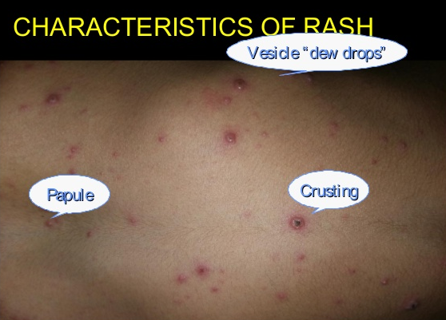

Slide 4
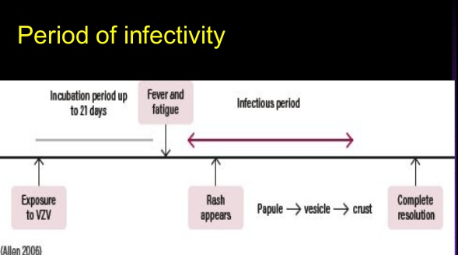

Slide 5
Diagnosis is clinical but may be confirmed by PCR of vesicular fluid.
Complications include:
● Secondary bacterial infection of rash (due to scratching).
● Selflimiting cerebellar ataxia.
● Congenital abnormalities if maternal disease is contracted in the first trimester.
● Pneumonitis, which may be fatal.

Slide 6
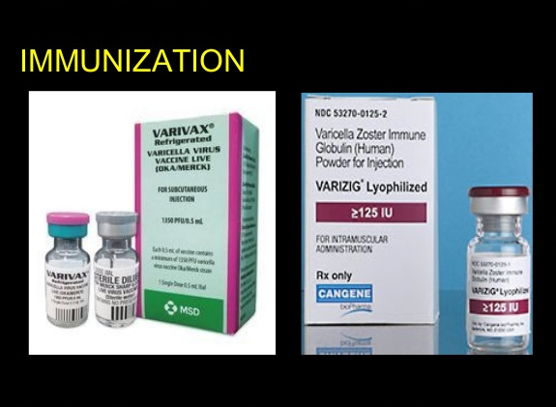
Notes:
VZIG for immunocompromised or pregnant.

Slide 7
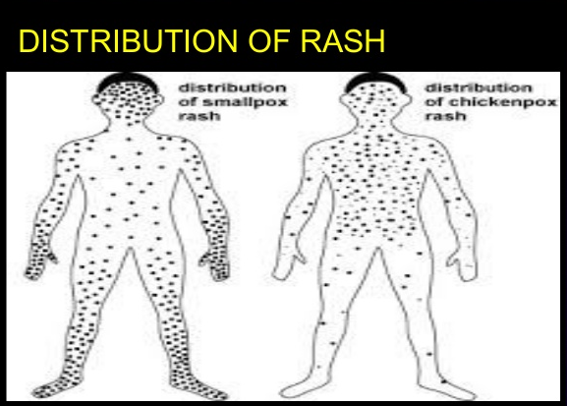

Slide 8
Shingles (herpes zoster) :
reactivation of latent VZV .
most commonly involves thoracic dermatomes .
ophthalmic division of the trigeminal nerve.

Slide 9
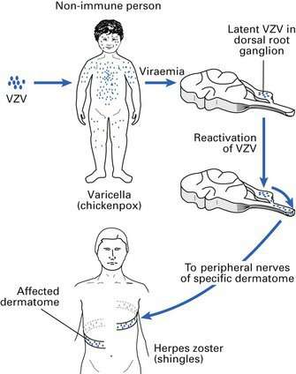

Slide 10
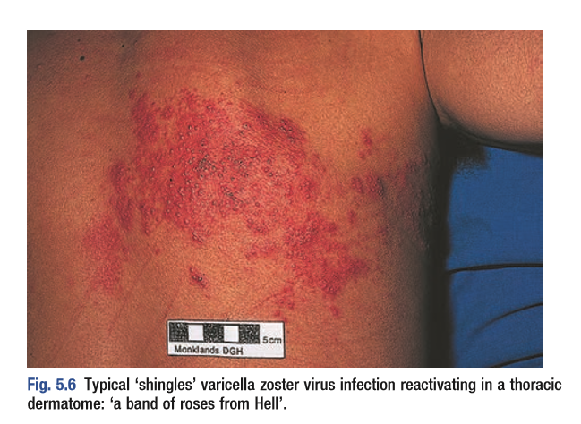

Slide 11
Complications:
● Ophthalmic trigeminal involvement: may lead to corneal ulceration .
● Ramsay Hunt syndrome: facial palsy, ipsilateral loss of taste and buccal ulceration, and a rash in the external auditory canal.
● Post-herpetic neuralgia: can be difficult to treat but may respond to amitriptyline or gabapentin.
● Myelitis/encephalitis: rare.
Early therapy with aciclovir helps to limit early- and late-onset pain and to prevent the development of post-herpetic neuralgia.

Slide 12
Dengue :
Dengue flavivirus .
Aedes aegypti .
Endemic in South-east Asia, India, Africa and the Americas.
The incubation period following a mosquito bite is 2–7 days.
Dengue haemorrhagic fever and dengue shock syndrome

Slide 13
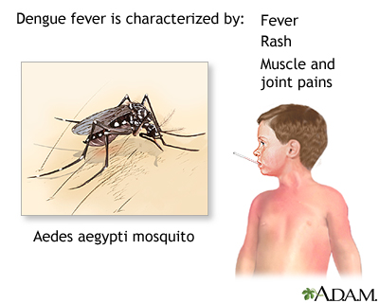

Slide 14
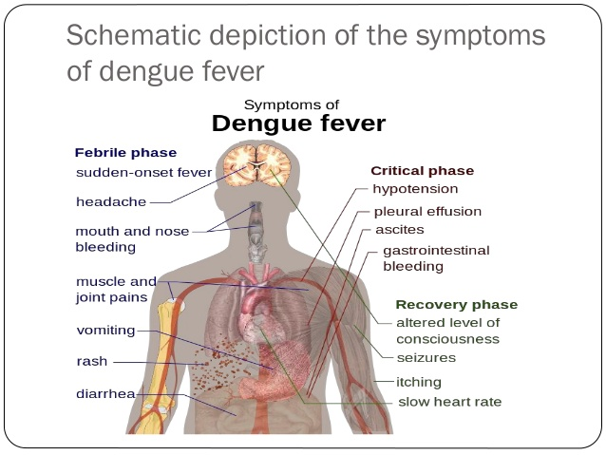

Slide 15
Investigations
● Detection of a 4 × rise in anti-dengue IgG antibody titres.
● Amplification of dengue RNA by PCR.

Slide 16
Management and prevention
Management is supportive, with treatment of haemorrhage, shock and pain as required. Insecticides that control mosquito levels help to limit transmission.
Aspirin should be avoided and steroids are ineffective.
There is currently no licensed vaccine.

Slide 17


