Slide 1
Systemic viral infections without exanthem
د. محمد يوسف حسن

Slide 2
Mumps
Mumpus virus( paramyxoviruses ).
parotid glands.
It is endemic worldwide and peaks at 5–9 yrs of age.
Vaccination has reduced childhood incidence but, if incomplete, leads to outbreaks in young adults.
Infection is by respiratory droplets.
Incubation lasts 15–24 days, and tender parotid swelling (bilateral in 75%) develops after a prodrome of pyrexia and headache.
Diagnosis is clinical.

Slide 5
Complications
● Epididymo-orchitis: occurs in 25% of post-pubertal males, with testicular atrophy, although sterility is unlikely.
Oophoritis is less common.
● Mumps meningitis: complicates 10% of cases, with lymphocytes in CSF.
● Encephalitis.
● Transient hearing loss and labyrinthitis: uncommon.
● Spontaneous abortion.

Slide 6
Management
Analgesia for symptoms is sufficient.
There is no evidence that corticosteroids are of value in orchitis.
Mumps vaccine, given as part of MMR vaccine (15mon) , has markedly reduced incidence and, if used widely, abolishes the epidemic pattern of disease.

Slide 7
Influenza
acute systemic viral illness caused by influenza A or B viruses.
Seasonal changes in haemagglutinin (H) and neuraminidase (N) glycoproteins .

Slide 10
Clinical features
infectious by respiratory droplet.
Incubation is 1–3 days and onset is with fever, malaise, myalgia and cough.
Viral or superadded bacterial pneumonia is an important complication.
Myositis, myocarditis, pericarditis and encephalitis are rare complications.

Slide 11
Management involves early diagnosis, scrupulous hand hygiene and infection control to limit spread by coughing and sneezing.
Neuraminidase inhibitors such as oseltamivir (75 mg twice daily for 5 days) can reduce the severity of symptoms if started within 48 hrs of symptom onset.

Slide 12
Prevention involves seasonal vaccination of vulnerable groups, e.g. people over 65, the immunosuppressed and those with chronic illnesses.

Slide 13
Avian influenza ( h5n1) is the transmission of avian influenza A from sick poultry to humans, causing severe disease. Human–human spread is rare.
Swine influenza, caused by a H1N1 strain infecting humans, spread around the world from Mexico in 2009.

Slide 15
Infectious mononucleosis
Infectious mononucleosis (IM) is a syndrome of pharyngitis, cervical lymphadenopathy, fever and lymphocytosis, most often caused by the Epstein–Barr virus (EBV)= a gamma herpesvirus.
In developing countries, subclinical infection in childhood is virtually universal.
In developed countries, primary infection often occurs in adolescence or later, from asymptomatic excreters.

Slide 16
Saliva is the main means of spread, either by droplet infection or environmental contamination in childhood, or by kissing among adolescents and young adults (kissing dis ).
IM is not highly contagious, so case isolation is unnecessary.
In addition to EBV, an IM syndrome may result from infection with CMV, herpesvirus 6 or 7, HIV-1 or toxoplasmosis.

Slide 18
Clinical features
● Prolonged prodrome of fever, malaise and headache.
● Lymphadenopathy, especially posterior cervical.
● Pharyngeal inflammation or exudates.
● Persisting fever and fatigue.
● Splenomegaly.
● Palatal petechiae.
● Periorbital oedema.
● Clinical or biochemical hepatitis.
● A non-specific rash.

Slide 20
Complications
Common: Include an antibiotic-induced rash (classically amoxicillin), severe laryngeal oedema and post-viral fatigue.
Less common: Cranial nerve palsies, meningoencephalitis, haemolytic anaemia, glomerulonephritis, pericarditis, pneumonitis and haemorrhage from splenic rupture or thrombocytopenia.
Long-term: Include lymphoma in the immunosuppressed. EBV is also implicated in some forms of Hodgkin’s lymphoma, Burkitt’s lymphoma, and nasopharyngeal carcinoma in China and Alaska.

Slide 21
Investigations
● Monospot test (heterophile antibody absorption test): may initially be negative so should be repeated if clinical suspicion is high.
● Atypical lymphocytes on blood film.
● EBV IgM antibodies.

Slide 23
Management
Treatment is symptomatic, e.g. aspirin gargles to relieve a sore throat.
Oral prednisolone may be required to relieve laryngeal oedema.
Chronic fatigue may respond to graded exercise programmes.
Contact sports should be avoided until splenomegaly has resolved to avoid splenic rupture.

Slide 24
Cytomegalovirus
Cytomegalovirus (CMV) usually has no symptoms.
saliva, urine and genital secretions.
There is a second period of virus acquisition in teenagers and adults up to 35, with significant sexual and oral spread.

Slide 25
Most CMV infections are asymptomatic, but in adults may produce an illness resembling IM.
Lymphadenopathy, pharyngitis and tonsillitis are found less often than in IM, while hepatomegaly is more common. Unusual complications include neurological involvement, autoimmune haemolytic anaemia, pericarditis, pneumonitis and arthropathy.
Hepatitis, retinitis, colitis and encephalitis are among serious complications in immunosuppressed patients.
CMV infection during pregnancy carries a 40% risk of fetal infection, causing rashes, hepatosplenomegaly and a 10% risk of neurological damage to the fetus.

Slide 26
Atypical lymphocytes are seen less commonly than in IM, and the Monospot test is negative.
Detection of CMV-specific IgM antibody confirms the diagnosis and treatment is symptomatic in the immunocompetent.
In immunosuppressed patients, IV ganciclovir or oral valganciclovir is useful.

Slide 27
Yellow fever
Yellow fever is a flavivirus infection
monkeys in the tropical rainforests of West and Central Africa and South and Central America.
It is transferred to humans by infected Aedes or Haemagogus mosquitoes
200 000 infections/yr, mainly in sub-Saharan Africa, with a mortality of ~15%.

Slide 28
The incubation period is 3–6 days, and the acute phase is usually characterised by a mild febrile illness lasting less than a week. Fever remits, then recurs in some cases after a few hours to days.
In severe cases: rigors and high fever, severe backache, abdominal pain, nausea, vomiting, bradycardia and jaundice.
This may progress to shock, DIC, hepatic and renal failure with jaundice, petechiae, mucosal haemorrhages, GI bleeding, seizures and coma.

Slide 29
Diagnosis is by virus isolation from blood or the identification of IgM antibodies.

Slide 30
Management
Treatment is supportive, with meticulous attention to fluid and electrolyte balance, urine output and BP. Blood transfusions, plasma expanders and peritoneal dialysis may be necessary.
A vaccine effective for at least 10 yrs is available.

Slide 31
Viral haemorrhagic fevers

Slide 32
The viral haemorrhagic fevers are zoonoses caused by several different viruses, and occur in rural and health-care settings in defined regions
Management is supportive; ribavarin is effective in some viral haemorrhagic fevers.
Transmission by infected secretions can cause major outbreaks, e.g. Ebola in West Africa in 2014.
Case isolation and scrupulous infection control are essential.

Slide 33
Viral infections of the skin

Slide 34
Herpes simplex virus 1 and 2
Type 1 herpes simplex virus (HSV) typically produces mucocutaneous lesions of the head and neck, while type 2 predominantly affects the genital tract.
Seroprevalence is 30–100% for HSV-1 and 20–60% for HSV-2.
Virus shed by an infected individual infects via a mucosal surface of a susceptible person.
HSV infects ganglia.

Slide 35
Primary infection normally occurs as a vesiculating gingivostomatitis.
It may also present as a keratitis (dendritic ulcer), viral paronychia, vulvovaginitis, cervicitis (often unrecognised), balanitis or rarely as encephalitis.
Diagnosis is by PCR, electron microscopy or culture of vesicular fluid.

Slide 36
Complications
● Corneal dendritic ulcers: may produce scarring.
● Encephalitis: preferentially affects the temporal lobe.
● HSV infection in patients with eczema: can result in disseminated skin lesions (eczema herpeticum.
● Neonatal HSV infection: may be disseminated and potentially fatal.

Slide 37
Management
Treatment is with antiviral agents such as aciclovir; best results are achieved with early treatment.

Slide 39
Human herpesvirus 8
This virus, which spreads via saliva, causes Kaposi’s sarcoma in both AIDS-related and endemic non-AIDS-related forms.

Slide 40
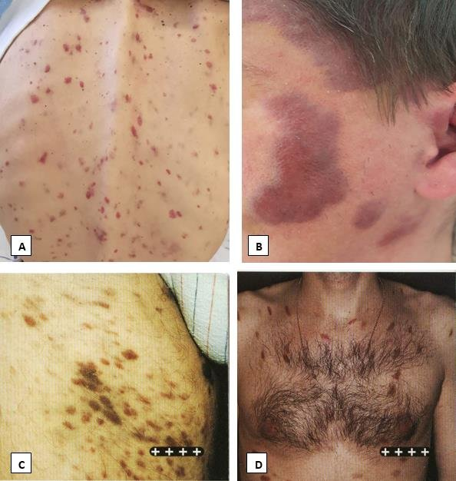
Kaposi sarcoma

Slide 41
Enterovirus infections
Hand, foot and mouth disease: A mild febrile illness affecting children, mainly in the summer months, and caused by Coxsackie viruses or echoviruses.
There is fever, lymphadenopathy, mouth ulceration and a vesicular eruption on the hands and feet. Herpangina: Causes discrete vesicles on the palate associated with high fever, sore throat and headache.
Both of these conditions are self-limiting without treatment.

Slide 42
Herpangina.
Hand-foot -mouth

Slide 43
Poxvirus infections
These DNA viruses are potentially important pathogens but nowadays rarely cause significant human disease. They include smallpox, monkey pox and cow pox, as well as orf and molluscum contagiosum .
Smallpox (variola): was eradicated worldwide in 1980.
The classical form is characterised by a typical centrifugal vesicular/pustular rash, worst on the face and extremities, with no cropping (i.e. unlike chickenpox), and accompanied by fever, severe myalgia and odynophagia.

