Slide 1
د.محمد يوسف حسن
أمراض خمجية

Slide 2
Non-infectious food poisoning
Plant toxins: Those causing diarrhoea or vomiting occur in undercooked red kidney beans, in potatoes discoloured green by light and in many fungi.
Chemical toxins: Originating in dinoflagellates and concentrated by shellfish or fish, these can cause gastrointestinal symptoms and paralysis. Scombrotoxic food poisoning results from eating contaminated tuna, mackerel or sardines.
Antimicrobial-associated diarrhoea: This is common in the elderly. Between 20 and 25% of cases are caused by C. difficile; if this toxin is detected, treatment with metronidazole or vancomycin is effective.
Notes:
Mackrel=الاسقمري سمك بحري.

Slide 3
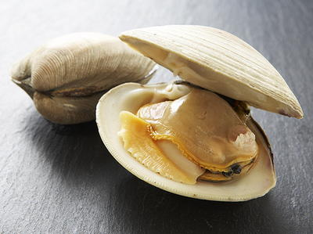
Notes:
shellfishمحار

Slide 4
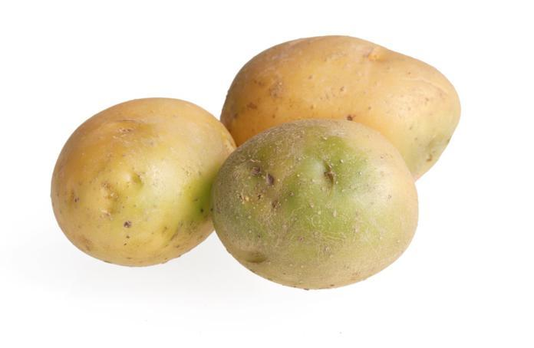
Notes:
Glycoalkaloidsقلويدات سكرية سامة =اسهال

Slide 5
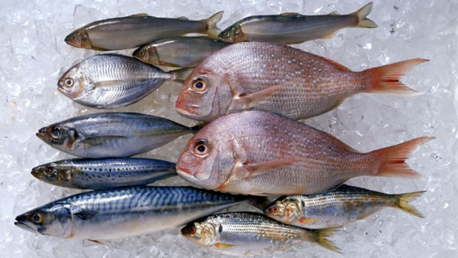
Notes:
Scombroid fish poisoning لاحتوائه تراكيز عالية من الهيستامين

Slide 6
Infections acquired in the tropics

Slide 7
Fever in travellers recently returned from the tropics
Both tropical and non-tropical infection may present with fever after tropical travel. Frequent final diagnoses are:
● Malaria.
● Typhoid fever.
● Viral hepatitis.
● Dengue fever.
● Travellers to West Africa may have viral haemorrhagic fevers (e.g. Marburg, Lassa or Ebola) while those in South-east Asia may have avian influenza (H5N1); all these require special isolation.

Slide 8
Clinical assessment
History:
● Countries and environments visited.
● Travel dates.
● Exposures: ill people, animals, insect bites, freshwater swimming.
● Dietary history.
● Sexual history.
● Malaria prophylaxis – what taken and local resistance.
● Any local medicines/remedies taken.
● Vaccination history – if the patient was vaccinated against yellow fever and hepatitis A and B, this virtually rules out these infections. Oral and injectable typhoid vaccinations are 70–90% effective.
Examination: Careful, repeated examination is vital, paying particular attention to rashes or lesions, throat, eyes, nail beds, lymph nodes and abdomen .

Slide 9
Investigations
Initial investigations in all settings should start with thick and thin blood films for malaria parasites, FBC, urinalysis and CXR if indicated.

Slide 10
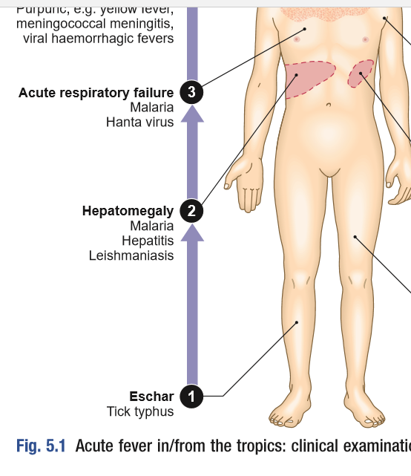

Slide 11
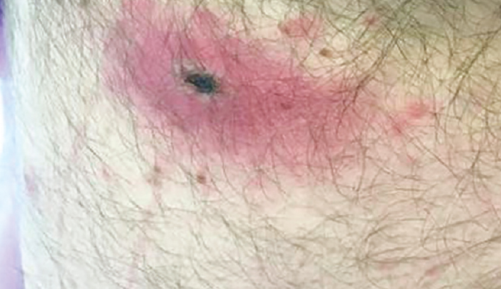
Notes:
إششار خشارة

Slide 12
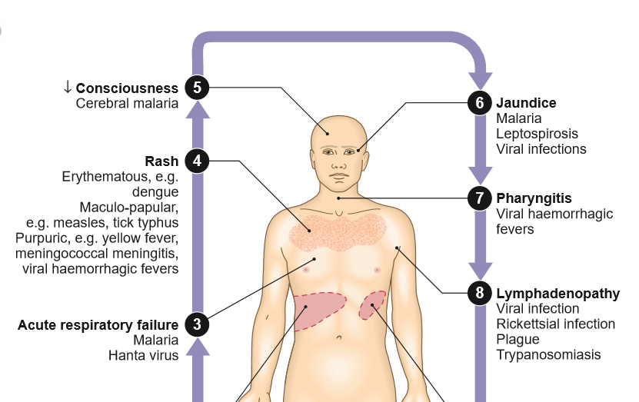

Slide 13
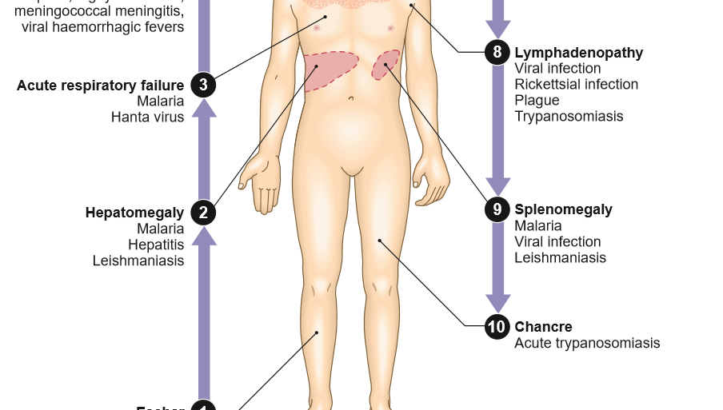
Notes:
تشانكر=قرح

Slide 14
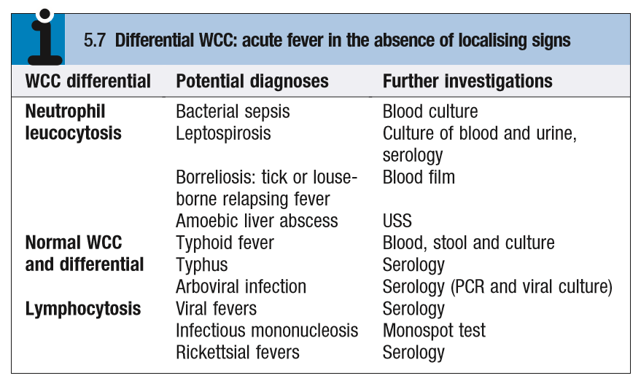
Notes:
COVID 19 cause lymphopenia !
Arboviral =متعلق بالفيروسة المنقولة بالمفصليات.

Slide 15
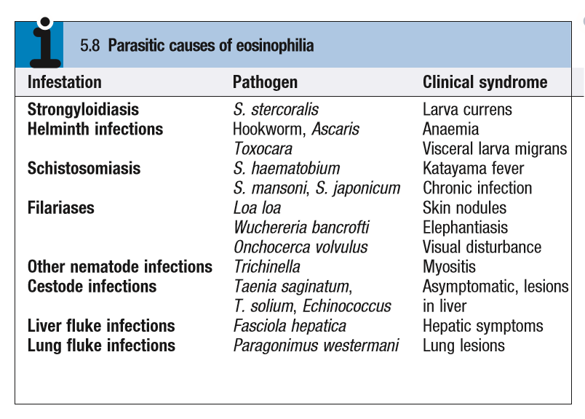
Notes:
ووكي ريريا
اونشوسيركا
تراي شينيلا شعرينة
ديدان مثقوبة= فلوك
فاشيولا=المتورقة

Slide 16
Diarrhoea acquired in the tropics
Common causes include Salmonella, Campylobacter and Cryptosporidia infections.
Typhoid, paratyphoid, shigellosis and amoebiasis usually occur in visitors to the Indian subcontinent and sub-Saharan Africa. Other causes to be considered are tropical sprue , giardiasis and HIV enteropathy.

Slide 17
Eosinophilia acquired in the tropics
Non-parasitic causes:
haematological conditions.
allergic reactions .
HIV-1.
human T-cell lymphotropic virus (HTLV)-1 infection.
In travellers or tropical residents, however, eosinophilia is associated with parasite infections (particularly helminths).
Anybody with an eosinophil count > 0.4 × 109/L should be investigated for both parasitic and non-parasitic causes .
Eosinophilia is not a typical feature in malaria, amoebiasis, leishmaniasis, leprosy or tapeworm infections other than cysticercosis.
Notes:
داء الكيسات المذنَّبة

Slide 18
Clinical assessment
● Travel history, e.g. freshwater bathing in sub-Saharan Africa.
● Any rashes or itching (schistosomiasis, strongyloidiasis).
● Haematuria (schistosomiasis).
● Subcutaneous swellings (loiasis, cutaneous larva migrans).
● Febrile hepatosplenomegaly (schistosomiasis, toxocariasis).
● Myositis (trichinosis, cysticercosis).
● Pneumonitis (helminth infection, filariasis, strongyloidiasis). Loffler syn.
● Meningitis (strongyloidiasis).

Slide 19
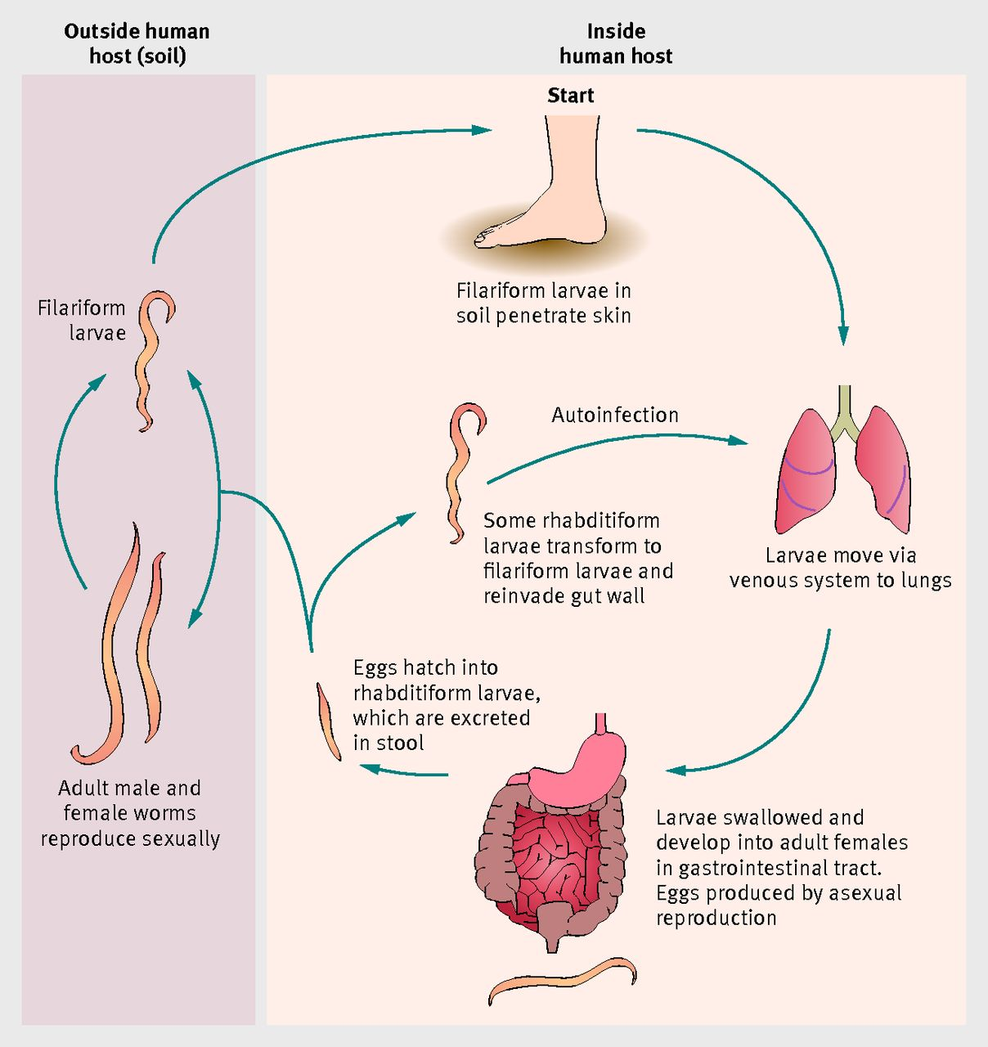
strongyloids
Notes:
شكل فيلاري

Slide 20
Investigations
Direct visualisation of adult worms, larvae or ova provides the best evidence.
The following box lists the initial investigations for eosinophilia.

Slide 21
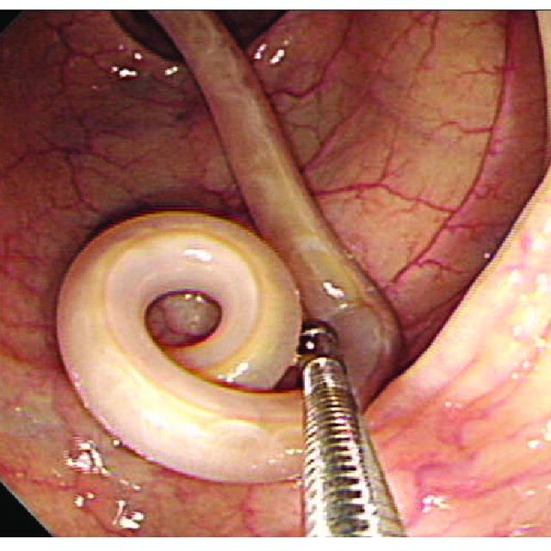
Notes:
Ascaris lumbricoides

Slide 22
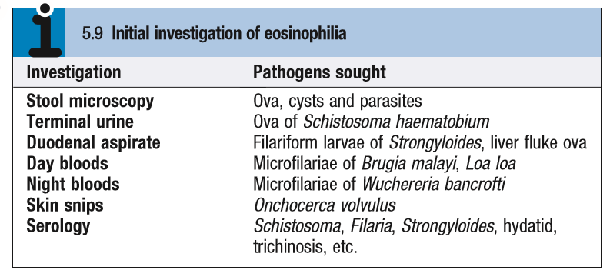

Slide 23
Skin conditions acquired in the tropics
The most common skin problems in the tropics are bacterial and fungal skin infections, scabies and eczema
In travellers, infected insect bites and cutaneous larva migrans are common.
The next Box summarises the types of rash commonly seen in tropical travellers/residents.
Skin biopsy and culture may be required to achieve a firm diagnosis.

Slide 24
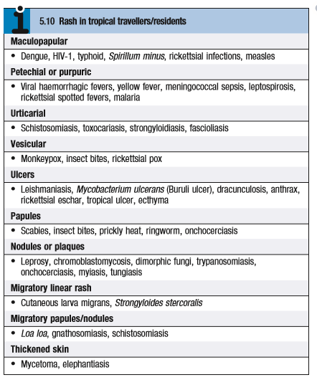
Notes:
Chromoblastomycosis=الفطار الاصطباغي-حصف شائك=prickly heat.

Slide 25
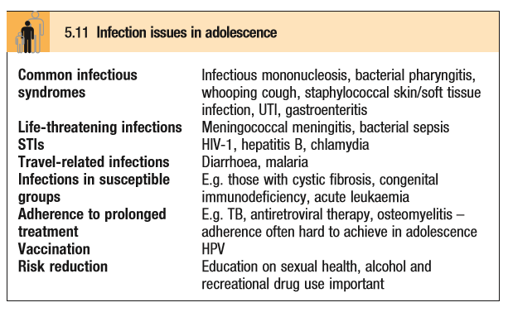
Infection issues in adolescence

Slide 26
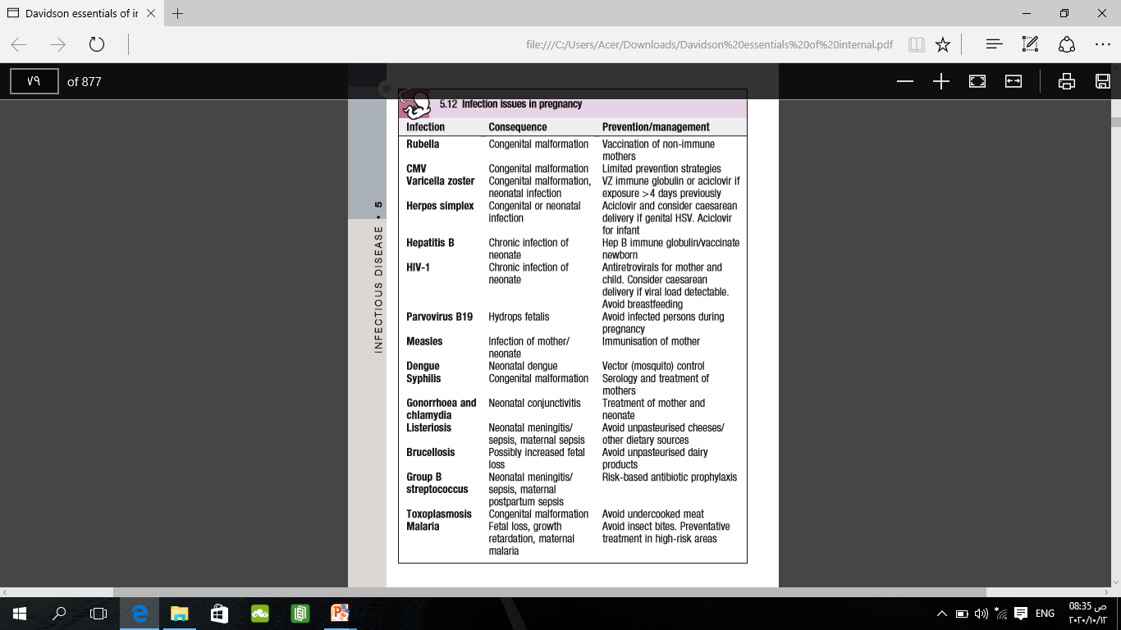
Infection issues in pregnancy

Slide 27
VIRAL INFECTIONS

Slide 28
Viruses (RNA or DNA).
how to survive.
Inside cells.
Need for infected source .
Notes:
Viruses are simple infectious agents consisting of a portion of genetic material, RNA or DNA, enclosed in a protein coat that is antigenically unique for that species. They cannot exist in a free-living state, needing to infect host cells to survive. Once inside cells, they utilise host material for protein synthesis and genetic reproduction. All viral infections must therefore originate from an infected source by either direct or vector-mediated spread.

Slide 29
Systemic viral infections with exanthem
Maternal antibodies protect for the first 6–12 mths .
Role of vaccines.
Notes:
Maternal antibodies protect for the first 6–12 mths . Although the incidence of exanthems has diminished as a result of vaccination programmes, incomplete uptake can increase infection in later life.

Slide 30
Measles
The WHO has set the objective of eradicating measles but vaccination of 95% of a population is required to prevent outbreaks. Natural illness produces lifelong immunity.

Slide 31
Leading cause of childhood deaths.
30 million new cases annually.
1 million deaths.

Slide 32
Clinical features
Incubation period .
A prodromal illness .
‘Koplik’s spots’
maculopapular rash.
Lymphadenopathy and diarrhoea are common.
Complications include:
● Otitis media.
● Bacterial pneumonia.
● Encephalitis/convulsions.
● Subacute sclerosing panencephalitis (rare, late and serious).
Notes:
Infection is by respiratory droplets with an incubation period of 6–19 days to onset of rash.
A prodromal illness 1–3 days before the rash appears heralds the most infectious stage with upper respiratory symptoms, conjunctivitis and the presence of ‘Koplik’s spots’ (small white spots surrounded by erythema) on the internal buccal mucosa (Fig. 5.2). As natural antibody develops, the maculopapular rash appears (Fig. 5.3), spreading from face to extremities. Lymphadenopathy and diarrhoea are common.
Complications include: ● Otitis media. ● Bacterial pneumonia. ● Encephalitis/convulsions. ● Subacute sclerosing panencephalitis (rare, late and serious).

Slide 33
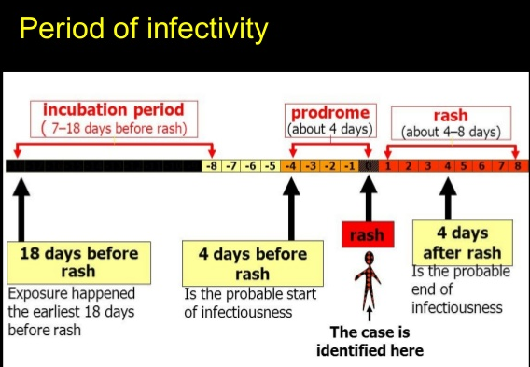

Slide 34
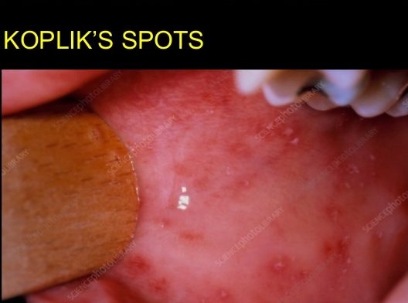

Slide 35
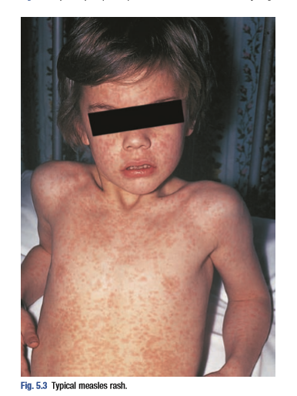

Slide 36
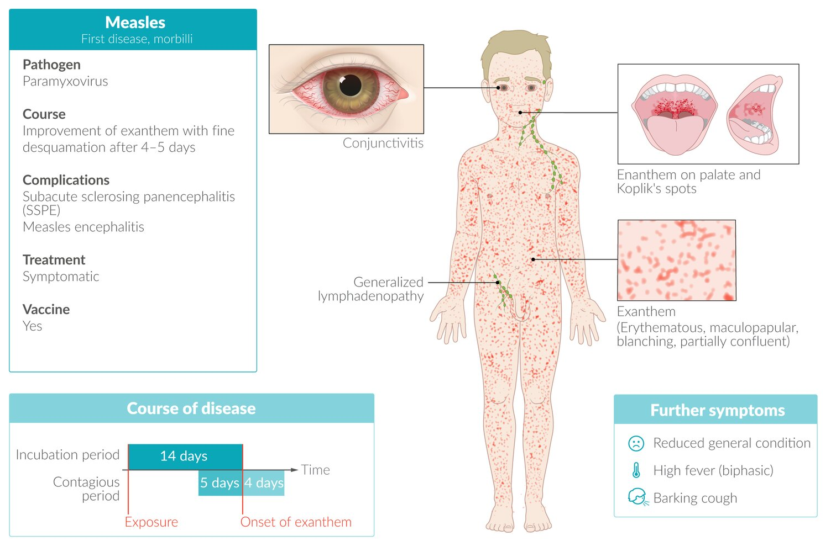

Slide 37
Management
In the immunocompetent, the disease is self-limiting; however, severity and complications are increased in the malnourished and immunosuppressed.
Pregnant women should be considered for treatment with immunoglobulin.
All children aged 12–15 mths should be vaccinated against measles as a combined vaccine with mumps and rubella (MMR), with a further dose at age 4 yrs.
Antibiotics are only indicated for superinfection.
Notes:
In the immunocompetent, the disease is self-limiting; however, severity and complications are increased in the malnourished and immunosuppressed. Pregnant women should be considered for treatment with immunoglobulin. All children aged 12–15 mths should be vaccinated against measles as a combined vaccine with mumps and rubella (MMR), with a further dose at age 4 yrs. Antibiotics are only indicated for superinfection.

Slide 38
Rubella (German measles)
Transmitted by aerosol.
infectivity from up to 10 days before to 2 wks after the onset of the rash.
The incubation period is 15–20 days.
Most childhood cases are subclinical, although disease can present with lymphadenopathy and a maculopapular rash that starts on the face and moves to the trunk.
Complications include arthralgia, thrombocytopenia, hepatitis and rarely encephalitis.
Notes:
Rubella is a viral exanthem transmitted by aerosol, with infectivity from up to 10 days before to 2 wks after the onset of the rash. The incubation period is 15–20 days. Most childhood cases are subclinical, although disease can present with lymphadenopathy and a maculopapular rash that starts on the face and moves to the trunk. Complications include arthralgia, thrombocytopenia, hepatitis and rarely encephalitis. The greatest significance of rubella is for pregnant women, as transplacental infection may result in severe congenital disease. If rubella is suspected in a pregnant woman, confirmation is provided either by rubella IgM antibodies in serum or by IgG seroconversion. In the exposed pregnant woman, the absence of rubella IgG indicates potential for infection. Children should be immunised against rubella as part of standard vaccination programmes using MMR (see above). Women of child-bearing age should be tested and vaccinated if seronegative.

Slide 39
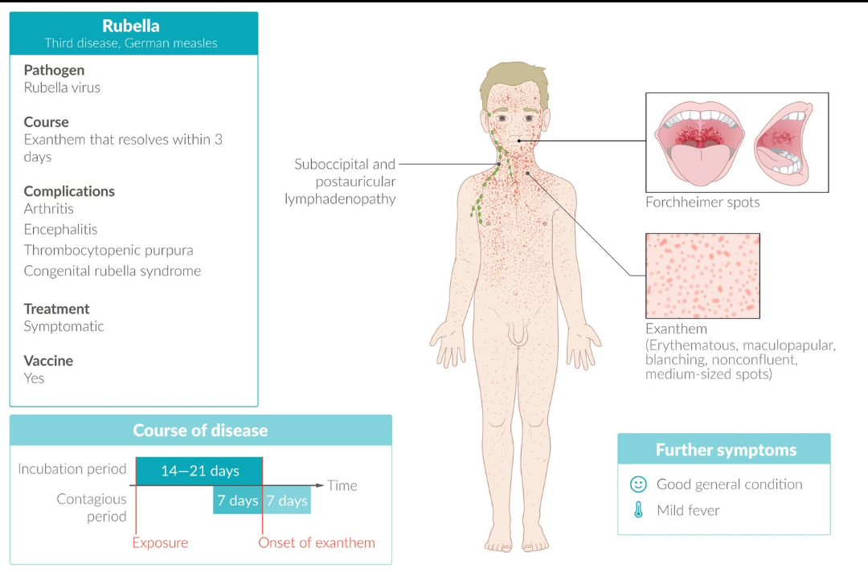

Slide 40
Transplacental infection may result in severe congenital disease= CRS( heart defects –PDA-, deafness, eye problems, learning disability &microcephaly ..).
If rubella is suspected in a pregnant woman, confirmation is provided either by rubella IgM antibodies in serum or by IgG seroconversion.
In the exposed pregnant woman, the absence of rubella IgG indicates potential for infection.
Children should be immunised against rubella as part of standard vaccination programmes using MMR.
Women of child-bearing age should be tested and vaccinated if seronegative.

Slide 41
Parvovirus B19
This air-borne virus causes mild or subclinical infection in normal hosts.
Around 50% of children and 60–90% of adults are seropositive.
clinical manifestations.
transient block in erythropoiesis.
Parvovirus B19 DNA may be detected in the serum by PCR.
If infection occurs during pregnancy, the fetus should be monitored closely for signs of hydrops.
Notes:
This air-borne virus causes mild or subclinical infection in normal hosts.
Around 50% of children and 60–90% of adults are seropositive.
clinical manifestations.
transient block in erythropoiesis, which is insignificant unless haemoglobinopathy or haemolysis is also present.
Parvovirus B19 DNA may be detected in the serum by PCR; however, as illness is usually mild or subclinical and self-limiting, confirmatory blood tests are not always required.
If infection occurs during pregnancy, the fetus should be monitored closely for signs of hydrops.

Slide 42
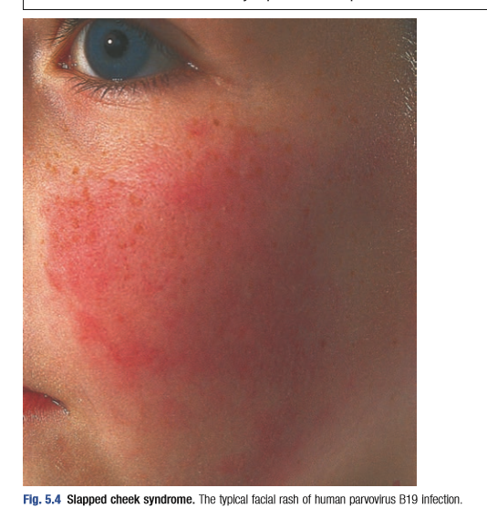

Slide 43
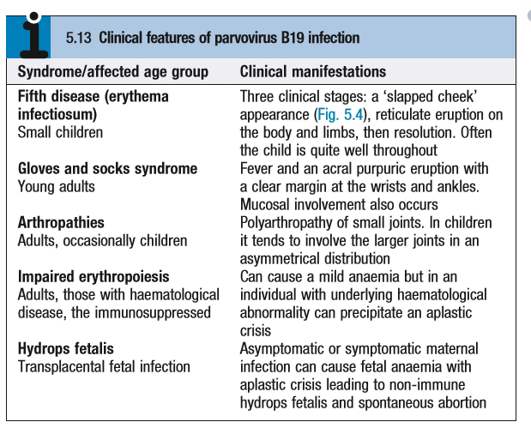

Slide 44
Human herpesvirus 6 and 7
Sixth disease.=roseola
These viruses are associated with a benign febrile illness of children with a maculopapular erythematous rash: ‘exanthem subitum’.
In the immunocompromised they cause an infectious mononucleosis-like syndrome.
Around 95% of children are infected by age 2.

Slide 45
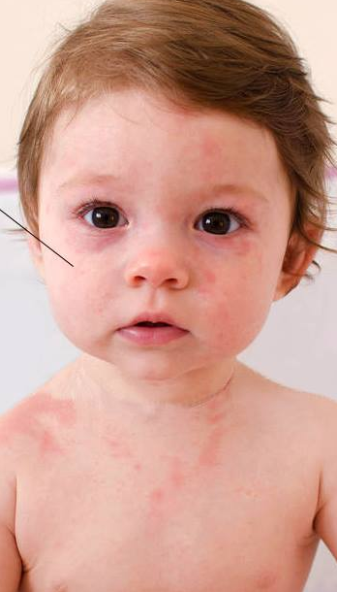
Roseola.

Slide 46
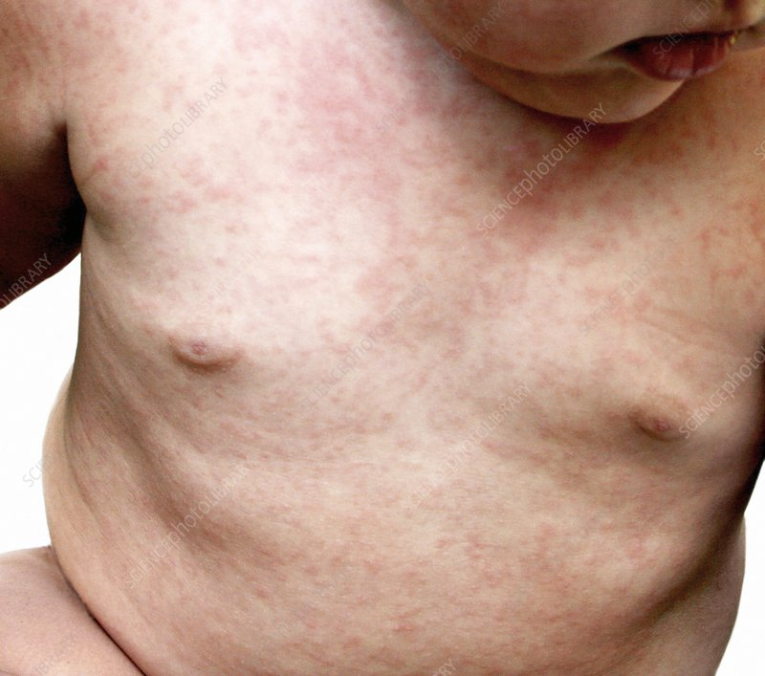

Slide 47


