Slide 1
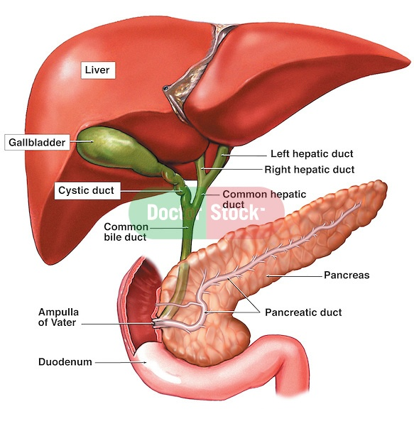
Biliary tract anatomy

Slide 2
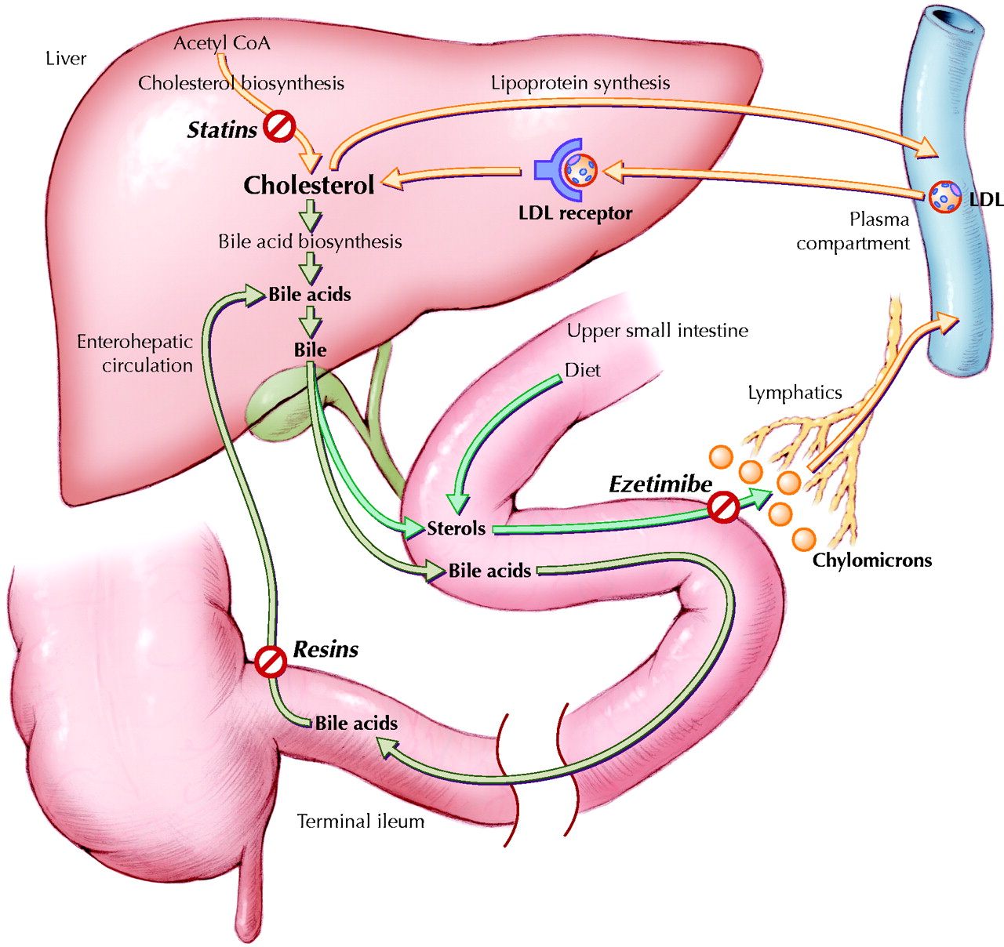
Principal pathways of metabolischolesterol in liver

Slide 3
Composition of bile:
    Bilirubin (by-product of haem degradation)
    Cholesterol (kept soluble by bile salts and lecithin)
    Bile salts/acids (cholic acid/chenodeoxycholic acid): mostly reabsorbed in terminal ileum(entero-hepatic circulation).
    Lecithin (increases solubility of cholesterol)
    Water (makes up 97% of bile)

Slide 4
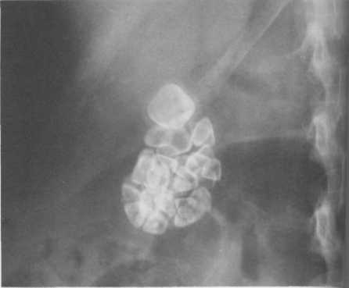
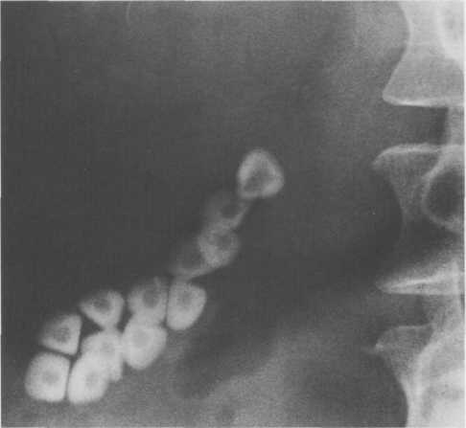
الوسائل التشخيصية :
1-الصورة الشعاعية البسيطة للبطن : تظهر الحصيات بنسبة 15-10 %
بعض أمراض الطرق الصفراوية فإن وجود الهواء في الطرق الصفراوية على الصورة البسيطة يدل على:
1- ناسور معوي صفراوي ( من مرض أو جراحة ) 2- التهاب طرق صفراوية
3- التهاب مرارة نفاخي 4- أسكاريس الطرق الصفراوية
Radio-opaque gall stones. Plain film showing multiple faceted stones with lucent centres. Calculi in the gallbladder.

Slide 5
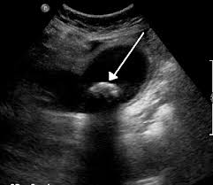
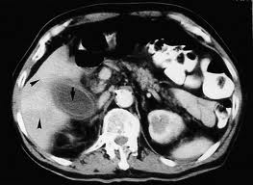
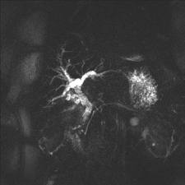
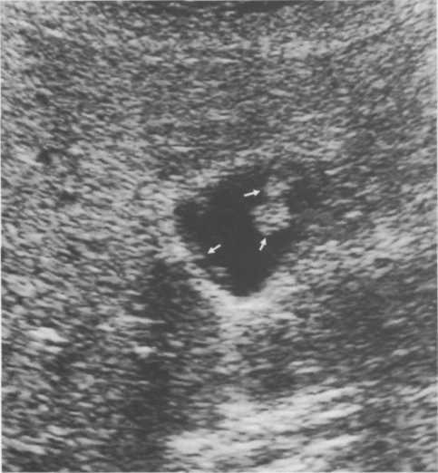
2- تصوير المرارة بإعطاء المادة الظليلة عن طريق الفم ( Oral Cholecystography
تؤخذ مادة ظليلة فموياً ليلاَ قبل الفحص و التي تمتص و تفرز عبر الصفراء لتعبر إلى المرارة , و تؤخذ صور شعاعية , و تشاهد الحصيات بشكل عيوب إمتلاء في المرارة , أو عدم ارتسام المرارة يدل على أمراض فيها , و لقد أستبدل هذا الإجراء بالتصوير بالأمواج فوق الصوتية على نطاق واسع
Polyps. These tiny polyps (arrows) in the gall bladder are aggregations of cholesterol and do not cause acoustic shadowing.

Slide 6
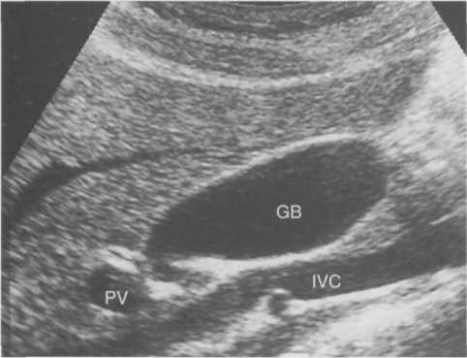
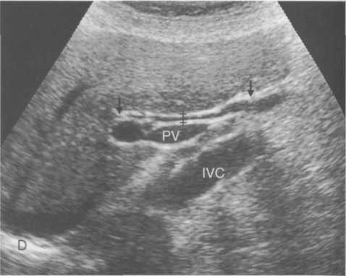
Ultrasound of normal gall bladder. Note the thin wall and absence of echoes from within the gall bladder. GB, gall bladder; IVC, inferior vena cava; PV, portal vein.
Normal common bile duct. Longitudinal ultrasound sum showing the common bile duct, situated between the arrows, lying anterior to the portal vein. The common bile duct measures 4 mm in diameter (crosses). D, diaphragm; PV, portal vein; IVC, inferior vena cava.

Slide 7
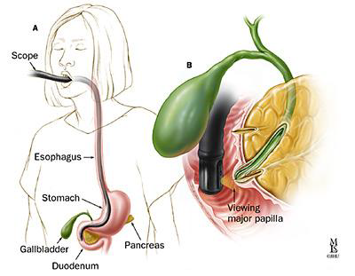
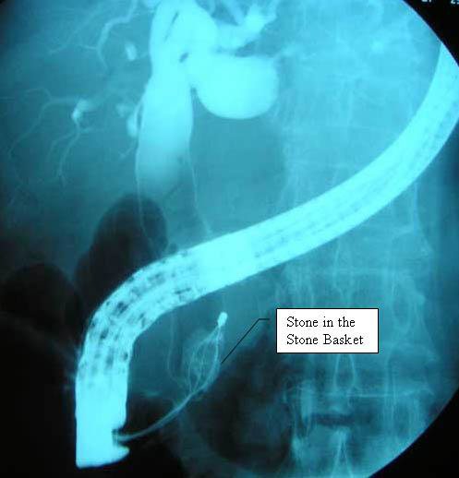
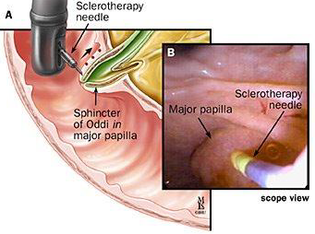
ERCP
Endoscopic retrograde
cholangiopancreatography (ERCP)
Endoscopic tube is placed into the patient’s mouth, through the stomach, and into the duodenal portion of the small intestine.
Contrast is introduced into the biliary tract through the endoscope, in a retrograde manner.
X-rays taken

Slide 8
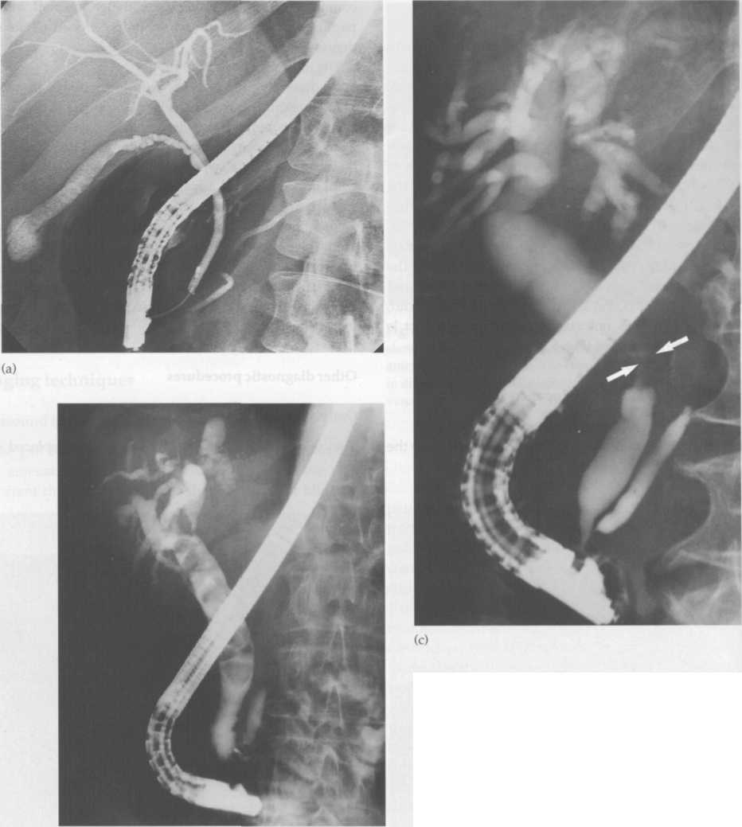
ERCP
Indications
  Jaundice with dilated ducts on USS
  Recurrent pancreatitis
  Post cholecystectomy pain (check for retained stone)
Complications
    Acute pancreatitis
    Bleeding
    Infection – cholangitis
    Perforation

Slide 9
Indications For Biliary Stenting
Indications for stent insertion include:
Ampullary Stenosis
Bile duct injury
Benign or malignant biliary obstruction
Prevention of obstruction where stone extraction is not possible at that time
Pancreatic duct strictures, stones and sphincter of Oddi dysfunction

Slide 10
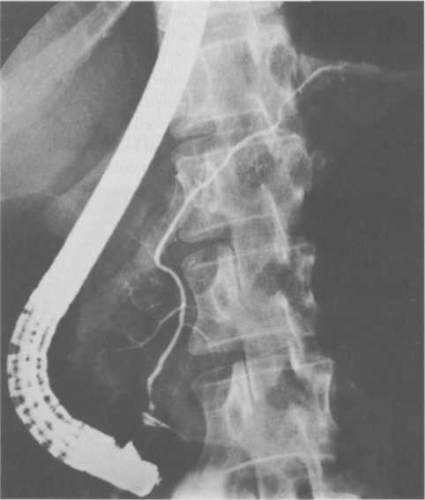
Endoscopic retrograde pancreatography. The pancreatic duct has been cannulated from the endoscope in the duodenum. Contrast has been injected to demonstrate a normal duct system.

Slide 11
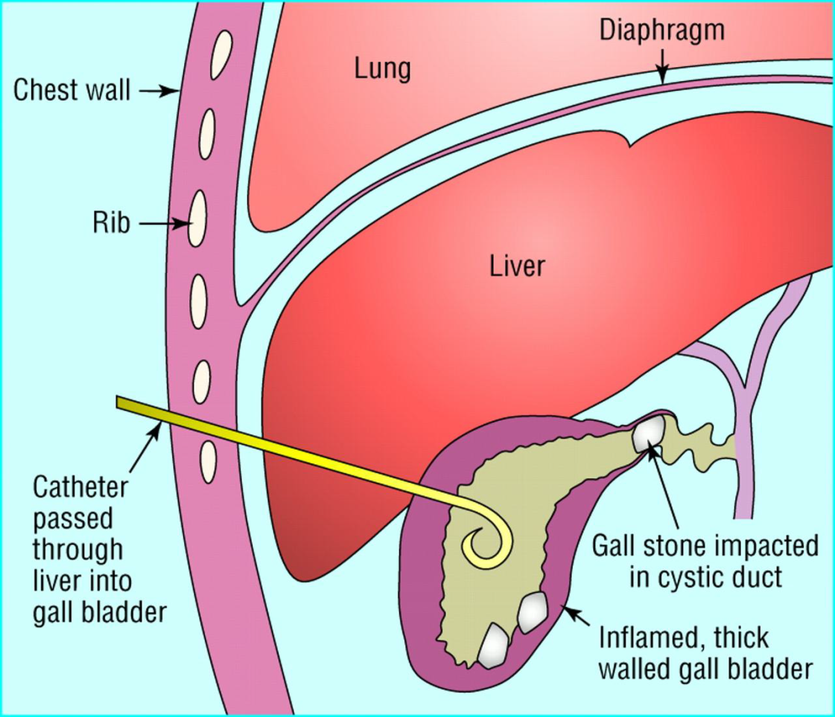
PCC
PerCutaneous Cholecystostomy
تصوير الطرق الصفراوية عبر الجلد من خلال الكبد ( Percutaneous Cholangiography ) : ( PTC ) : و يعتبر مفيداً في حالات تضيقات و أورام القناة الجامعة , و يمكن إجراء صورة للطرق الصفراوية عبر القثطرة , كما يمكن

Slide 12
اليرقان الإنسدادي : هو فرط بيلليروبين الدم >2,5 ملغ/د.ل و هو ناتج عن انسداد الجريان الصفراوي إلى الإثنى عشر
الإيكو هو الدراسة الأولية المفضلة في اليرقان الإنسدادي.
يصنف إلى قبل كبدي و انحلال الدم هو الأشيع و كذلك جلبرت أو تناذر ناجار
اليرقان الكبدي ( التهاب الكبد و تشمع الكبد الكحولي , و أثناء الحمل و بعد العمليات )
اليرقان بعد الكبدي الإنسدادي .
أعراض و علامات اليرقان الإنسدادي : اليرقان – بول غامق – براز شاحب عديم اللون –غثيان – فقد الشهية- حكة بسبب ترسب الأملاح الصفراوية في الأدمة .
بالفحص نجد ضخامة كبد و تكون شائعة في اليرقان الكبدي و بعد الكبدي , و كذلك ضخامة الطحال و الحبن مع التشمع
علامة كورفوازييه ( Courvoisier Law ) :مرارة مجسوسة غير محصاة و قادرة على التمدد لأنها غير متندبة بسبب الحصيات , و في مريض اليرقان يقترح ورم خبيث يسد القناة الجامعة .
التشخيص التفريقي لإنسداد القناة الصفراوية : 1- سرطان المرارة و الأقنية الصفراوية
2- الحصيات 3- التهاب الطرق الصفراوية المصلب 4- ورم القناة الصفراوية السليم
5- الطفيليات 6- تضيق بعد الجراحة 7- سرطان البنكرياس والمجل 8- التهاب البنكرياس و الكيسة الكاذبة

Slide 13
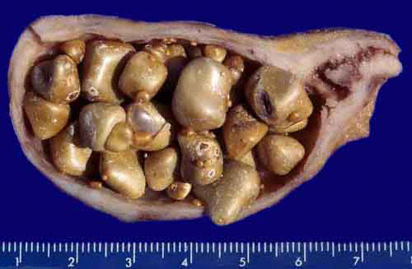
Gallstones
Risk factors:
Obesity
Female gender
Parity
Ethnic predilection (Hispanic, Native americans)
Increasing age
Rapid weight loss Ileal disease
Lipid abnormalities (high TG, low LDL)
Medications (contraceptives, postmenopausal
estrogens, lipid lowering agents
fibric acid derivated)
TPN

Slide 14

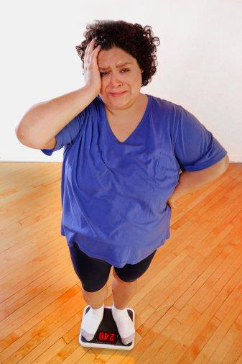


Those who are most at risk.
These are all adjectives to describe the person most at risk of developing symptomatic gallstones.
5 F’s
FAIR
FAT
FORTY
FEMALE
Fertile

Slide 15
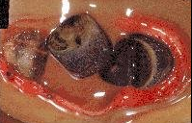
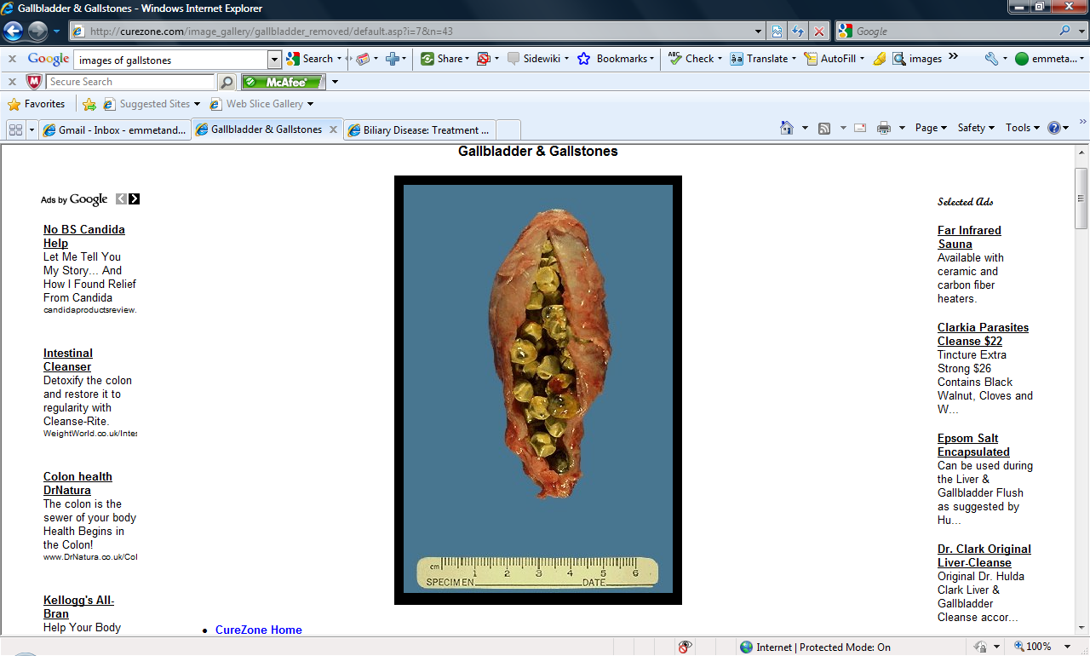
Gallstones – Types
Two main types:
  Cholesterol stones (85%)
  Pigment stones (15%) occur in 2 subtypes
  brown and black.
80% of patients, gallstones are clinically silent
20% of patients develop symptoms over 15-20 years (1-2% per year)

Slide 16
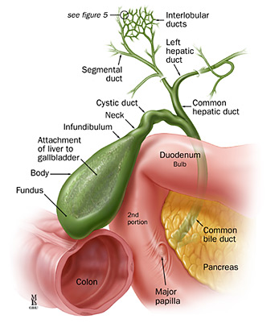
Complications of Gallstones
Biliary Colic
Acute Cholecystitis
    Gallbladder Empyema
    Gallbladder gangrene
    Gallbladder perforation
Obstructive Jaundice
Ascending Cholangitis
Pancreatitis
Gallstone Ileus (rare)

Slide 17
Complications of gallstones
In the gall bladder:
        biliary colic
        Acute and chronic cholecystitis
        Empyema, mucocele
        Carcinoma
In the bile ducts
        Obstructive Jaundice
        Pancreatitis
        Cholangitis
In the Gut
        Gallstone ileus

Slide 18
Biliary Colic
Intermittent obstruction of the cystic duct, no inflammation of GB
Severe epigastric/ RUQ pain growing over 15 min and remaining constant up to 3h
Frequency of attacks varies
Normal examination
Lab tests usually normal
DS: US, EUS
Natural history: 30% have no further symptoms
50% continue symptoms in 2y

Slide 19
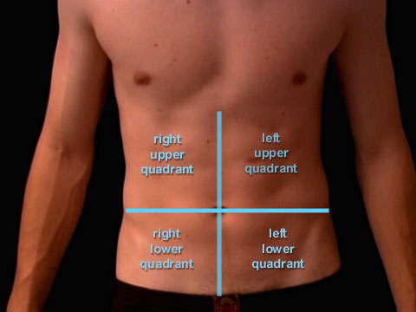
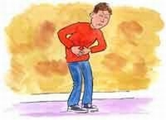
Signs and Symptoms.
Complaints of indigestion after eating high fat foods.
Localized pain in the right-upper quadrant epigastric region.
Anorexia, nausea, vomiting and flatulence.
Increased heart and respiratory rate – causing patient to become diaphoretic which in turn makes them think they are having a heart attack.
DD:

Slide 20
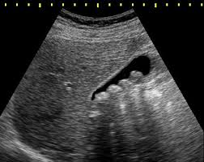
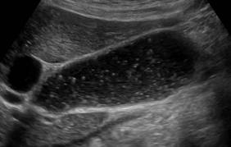

Slide 21
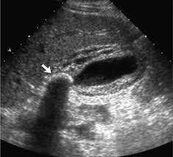
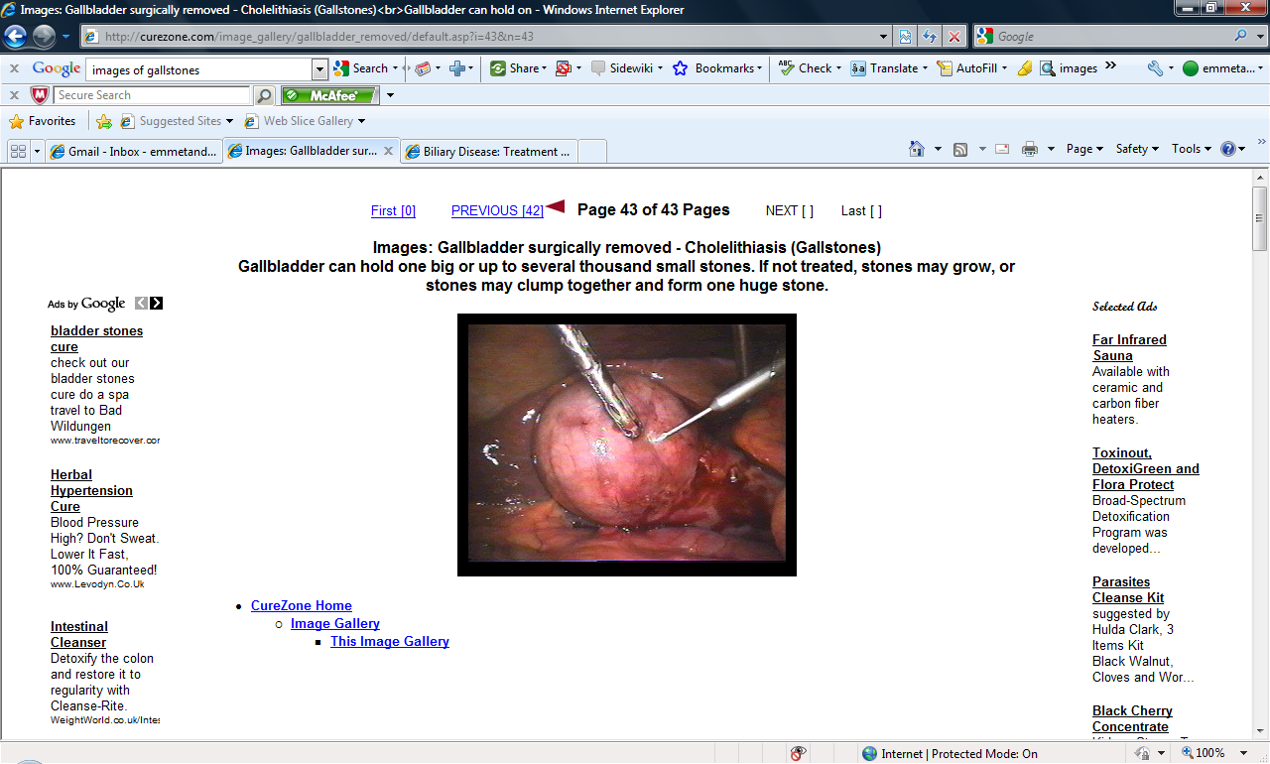
Acute Calculous Cholecystitis
Impacted stone in the cystic duct
75% are preceded by attacks of biliary colic
Visceral epigastric pain – mod to severe, irradiated to RUQ, back, shoulder, chest and lasting > 6 h
Fever, Right subcostal tenderness with inspiratory arrest
( Murphy’s sign) , palpable GB
Leucocytosis, mild elevation of BIL, Amylase
50% resolve spontaneously in 7-10 days without surgery
DS: US, EUS, CT
10% are complicated by perforation.

Slide 22
Pathogenesis
Impaction of gallstones in the cystic duct (>90% cases)
↓
Obstruction and dilatation of gallbladder
↓
Vascular congestion and oedema
↓
Necrosis of wall, bacterial proliferation
↓
Complications eg. gangrene, perforation, liver abscess, cholangitis, bacteraemia etc.

Slide 23
Complications
Infection – develops in >50% cases
Gangrene/empyema
Perforation (10-15%)
Obstruction of bile duct; cholangitis; pancreatitis
Liver abscess
Peritonitis
Bacteraemia

Slide 24
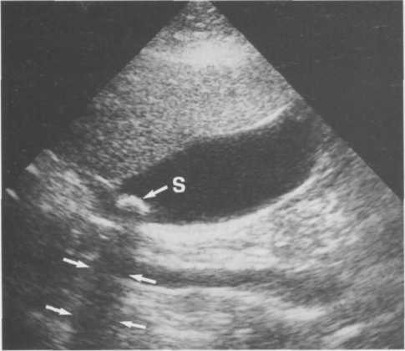
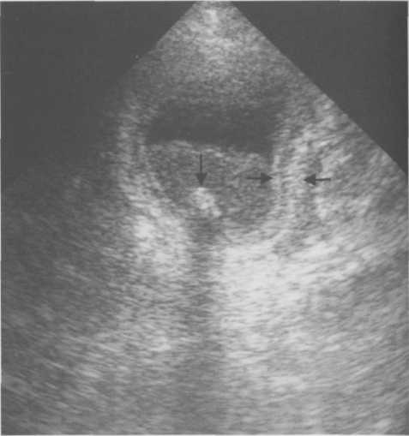
Gallstone. Ultrasound shows a stone (S) in the gall bladder. The arrows, point to the acoustic shadow behind the stone.
Acute cholecystitis. Ultrasound showing a thick oedematous gall bladder wall indicated by the arrows. The gall bladder contains a gall stone (arrow head) and inflammatory debris.

Slide 25
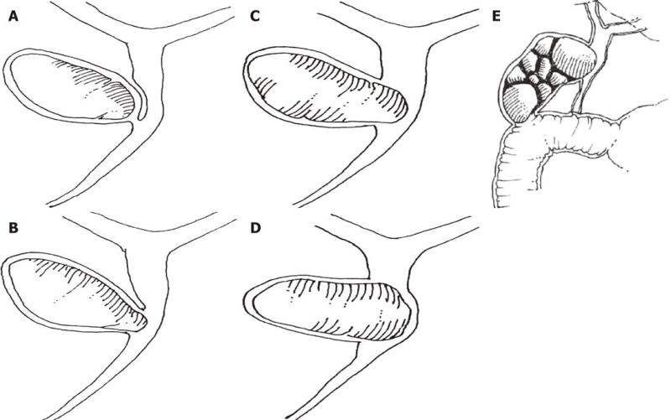
Mirizzi’s Syndrome
Inflammatory phenomenon secondary to a pressure ulcer caused by an impacted gallstone at the gallbladder infundibulum
The impacted gallstone causes first external obstruction of the CBD
Eventually erodes into the bile duct evolving into a cholecystocholedochal fistula with different degrees of communication between the GB and CBD

Slide 26
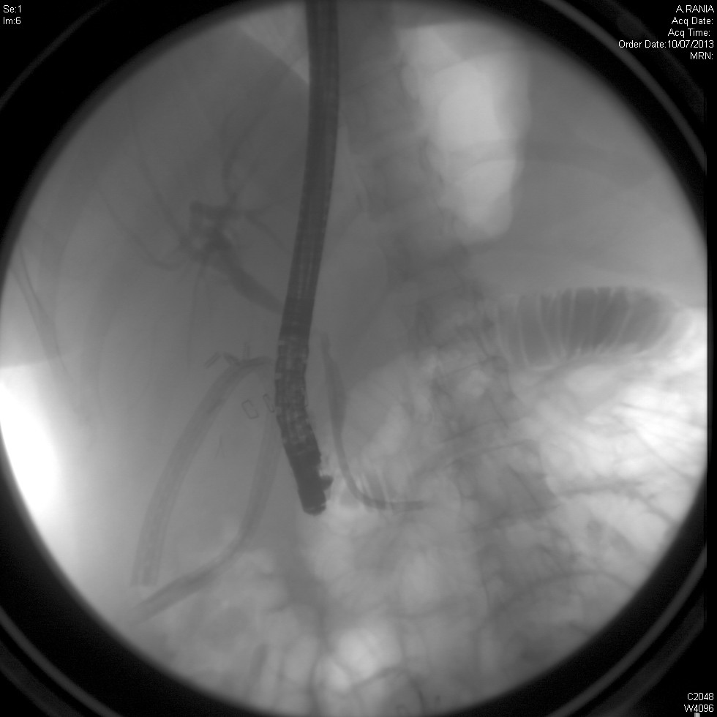
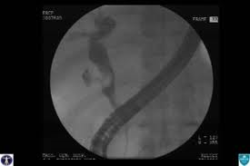

Slide 27
Acute Acalculous Cholecystitis
Presence of an inflamed gallbladder in the absence of an obstructed cystic or common bile duct
Typically occurs in the setting of a critically ill patient (eg, severe burns, multiple traumas, lengthy postoperative care, prolonged intensive care)
Accounts for 5% of cholecystectomies
Etiology is thought to have ischemic basis, and gangrenous gallbladder may result
Increased rate of complications and mortality
An uncommon subtype known as acute emphysematous cholecystitis generally is caused by infection with clostridial organisms and occlusion of the cystic artery associated with atherosclerotic vascular disease and, often, diabetes.

Slide 28
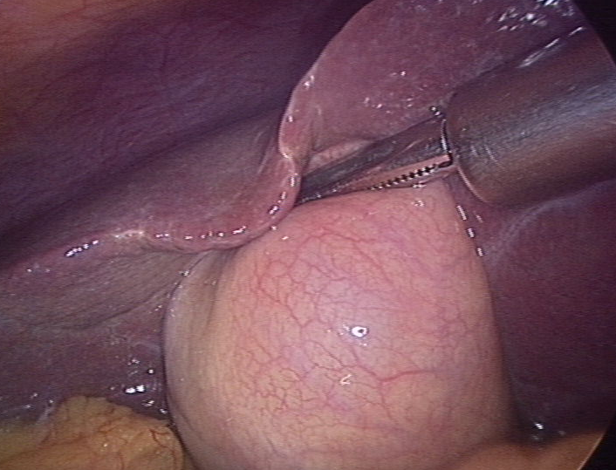
Cholecystectomy
Laparoscopic cholecystectomy standard of care
Timing
  Early vs interval operation
Patient consent
  Conversion to open procedure 10%
  Bleeding
  Bile duct injury
  Damage to other organs

Slide 29
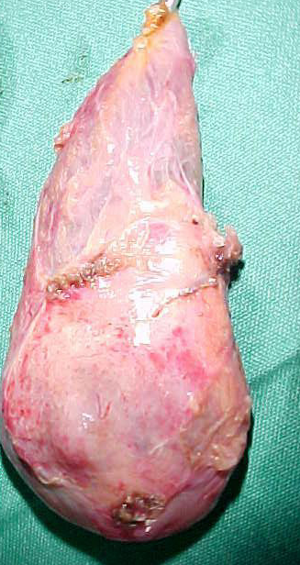
Empyema / Mucocoele
Mucocele refers to an overdistended gallbladder filled with mucoid or clear and watery content.
Empyema refers to a gallbladder filled with pus due to acute cholecystitis

Slide 30
Choledocholithiasis
Intermittent obstruction of CBD
Often symptomatic –
indistinguishable from biliary colic
Predisposed to acute cholangitis and pancreatitis
Signs : jaundice with pain.
Investigations :
  Elevated BIL, transient spike in TranSaminases / Amylase,
  US, EUS, CT
Treatment :
  ERCP - Endoscopic Retrograde CholangioPancreatography

Slide 31
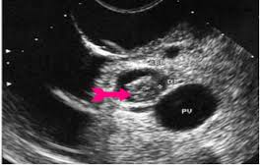
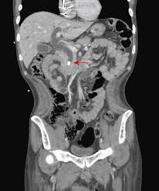
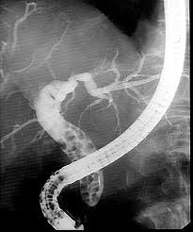

Slide 32
Ascending Cholangitis
Impacted stone in CBD causing bile stasis
Bacterial superinfection
Charcot’s triad : pain, jaundice, fever – 70%
Mental confusion, hypotension, RUQ tenderness
Jaundice (>80%)
Peritoneal signs (15%)
Elevated WBC, BIL, APH (blood cult usually pos)
Emergent decompression of the CBD
(ERCP, PTC)

Slide 33
Acute biliary pancreatitis
  Pancreatic duct obstruction or chemical inflammation
  Signs - Variable – None to Sepsis
(Severe pain, fever, tachycardia, low BP),
Jaundice, acute abdomen
Investigations
  Bloods – U&E, FBC, LFT, Amylase, CRP
  Ultrasound of abdomen
  MRCP
  CT Pancreas
Treatment Supportive / ERCP

Slide 34
Gallstone ileus
Obstruction of the small bowel by a large gallstone
  A stone ulcerates through the gallbladder into the duodenum and causes obstruction at the terminal ileum/rt colon
Symptoms : SBO - vomiting, abdominal pain, distension, obstructive bowel sounds
Investigations: X-ray, US/CT - air in CBD
Treatment : Laparotomy and removal of stone from small bowel and cholecystectomy.

Slide 35
الكيسات الصفراوية : توسعات كيسية خلقية في الشجرة الصفراوية خارج أو داخل الكبد , و هي نادرة الحدوث
و تحدث كيسات القناة الجامعة في الإناث أكثر من الذكور , و رغم أنها كثيراً ما تشخص عند الرضع أو الأطفال , فإن حوالي نصف الحالات لا تشخص إلا عند البلوغ
لا يعرف سبب تشكل هذه الكيسات , و لكن ضعف جدار الأقنية الصفراوية و زيادة الضغط الثانوي للإنسداد الصفراوي الجزئي تعتبر عوامل هامة لتشكل الكيسة الصفراوية , و تكون الكيسات مبطنة بظهارة مكعبة , حيث يتراوح حجمها من 2 سم إلى الكيسات العرطلة
الشكل المغزلي الكيسي في الشجرة الصفراوية خارج الكبد هو الشكل الأشيع , و إن نسبة تطور كارسينوما الطرق الصفراوية في المرضى الذين يعانون من كيسات القناة الجامعة تصل إلى 15 % في البالغين .
الأعراض و العلامات : ألم بطني , يرقان , و كتلة و يؤكد التشخيص بالإيكو أو CT Scan , و لكن تقييم التشريح الصفراوي و التخطيط للمعالجة الجراحية يتطلب تصوير الطرق الصفراوية بواسطة ERCP , MRCP أو PTC
العلاج : استئصال الشجرة الصفراوية خارج الكبد بما في ذلك المرارة مع مفاغرة كبدية صائمية

Slide 36
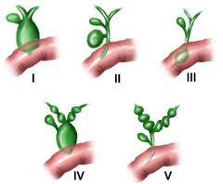
Choledochal cysts
Classified into 5 types
Can occur in the presence of pancreatico-biliary maljunction (PBM)
Treatment for choledochal cysts is surgical excision of the cyst with construction
Most ominous complication is malignancy 15 %
PBM
Caroli disease

Slide 37
Biliary Tract Tumor
Cholangiocarcinoma
Cancer of the Gall Bladder

Slide 38
Cholangiocarcinoma
Slow growing malignancy of biliary tract which tend to infiltrate locally and metastasize late
90% adenocarcinoma
60-70% at the bifurcation ofhepatic ducts
20-30% - in the distal CBD
5-10% - arise within the liver (peripheral)

Slide 39
Biliary Tree Neoplasms
  Fever (21%)
  Malaise (19%)
  Diarrheoa (19%)
  Constipation (16%)
  Abdominal fullness (16%).
Clinical symptoms:
  Weight loss (77%)
  Nausea (60%)
  Anorexia (56%)
  Abdominal pain (56%)
  Fatigue (63%)
  Pruritus (51%)
Symptomatic patients usually have advanced disease, with spread to hilar lymph nodes before obstructive jaundice occurs
Associated with a poor prognosis

Slide 40
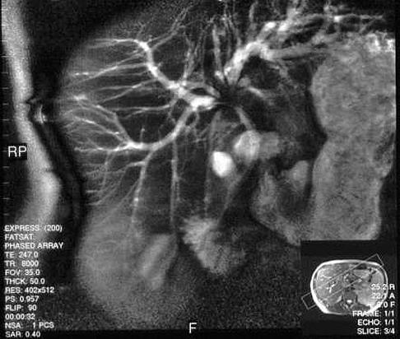
MRCP: Cholangiocarcinoma at the Bifurcation
Klatskin tumour - Cholangiocarcinoma of junction of right & left hepatic ducts

Slide 41
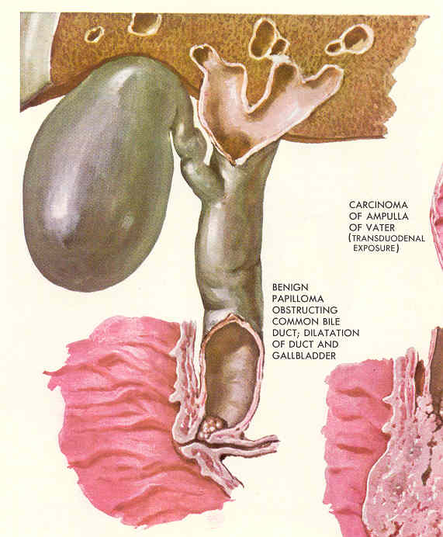
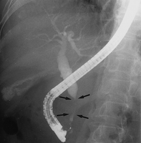
ERCP: Distal CBD Cancer

Slide 42
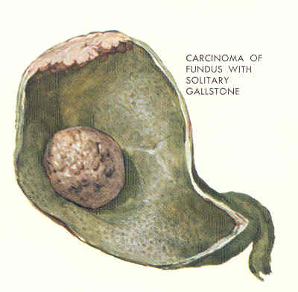
Gallbladder Cancer
6th decade
1:3, Male:Female
Highest prevalence in, Mexico, Chile, Japan, and Native American women.
Risk Factors: 90% have gallstones, porcelain gallbladder
polyps particulary larger than 10 mm, Choledochal cysts
Uncommonly diagnosed preoperatively
>80% with gallstones
Clinical manifestation from abdominal pain to unexplained weight loss and jaundice
Palpable RUQ mass
Jaundice suggests local extention with ductal obstruction
DS: US, EUS, CT
Surgery is the only curative option :Treatment
Tumors limited to the muscular layer (T1) need simple cholecystectomy

Slide 43
Adenocarcinomas is 80-90%
Cancer spreads through the lymphatics, venous drainage, and with direct invasion
Clinical Manifestations :
vomiting. abdominal discomfort, right upper quadrant pain, nausea, and
less common: Jaundice, weight loss, anorexia, ascites, and abdominal mass

Slide 44
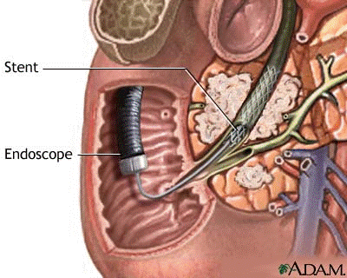
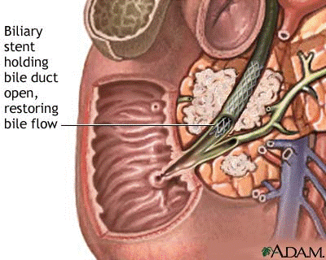
Stent Placement -Endoscopic Approach
A catheter is inserted through the endoscope into the ostium of the common bile duct.
While maintaining the endoscope position in the duodenum, a wire is inserted through the catheter into the bile duct.
The stent delivery system is then inserted over the wire
to the site of obstruction, where the stent is deployed.

Slide 45
Bile Duct Carcinoma
Etiology :
Primary sclerosing cholangitis
choledochal cysts ulcerative colitis
hepatolithiasis biliary-enteric anastomosis infection with Clonorchis or in chronic typhoid carriers
Adenocarcinomas is Over 95%
Anatomically divided into distal, proximal, or perihilar tumors

Slide 46
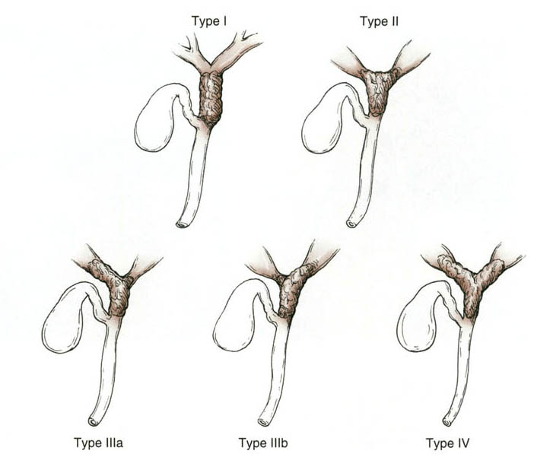

Slide 47
Clinical Manifestations :
Painless jaundice
Pruritus,
mild right upper quadrant pain,
anorexia,
fatigue,
weight loss
: Diagnosis
ultrasound
CT scan
Cholangiography( PTC, ERC )
celiac angiography
MRI
Treatment :
Surgical excision is the only potentially curative treatment
unresectable perihilar cholangiocarcinoma need Roux-en- Y cholangiojejunostomy to segment II or III bile ducts or to the right hepatic duct

Slide 48
Complication | History | Examination | Blood tests
Biliary Colic | - Intermittent RUQ/epigastric pain (minutes/hours) into back or right shoulder - N&V | -Tender RUQ -No peritonism -Murphy’s – -Apyrexial, HR and BP (N) | -WCC (N) CRP (N) - LFT (N)
Acute Cholecystitis | -Constant RUQ pain into back or right shoulder -N&V -Feverish | Tender RUQ Periotnism RUQ (guarding/rebound) Murphy’s + Pyrexia, HR (↑) | WCC and CRP (↑) LFT (N or mildly (↑)
Empyema | -Constant RUQ pain into back or right shoulder -N&V -Feverish | Tender RUQ Peritonism RUQ Murphy’s + Pyrexia, HR (↑), BP (↔ or ↓) More septic than acute cholecystitis | WCC and CRP (↑) LFT (N or mildly (↑)
Obstructive Jaundice | Yellow discolouration Pale stool, dark urine painless or assocaited with mild RUQ pain | Jaundiced Non-tender or minimally tender RUQ No peritonism Murphy’s – Apyrexial, HR and BP (N) | WCC and CRP (N) LFT: obstructive pattern bili (↑), ALP (↑), GGT (↑), ALT/AST (↔) INR (↔ or ↑)
Ascending Cholangitis | Becks triad -RUQ pain (constant) -Jaundice -Rigors | -Jaundiced -Tender RUQ -Peritonism RUQ Spiking high pyrexia (38-39) HR (↑), BP (↔ or ↓) Can develop septic shock | WCC and CRP (↑) LFT : obstructive pattern bili (↑), ALP (↑), GGT (↑), ALT/AST (↔) INR (↔ or ↑)
Acute Pancreatitis | Severe upper abdominal pain (constant) into back Profuse vomiting | -Tender upper abdomen -Upper abdominal or generalised peritonism -Usually apyrexial, HR (↑), BP (↔ or ↓) | -WCC and CRP (↑) -LFT: (N) if passed stone or obstructive pattern ifstone still in CBD Amylase (↑) INR/APTT (N) or (↑) if DIC
Gallstone Ileus | - 4 cardinal features of SBO | -distended tympanic abdomen -hyperactive/tinkling bowel sounds

Slide 49
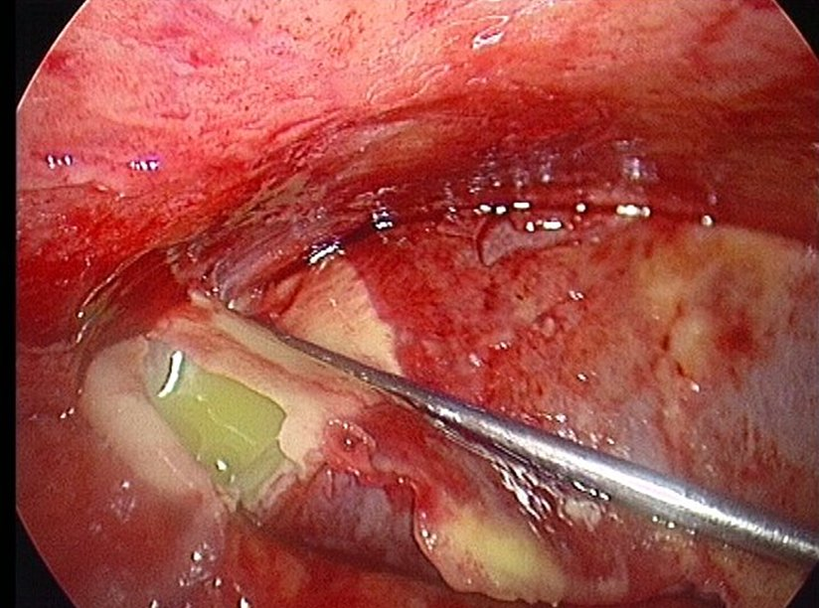

Slide 50
Acute Cholangitis
Pus under pressure
May be difficult to distinguish from acute cholecystitis
Managed medically with support, antibiotics
Drainage is key
Etiology
Stone disease
Anomalous PBJ
Malignant biliary obstruction
Primary sclerosing cholangitis
Post instrumentation
  Cholangiography
  Surgery
  Sphincterotomy
  Stents
Charcot’s triad
  Pyrexia, Pain, Jaundice
Elevated liver enzymes
Leukocystosis

Slide 51
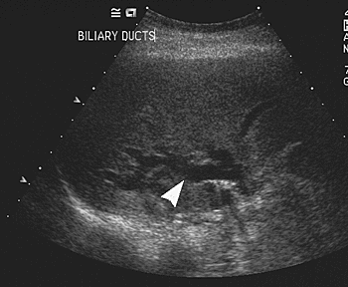
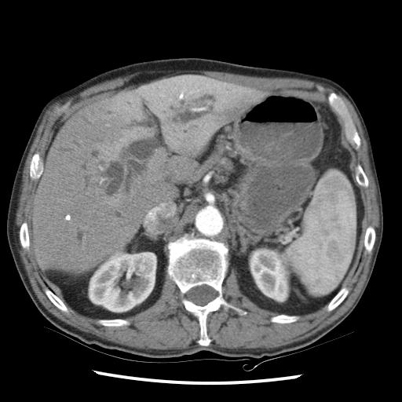
Diagnosis
Clinical
Ultrasound
  Duct dilation
  Presence of gallbladder or CBD stones
CT
  Duct dilation
  R/O other causes
MRCP (especially for hilar obstruction, if stable pt.)
ERCP (generally for therapy)

Slide 52
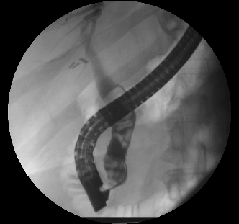
Biliary Drainage
Endoscopic
Surgical
Percutaneous

Slide 53
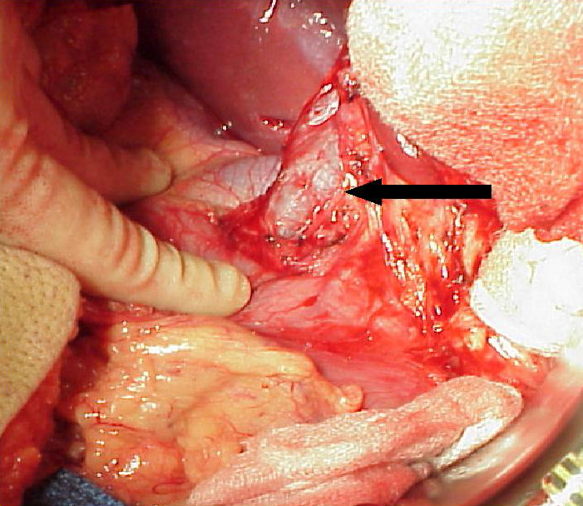

Slide 54
Cholangitis
Inflammation involving the hepatic and common bile ducts
Pathogenesis similar to that of cholecystitis: obstruction of common bile duct → oedema, congestion, necrosis of walls → bacterial proliferation within biliary tree.
Causes of obstruction:
- gallstones
- biliary tract surgery, tumour, parasitic infection, calcific pancreatitis etc.
Clinical features
High fever
RUQ pain
Jaundice (usually prominent)
(Charcot’s triad: present in 85% cases)
Chills, rigors
RUQ tenderness, pale stools
Sepsis, septic shock

Slide 55
Complications
Bacteraemia (about 50% cases)
Liver abscesses
Septic shock
Diagnosis
Marked leukocytosis
Marked ↑ bilirubin, alk phosphatase; moderate ↑ transaminases
Blood cultures:
- enteric GNB and anaerobes most frequently isolated.
Imaging studies:
- ultrasound; CT scan
- ERCP (endoscopic retrograde cholangio-pancreatography), PTC (percutaneous transhepatic cholangiography)
Treatment
Prompt institution of appropriate antimicrobial therapy essential:
- initial choice usually empirical
- eg. 3rd gen cephalosporin/quinolones/co-amoxiclav + metronidazole.
Surgery:
- usually necessary in most patients
- decompression & exploration of cbd, T-tube drainage, +/- cholecystectomy.

Slide 56



Dilated intrahepatic ducts, (a) Longitudinal scan through the liver showing dilatation of the biliary system. Dilated intrahepatic ducts are arrowed. GB, gall bladder, (b) Double-channel sign. A dilated biliary duct lies in front of a portal vein. Normally the duct is much smaller than the accompanying portal vein, (c) CT scan showing dilated intrahepatic ducts (arrows) in the liver.
c
a
b

Slide 57


Stones in the common bile duct (CBD). The common bile duct is dilated measuring 2 cm in diameter and a large stone (arrow) is seen in its lower portion. PV, section through portal vein.
Percutaneous cholangiogram. Carcinoma of the pancreas. There is complete obstruction of the common bile duct (arrow). Note the dilated intrahepatic ducts.

Slide 58

What does this ERCP show?

Slide 59


