Slide 1
Skin Anatomy

Slide 2
Skin Appendages

Slide 3
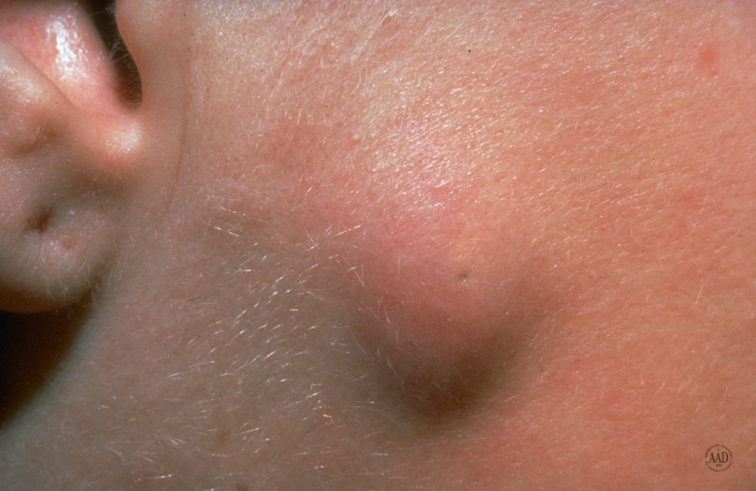
Epidermoid Cyst
Common, affecting young and middle age adults
Usually seen on the head, neck and trunk
Often can identifiy a punctum
Cyst contains keratin

Slide 4
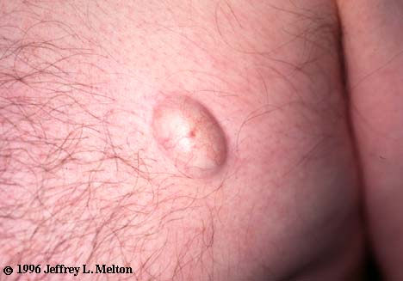
Superficial Epidermal cyst
5 cm
Fluid filled
Fluctuant
Orifice or "pore" near the center

Slide 5
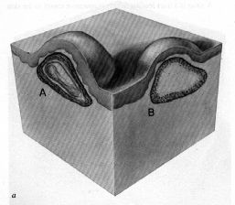
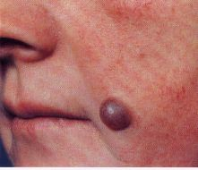
Skin Lesions and Diagnosis
Notes:
A cyst is a sac that contains liquid or semisolid material such as fluid, cells, and cell products. A spherical or oval nodule or papule may clinically be suspected of being a cyst if it is resilient on palpation. The common cysts, shown in the drawing at left, include epidermal cysts (A), lined with squamous epithelium which produce keratinous material. Cysts of hair follicle origin are lined with multilayered epithelium that does not mature through a granular layer. These are called pilar cysts (B).The bluish resilient cyst shown on the right photograph represents a cystic adnexal tumor, in this case a cystic hidradenoma, which is filled with a mucus-like material.

Slide 6
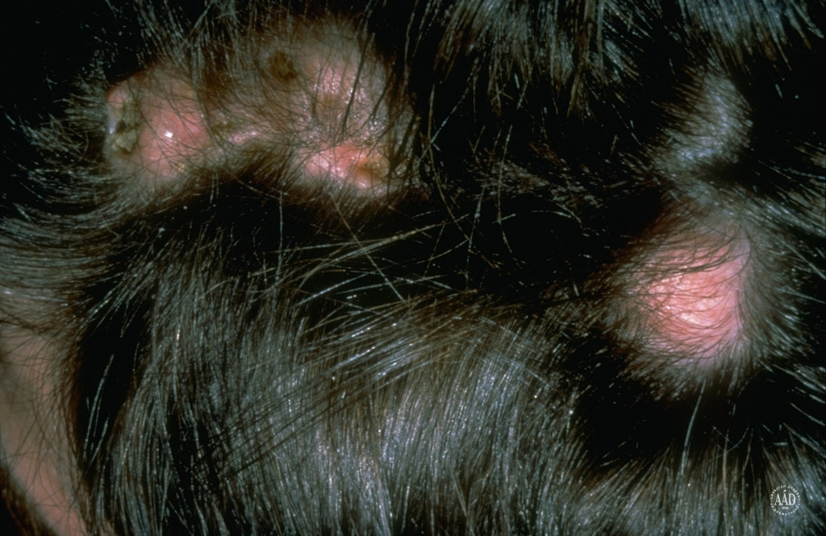
Pilar Cysts

Slide 7
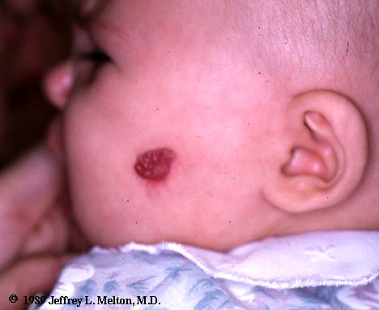
Strawberry hemangioma
Red
Patch
5 cms
Elevated
Blanch with pressure
Capillary angiomas composed of small, superficial vessels

Slide 8
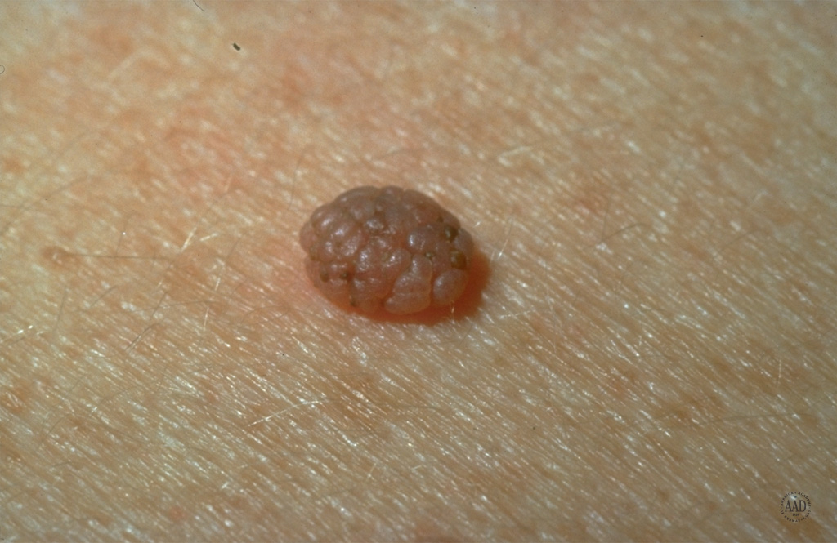
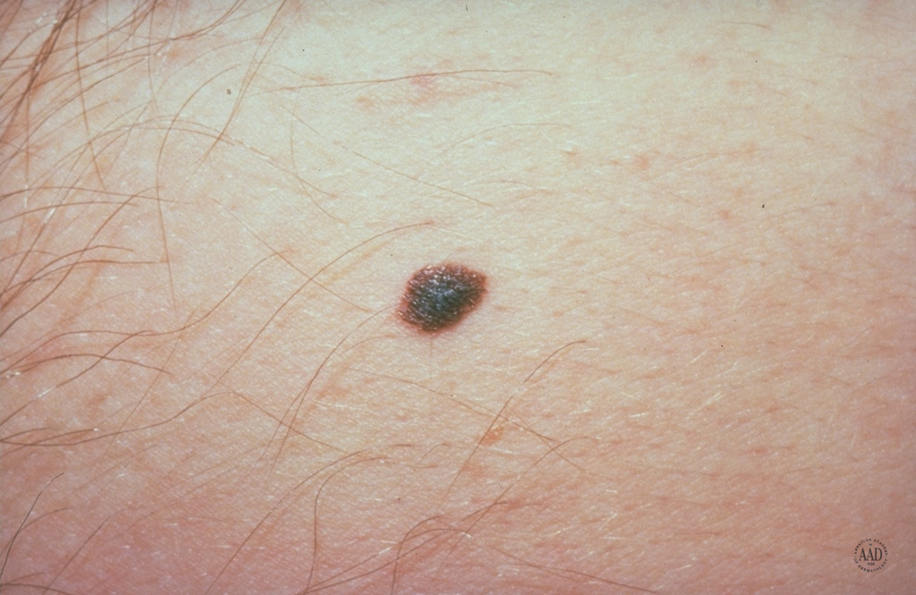
Nevus A benign cluster of melanocytic cells arising as a result of proliferation of melanocytes at the dermo-epidermal junction. These may all remain in contact with the basal layer (the junctional nevus) or may become dettached from the basal layer and lie free in the dermis (the compound and intradermal nevus).

Slide 9
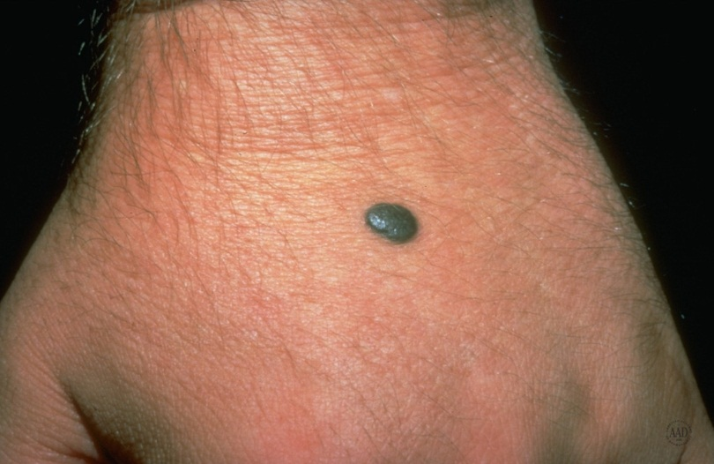
Blue Nevus
An area of blue-black dermal pigmentation produced by an aberrant collection of pigment producing melanocytes
The brown pigment absorbs the longer wavelength of light and scatters blue light (Tyndall effect)
Extend into the deep dermis, often occur on extremities and the dorsum of the hand

Slide 10
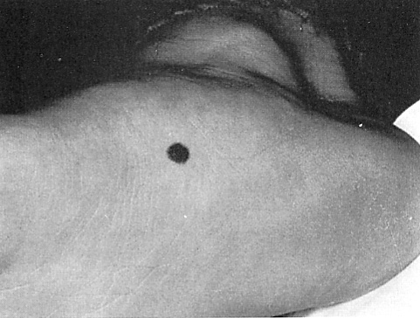
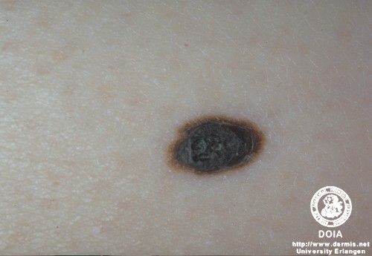
Junctional Nevi
Nevi begin as small, flat, pigmented macules = junctional nevi
A smooth, hairless, light to dark brown macule, varying in size from 1 –6 mm
Occurs on any site, especially on palms, soles, scrotum
During adolescence some will become compound or intradermal
It is characterized by single melanocytes, or theques of them in the lower epidermis

Slide 11
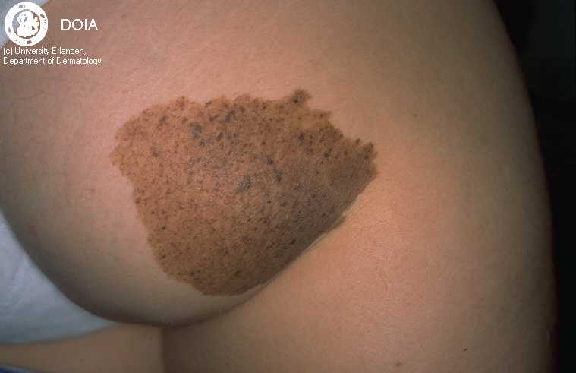
Nevus Spilus
Pigmented, light brown or tan macule, varied diameter, speckled with smaller, darker-colored macules or papules
Lower extremity & trunk frequently
May be <1cm or large
May follow a dermatomal distribution when large
Usually they do not cross the midline

Slide 12
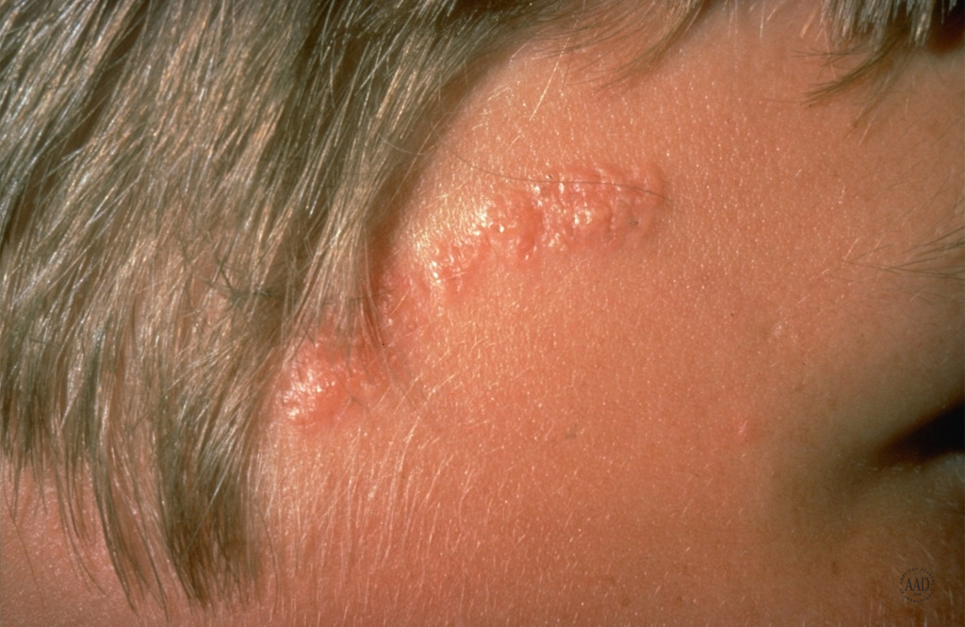
Epidermal Nevus

Slide 13
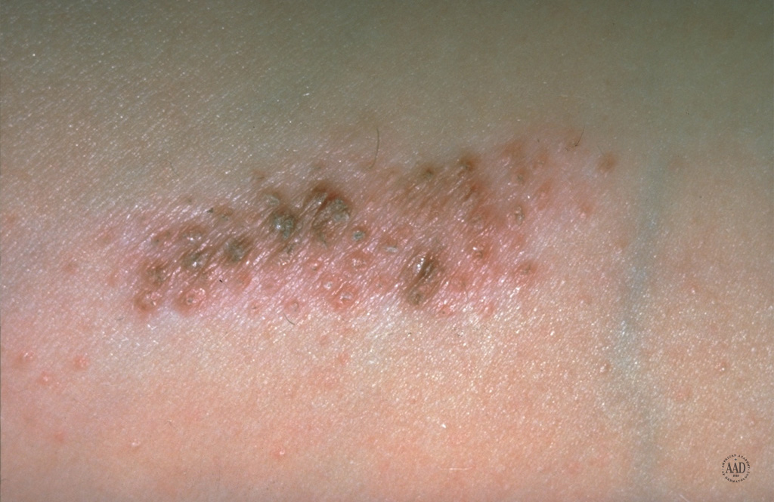
Nevus Comedonicus

Slide 14
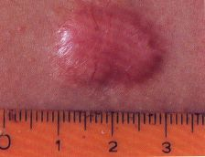
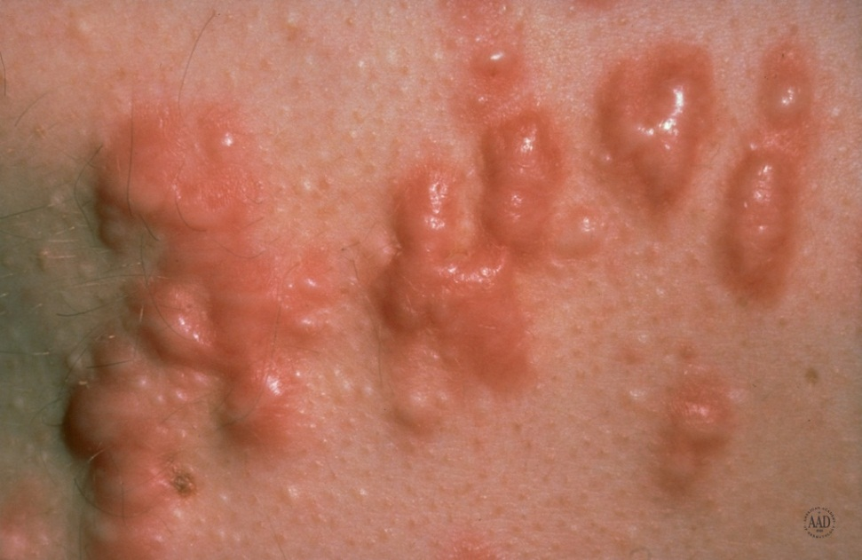
Keloid
An exaggerated reparative fibroblastic response to injury of the skin
Genetic tendency
Most commonly found on the ears, neck and trunk

Slide 15
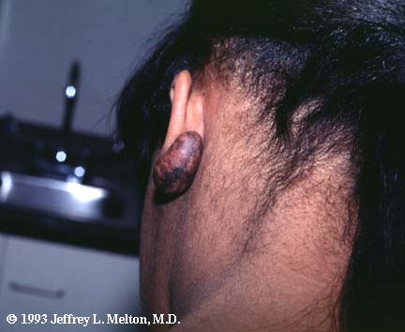
Keloid (after piercing)
Very firm
Rubbery lesions
Reddish or darkly colored
Occur after trauma sometimes very minor trauma
May itch.

Slide 16
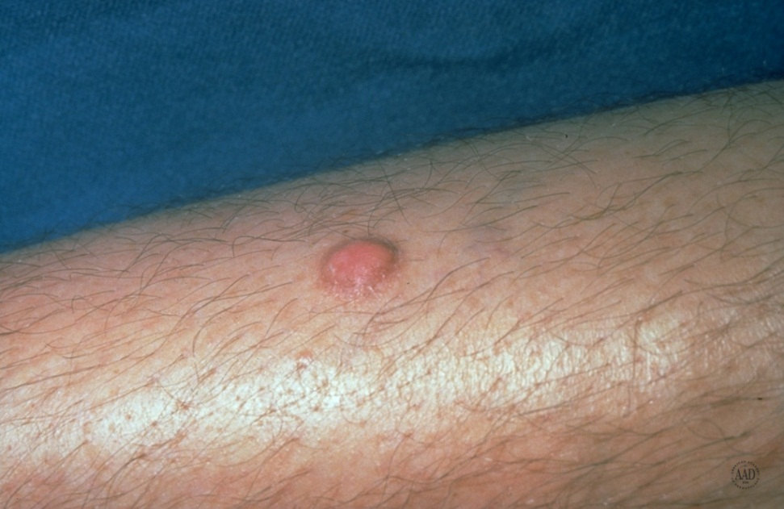
Dermatofibroma
Can occur on any part of the body, most common on the lower extremities, to a lesser degree on the upper extremities and trunk
May be single or multiple
Usually pink or brown
Commonly 6mm or less
Hard consistency

Slide 17
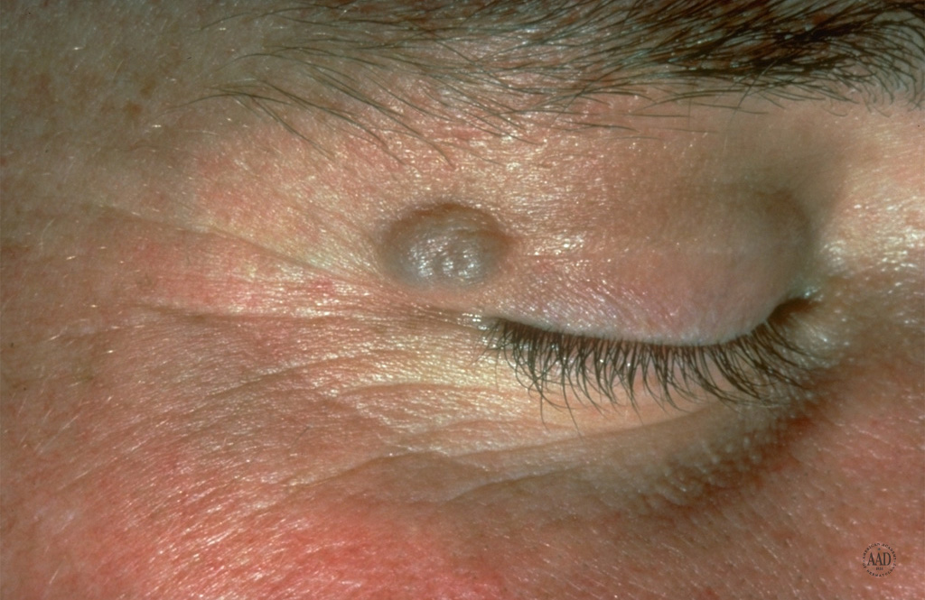
Hidrocystoma

Slide 18
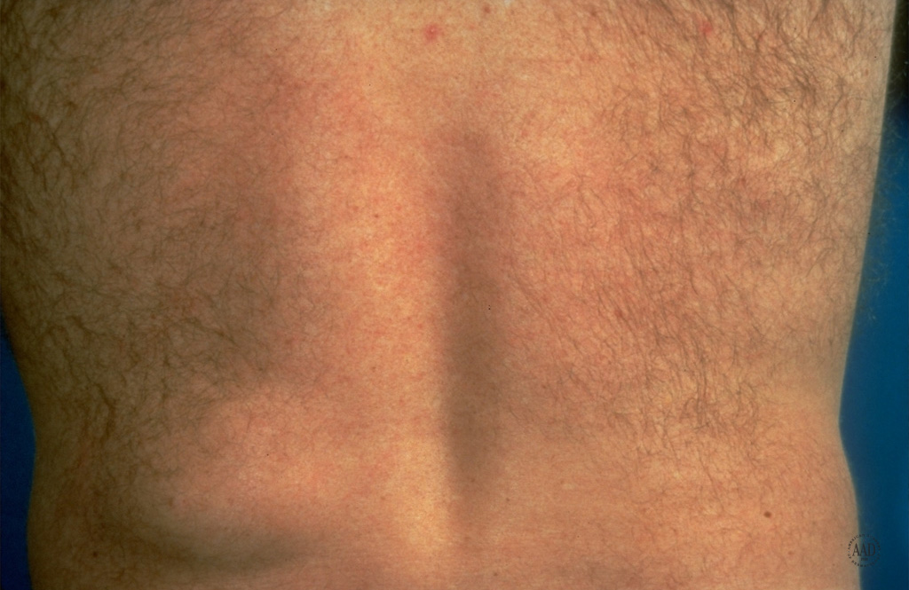
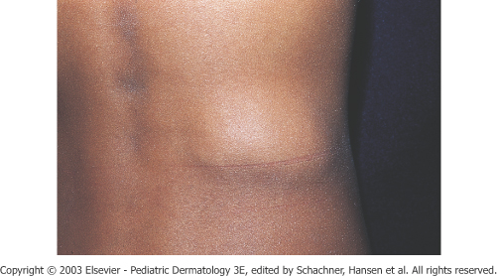
Lipoma

Slide 19
Premalignant Tumors

Slide 20
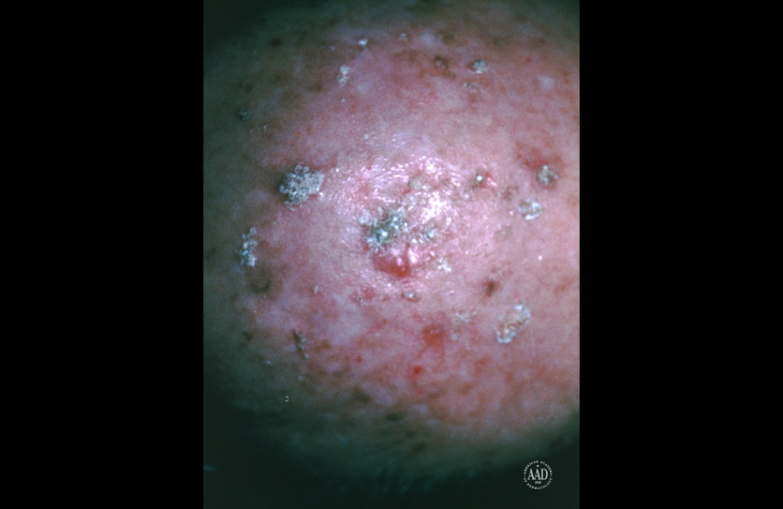
Actinic Keratosis
Hyperkeratotic lesions occurring in sun exposed adult skin
May exist in a premalignant state for years
Often begin as an area of increased vascularity with the surface becoming rough
May progress to squamous cell carcinoma

Slide 21
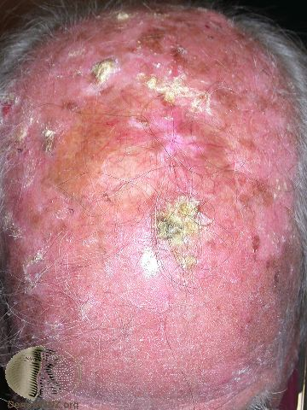
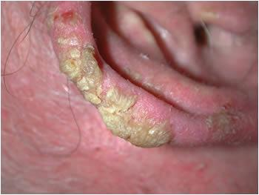
Actinic keratosis

Slide 22


Actinic Keratosis
A pre-cancerous condition of thick, scaly patches of sun-damaged skin.
Notes:
The 2 words ACTINIC KERATOSIS are Greek and describe precisely what is happening to the skin. Actinic means “rays” or radiant energy. Keratosis stands for hard and callous. Actinic keratosis are areas of calloused (thick and scaly) skin caused by chemical changes brought about by exposure to the radiant energy (sunlight, tanning beds, etc).
So we see these lesions on body areas exposed to the sun. The face, ears, lips, scalp, hands, neck, forearms and the “V” of the neck are especially susceptible. They are generally small in size (less than ¼ in across), slow growing, rough, and appear pink-red or flesh-colored.
Early on, it may disappear only to reappear later. It is not uncommon to see several of these lesions at a time; and people with one actinic keratosis usually develop many more. Those having this condition need to be seen by their physician and managed by a dermatologist since it can develop into squamous cell carcinoma. Actinic Keratosis is a warning that your skin has suffered significant sun damage.
The most common treatment used for AKs is cryosurgery. This is using liquid nitrogen to freeze them. They subsequently shrink or become crusted and fall off.
(www.cancer.gov/cancertopics/wyntk/skin)

Slide 23
Types of Skin Cancer
Pre-Cancerous
  Actinic keratosis
Cancerous
  Squamous cell carcinoma
  Basal cell carcinoma
  Melanoma
  Others
Notes:
Here are the types of skin cancer we will discuss.
(www.cancer.gov/cancertopics/wyntk/skin)

Slide 24
Malignant Tumours of The Skin
Basal Cell Carsinoma (BCC)
Squamous Cell Carsinoma (SCC)
Malignant Melanoma (MM)

Slide 25
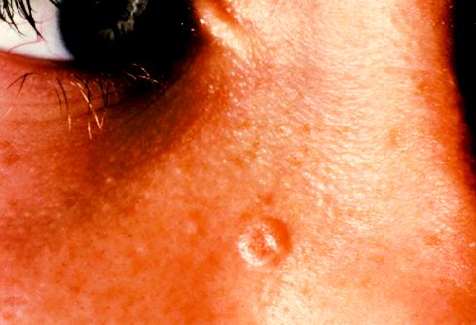
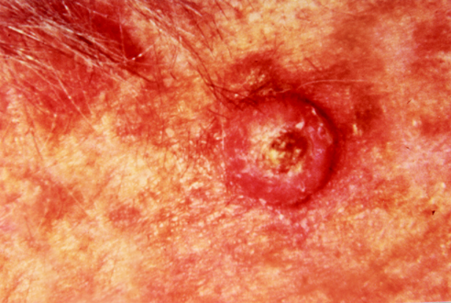
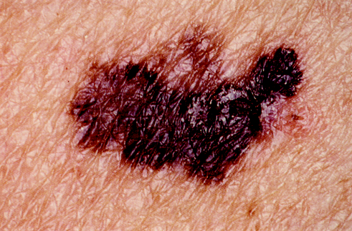
Skin Cancer
Basal Cell
Squamous Cell
Melanoma

Slide 26
Basal Cell Carcinoma
Basal cell carcinoma is the most common malignancy of whites, arising from cells of the basal layer of the epithelium or from the external root sheath of the hair follicle

Slide 27
Basal Cell Carcinoma
Skin cancer that arises from basal cells, small round cells found in the lower part of the skin (epidermis).
  Over 75% of all skin cancers
  Slow-growing
  Generally treatable
Notes:
“Each year about 750,000 people in the U.S. learn that a small growth in their body is basal cell carcinoma—the most common skin cancer. Repeated long-term exposure to sunlight is the primary cause. Light-skinned and middle-aged people who spent a lot of time in the sun as children are especially susceptible. X-ray treatments for acne and exposure to arsenic and hydrocarbons (industrial pollutants) also increase their chances of basal cell cancer.” (Harvard Medical School Family Health Guide / Copyright 1999)
According to the Skin Cancer Foundation, from their 2007 Skin Cancer Facts, the percentage of women under age 40 with basal cell carcinoma has tripled in the last thirty years….
ASK THE QUESTION: Why do you think this is?

Slide 28
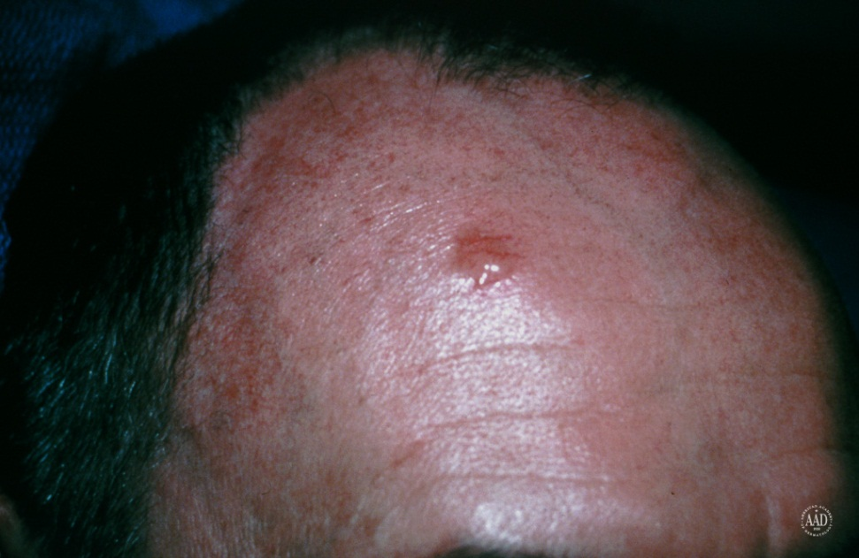
Basal Cell Carcinoma
Most common form of skin cancer
Usually appears on sun damaged skin
Pearly appearance with superficial telangiectasias
Rarely metastasizes
Derived from basal cell layer of the epidermis

Slide 29
Classification of BCC(ACKERMAN):
A- LOCALIZED
1- Nodular
2- Nodulocystic
3-Pigmented
B- SUPERFICIAL
1-Superficial spreading
2-Multifocal
C-INFILTRATIVE
1- Mopheic

Slide 30
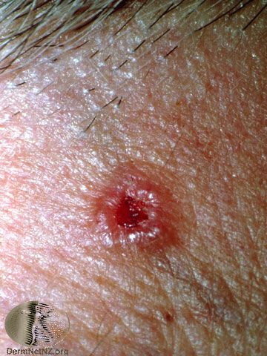
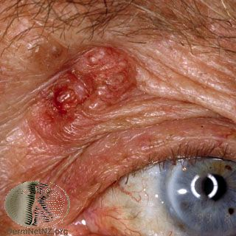
Nodular basal cell carcinoma

Slide 31
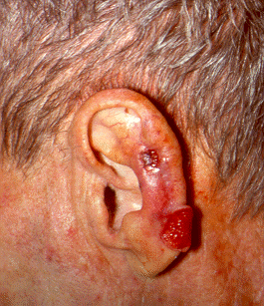
Basal Cell Carcinoma
Notes:
Small, fleshy bumps—normally on ears, nose, neck, head. Slow growing, doesn’t metastasize but can’t penetrate to bony areas that require more invasive surgery.

Slide 32
Superficial BCC
Often multiple
Upper trunk or shoulders commonest site but can appear anywhere
Pink or red scaly patch with raised edge on close examination
Slowly growing over months or years
Bleed or ulcerate easily

Slide 33
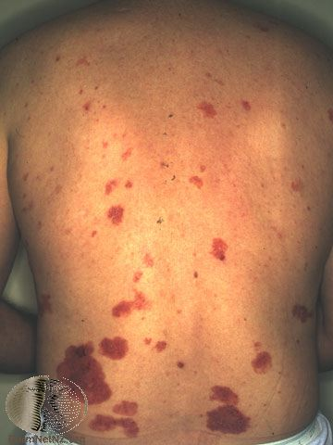
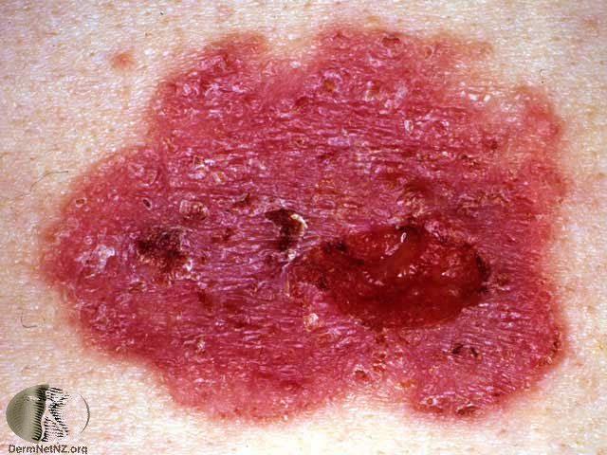
Superficial basal cell carcinoma

Slide 34
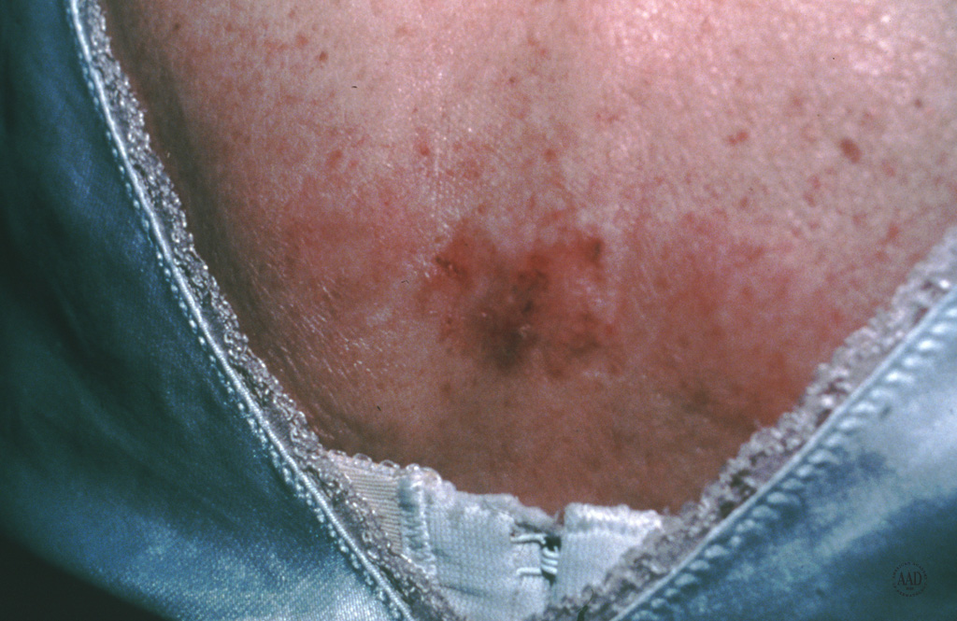
Superficial Basal Cell Carcinoma

Slide 35
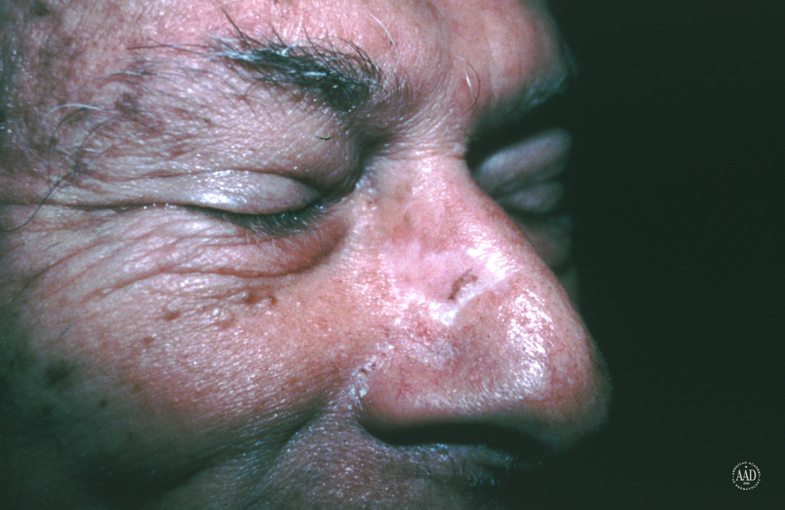
Sclerosing Basal Cell Carcinoma

Slide 36
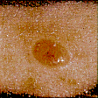
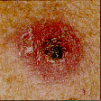
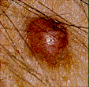
Basal Cell Cancer Warning Signs
Small, smooth, pale, or waxy shiny lump
Firm, red lump
A lump that bleeds or develops a crust
Notes:
Some of the warning signs for basal cell cancer are the same for squamous cell. Here are five signs you need to watch for:
OPEN SORE-it bleeds, oozes, or just won’t heal.
REDDISH PATCH- crusty, can itch, and sometimes, but not always hurts.
SHINY BUMP- can be waxy looking or sometimes resemble a blemish or pimple.
PINK GROWTH- pink lesion with sometimes an indentation in the center.
SCAR-LIKE AREA – shiny, flat, skin may be taut. Sometimes skin cancer can just appear as if there is a texture change in the skin.
When in doubt, ask your physician. Treatment for this kind of cancer as stated before is surgery. Some may have freezing done, but the only accurate way to determine if it is skin cancer and the type is by biopsy. Always ask that your skin lesions are sent to a pathologist.
(www.cancer.gov/cancertopics/wyntk/skin)

Slide 37
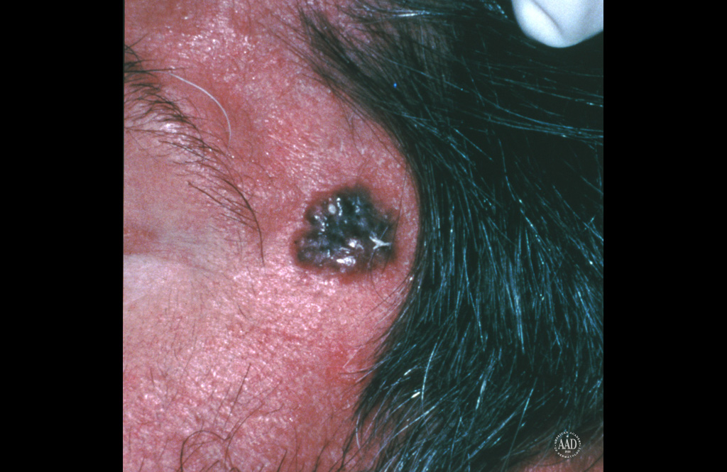
Pigmented Nodular Basal Cell Carcinoma

Slide 38
Squamous Cell Carcinoma
Squamous cell carcinoma originating from the keratinizing or malpighian (spindle) cell layer of the epithelium, is seen primarily in older patients, mostly men

Slide 39
Squamous Cell Carcinoma
Begins in squamous cells which are found in the surface of the skin
They are thin, flat cells that look like fish scales
  Approximately 20% of all skin cancers
Notes:
This slow-growing disease affects individuals who have regular exposure to sunlight. Until recently, this cancer was most common in older people, particularly men who worked outdoors. Now, however, more women and younger individuals are being diagnosed with squamous cell carcinoma, especially those who spend leisure time in the sun. We need to avoid long exposure to the sun, especially at midday, to prevent this type of cancer.
This form of skin cancer occurs most frequently on areas of the body exposed to the sun—the face, ears, neck, scalp, shoulders, and back. The rim of the ear and lower lip are especially vulnerable. Squamous cell carcinoma also can develop on areas of the skin that have been injured or damaged: not just sun damage but also burns, scars, sores, or sites exposed to x-rays or chemicals.
Depending on your risk factors, your physician may recommend that your skin be examined regularly to detect skin cancer Watch for changes in size, color, texture and appearance, as well as skin pain, bleeding, itching, crusting, or inflammation. Diagnosis is always a biopsy of the area with a clear and concise pathology report.
Treatment for this kind of cancer depends upon the size, depth and location. The usual treatments is to remove the tumor by cutting it out (surgical), cryosurgery (freezing), topical medication (kills the rapidly dividing cells) or radiation.
(www.cancer.gov/cancertopics/wyntk/skin)

Slide 40
Squamous Cell Carcinoma
most common below the line “tragus-comissura”
the primary etiological factor is solar radiation.
chronic ulcers including chronic lesions, burn wound, osteomyelitis, cytotoxic drugs,
immunosuppressant drug treatment,
a wide variety of dermatoses, discoid lupus erythematosus, and hidradenitis suppurativa play a significant role in the development of the relatively small number of these skin cancers.
Seen most often in black skined people
Radioresistance
Five percent to 10% of squamous cancers metastasize

Slide 41
COMISSURA - TRAGUS LINE

Slide 42
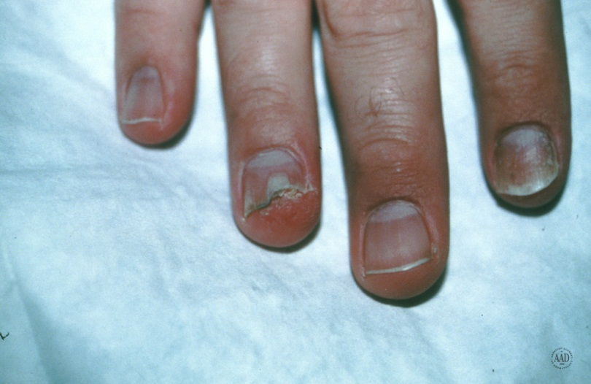
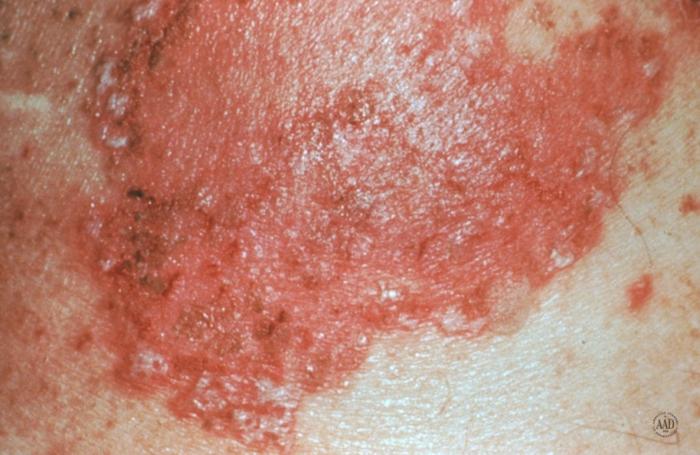
Squamous Cell Carcinoma in situ
(Bowen’s Disease)
A persistent, progressive, nonelevated, red, scaly or crusted plaque
An intraepidermal proliferation on exposed and nonexposed areas of the body
Often mistaken for eczema or psoriasis

Slide 43
BOWEN’S DISEASE 1912
SQUAMOUS CELL CARCINOMA IN SITU
AFFECTS BOTH SKIN & MUCOUS MEMBRANES -HAVING POTENTIAL TO PROGRESS INTO INVASIVE CARCINOMA
AGE >60 RARELY BEFORE 30 YEARS OF AGE
CAN OCCUR AT ANY BODY PARTS – SUN OR NON SUN EXPOSED AREAS OF BODY
SUN EXPOSURE,
ARSENIC EXPOSURE
IONIZING RADIATION,
IMMUNOSUPPRESSION
INFECTION WITH HPV-16 SPECIALLY ANOGENITAL BOWEN’S DISEASE

Slide 44
Bowen’s disease
Bowen’s disease is intraepidermal squamous cell carcinoma
It is effectively carcinoma-in situ
It may progress into squamous cell carcinoma (approximately 5%)
Because of this, it is very important to treat it effectively

Slide 45
Bowen’s disease
Presents as a pink or red ,irregular scaly patch
Usually develops in a sun –exposed area of skin
Common sites include hands and face in both sexes, scalp in men, lower legs in women
Diagnosis should be confirmed by biopsy

Slide 46
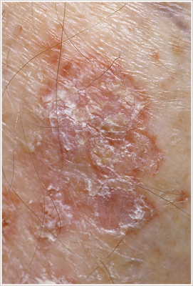
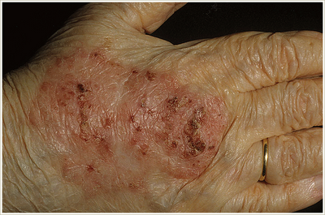
Bowen’s disease

Slide 47
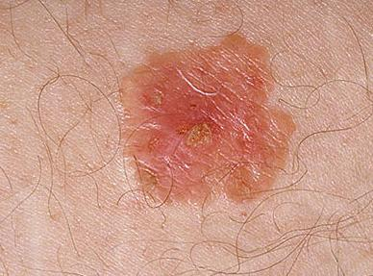
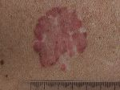
Bowen’s disease

Slide 48
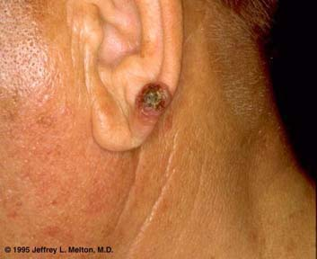
Suqmous cell carcinoma
Ulcer
Ear lobe
Crusted lesion
Sharp margin
Indurated

Slide 49
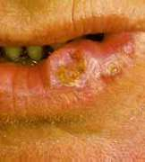
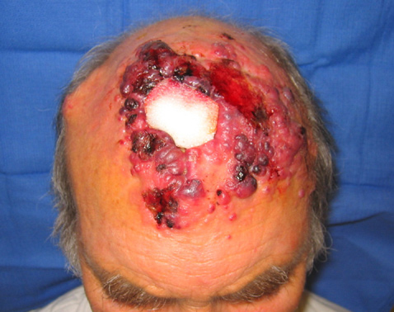
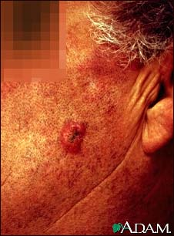
Squamous cell carcinoma

Slide 50
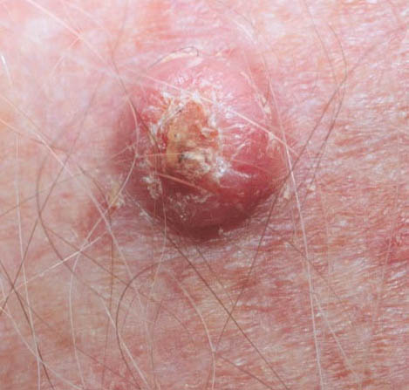
Squamous cell carcinoma,or is it?

Slide 51

Squamous Cell Carcinoma

Slide 52


The Skin & Melanoma
Can occur anywhere on the body Less common, but more serious Almost always curable when detected early More likely to spread to other parts of body

Slide 53

Who is at Risk
Light skin color, hair color, eye color, freckles
Genetics
Certain types of moles
Long-term sun exposure
History of childhood sunburns
Notes:
Melanin offers protection against UV rays for African Americans and other dark-skinned people. Conversely, fair-skinned people are much less protected and more susceptible to skin cancer. Furthermore, albinos’ skin offers no protection.
Although dark-skinned people produce more melanin than lighter-skinned, all skin has the same number of cells that manufacture the melanin.
The same individuals who are most likely to burn are also most vulnerable to skin cancer. Studies have shown that individuals with large numbers of freckles and moles also have a higher risk of developing skin cancer. Although individuals with darker skin are less likely to develop skin cancer, they should still take action to protect their skin and eyes from overexposure to the sun.
People who have had a least one severe, blistering sunburn as a child or teenager are at increased risk of melanoma. Because of this, doctors advise that parents protect children’s skin from the sun. Such protection may reduce the risk of melanoma later in life. Sunburns in adulthood are still a risk factor for melanoma.
(www.cancer.gov/cancertopics/wyntk/skin)

Slide 54
Factors that may also influence the chance of getting melanoma include
Fair skin or freckles.
Being male.
Family or personal history of melanoma.
Chronic UV light exposure.
Severe sunburns.
Unusual moles or a large number of moles.
Weak immune system.

Slide 55

Malignant melanoma

Slide 56


Benign Mole or Melenoma
How Do I Tell The Difference?
NORMAL
ABNORMAL
Notes:
NORMAL: Here is the a picture of a mole (Nevus). This is a benign growth on the skin. While very few moles become cancer, abnormal or atypical moles can develop into melanoma over time. "Normal" moles can appear flat or raised or may begin flat and become raised over time. The surface is typically smooth. Normal moles are round or oval and no larger than a pencil eraser. Most moles develop in youth or young adulthood. It's unusual to acquire a mole in the adult years.
ABNORMAL: Here is picture of an abnormal skin growth. This is an early type of squamous cell carcinoma "in situ “(Boman’s disease). This type of skin cancer spreads outward on the surface of the skin. By contrast, "invasive" squamous cell carcinomas can grow inward and spread to the interior of the body. Bowen disease looks like scaly, reddish patches that may be crusted; it may be mistaken for rashes, eczema, fungus, or psoriasis.
So for most of us it may not always be easy to tell the difference between a normal or abnormal skin lesion. In the next few slides I want to give you some general rules to help you determine when a “funny looking” skin lesion should be evaluated by a professional.

Slide 57

Normal Mole
Tan to brown
Uniformly pigmented
Small (usually less than 6 mm across)
Solid regions of relatively flat (macules) to elevated skin (papules)
Well-defined, rounded borders

Slide 58

Melanoma
Originate from melanocytes at epidermal-dermal junction
Half will develop in preexisting nevi Usually begins in a mole
Prolonged, non invasive, horizontally oriented growth phase
When tumor nodule develops the vertical growth phase is occurring and the risk of metastatic disease increases dramatically
  5% of all skin cancers
  Can be found anywhere on the body

Slide 59


Lentigo maligna(melanoma in situ, noninvasive melanoma)

Slide 60


Classification
Superficial spreading: is the most common of the melanomas (70%). It usually occurs in middle age, but may occur in younger people. It can assume many shapes, and have a variety of colors, though there is usually a reddish hue
Lentigo maligna (10-15%): usually occurs in older people (>6th decade) and occurs in chronically sun exposed areas, most commonly on the face. Hutchinson Freckle This type carries the best prognosis

Slide 61


Superficial Spreading Melanoma
Most common in middle age
Develops anywhere on the body, back in both sexes and legs in females
Haphazard combination on colors but may be uniformly brown or black

Slide 62

Skin Cancer
ABCDE’s of Skin Cancer

Slide 63

Normal Mole

Slide 64


Slide 65


ABCDEs of Melanoma Screening
“A” = ASYMMETRY
NORMAL
ABNORMAL
Notes:
ABCDE’s of Skin Cancer.
“A” stands for asymmetry. Asymmetry means one half of a mole does not match the other half. Normal moles are symmetrical. When checking your moles or freckles, draw an imaginary line through the middle and compare the two halves. If they do not look the same on both sides, have it checked by a dermatologist.
In this example, you can easily see that one half of the NORMAL lesion, on the left, is almost a duplicate of the other half.
In the ABNORMAL example, you can see that one side of the lesion is raised and round and the other side is flat and irregular.
If you have a lesion like this --- it does not mean you have cancer -- but does suggest the lesion is growing more asymmetrical or haphazard. Lesions that grow fast or appear non-uniform (out of control) are suspicious and should be watched more careful. Let’s finish your ABCDE screening criteria using these examples.

Slide 66
ABCDEs of Melanoma Screening
“B” = BORDERS
NORMAL
ABNORMAL
Notes:
ABCDE’s of Skin Cancer.
“B” stands for Borders. If the border or edges of the mole are ragged, blurred, or irregular, have it checked by a dermatologist. Melanoma lesions often have uneven borders.

Slide 67
ABCDEs of Melanoma Screening
“C” = COLORS
Multiple
Colors
Uniform
Color
NORMAL
ABNORMAL
Notes:
ABCDE’s of Skin Cancer.
“C” stands for Color. A mole that does not have the same color throughout or that has shades of tan, brown, black, blue, white, or red is suspicious. Normal moles are usually a single shade of color. A mole of many shades or that has lightened or darkened should be checked by a doctor.
Variation of color (e.g., more than one color or shade) within a mole is a suspicious finding. Different shades of browns, blues, reds, whites, and blacks are all concerning.

Slide 68
ABCDEs of Melanoma Screening
“D” = DIAMETER
<6mm
>6mm
NORMAL
ABNORMAL
Notes:
ABCDE’s of Skin Cancer.
“D” stands for Diameter A mole is suspicious if the diameter is larger than the eraser of a pencil. Benign moles are usually less than 6 millimeters in diameter. This is the size of a pencil eraser. Small lesions on the left that are smaller then a pencil eraser are usually not something to be concerned about. Larger lesion on the right that are larger then a pencil eraser can be something you should be more concerned about.
If a portion of the mole appears elevated, or raised from the skin, have it looked at by a doctor. Melanoma lesions often grow in size or change in height rapidly. A mole that is evolving – shrinking, growing larger, changing color, begins to itch or bleed – should also be checked.
Examine your skin after a shower while skin is wet. A common location for melanoma in men is on the back, and in women, the lower leg. But check your entire body for moles or suspicious spots once a month. Start at your head and work your way down. Check the "hidden" areas: between fingers and toes, the groin, soles of the feet, the backs of the knees. Check your scalp and neck for moles. Use a handheld mirror or ask a family member to help you look at these areas. Be especially suspicious of a new mole. Take a photo of moles and date it to help you monitor them for change. Pay special attention to moles if you're a teen, pregnant, or going through menopause, times when your hormones may be surging.
If you find a mole or spot that has any ABCDE's of melanoma -- or one that's tender, itching, oozing, scaly, doesn't heal or has redness or swelling beyond the mole -- see a doctor. Your doctor may want to remove a tissue sample from the mole and biopsy it. If found to be cancerous, the entire mole and a rim of normal skin around it will be removed and the wound stitched closed. Additional treatment may be needed.
Malignant melanoma, especially in the later stages, is serious and treatment is difficult. Early diagnosis and treatment can increase the survival rate. Nonmelanoma skin cancers include basal cell carcinoma and squamous cell carcinoma. Both are common and are almost always cured when found early and treated. People who've had skin cancer once are at risk for getting it again; they should get a checkup at least once a year.
Melanoma is not as common as other types of skin cancer, but it's the most serious and potentially deadly. Possible signs of melanoma include a change in the appearance of a mole or pigmented area. Consult a doctor if a mole changes in size, shape, or color, has irregular edges, is more than one color, is asymmetrical, or itches, oozes, or bleeds.
This nonmelanoma skin cancer may appear as a firm red nodule, a scaly growth that bleeds or develops a crust, or a sore that doesn't heal. It most often occurs on the nose, forehead, ears, lower lip, hands, and other sun-exposed areas of the body. Squamous cell carcinoma is curable if caught and treated early. If the skin cancer becomes more advanced, treatment will depend on the stage of cancer.
Bowen disease is also called squamous cell carcinoma "in situ." It is a type of skin cancer that spreads outward on the surface of the skin. By contrast, "invasive" squamous cell carcinomas can grow inward and spread to the interior of the body. Bowen disease looks like scaly, reddish patches that may be crusted; it may be mistaken for rashes, eczema, fungus, or psoriasis.
Basal cell carcinoma is the most common and easiest-to-treat skin cancer. Because basal cell carcinoma spreads slowly, it occurs mostly in adults. Basal cell tumors can take on many forms, including a pearly white or waxy bump, often with visible blood vessels, on the ears, neck, or face. Tumors can also appear as a flat, scaly, flesh-colored or brown patch on the back or chest, or more rarely, a white, waxy scar.
Uncommon types of skin cancer include Kaposi's sarcoma, mainly seen in people with weakened immune systems; Merkel cell carcinoma, which is usually found on sun-exposed areas on the head, neck, arms and legs but often spreads to other parts of the body; and sebaceous gland carcinoma, an aggressive cancer originating in the oil glands in the skin.
Sun exposure is the biggest cause of skin cancer. But it doesn't explain skin cancers that develop on skin not ordinarily exposed to sunlight. Exposure to environmental hazards, radiation treatment, and even heredity may play a role. Although anyone can get skin cancer, the risk is greatest for people who have:
Fair skin or light-colored eyes
An abundance of large and irregularly-shaped moles
A family history of skin cancer
A history of excessive sun exposure or blistering sunburns
Lived at high altitudes or with year-round sunshine
Received radiation treatments
Limit your exposure to the sun's ultraviolet rays, especially between 10 a.m. and 4 p.m., when the sun's rays are strongest. While outdoors, apply sunscreen liberally (don't forget the lips and ears!), wear a hat and sunglasses, and cover up with clothing. And remember, if you notice changes to your skin such as a new growth, a mole changing appearance, or a sore that won't heal, see a doctor right way.
Skin Cancer 101
What You Need to Know About Melanoma
Does Skin Cancer Lead to Other Cancers?
Treatment Options for Skin Cancer
Preventing Sun Exposure in Children
Treating Skin Cancer? Share Your Experience
Video: Surgery-Free Skin Cancer Treatment
Free Skin & Beauty Newsletter
Previous
13/23

Slide 69
ABCDEs of Melanoma Screening
“E” = Elevation
Raised
Area
Flat
Area
NORMAL
ABNORMAL
Notes:
ABCDE’s of Skin Cancer.
“E” stands for Elevation. If a portion of the mole appears elevated, or raised from the skin, have it looked at by a doctor.
When part of the lesion is elevated but other parts are not then that can be an important danger sign. Melanoma lesions often grow in size or change in height rapidly. A mole that is evolving – shrinking, growing larger, changing color, begins to itch or bleed – should also be checked.
Examine your skin after a shower while skin is wet . A common location for melanoma in men is on the back, and in women, the lower leg.
Check your entire body for moles or suspicious spots once a month. Start at your head and work your way down. Check the "hidden" areas: between fingers and toes, the groin, soles of the feet, the backs of the knees. Check your scalp and neck for moles. Use a handheld mirror or ask a family member to help you look at these areas. Be especially suspicious of a new mole. Take a photo of moles and date it to help you monitor them for change. Pay special attention to moles if you're a teen, pregnant, or going through menopause, times when your hormones may be surging.
If you find a mole or spot that has any ABCDE's of melanoma -- or one that's tender, itching, oozing, scaly, doesn't heal or has redness or swelling beyond the mole -- see a doctor. Your doctor may want to remove a tissue sample from the mole and biopsy it. If found to be cancerous, the entire mole and a rim of normal skin around it will be removed and the wound stitched closed. Additional treatment may be needed.
Although anyone can get skin cancer, the risk is greatest for people who have:
Fair skin or light-colored eyes
An abundance of large and irregularly-shaped moles
A family history of skin cancer
A history of excessive sun exposure or blistering sunburns
Lived at high altitudes or with year-round sunshine
Received radiation treatments

Slide 70



The ABCDEs of Melanoma
One half is unlike the other half.
Irregularity – edges are ragged or blurred

Slide 71


The ABCDEs of Melanoma
Varies from one area to another
Usually > 6mm when diagnosed, but can be smaller

Slide 72

Asymmetry
One half does not match
the other half.

Slide 73

Border irregularity
The edges are ragged, notched,
or blurred.

Slide 74

Color
The pigmentation is not uniform.
Shades of tan, brown, or black are
present. A mottled appearance

Slide 75

Diameter
Greater than ¼ inch. Any sudden
or continuing increase in size is
of special concern

Slide 76

Malignant melanoma

Slide 77


Malignant melanoma

Slide 78


Malignant melanoma

Slide 79

In Situ Malignant Melanoma
Melanoma cells confined to the epidermis
Lack in invasion may persist for months to years
Simple excision is often curative

Slide 80


Classification
Acral-lentiginous melanoma (5%) is most frequent in blacks and Asians. The most common site is the plantar surface of the foot; may be subungual
Nodular melanoma (15%)most often occurs in middle age and is more frequent in males. It is usually dome shaped and may ulcerate. Typically carries the worst prognosis

Slide 81

Nodular Melanoma
Occurs in the fifth or sixth decade
More frequent in males with a ratio of 2:1
Found anywhere on the body
Most frequently misdiagnosed because it can resemble a blood blister, hemangioma, dermal nevus or polyp

Slide 82

Acral Lentinginous Melanoma
Most common in blacks and orientals
Appears on the palms, soles terminal phalanges and mucous membranes
The tumor is very aggressive and metastasizes early

Slide 83


Malignant melanoma

Slide 84


Malignant melanoma

Slide 85
Histological classification:
Breslow thickness:
This is the thickness of the melanoma in mm
Clark’s level:
This describes which layer of skin has been breached
Clark’s level 1-epidermis-melanoma in situ
Clark’s level 2-dermal invasion
Clark’s level 5- invasion of subcutaneous fat

Slide 86

Clark’s Level
describes the level of anatomical invasion of the melanoma in the skin
Five anatomical levels, and higher levels have worsening prognostic implications
1. Melanoma confined to the epidermis
2. Invasion into the papillary dermis
3. Invasion to the junction of the papillary and reticular dermis
4. Invasion into the reticular dermis
5. Invasion into the subcutaneous fat

Slide 87
BRESLOW THICKNESS
STAGE I
  0.75MM OR LESS
STAGE II
  0.76MM TO 1.50MM
STAGE III
  1.51MM TO 4.0MM
STAGE 1V
  4.0MM OR GREATER

Slide 88
Staging
Stage 0: Melanoma in Situ (Clark Level I), 99.9% Survival
Stage I/II: Invasive Melanoma, 85-99% Survival
-T1a: Less than 1.00 mm primary tumor thickness, w/o Ulceration and mitosis < 1/mm2
-T1b: Less than 1.00 mm primary tumor thickness, w/Ulceration or mitoses ≥ 1/mm2
-T2a: 1.00-2.00 mm primary tumor thickness, w/o Ulceration
Stage II: High Risk Melanoma, 40-85% Survival
-T2b: 1.00-2.00 mm primary tumor thickness, w/ Ulceration
-T3a: 2.00-4.00 mm primary tumor thickness, w/o Ulceration
-T3b: 2.00-4.00 mm primary tumor thickness, w/ Ulceration
-T4a: 4.00 mm or greater primary tumor thickness w/o Ulceration
-T4b: 4.00 mm or greater primary tumor thickness w/ Ulceration
Stage III: Regional Metastasis, 25-60% Survival
-N1: Single Positive Lymph Node
-N2: 2-3 Positive Lymph Nodes OR Regional Skin/In-Transit Metastasis
-N3: 4 Positive Lymph Nodes OR Lymph Node and Regional Skin/In Transit Metastases
Stage IV: Distant Metastasis, 9-15% Survival
-M1a: Distant Skin Metastasis, Normal LDH
-M1b: Lung Metastasis, Normal LDH
-M1c: Other Distant Metastasis OR Any Distant Metastasis with Elevated LDH

Slide 89
Adjuvant Therapy
Interferon-alpha2b: improve disease free and overall survival rates in pts with stage IIb or III disease
IL-2 for stage IV disease
Ipilimumab: increase in median survival from 6.4 to 10 months in patients with advanced melanomas treated with the monoclonal antibody, versus an experimental vaccine
Vaccine trials for local 1.5-4mm
Radiation: typically used for palliation of bone pain or brain metastasis, may reduce rate of local reoccurance but not survival
Chemotherapy: not very useful, reports of isolated hyperthermic limb perfusion to treat in transit metastasis of extremities using TNF

Slide 90

Kaposi Sarcoma
Nonblanching red macule
Surrounding ecchymoses and acquire more of a violet hue
The lesions may become nodular

