Slide 1
Infectious diseases lecture 1
Dr.Mohammad Hasan 2022

Slide 2
infection
interaction
Human body
organism
harmless colonisation
harmful infectious disease

Slide 3
Infectious agents
● Prions – misfolded proteins devoid of nucleic acids, which cause transmissible spongiform encephalopathies.
● Viruses – RNA- or DNA-containing pathogens that rely on host cells for replication.
● Bacteria – prokaryotes capable of independent replication but lacking a nucleus.
● Eukaryotic pathogens – fungi, protozoa and helminths.

Slide 4
Many organisms live symbiotically in the human body as colonising normal flora, often benefiting the host (e.g. vitamins K and B12, produced by gut flora).
In contrast, disease results when pathogenic organisms produce virulence factors that damage host cells.
Primary pathogens cause disease in healthy hosts, while opportunistic pathogens cause disease only in the immune-compromised host.

Slide 5
DETECTION OF INFECTION
A variety of methods are used:
Nucleic acid amplification tests (NAAT): Can not only identify viruses and bacteria but also detect strain types and toxin or resistance genes.
Culture: Largely supplanted by NAAT for viruses. Bacterial culture is still widely used for identification and antibiotic sensitivity testing, but can be slow and not all organisms grow in culture.

Slide 6
Specialised mass spectrometers can be used for rapid identification of organisms in blood cultures.
Immunological tests:
antibodies can be detected using various in vitro immunological assays.
Interferon-gamma (from sensitised T cells as response to bacteria) .
Notes:
Specialised mass spectrometers can be used for rapid identification of organisms in blood cultures.
Immunological tests: Host antibodies can be detected using various in vitro immunological assays. A rise in titre between acute and convalescent serum samples indicates recent infection, but tests may be negative in the immunocompromised. Interferon-gamma release assays detect infection through the release of interferon from sensitised host T cells exposed to bacterial peptides.

Slide 7
مستودعات الخمج
RESERVOIRS OF INFECTION
Human reservoirs: Colonised or infected individuals may act as reservoirs, carrying organisms on the skin, throat (e.g. meningococci), nose, bowel (e.g. Salmonella) or blood (e.g. hepatitis B).
Animal reservoirs: Animals are a source of human infections (zoonoses), e.g. Salmonella from poultry, TB and brucellosis from milk. Spread may continue from cases to other humans (e.g. Q fever)
Environmental reservoirs: Environmental pathogens include Legionella in air conditioning or water, and enteropathogens (typhoid, cholera, Cryptosporidia or hepatitis A) in water.
Soil may harbour spores of Clostridia (tetanus) or anthrax.

Slide 8
TRANSMISSION OF INFECTION
This occurs by several routes:
● Respiratory – inhalation.
● Faecal–oral – ingestion.
● Sexually transmitted – via mucous membranes.
● Blood-borne – inoculation.
● Via vector or fomite (tool) : an animal or object bridges the gap between host and reservoir.
Notes:
This occurs by several routes:
● Respiratory – inhalation.
● Faecal–oral – ingestion.
● Sexually transmitted – via mucous membranes.
● Blood-borne – inoculation.
● Via vector or fomite: an animal or object bridges the gap between host and reservoir.
Health care-acquired infection Health care-acquired infections (HAIs) affect 6–10% of all hospital admissions and create a significant clinical and economic burden. The close proximity of hospital inpatients, the widespread use of antibiotics and the ease of transmission by health-care workers have led to the selection of multidrug-resistant organisms such as MRSA and vancomycin-resistant enterococci (VRE). Spread of these organisms, plus infections such as Clostridium difficile and norovirus, may lead to outbreaks of infection and necessitate ward or hospital

Slide 9
PREVENTION OF INFECTION
Health care-acquired infection Health care-acquired infections (HAIs) affect 6–10% of all hospital admissions and create a significant clinical and economic burden.
HAIs have to be managed by comprehensive antibiotic policies and careful adherence to strict infection control protocols.
Although environmental cleanliness and clean clothing are cosmetically important, recent evidence has confirmed the absolute importance of hand hygiene in the control of HAI.
The use of alcohol hand lotion by all health-care workers between every patient contact is an effective alternative to soap and water in prevention of most HAI, but not Clostridium difficile.

Slide 10
Outbreak control
An outbreak of infection is defined as the occurrence of any disease clearly in excess of normal expectancy. Confirmation requires evidence of identical genotype in organisms isolated from cases.
Notes:
An outbreak of infection is defined as the occurrence of any disease clearly in excess of normal expectancy. Confirmation requires evidence of identical genotype in organisms isolated from cases.
Cases are sought by testing and then plotted on an outbreak curve. Casecontrol studies may be used to establish the source. Good communication of data to health-care workers is needed to achieve control. Many countries have systems of compulsory notification of contagious conditions to public health authorities to assist outbreak control.

Slide 11
Immunisation
Passive immunisation :
antibodies to a specific pathogen.
temporary protection after exposure.
may carry risks of bloodborne infection.
Active immunisation
whole live attenuated organisms or components of organisms . Vaccination may be applied to entire populations or to subpopulations at specific risk through travel or occupation.
Usually the goal is to prevent infection, but vaccination against human papillomavirus (HPV) was introduced to prevent cervical cancer.
Notes:
Passive immunisation means administering antibodies to a specific pathogen. This produces temporary protection after exposure but, as antibodies are obtained from blood, this may carry risks of bloodborne infection.
Active immunisation uses whole live attenuated organisms or components of organisms to prevent disease by inducing immunity. Vaccination may be applied to entire populations or to subpopulations at specific risk through travel or occupation. Usually the goal is to prevent infection, but vaccination against human papillomavirus (HPV) was introduced to prevent cervical cancer. Vaccination is successful when the number of susceptible hosts in a population becomes too low to sustain transmission (herd immunity). Naturally acquired smallpox was eradicated by vaccination in 1980. A similar programme aims to eradicate poliomyelitis.

Slide 12
Vaccination is successful when the number of susceptible hosts in a population becomes too low to sustain transmission (herd immunity).
Naturally acquired smallpox was eradicated by vaccination in 1980.
A similar programme aims to eradicate poliomyelitis.

Slide 13
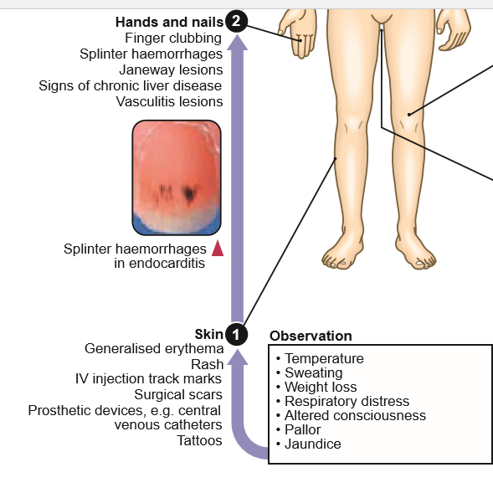
CLINICAL EXAMINATION OF PATIENTS WITH INFECTIOUS DISEASE

Slide 14
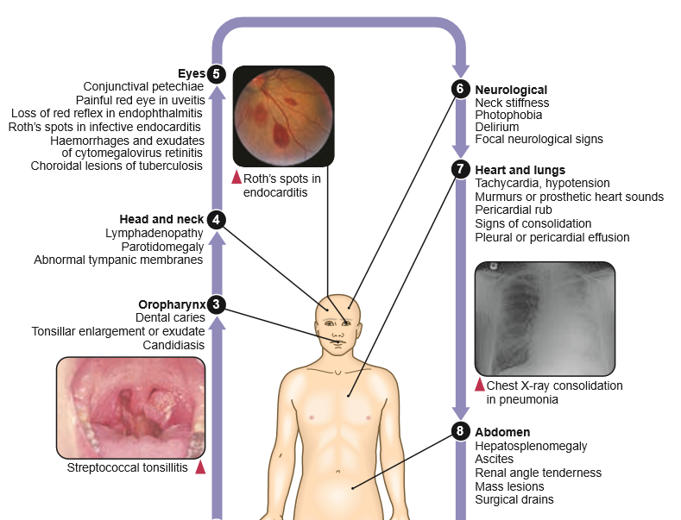

Slide 15
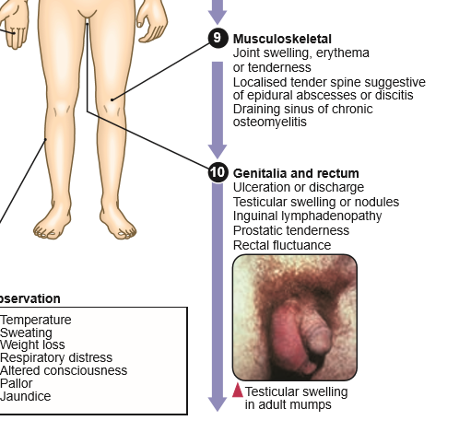

Slide 16
PRESENTING PROBLEMS IN INFECTIOUS DISEASES
Fever
Fever implies an elevated core temperature of > 38°C. Clinical features are used to guide appropriate investigations, which include:
● FBC and differential.
● U&Es, liver function, glucose and muscle enzymes.
● ESR and CRP.
● Autoantibodies.
● CXR and ECG.
● Urinalysis and culture.
● Blood culture.
● Throat swab.
Additional tests are indicated by local symptoms and if the patient is immunocompromised

Slide 17
Pyrexia of unknown origin
Pyrexia of unknown origin (PUO) is a common presenting problem and may be defined as a consistently elevated body temperature of > 38°C persisting for > 3 wks with no diagnosis after initial investigation.

Slide 18
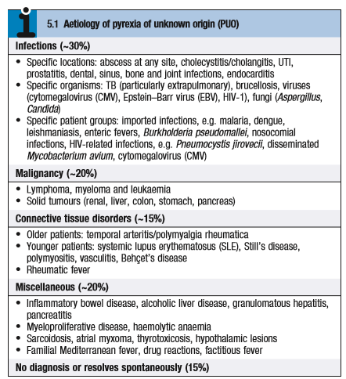

Slide 19
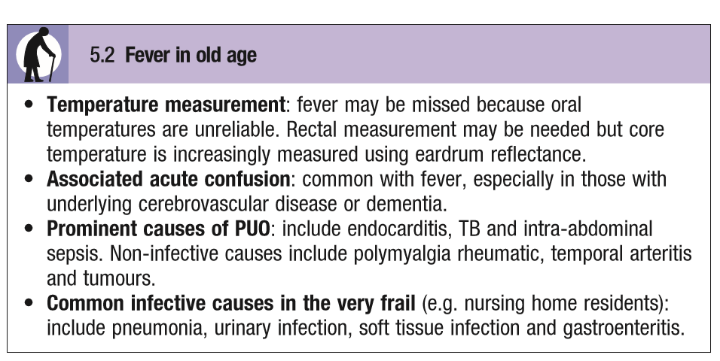

Slide 20
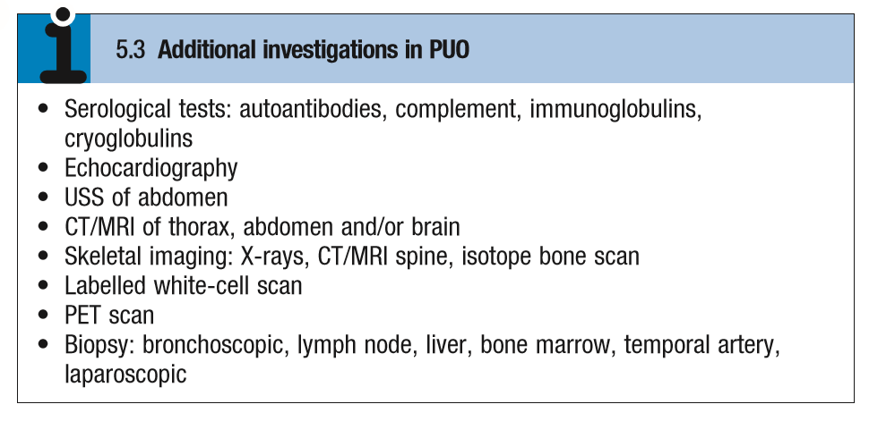

Slide 21
Detailed history should include:
Recent travel history: Malaria, respiratory infections, viral hepatitis, typhoid and dengue are the most common causes of imported fever in the UK.
Personal and social history: Exposure to STI, illicit drug use.
Occupational or recreational history: Animal exposure, consumption of unpasteurised milk.

Slide 22
Investigations and management
Measure temperature and vital signs 4-hourly.
Regularly review and expand history-taking.
Repeat physical examination regularly for emerging signs such as cardiac murmurs, lymphadenopathy and rashes.
Lesions on imaging should normally be biopsied to detect pathogens by culture or nucleic acid detection.

Slide 23
Liver biopsy: May reveal TB, lymphoma or granulomatous disease, including sarcoidosis. It is unlikely to help unless the liver is biochemically or radiologically abnormal.
Bone marrow biopsy: Has a diagnostic yield in PUO of ~15%, the most commonly detected diseases being myelodysplasia, other haematological malignancies and TB.
More rarely, brucellosis, enteric fever or visceral leishmaniasis may be detected, underlining the importance of sending samples for culture as well as microscopy.
Temporal artery biopsy: Should be considered in patients > 50 yrs, even if the ESR is not significantly elevated. Since arteritis is patchy, diagnostic yield is increased if a 1.5 cm section of artery is biopsied.

Slide 24
Prognosis
The overall mortality of PUO is 30–40% mainly because of malignancy in older patients.
If no cause is found on exhaustive investigation, the mortality is low and spontaneous recovery often occurs.

Slide 25
Fever in the injection drug-user
Infection is introduced by non-sterile (often shared) equipment, and is facilitated by immunodeficiency due to malnutrition or the toxic effects of drugs.
Risks increase with prolonged drug use and central injection in large veins, necessitated by thrombosis of peripheral veins.
Fever is usually due to soft tissue or respiratory infections.

Slide 26
Clinical assessment
Site: Femoral vein injections may cause DVT, of which 50% are infected; arterial injection may cause false aneurysm formation and compartment syndrome. Psoas abscess and septic arthritis also occur. Clostridium infection has been recorded with IM injection of heroin.

Slide 27
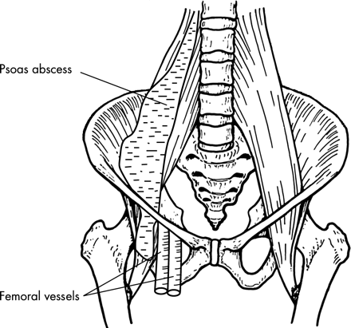

Slide 28
Technical details:
Sharing of needles and spoons
contaminated drugs or solvents increase the risk of infection (e.g. HIV-1, hepatitis B or C).
Other details:
what solvents were used?.
Check recent viral test status.
Beware surreptitious self-treatment with antibiotics, which may mask culture results.
Symptoms that may accompany fever: Include breathlessness, myalgia, confusion and tachycardia.
Notes:
Suureptitious سري
It may be difficult to distinguish symptoms due to infection from those accompanying drug withdrawal.

Slide 29
Signs: These include:
● Rashes.
● Injection site abscess.
● Joint pain or swelling from injection.
● DVT or compartment syndrome in the legs.
● Local tenderness or referred pain from an abscess site, e.g. flexion at the hip eliciting back pain is indicative of ilio-psoas abscess.
● New murmurs , splinter haemorrhages.
The JVP may show V waves in tricuspid endocarditis.
Pleural rub or effusion is seen in DVT with PE, or septic emboli from endocarditis or infected DVT.
● Stupor: occurs in drug overdose or hepatic encephalopathy; agitation with drug withdrawal; headache and drowsiness in meningitis or encephalitis; local paralysis or spasms with tetanus or botulism.
Notes:
● Rashes.
● Injection site abscess.
● Joint pain or swelling from injection.
● DVT or compartment syndrome in the legs.
● Local tenderness or referred pain from an abscess site, e.g. flexion at the hip eliciting back pain is indicative of ilio-psoas abscess.
● New murmurs or evidence of cardiac decompensation: may suggest either right- or left-sided endocarditis (check nails for splinter haemorrhages), or the cardiomyopathy of generalised sepsis.
The JVP may show V waves in tricuspid endocarditis. Pleural rub or effusion is seen in DVT with PE, or septic emboli from endocarditis or infected DVT.

Slide 30
Management
Management is that of the underlying condition.
Flucloxacillin is useful against Staphylococcus aureus, although vancomycin may be needed if MRSA is present.
Appropriate sedative medicines should be provided for those suffering withdrawal symptoms after a long period of dependency.

Slide 31
Fever in the immunocompromised host
Immunosuppression may be:
congenital
acquired through infection or haematological disease.
Iatrogenic, induced by chemotherapy for cancer or for autoimmune diseases.
Notes:
These may be distinguished by history, and careful examination may reveal where infection has breached the skin or mucosal barriers. Blood and urine cultures, with imaging – including chest CT and virology of nasopharyngeal aspirates – may reveal the nature and site of infection.

Slide 32
Patients with respiratory signs should have induced sputum or bronchoscopy for Pneumocystis jirovecii, bacteria and fungi.
Neutropenic fever is defined as:
a neutrophil count of < 0.5 × 109/L, with fever > 38.5°C, although risk increases as the neutrophil count falls < 1.0 × 109/L.
Patients with neutropenia are particularly prone to bacterial and fungal infections.

Slide 33
Gram-positive organisms are the most common pathogens, particularly in the presence of in-dwelling catheters.
Blood cultures, swabs and urine samples should be taken, potential sources removed and empirical antibiotic therapy started, with a broad-spectrum penicillin (e.g. piperacillin/tazobactam).
An aminoglycoside (e.g. gentamicin) is often given too, although data suggest monotherapy is as effective.
Antifungals such as caspofungin may be added if fever has not resolved in 3–5 days.

Slide 34
Severe skin and soft tissue infections /Necrotising fasciitis
There are two types of necrotising fasciitis:
Type 1: This is a mixed infection with Gram-negative bacteria and anaerobes, often seen following surgery or in diabetic or immunocompromised patients.
Type 2: This is caused by group A or other streptococci. About 60% of cases are associated with streptococcal toxic shock syndrome .

Slide 35
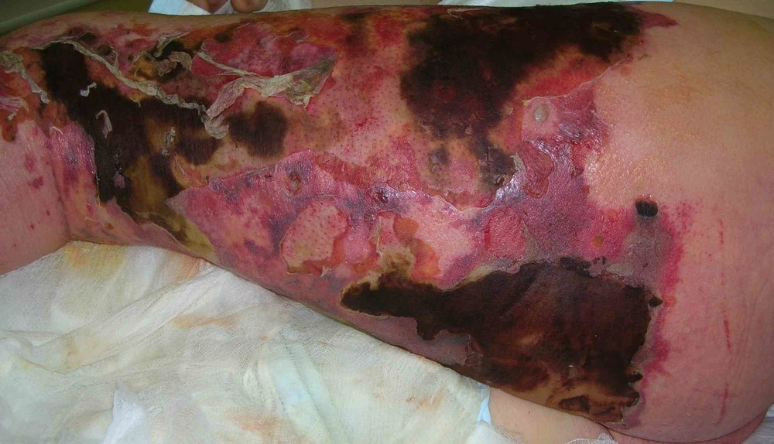

Slide 36
Both types produce a severe, rapidly progressive and destructive inflammation of the dermis and subcutaneous tissues, leading to intense pain, profound toxaemia and multisystem failure.
The affected area is erythematous, hot and shiny. Central anaesthesia (due to cutaneous nerve damage), surrounded by exquisitely tender erythematous skin, is pathognomonic.
Treatment is with broad-spectrum antibiotics, e.g. piperacillin/ tazobactam with metronidazole. Streptococcal infections respond to benzylpenicillin with clindamycin. Surgical débridement should subsequently be considered if control is not achieved.

Slide 37
Clostridial soft tissue infections
Gas gangrene or myonecrosis
Although Clostridia may colonise or contaminate wounds, no action is required unless spreading infection is present.
In anaerobic cellulitis, usually due to C. perfringens, gas forms locally and extends along tissue planes, but bacteraemia does not occur. Prompt surgical débridement, along with penicillin or clindamycin therapy, is usually effective.

Slide 38
Gas gangrene is defined as acute invasion of healthy living muscle undamaged by previous trauma by C. perfringens.
It develops following deep penetrating injury sufficient to create an anaerobic environment and allow clostridial introduction and proliferation.
Severe pain at the site of the injury progresses rapidly over 18–24 hrs. Bronze/purple discoloration develops in tense and exquisitely tender skin.

Slide 39
Gas in tissues may cause crepitus on examination or be visible on X-ray, CT or USS. Systemic toxicity develops rapidly with high leucocytosis, multi-organ dysfunction, raised creatine kinase and disseminated intravascular haemolysis. High dose IV penicillin, clindamycin, cephalosporins and metronidazole therapy is very effective, coupled with aggressive surgical débridement of affected tissues.
Use of hyperbaric oxygen is controversial.

Slide 40
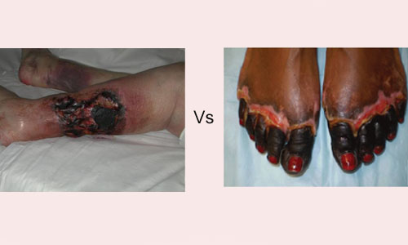

Slide 41
Acute diarrhoea and vomiting
Acute diarrhoea, sometimes with vomiting, is an extremely common presenting problem, and may result from both infectious and noninfectious causes.

Slide 42
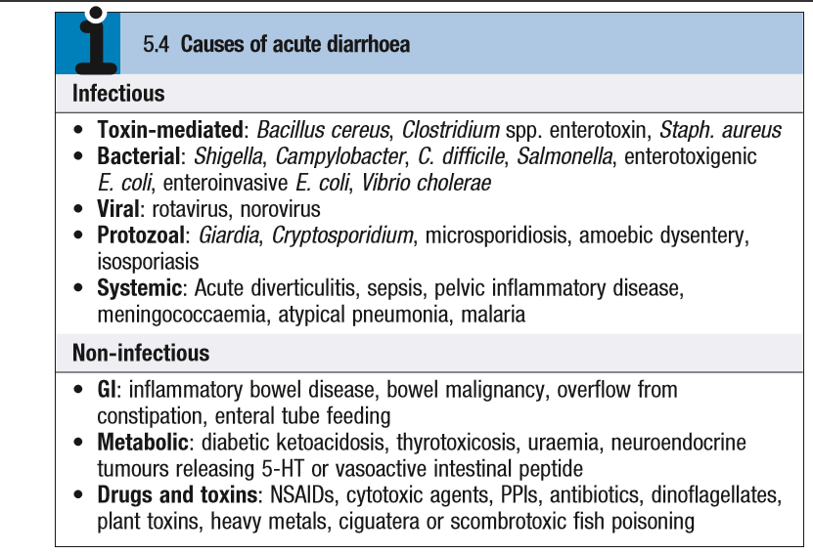

Slide 43
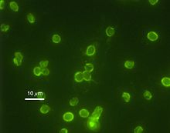
Notes:
cryptosporidium

Slide 44
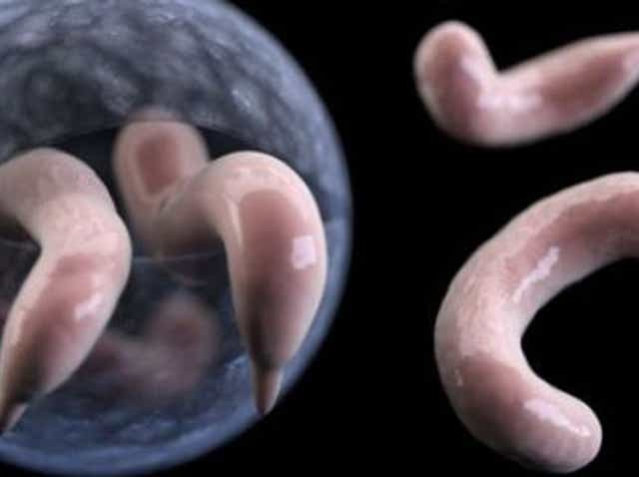
Notes:
cryptosporidium

Slide 45
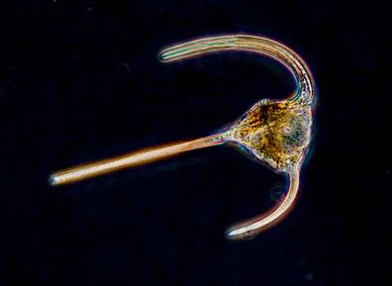
dinoflagellate
Notes:
سوطيات دوارة =من الطحالبزوحيدات خلية لها سوطين للدوران.

Slide 46
Infectious diarrhoea is caused by transmission of viruses, bacteria or protozoa either by the faecal–oral route or via infected fomites, food or water.
Psychological or physical stress may also precipitate diarrhoea.
Occasionally, diarrhoea may be the presenting feature of another systemic illness, such as pneumonia.

Slide 47
Enterotoxic organisms, e.g. Bacillus cereus, Staph. aureus and Vibrio cholerae, produce vomiting and/or ‘secretory’ watery diarrhoea.
Organisms that invade the mucosa, such as Shigella, Campylobacter and enterohaemorrhagic E. coli (EHEC), have longer incubation periods and may cause systemic upset and blood in the stool.

Slide 48
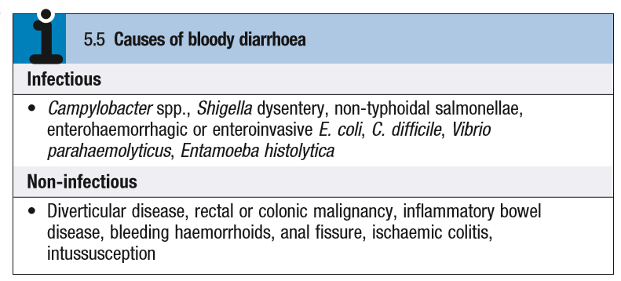

Slide 49
Clinical assessment
History: Should include:
● Duration and frequency of diarrhoea
● Presence of blood, abdominal pain and tenesmus.
● Recent foods ingested .
● Other family members affected.
Fever and bloody diarrhoea suggest an invasive, colitic, dysenteric process. Incubation < 18 hrs suggests a toxin-mediated food poisoning; > 5 days suggests protozoal or helminthic infection.

Slide 50
Examination:
● Assess degree of dehydration by skin turgor, pulse and BP measurement.
● Measure urine output and ongoing stool losses.
● Carry out regular full abdominal examination.

Slide 51
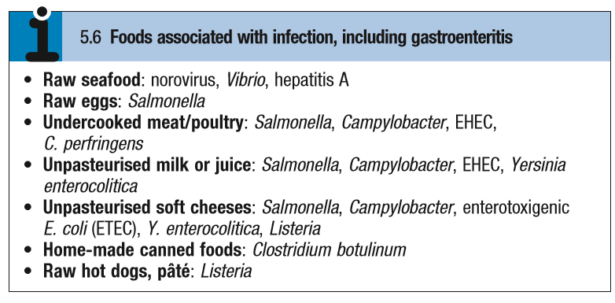

Slide 52
Investigations
● Stool microscopy (for cysts, ova and parasites), culture and C. difficile toxin assay.
● FBC, U&Es.
● Blood film for malaria if patient has been in an affected area.
● Blood/urine culture and CXR: may reveal an underlying diagnosis

Slide 53
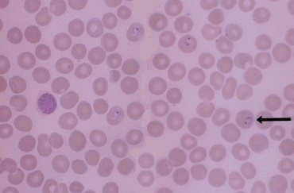
Notes:
P>vivax

Slide 54
Management of acute diarrhoea
Isolation:
Fluid replacement: Replace established losses and ongoing losses, as well as normal daily requirements. This may be done with IV fluid or with oral rehydration solution (ORS).
One sachet of commercial ORS made up to 200 mL is given for each diarrhoea stool.
Notes:
Isolation: All patients with acute, potentially infective diarrhoea should be appropriately isolated to minimise person-to-person spread of infection.
Fluid replacement: Replace established losses and ongoing losses, as well as normal daily requirements. This may be done with IV fluid or with oral rehydration solution (ORS). One sachet of commercial ORS made up to 200 mL is given for each diarrhoea stool.

Slide 55
Antibiotics/antimicrobial therapy: Not generally used, except in severe cases (e.g. immunocompromise, comorbidity, systemic involvement).
May precipitate haemolytic uraemic syndrome in EHEC infection.
Adjunctive antidiarrhoeal therapy: Anti-motility drugs are not generally recommended and may indeed prolong or worsen the course of an acute infective gastroenteritis.

Slide 56

Thank you

