Slide 1
History of Chemotherapy
Era of modern chemotherapy began in early .1940s
Goodman and Gilman first administered nitrogen mustard to patients with lymphoma.
nitrogen mustard was developed as a war gas .rather than as a medicine.
.toxic effects on the lymphatic system led to clinical .trials

Slide 9
Classification of Chemotherapeutic Agents

Slide 12
Alkylating Agents
Main effect is on DNA synthesis with most cytotoxicity to rapidly proliferating cells

Slide 13
Cyclophosphamide and Toxicity
600 MG/M2 (BREAST- SARCOMA-CLL-NHL)
Myelosuppression
principle dose-limiting toxicity.
primarily leukopenia.
Hemorrhagic cystitis
*acrolein metabolite.
*associated with high-dose therapy.
*more common in poorly hydrated or renally compromised patients.
*onset may be delayed from 24 hours to several weeks.
*manifests as gross hematuria.
*aggressive hydration required with high dose therapy
mesna administration.
*management: increase IVF, mesna, total bladder irrigation

Slide 14
Cyclophosphamide Toxicity
*Syndrome of inappropriate antidiuretic hormone.
*Alopecia.
Highly emetogenic if ≥ 1500 mg/m^{2*}

Slide 15
Ifosfamide Toxicity
Sarcoma –ICE (NHL) .)........ d1-d5 1-2 G/M2
Hemorrhagic cystitis
*excretion of acrolein into the urinary bladder.
*greater with bolus regimen.
*higher after ifosfamide that after equivalent doses of cyclophosphamide
symptoms of dysuria and urinary frequency.
mesna binds acrolein.*
*routinely recommended to protect against urothelial toxicity.
*treatment of hemorrhagic cystitis requires evacuation of clots and continuous bladder irrigation;, prostaglandins, or high-dose tranexamic acid have been tried with varying results.

Slide 17
The Platinums

Slide 18
Cisplatin Toxicity
MOST SOLID TUMORS(lung- breast) 75Mg/m2
Hematologic toxicity
can affect all 3 blood lineages
minor neutropenia, thrombocytopenia, and ANEMIA.
its mild hematologic toxicity has allowed its combination with highly myelosuppressive chemotherapy
Ototoxicity
audiograms show bilateral and symmetrical high frequency hearing loss
usually irreversible.
caution with other drugs (aminoglycosides)

Slide 19
Cisplatin Toxicity
Neurotoxicity
dose-limiting toxicity
*most common symptoms are peripheral neuropathy and hearing loss.
*less common include Lhermitte’s sign (electric shock-like sensation transmitted down the spine upon neck flexion)
autonomic neuropathy, seizures, encephalitic symptoms, and vestibular disturbances.
recovery is typically incomplete

Slide 20
Cisplatin Toxicity
Nephrotoxicity
dose-limiting toxicity.
renal damage is usually reversible but rarely can be irreversible and require dialysis.
platinum concentrations are higher in the kidney than in the plasma or other tissues
initiating event is proximal tubular lesion
secondary events such as disturbances in distal tubular reabsorption, renal vascular resistance, renal blood flow, and glomerular filtration, and polyuria seen 2 to 3 days later
hypomagnesemia develops in about 75% of patients, beginning 3 to 12 weeks after therapy and persisting for months to years….

Slide 21
Cisplatin Toxicity
Nausea and vomiting
acute or delayed
highly emetogenic if use doses ≥ than 50 mg/m²
moderately emetogenic if use doses ≤ 50 mg/m2
severe if not adequately prevented with appropriate medications
typical anti-emetic regimen
dexamethasone 12 mg po day 1 then 8 mg po daily x 3 days
ONDASTERON 8mg IVP day 1
metoclopramide 10 mg every 4 hours prn N/V

Slide 22
Cisplatin Nephrotoxicity
Preventive Measures
aggressive saline hydration (enhance urinary excretion)*
lower doses may require less hydration.*
infuse over 24 hours.*
*avoid other nephrotoxic agents.
magnesium supplementation.*
predisposing factors to developing nephrotoxicity include age 60 years or older, higher doses,
, pretreatment GFR < 75 ml/min,
cumulative dose,
low albumin,
single dose compared with daily x 5 administration schedules

Slide 23
Cisplatin Administration
Mixed in 250 - 1000 ml NS
Infused over at least 1hours
Pre-hydration of 250 – 1000 mL NS depending on dose
Caution in patients with HF who cannot tolerate this amount of fluids
May require furosemide IVP*
Post-hydration with 1 Liter NS *
instruct patient to drink 6 – 8 full glasses of water/day (1.5 – 2 Liters/day) at home)

Slide 24
Carboplatin Toxicity
Moderately emetogenic
Renal impairment is rare
because it is excreted primarily in the kidneys as an unchanged drug, it is not directly toxic to the renal tubules
Neurotoxicity is rare
Myelosuppression
especially THROMBOCYTOPENIA
dose-limiting toxicity
cumulative
Hypersensitivity reaction
thought to be due to type I hypersensitivity (IgE mediated)
incidence of hypersensitivity seems to be correlated with increased number of cycles of carboplatin administered
risk of hypersensitivity due to carboplatin exposure significantly increases during the sixth cycle, and it continues to increase up to cycle 8

Slide 25
Oxaliplatin Toxicity
|colorectal cancers ---pancreatic cancers
85mg/m2
Gastrointestinal
Moderate emetogenicity.
Diarrhea.
Minimal hematologic toxicity
Thrombocytopenia is dose-related (doses > 135 mg/m2)
mild neutropenia
mild anemia
No nephrotoxicity
Hypersensitivity reaction
*mild
* generally subside upon discontinuation
* slowing down infusion rate and giving an antihistamine
and/or steroid
desensitization protocol
Peripheral neuropathy
Prevention:

Slide 26
Oxaliplatin Neuropathy
Supportive care for prevention of oxaliplatin induced neuropathy
avoid cold temperatures if exposure to cold temperatures cannot be avoided, such as use of the refrigerator, wear gloves during the exposure use scarves and face masks in cold weather prolonging the infusion time use cotton socks, pot holders, rubber gloves for dish washing assess the water temperature in the home use moisturizer

Slide 27
Comparison of Platinum Toxicity
Table 5. Comparative adverse effect profiles of platinum drugs
Adverse effect | cisplatin | carboplatin | oxaliplatin
Nephrotoxicity | ++ | + | -
Gastrointestinal toxicity | +++ | + | +
Peripheral neurotoxicity | +++ | - | ++
Ototoxicity | + | - | -
Hematologic toxicity | + | ++ | +
Hypersensitivity | - | + | -

Slide 34
ondansetron

Slide 35
وخاصة بوجود وظيفة قلبية سيئة وحالة عامة دون الوسط

Slide 40
How to hit the target
If you know the target, and there is only one
target you can be very specific.
If you don’t really know or it’s a really big
target, a larger weapon may be needed.

Slide 41
“Targeted” Cancer Treatment
How does it work?
Attack targets which are specific for the cancer cell and are critical for its survival or for its malignant behavior
Why is it better than chemotherapy?
More specific for cancer cells .
Possibly more effective.

Slide 42
Targets
The targets currently being used are those that block the growth and spread of cancer by interfering with specific molecules involved in tumor growth and progression.
The focus is on proteins that are involved in cell signaling pathways, which form a complex communication system that governs basic cellular functions and activities, such as cell division, cell movement, how a cell responds to specific external stimuli, and even cell death.
We use the term “signal transduction” to refer to the actions of these proteins.

Slide 43
FDA-Approved TKIs
Generic Name | Brand Name | Cancer
Imatinib | Gleevec | CML, GIST, others
Dasatinib | Sprycel | CML, ALL
Nilotinib | Tasigna | CML
Gefitinib | Iressa | Lung
Erlotinib | Tarceva | Lung, Pancreas
Lapatinib | Tykerb | Breast
Sorafenib | Nexavar | Kidney, Liver
Sunitinib | Sutent | Kidney

Slide 44
Monoclonal Antibodies
Another type of targeted therapy – they are largemolecules produced through genetic
engineering
They usually have to be given IV
Side effects can include reactions to non-human proteins
They can cause cell damage in several ways, most often by attacking cell-surface receptors

Slide 45
Monoclonal Antibodies
FDA-Approved “Naked” (Non-Conjugated) MoAbs
Generic Name | Brand Name | Target | Cancer(s)
Alemtuzumab | Campath | CD52 | CLL
Bevacizumab | Avastin | VEGF | Multiple
Cetuximab | Erbitux | EGFR1 | Colon, H&N
Panitumumab | Vectibix | EGFR1 | Colon
Rituximab | Rituxan | CD20 | Lymphomas
Trastuzumab | Herceptin | HER-2 | Breast

Slide 46
Trastuzumab
* Monoclonal antibody against epidermal
growth factor receptor 2 (EGFR2, HER-2)
Very effective against breast cancers in which HER-2 is “over-expressed” (more than usual amount per cell) (about 20% of all breast cancers)
Often used in combination with chemotherapy

Slide 52
Cetuximab
* Monoclonal antibody against epidermal
growth factor receptor 1 (EGFR1)
* Effective in colon cancer and head and neck cancer; possibly useful in lung cancer
* Used with chemotherapy and with radiation therapy

Slide 53
Angiogenesis (New Blood Vessel Growth)

Slide 54
Bevacizumab
*Monoclonal antibody against vascular endothelial growth factor (VEGF), which stimulates angiogenesis (growth of new blood vessels into tumor)
*Deprives tumors of the blood supply they need for growth and invasion
*Effective against cancers of colon, lung, breast, kidney, and brain

Slide 60
كيف تعمل مثبطات نقاط التفتيش المناعية ضد السرطان؟
نقاط التفتيش المناعية هي جزء طبيعي من الجهاز المناعي. دورهم هو منع الاستجابة المناعيةمن أن تكون قوية لدرجة أنها تدمرالخلاياالسليمة في الجسم.
تتفاعل نقاط التفتيش المناعية عندما تتعرف البروتينات الموجودة على سطح الخلاياالمناعية التي تسمى الخلايا التائية عل ىالبروتينات ا لشريكة في الخلايا الأخرى وترتبط بها، مثل بعض الخلاياالسرطانية. وتسمى هذه البروتينات بروتينات نقطة التفتيش المناعية.
عندما ترتبط نقطة التفتيش والبروتينات الشريكة معا ، فإنها ترسل إشارة "إيقاف" إلى الخلايا التائية. هذا يمكن أن يمنع الجهاز المناعي من تدمير السرطان.

Slide 61
تعمل أدوية العلاج المناعي التي تسمى مثبطات نقاط التفتيش المناعية عن طريق منع بروتينات نقاط التفتيش
من الارتباط بالبروتينات الشريكة. هذا يمنع إرسال إشارة "إيقاف" ، مما يسمح للخلايا التائية بقتل الخلاياالسرطانية.
أحد هذه الأدوية يعمل ضد بروتين نقطة تفتيش يسمى CTLA-4
تعمل مثبطات نقاط التفتيش المناعية الأخرى ضد بروتين نقطة تفتيش يسمىPD-1أو البروتين الشريكPD-L1.

Slide 62
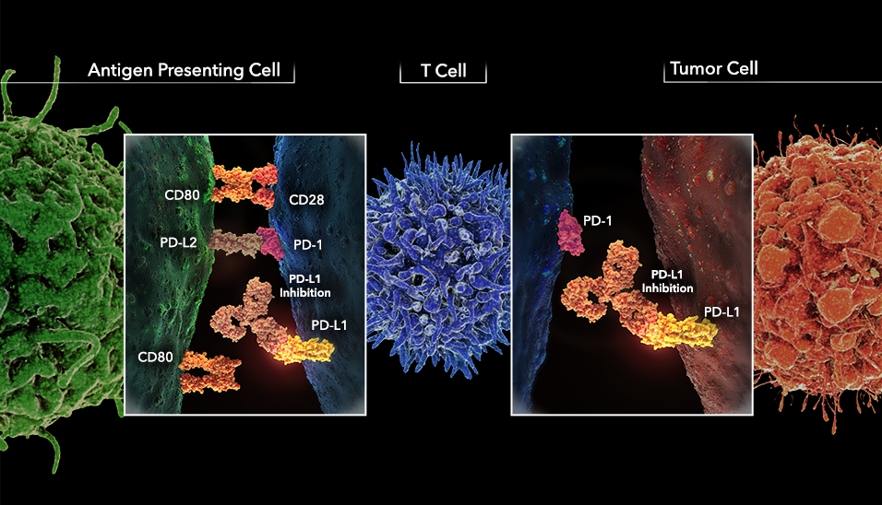

Slide 63
IMMUNO THERAPY
HEAD NECK-HD-LUNG-TCC-RCC)NIVOLUMAB 3MG/KG
PEMBR0LIZUMAB HEAD NECK-HD-LUNG-TCC-2MG/KG...RCC)
ATEZOLIZUMAB 1200 MG >>TCC

Slide 71
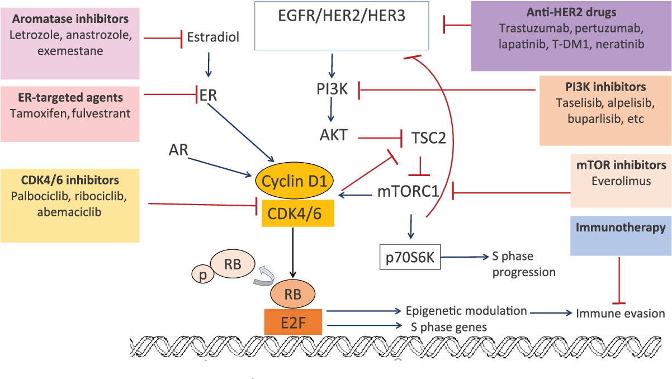
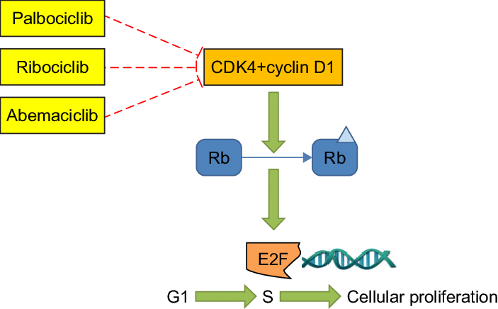
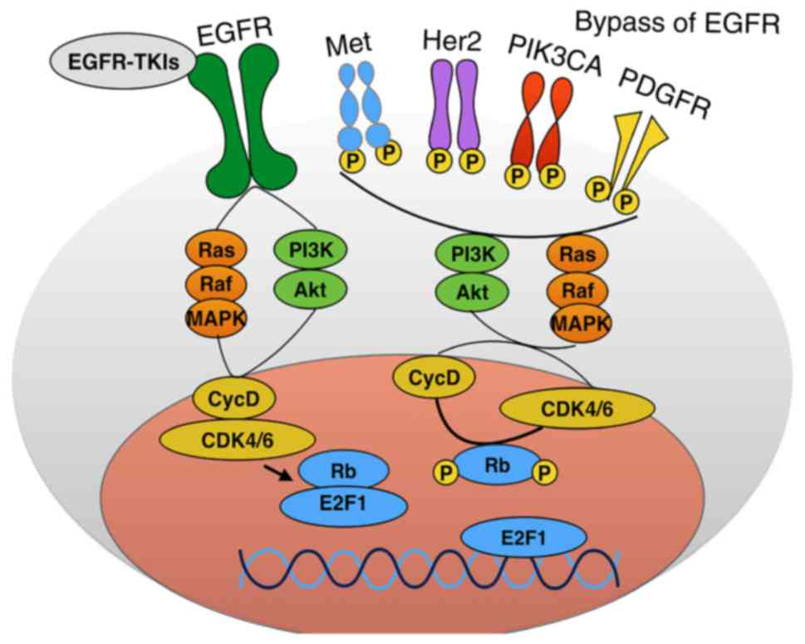
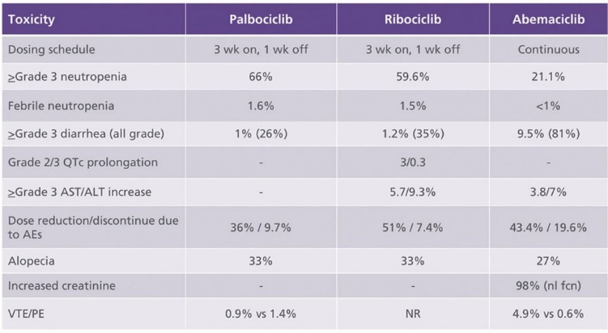

Slide 75
Antibody-drug conjugates or ADCs مترافقات الاجسام المضادة
s هي جزيئات معقدة تتكون من جسم مضادمرتبط بحمولة أو دواءنشط بيولوجيا (مضاد للسرطان).
الاقترانات بين الأجسام المضادة والأدوية هي مثال على الاقترانالحيوي والاقتران ا لمناعي.
تجمع ADCs بين خصائص استهداف الأجسام المضادة وحيدة النسيلة وقدرات قتل السرطان ب للأدوية السامة للخلايا.

Slide 78
نهاية المحاضرة

