Slide 1
Brittle Diabetes
د. رنا شنات
اختصاصية غدد وسكري
المؤتمر العلمي الطبي الثاني/ حماة20 آذار 2019

Slide 2
Brittle diabetes is defined as severe instability of blood glucose levels with frequent and unpredictable episodes of hypoglycaemia or ketoacidosis that disrupts day to day life

Slide 3
Brittle diabetes is uncommon (less than 1% of insulin taking population) and it causes a huge burden on the patient due to multiple hospital admissions

Slide 4
It is episodic and almost always related to stressful life situations.
It affects 3/1000 insulin dependent diabetic patients mainly young women.

Slide 5
Brittle diabetes is less common in people over 40 years of age which suggests that brittle diabetes may, in some cases, resolve itself in time

Slide 6
prognosis
Its is poor with lower quality of life scores, more microvascular and
pregnancy complications and
shortened life expectancy

Slide 7
CAUSES OF BRITTLE DIABETES
Main causes includes
• Non physiologic matching of meals/exercise and insulin administration.
• Malabsorption
• Certain Drugs (alcohol, antipsycotics)
• Defective insulin absorption or degradation
• Defect of hyperglycaemic hormones especially glucocorticoid and glucagon.
• Delayed gastric emptying as a result of autonomic neuropathy.

Slide 8
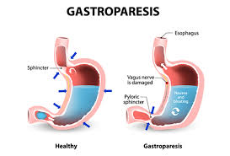
Autonomic neuropathy, nerve damage that affects the functioning of organs, can lead to problems with delayed stomach emptying (gastroparesis) and affect the functioning of the intestines.
Not knowing when food will be digested can make it hard to judge when or how much insulin should be given.

Slide 9
• Psycosocial factors are very important and factitious brittleness may lead to a self perpetuating condition. This is because of patient centred behavioral issues.
Some of these problems may be short lived and related to a stressful situation (unhappiness at school or home).

Slide 11
Brittle diabetes is often associated with stress, depression and other psychological issues. Stress can lead to acute and temporary insulin resistance. This means that the body does not respond to insulin and this can come on and disappear very quickly without warning. This can lead to distinct challenges when needing to judge insulin doses.
Additionally, other psychological issues may add further complications to the management of type 1 diabetes

Slide 12
CLINICAL MANIFESTATIONS
Patients have wide swings of blood sugar levels and report differing blood sugar responses to the same dose and type of insulin.
Most patients are in their twenties or thirties.
Their glycated haemoglobin (HbA1c) are typically elevated (10-14%) and acute complications (DK and hypo) and chronic microvascular complications are commoner (67% versus 25%)

Slide 13
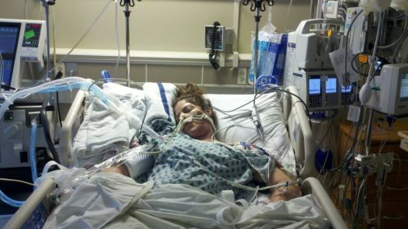
Brittle diabetics also had a lower quality of life score. The age of death ranges from 27-45 years with a predominance in young women. Those
who survived had resolution of brittleness, but suffered a significant complication burden

Slide 14
clinical presentations
Three clinical presentations of brittle diabetes have been described:
(1) predominant hyperglycemia with recurrent ketoacidosis,
(2) predominant hypoglycemia, and
(3) mixed hyper- and hypoglycemia].
Frequent hypoglycemia, even if asymptomatic, causes both defective glucose counterregulation and hypoglycemia unawareness and, thus, a vicious cycle of recurrent hypoglycemia.

Slide 15
What are the Signs and Symptoms of Brittle Diabetes?
The signs and symptoms of Brittle Diabates may fluctuate, depending on the glycemic status of the affected individual.
The signs and symptoms of Brittle Diabetes caused by hyperglycemia:
Thirst despite excessive drinking of water
Excessive urination
Weakness and severe fatigue
Confusion
Blurred vision

Slide 16
The signs and symptoms of Brittle Diabetes caused by
hypoglycemia:
Anxiety, confusion, or irritability
Fatigue
Heart palpitations
Headaches
Clammy skin, excessive sweating
Shakiness/trembling, loss of coordination
Numbness around the mouth
Dilated pupils

Slide 18
Somogyi Effect
. The Somogyi effect (or rebound hyperglycemia) results in morning high blood sugar (hyperglycemia) as a result very low blood sugar (hypoglycemia) during the night. It's a rare phenomenon and most often occurs in people with Type 1 diabetes.

Slide 20
dawn phenomenon
Everyone has a dawn phenomenon. Otherwise they'd be too weak to get breakfast. But in people without diabetes, insulin levels also increase to handle the extra glucose. People with diabetes can't increase insulin levels that much, so their early morning blood glucose levels can rise dramatically

Slide 22
CLINICAL ALGORITHM TO DETERMINE THE ETIOLOGY
The diagnostic algorithm was the glucose response to 0.1 unit / kg insulin administered subcutaneously and intravenously.
If this response was ’’normal’’ then psycosocial evaluations were completed, including psycolinguistic and health psycological testing.
Then other parameters affecting blood glucose concentration eg.
gastric motility,
counter regulatory hormones,
Coeliac disease,
hypothyroidism,
adrenal insufficiency,
insulin autoantibodies and most importantly patients compliance with prescribed regimens were assessed.

Slide 23
If the response were ‘’abnormal’’ the location of the insulin resistance was identified as being subcutaneous, intravascular or at the peripheral tissue.

Slide 24
Frequent episodes of hypoglycemia can lead to hypoglycemic unawareness and make the condition worse. Keeping diabetes under good control for at least several weeks can restore hypoglycemic awareness. New technologies such as continuous glucose monitors and insulin pumps may help improve control.

Slide 25
Hypoglycemia unawareness (HU)
is defined at the onset of neuroglycopenia before the appearance of autonomic warning symptoms.
It is a major limitation to achieving tight diabetes and reduced quality of life.
HU occurs in approximately 40% of people with type 1 diabetes mellitus (T1DM) and with less frequency in T2DM. Though the aetiology of HU is multifactorial, possible mechanisms include

Slide 26
chronic exposure to low blood glucose, antecedent hypoglycaemia,
recurrent severe hypoglycaemia and the failure of counter-regulatory hormones.
Clinically it manifests as the inability to recognise impeding hypoglycaemia by symptoms, but the mechanisms and mediators remain largely unknown. Prevention and management of HU is complex, and can only be achieved by a multifactorial intervention of clinical care and structured patient education by the diabetes team.

Slide 28
EVALUATION AND DIAGNOSIS
A careful evaluation should be performed in patients with brittle diabetes.
A detailed history as to the
duration of diabetes,
description of episodes of DK,
severe hypos,
presence of diabetic complications (particularly autonomic neuropathy)
and prescribed insulin regimens should be taken.

Slide 29
It should also be determined if there was a period of stable diabetes preceeding the brittleness
and what happened in the patient’s life circumstances coincident with the onset of brittleness.
Psycosocial factors need to be assessed. For patients with recurrent episodes of DK, a possible chronic cryptic infection (sinusitis, osteomyelitis, renal or perirenal abscess and lung abscess) should be excluded

Slide 30
For all patients a diabetic educational assessment is useful to evaluate whether the patients knows how to manage diabetes and rule out diabetes mismanagement (factitious brittle diabetes )
. In this case a “in hospital” assessment and management of blood sugar is necessary.

Slide 31
Iatrogenic hypoglycaemia is the result of the interplay of absolute or relative therapeutic insulin excess and compromised physiological and behavioural defences against falling plasma glucose concentrations in type 1 diabetes mellitus (T1DM) and advanced type 2 diabetes mellitus (T2DM).

Slide 32
What are the possible Complications of Brittle Diabetes?
The complications of Brittle Diabetes may include those resulting from hypoglycemia as well as hyperglycemia:
Hypoglycemia-related complications of Brittle Diabates:
Hypoglycemic unawareness
Loss of consciousness
Seizure
Risk of falls and injury due to seizures

Slide 33
Hyperglycemia-related complications of Brittle Diabetes:
Progressive weakness
Confusion
Progression to ketoacidosis, which can cause accumulation of toxic ketones in the blood
Kidney failure
Seizures
Risk of falls and injury due to seizures
Coma
The following complications may also occur in Brittle Diabetes:
Frequent hospital visits; long hospital stays
Reduced quality of life
Complications may occur with or without treatment, and in some cases, due to treatment also.

Slide 34
MANAGEMENT
Brittle diabetes is difficult to treat
General principle
• Patients to be instructed how to match the insulin dose to the amount of carbohydrates ingested.
• Insulin regimens must be individually tailored to reduce the risk of hypoglycaemia while matching glycaemic control. The use of insulin analogues with ultrafast or ultraslow action and use of subcutaneous insulin pumps are effective in brittle diabetes.

Slide 35
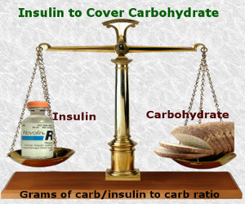
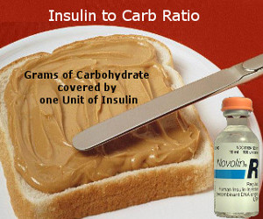

Slide 36
SMBG is an excellent tool for the patients and a
motivated patient can use this tool to manage his blood sugars.
• CGM (Continuous glucose monitoring) may further facilitate the understanding of glycaemic variability

Slide 38
Continuous glucose monitoring
Typical diabetes management involves regular testing of your blood to check your glucose levels, often several times each day. With brittle diabetes, that may not be often enough to keep your glucose levels under control.
With continuous glucose monitoring (CGM), a sensor is placed under your skin. This sensor constantly detects glucose levels in your tissues and can alert you when these levels get too high or too low. This allows you to treat your blood sugar issues right away.

Slide 39
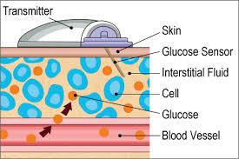

Slide 40
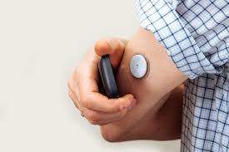
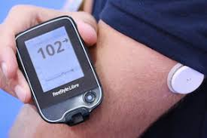

Slide 41
Subcutaneous insulin pump
The main goal for people with brittle diabetes is to better match the amount of insulin they get to how much they need at a given time. That’s where the subcutaneous insulin pump comes in. It’s the most effective tool for controlling brittle diabetes.
You carry this small pump in your belt or pocket. The pump is attached to a narrow plastic tube that is connected to a needle. You insert the needle under your skin. You wear the system 24 hours a day, and it continuously pumps insulin into your body. It helps keep your insulin levels steady, which in turn helps keep your glucose levels on a more even keel.

Slide 42
• Sensor augmented insulin pumps (an insulin pump with a CGM device) improves glycemic control without hypoglycaemia.
• Fully automated closed loop systems of insulin delivery based on CGM sensing (bionic pancreases) are available.
This device also integrates glucagon delivery.

Slide 43
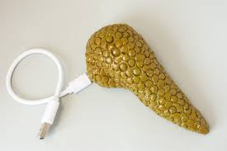
. In 2016, the Food and Drug Administration (FDA) approved a “hybrid closed-loop system” artificial pancreas that tests your glucose level every five minutes, 24 hours a day, automatically supplying you insulin as needed

Slide 44
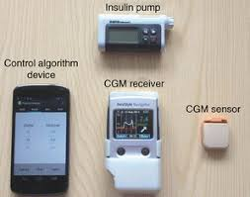

Slide 45
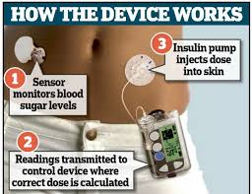

Slide 46
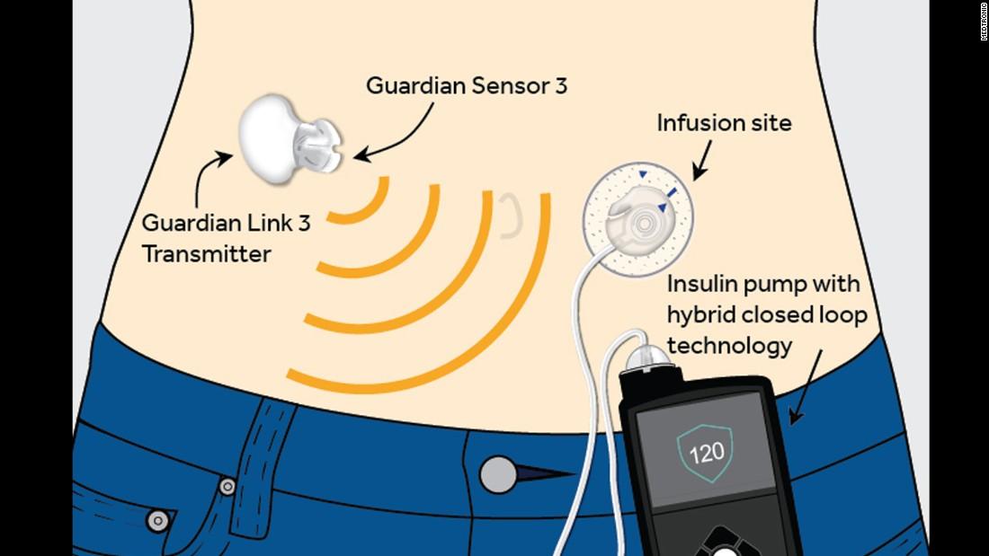

Slide 47
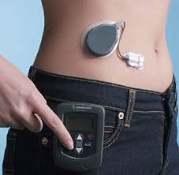

Slide 48
• Islet cell transplantation –an effective therapeutic option entailing good expected outcomes.
The limiting factor is the effect of immunosuppressive therapy and recurrence of autoimmunity

Slide 49
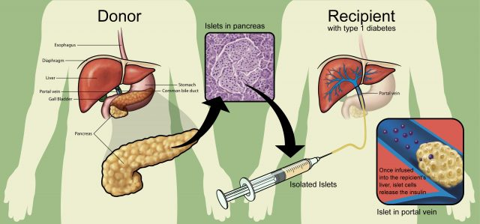

Slide 50
How can Brittle Diabetes be Prevented?
In some cases, Brittle Diabetes may be prevented by considering the following factors:
• Following a treatment regimen, in order to maintain good glycemic index
• Regular physical activity
• Avoiding exercise on an empty stomach
• Eating meals on time (small meals at regular intervals, without lengthy gaps between large meals)
• Avoiding refined carbohydrate products in meals
• Limiting alcohol and caffeine consumption
• Seeking prompt medical attention for conditions that may pre-dispose an individual to Brittle Diabetes
Regular medical screening at periodic intervals with tests and physical examinations

Slide 51
SPECIAL SITUATIONS
• Hypoglycaemia unawareness A 2-3 Week period of scrupulous avoidance of hypoglycaemia is advisable since that often restores awareness
• Gastroparesis – promotility agents improved gastric enptying and relieved the symptoms of gastroparesis but did not help with metabolic control.
• Psycosocial – Psycotherapy may help in selectedpatients.

Slide 52
SUMMARY AND RECOMMENDATIONS
• Brittle diabetes in defined as severe instability
of blood glucose levels with frequent and
unpredictable episodes of hypoglycaemia or
ketoacidosis.
• The diagnosis is established when a patient with
absolute insulin deficiency (type 1 or type 2) has
Frequent episodes of hyper or hypoglycaemia.
• The major cause of brittle diabetes is patient or clinician error in management, other causes
being psycosocial, malabsorbtion, delayed gastric
emptying, systemic insulin resistance.
• The treatment includes diabetes education,
intensive insulin therapy with frequent or
continuous glucose monitoring and constant
interaction between patient and the clinician.
Psycotherapy is advocated in selected patients.

