Slide 1




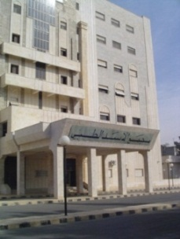

وراثيات الأورام العصبية..النوروبلاستوما نموذجاً
Neurologic tumors genetics..Neuroblastoma as a model
المؤتمر الطبي العالمي الثاني لجامعة حماة
د.عبدالمطلب أحمد السح
جامعة حماة
نقابة أطباء سورية
الهيئة العامة لمشفى الأسد الطبي في حماة
Dr. Abdul Muttaleb Alsah
(Ph.D, AMRCPCH, MA, MBBCH )
فندق أفاميا الشام، حماة 18-20 /آذار2019
2

Slide 2
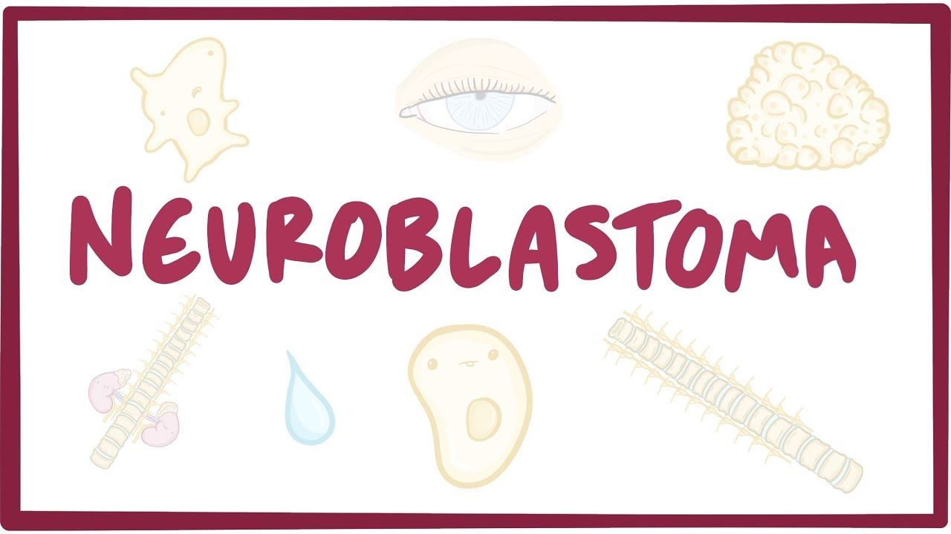

Slide 3
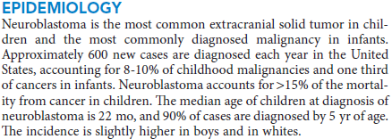
وبئيات
Neuroblastoma is the most common childhood cancer diagnosed before the age of 1 year.

Slide 4
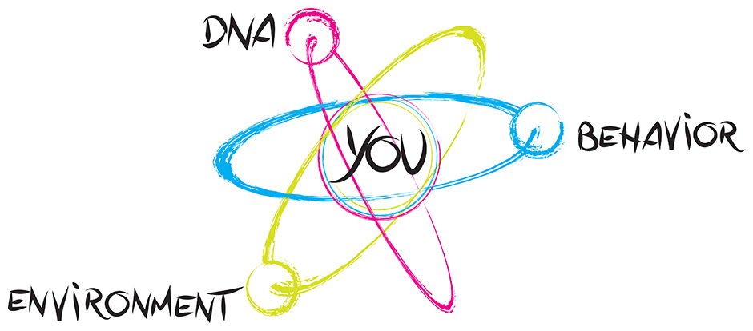
كينونة واحدة

Slide 5
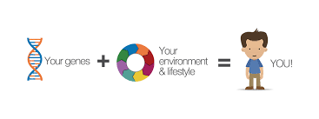
النتيجة محسومة وغير محسومة

Slide 6
أبوابنا تطرق بقوة
Genetics and genomics are beginning to strongly influence the care of patients with neurologic tumors. knowledge of genomic developments is increasingly highly useful to doctors and their patients.

Slide 7
وراثة
*Some patients inherit a genetic predisposition to neuroblastoma due to germline mutations.
*Others develop sporadic disease that may result from either :
germline or somatic mutations.

Slide 8

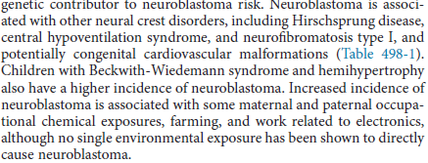

Slide 9
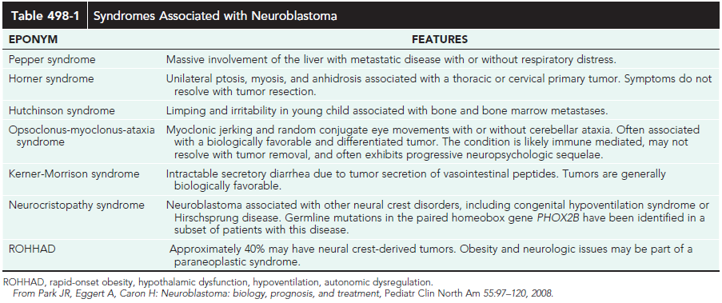

Slide 10
نسيجياً
Histopathologically, neuroblastoma can range in type from the most aggressive form, neuroblastoma, composed entirely of immature neural precursor cells, to ganglioneuroma, composed entirely of mature neural tissue.

Slide 11
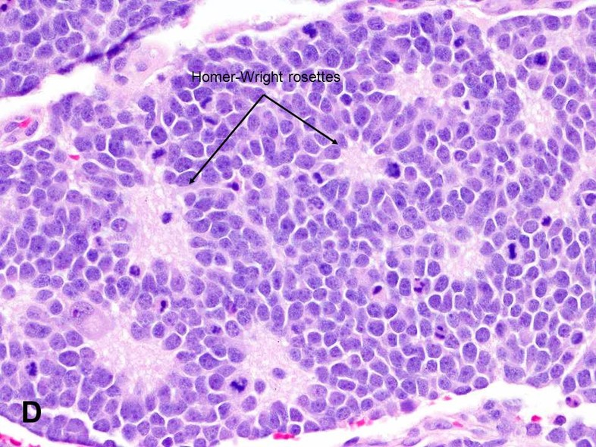

Slide 12
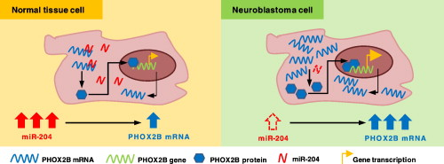

Slide 13
سريرياً
• One child had a tumor on the left side of the abdomen with liver and distal metastases. The biopsy confirmed the diagnosis of neuroblastoma. This child was not particularly bothered by her disease - and indeed, she received no chemotherapy, no radiation therapy - and she did well, and is teenager now and is fine.
• On the other hand another child with a small tumor in the adrenal gland with liver and distal metastases. However, there was also metastatic infiltration of the orbit. This child also had a biopsy that confirmed the diagnosis of neuroblastoma, - but, unlike the first child, received very intensive chemotherapy, radiation therapy and despite that died only 6 months after.

Slide 14
ثلاثة أطياف
• low risk: generally infants, less than 12 months of age, with localised tumors although they can have ocasionally metastatic disease. The vast majority of those patients are cured with just surgery and/or observation.
• high risk: generally children diagnosed after the first year of life. The patients usually have metastatic disease and most of these children will relapse despite intensive multimodal therapy.
• intermediate risk: This group is somewhat ill defined and comprises generally children with large abdominal tumors. Most of these patients can be cured with chemotherapy.

Slide 15
Genetic Heterogeneity of Susceptibility to Neuroblastoma
Susceptibility to neuroblastoma is genetically heterogeneous and is conferred by mutation in the PHOX2B gene on chromosome 4p12 (NBLST2) and by mutation in the ALK gene on chromosome 2p23 (NBLST3).
Loci implicated in the development of neuroblastoma include 6p (NBLST4), 2q35 (NBLST5), and 1q21 (NBLST6).

Slide 16
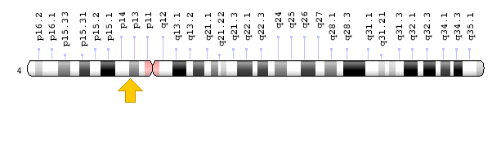
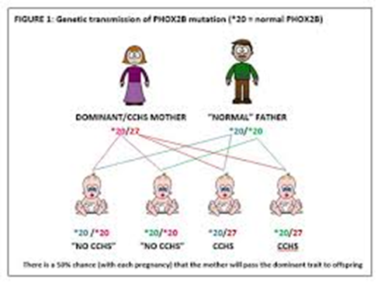


Slide 17
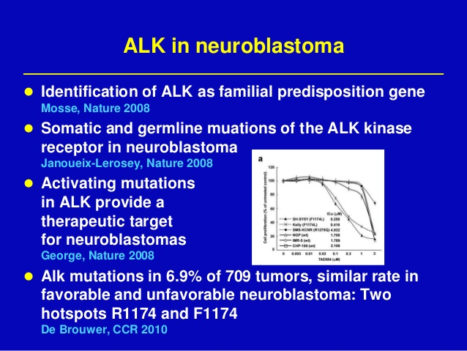

Slide 18
Somatically acquired abnormalitiles:
- Loss of genetic material (1p, 2q, 3p, 4p, 9p, 11q, 14q, 18q, other regions).
- 1p36: 19-36%
- 11q23: 40-45%
- 14q32: 20-25%

Slide 19
Somatically acquired abnormalitiles:
- Gain of genetic material (MYCN amplification, 17q gain)
- MYCN amplification: 20-25% of primary tumors
Highly associated with deletion of 1p
Elevated mRNA and protein expression (important in cell proliferation/cell cycle)
Independently predicts treatment failure
Only oncogene consistently activated
-Unbalanced Gain of distal 17q :
• -Originally identified in G-banded karyotypes -Gilbert (Cancer Res, 1984)
• -CGH studies show unb gain 17q to be most common genetic alteration in primary NBs - e.g. Brinkschmidt (J Pathol, 1997); Plantaz (Am J Pathol, 1997)
• - 25 Mb common region of gain at 17q23.1-17 qter - Meddeb (Genes Chromos Cancer, 1996)
• - Associated with adverse prognostic fetures and may be independently prognostic for survival - Brown (NEJM, 1999)

Slide 20
Somatic Mutations
Genes with significant somatic mutation frequencies included ALK (9.2% of cases), PTPN11 (2.9%), ATRX (2.5%, and an additional 7.1% had focal deletions), MYCN (1.7%, causing a recurrent P44L alteration), and NRAS (0.83%). Rare, potentially pathogenic germline variants were significantly enriched in ALK, CHEK2, PINK1, and BARD1.

Slide 21
Constitutional rearrangements
Constitutional rearrangements have been very important in the cloning of predisposition genes for both retinoblastoma and Wilms tumor. In neuroblastoma constitutional abnormalities have only been very rarely identified.

Slide 22
Hereditary neuroblastoma
Hereditary neuroblastoma does occur, however it is excedingly rare, and a recent survey of French data suggested 1.4 % of newly diagnosed cases of neuroblastoma have a positive familial history for the disease.
However in distinction to retinoblastoma, neuroblastoma is incompletely penetrant. In large part it is now clear that this is due to the fact that neuroblastomas sometimes spontaneously remit and just never come to clinical attention. In adition, neuroblastoma - unlike retinoblastoma and Wilms tumor - may often be fatal. Therefore large pedigrees are not common.

Slide 23
Alterations in gene expression during
neuroblastoma tumorigenesis
• Neurotrophin signaling pathway - TrkA, TrkB, TrkC
• Apoptotic signaling pathway - Caspase 8, BCL2, BCLX
• Multidrug resistance genes - MDR1, MRP
• Metastasis-Suppressing Genes - CD44, NME1 (NM23-H1)
• Telomerase subunits

Slide 24
Pathogenesis
High-Risk Neuroblastoma
Peifer et al. (2015) performed whole-genome sequencing of 56 neuroblastomas (high-risk, n = 39; low-risk, n = 17) and discovered recurrent genomic rearrangements affecting a chromosomal region at 5p15.33 proximal to TERT. These rearrangements occurred only in high-risk neuroblastomas (12/39, 31%) in a mutually exclusive fashion with MYCN amplifications and ATRX mutations, which are known genetic events in this tumor type.

Slide 25
Cytogenetics
Fong et al. (1989) found that somatic loss of heterozygosity occurred most consistently between 1p36.1 and 1p36.3 in neuroblastomas. They found a correlation between loss of heterozygosity on 1p and amplification of MYCN, which is on chromosome 2p24. Stating that at least 70% of neuroblastomas show cytogenetically visible aberrations in 1p, Weith et al. (1989) presented the results of studies of loss of heterozygosity in 9 different tumors and the corresponding normal tissue.

Slide 26
Molecular Genetics
Germline Mutations in the KIF1B Gene
In 1 pheochromocytoma and 3 neuroblastoma tumor samples and in corresponding germline DNA samples from the respective patients, Schlisio et al. (2008) identified 4 different missense mutations in the KIF1B gene on chromosome 1p36.2.

Slide 27
Biological Staging and survival:

Slide 28
Diagnosis
Screening for neuroblastoma using the detection of catecholamines in the urine was performed in 92% of the 476,654 children born in the province of Quebec during a 5-year period, 1989 to 1994 (Woods et al., 2002). The conclusion was that the program did not seem justified. Thus, there is a possibility of causing harm by treating cases detected by screening that would otherwise have a benign course. On the other hand, disease with an unfavorable prognosis is rarely detectable by screening and appears not to be affected by the screening procedure as a general public health intervention.

Slide 29
بركان معلوماتي وتطبيقي
New insights into the genetic basis of disease are being generated at an ever increasing rate. This explosion of information was ignited by technological advances, such as the polymerase chain reaction and automated DNA sequencing. Although its promise is great, the integration of genetics into the everyday practice of medicine remains challenging.

Slide 30
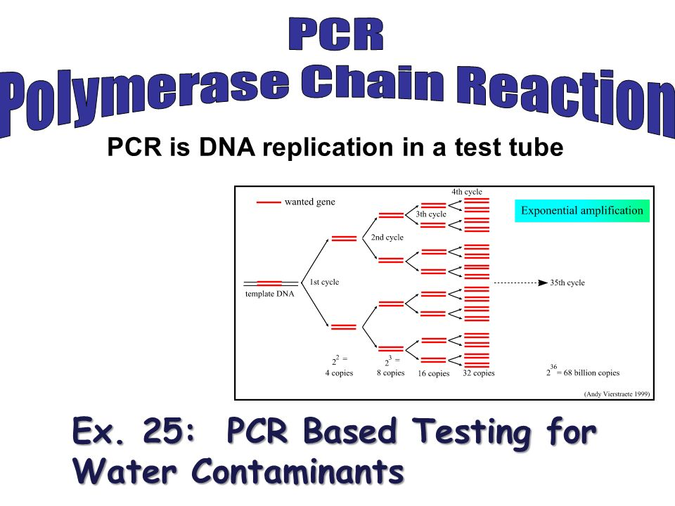
بركان معلوماتي وتطبيقي

Slide 31
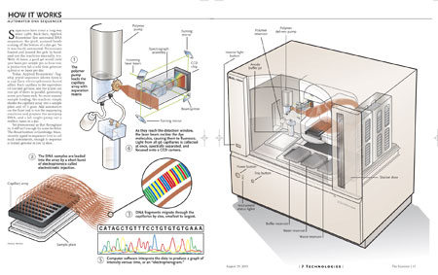
تسلسل الدنا المؤتمت

Slide 32
(46,831)
20,000 – 300,000

Slide 33
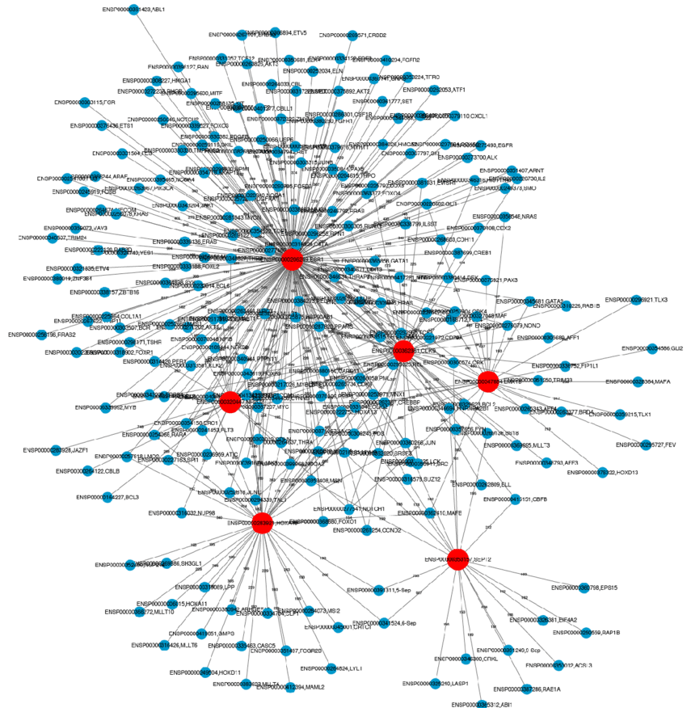
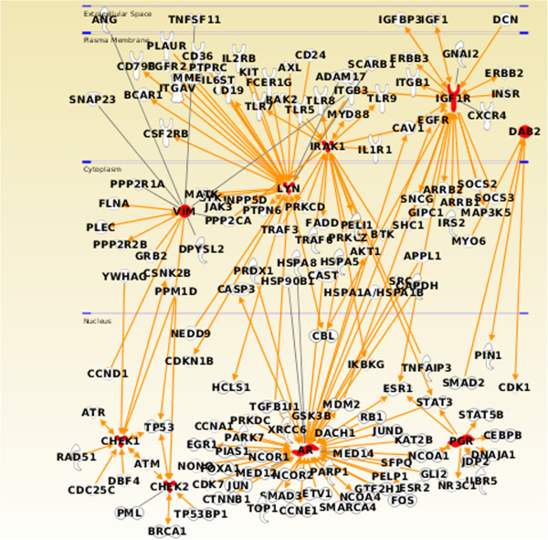

Slide 34
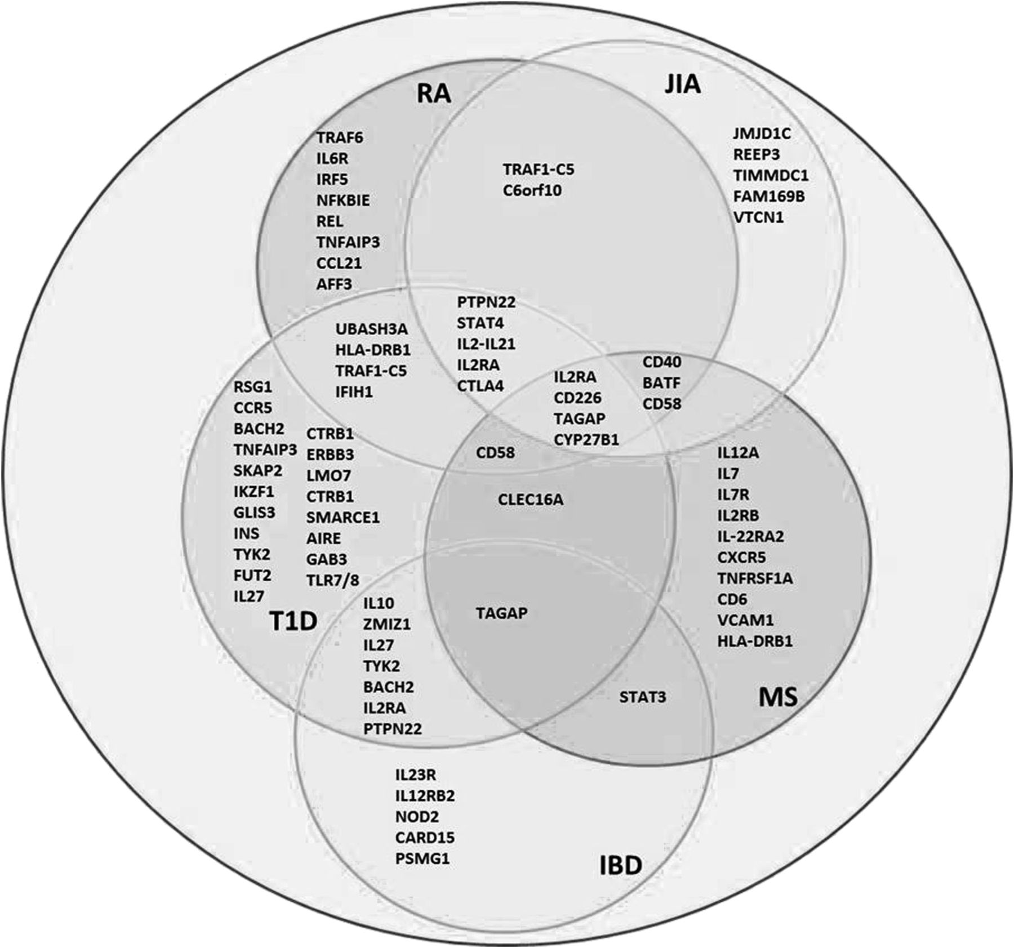
رفاق السوء على مستوى المورثات

Slide 35
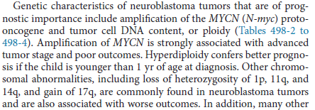
إنذارياً

Slide 36
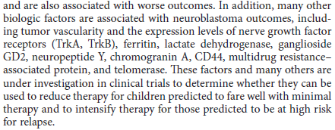

Slide 37
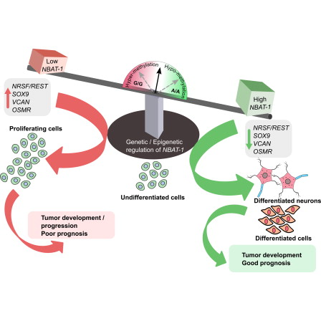

Slide 38



Slide 39
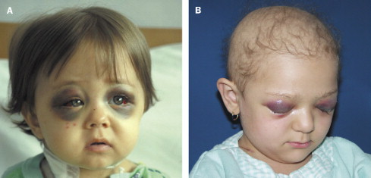

Slide 40

مشروع المجين ( الموروث ) البشري
الخارطة الوراثية
( Human Genome Project )

Slide 41
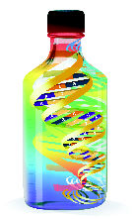
تطبيقات عملية :
* إن الاختبارات التشخيصية الأكثر نوعية و الأسرع ستسمح بكشف ووقاية ومعالجة مبكرة ونوعية لعدد لا محدود من الأمراض ومن بينها النوروبلاستوما.
* المعالجة المورثية عن طريق تصحيح أو تقوية أو استبدال المورثات المعيبة ً.
* الوراثيات الدوائية، وتعني إيجاد أدوية ورمية (هي الأروع) مصممة حســـــب الزبون ( المريض ) إن جاز لنا التعبير .

Slide 42
تقليل التكلفة
Decreases in the number of adverse drug reactions,
the number of failed drug trials,
the time it takes to get a drug approved,
the length of time patients are on medication,
the number of medications patients must take to find an effective therapy,
the effects of a disease on the body (through early detection),
and an increase in the range of possible drug targets will promote a net decrease in the cost of health care.

Slide 43
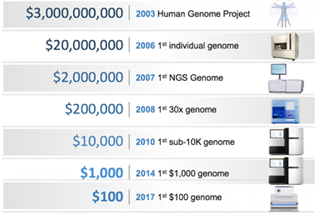

Slide 44
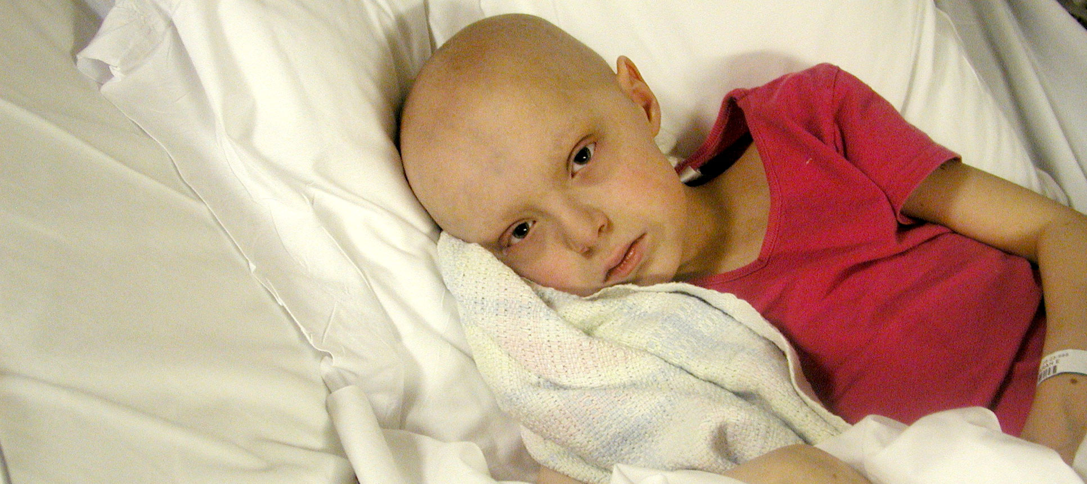

Slide 45




