Slide 1
Recombinant Nanobodies
Next Generation Diagnostics
Abdul Qader Abbady
Department of Molecular Biology and Biotechnology
AECS

Slide 2
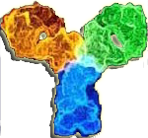
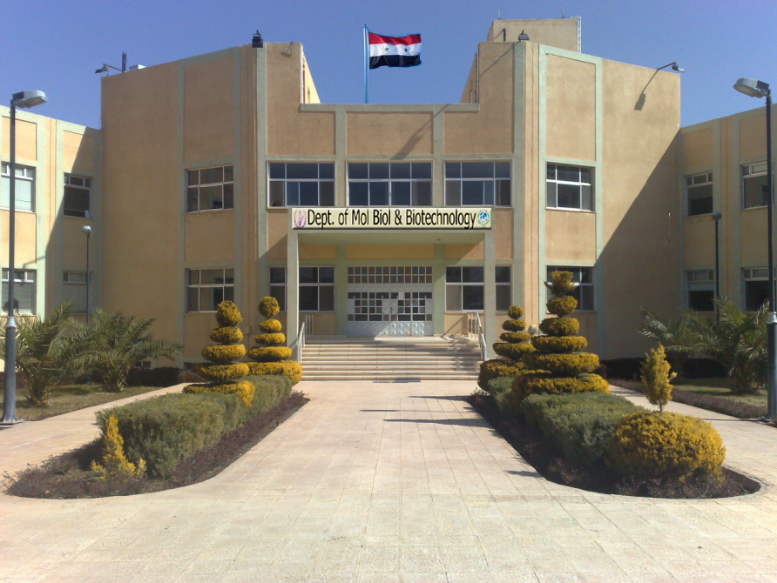
Atomic Energy Commission of Syria: AECS
Dept. of Molecular Biology and Biotechnology
Established in 2000

Slide 3
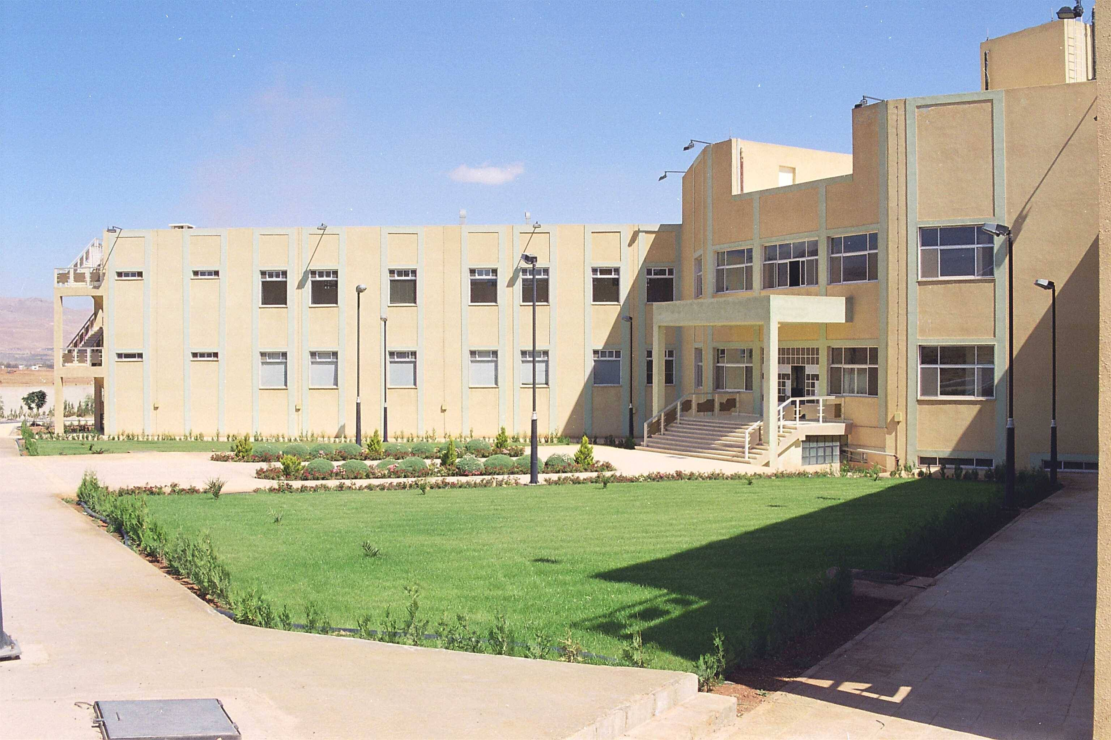
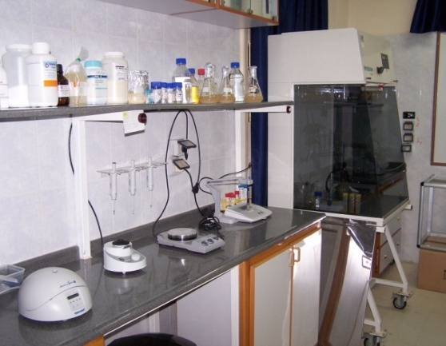
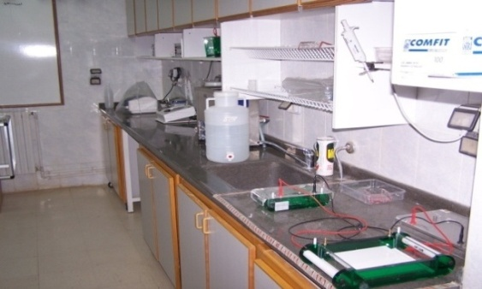
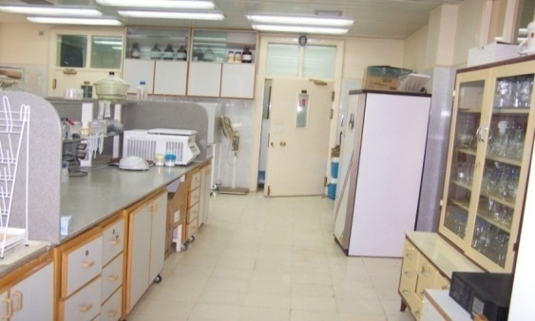
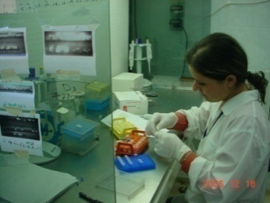
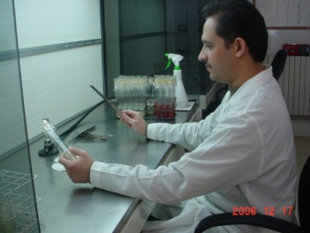
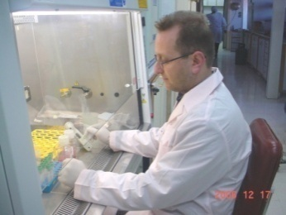
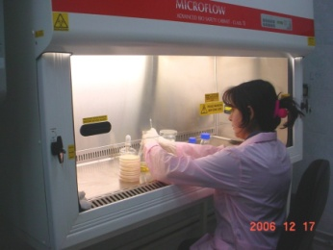
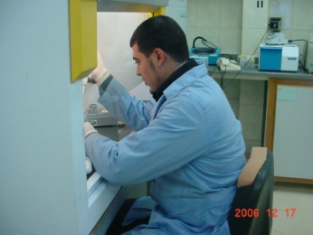
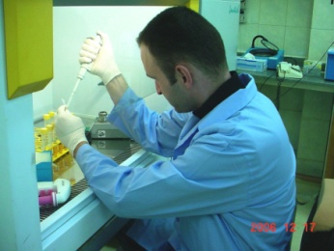
Laboratories at the AECS
Number of Scientific staff: 175
  Senior Researchers (Ph.Ds): 22
Facilities:
  Laboratory space: 3000 m²
Molecular Markers
Tissue Culture
Human Genetics
Transformation
Microbiology Lab
Brucella Lab
Notes:
3

Slide 4

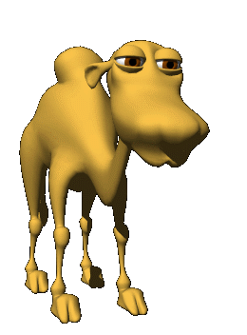
Introduction
Dr. Abdul Qader Abbady
MSc.
  France, ULP, 2001
  Pharmacology & Pharmacochemistry
PhD.
  France, ULP, 2005
  Life Sciences, Molecular Immunogenetics
Researcher, AECS
  Head of Div. Molecular Biomedicine
    Mol. Bio. Med.
  Dept. Molecular Biology & Biotechnology
Main project: Recombinant Antibodies
  Camel Nanobody
  Leishmaniasis

Slide 5
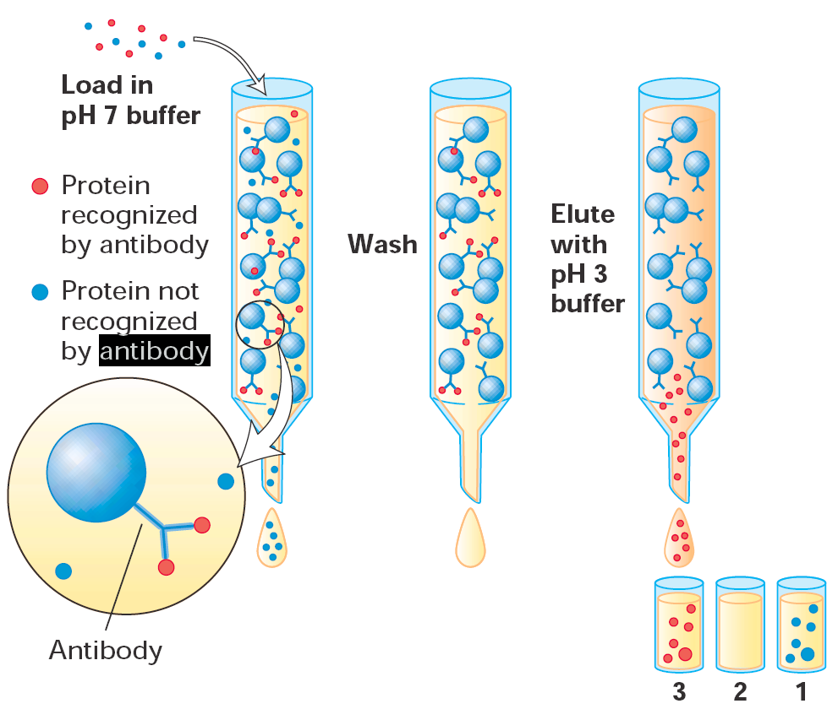
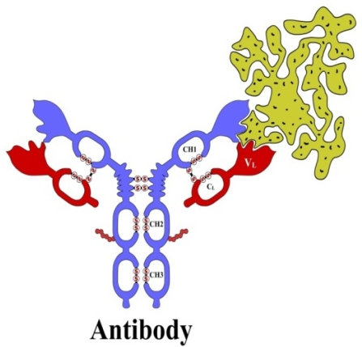
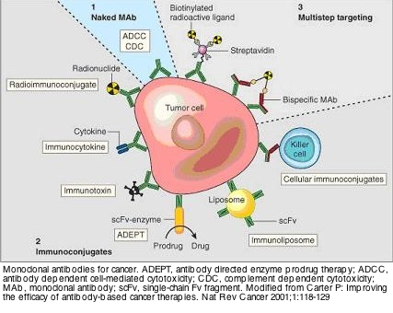
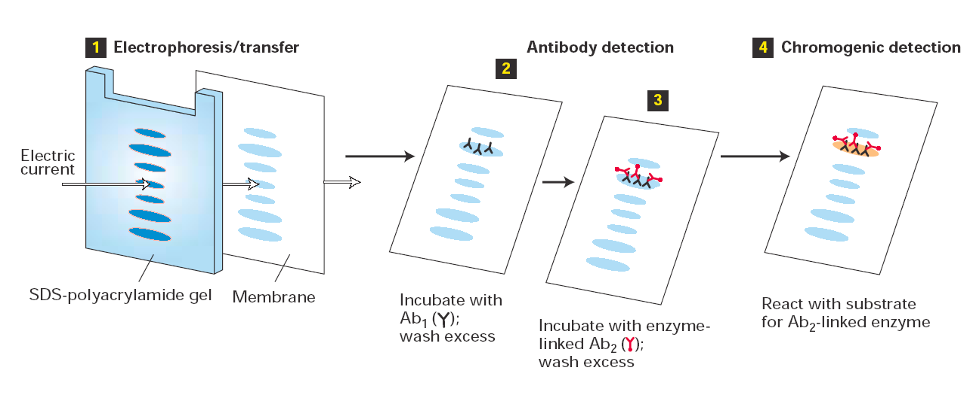
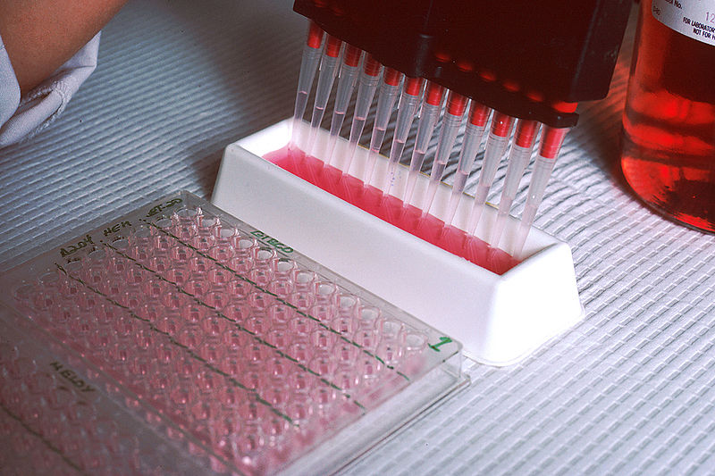

Antibody Applications
Molecular biology applications
  Active molecules purification
    Immunochromatography
  Antigen detection
    WB, ELISA, tests
Medical applications
    Transplant rejection
    Inflammation
    Infectious diseases
    Autoimmune diseases
    Oncology

Slide 6
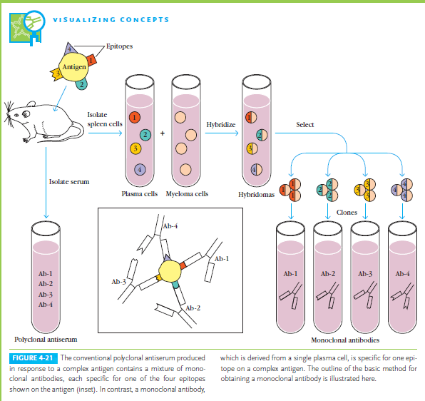
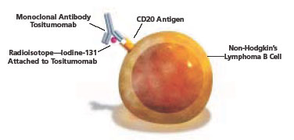
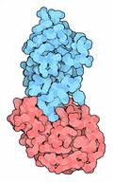
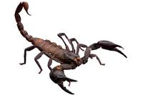
Production of Antibodies
Polyclonal Ab
  Serum & IgG
    Rabbit, Goat, etc..
Monoclonal Ab
  IgG
    Mouse
    Single B cell
Biopharmaceuticals
  Growing market
    80 b$ (therapeutics)
      cancer
      autoimmune diseases
    8 b$ (diagnostics)
    2.5 b$ (research)
Mechanisms of Action
  Blocking action
    Binding a receptor
    Binding an active molecule
  Effector groups
    Toxins, radionucleids, enzymes
    Apoptosis, cell division
Antidotes

Slide 7
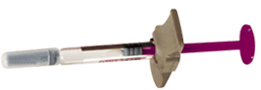
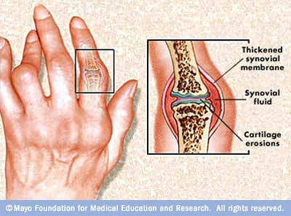
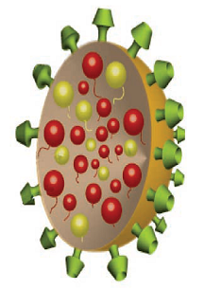
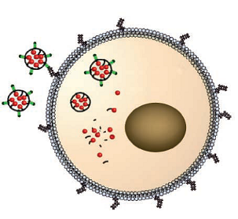
Pharmaceutical Antibodies
Autoimmune disease
  Rheumatoid Arthritis
    Anti-TNF
Cancer
  Diagnosis
  Treatment
    Un conjugated antibodies
      Inhibiting angiogenesis
      Blocking receptors
    Targeting tumour cells
    Cytotoxic drugs
      cytokines, toxins or radionuclides
  Nanomedicine
    Increase specificity
    Decrease side effects
    Increase desired effects
Adalimumab Or Infliximab

Slide 8
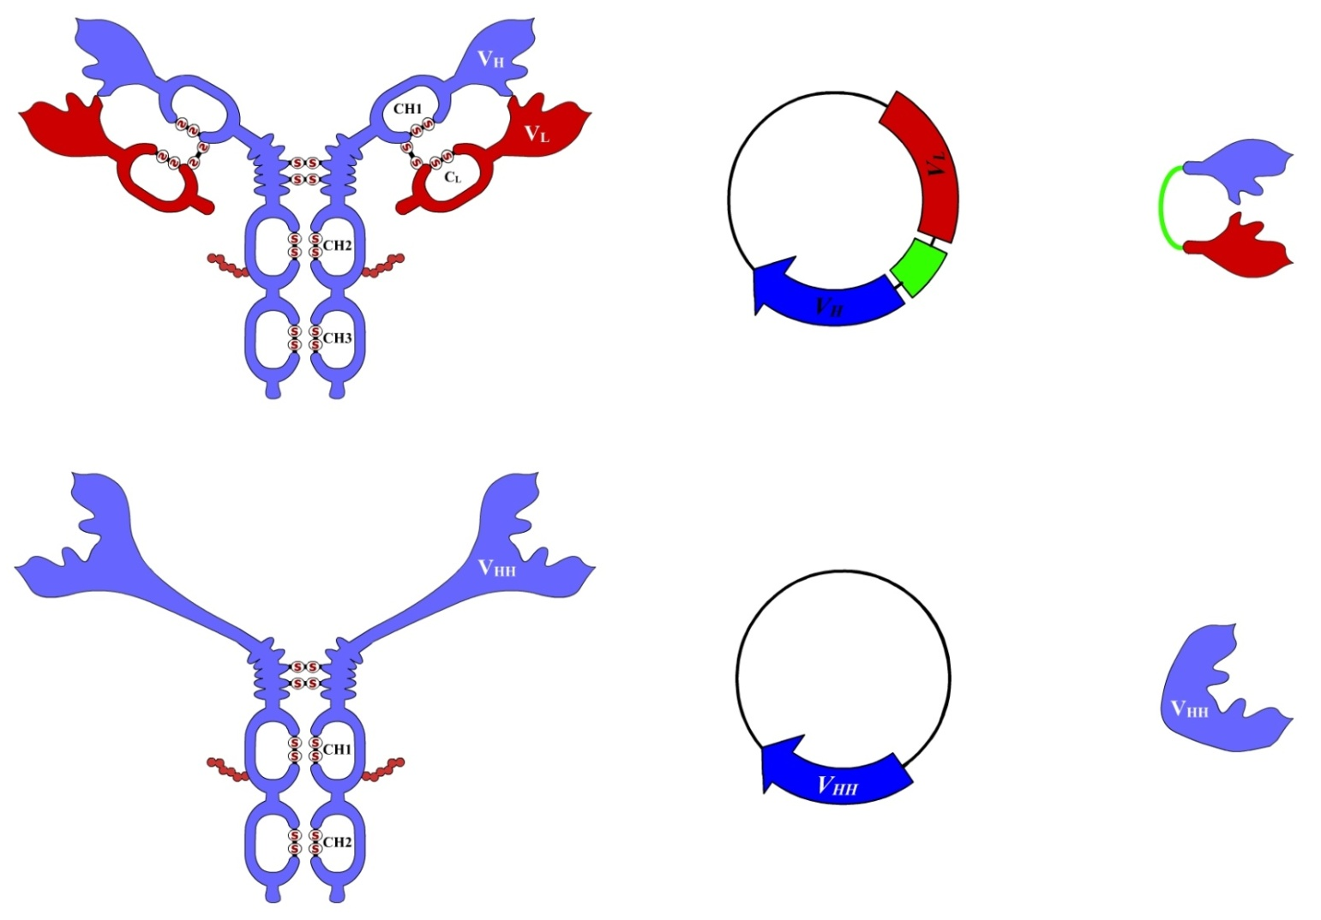

Nanobody
Camel Heavy-chain antibody
  Variable Domain = Nanobody
scFv
(25 kDa)
Antibody
VhH
(15 kDa)
Camel Heavy-Chain Antibody
Hamers et al., Nature, 1993

Slide 9
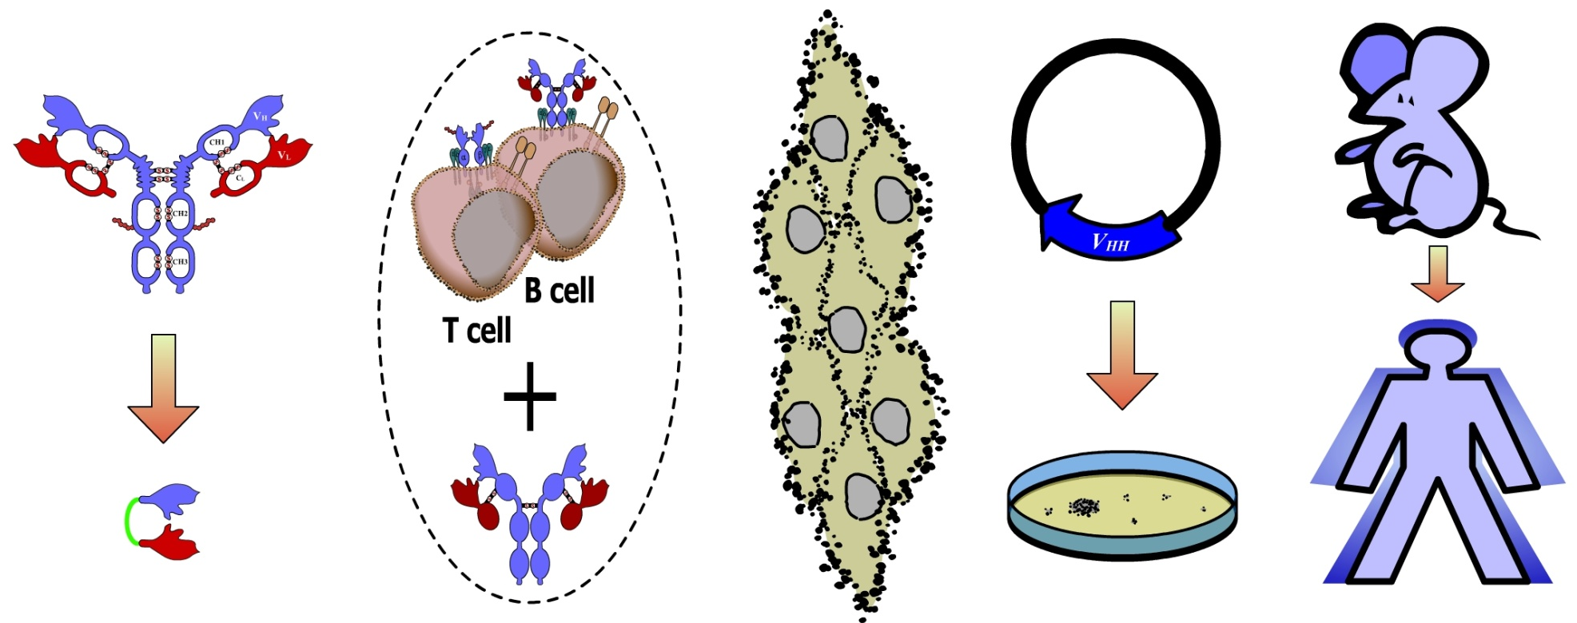
Advantages of Small Fragments
Stability in the immune system
Targeting cancer cells
Commercial production
Molecule stability
Immune control
Tissue penetration
Mass production
Humanization

Slide 10
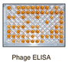
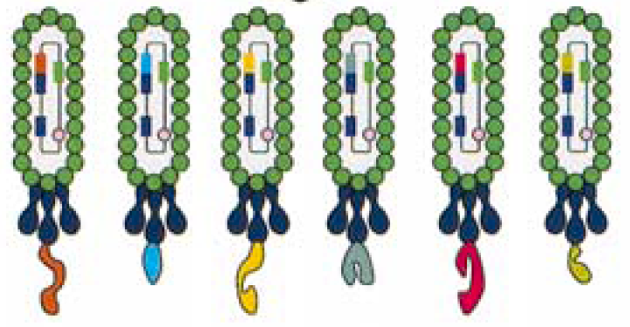

Selection of Specific Nanobodies
Collect
blood
Isolate lymphocytes
Phage Display
Extract mRNA
RT-PCR
Select Ag-specific
VHHs by panning
Produce soluble
antigen-specific VHH
Immunisation
(6-8 weaks)
Make library
of ~ 10⁷ transformants
Nanobody
Ghahroudi et al., FEBS Letters, 1997
Lauwereys et al., EMBO J., 1998

Slide 11
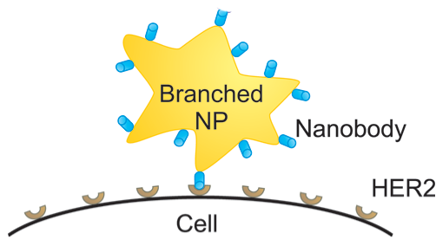
Tailoring into pluripotent constructs
Bivalent:
  Conrath et al., JBC 2001
Bispecific:
  Conrath et al., JBC 2001
Pentavalent:
  Zhang et al., JMB 2004
Decavalent/bispecific:
  Stone et al., J Imm Meth 2007
Immuno-enzyme (ADEPT):
  Cortez-Retamozo et al., Can Res 2004
Immuno-toxin:
  Baral et al., Nat Med 2006
Chromobody:
  Rothbauer et al., Nat Meth 2006
Scorpion (bispecific + Fc effector function)
  Hmila et al., Mol Immunol 2008
Anti-HER2 Nb for PET imaging of breast cancer
  Pruszynski, 2013
Nanomaterials targeting
  Van de Broek, 2011
NIR Laser
Single domain Antibodies
enzyme

toxin
VHH or
Nanobody
reporter
VHH
CH2
Fc
Fc
CH3

Slide 12


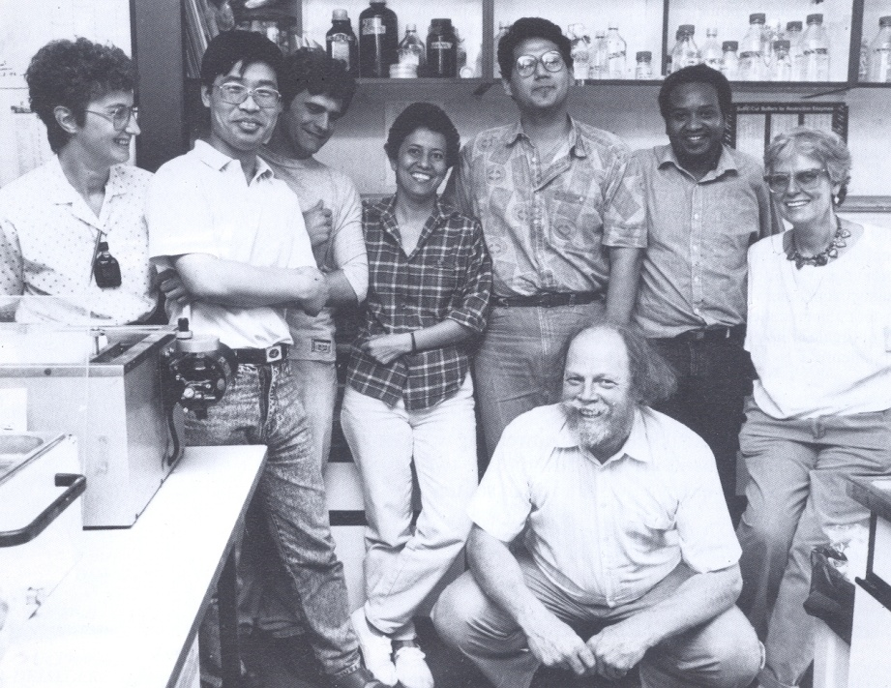
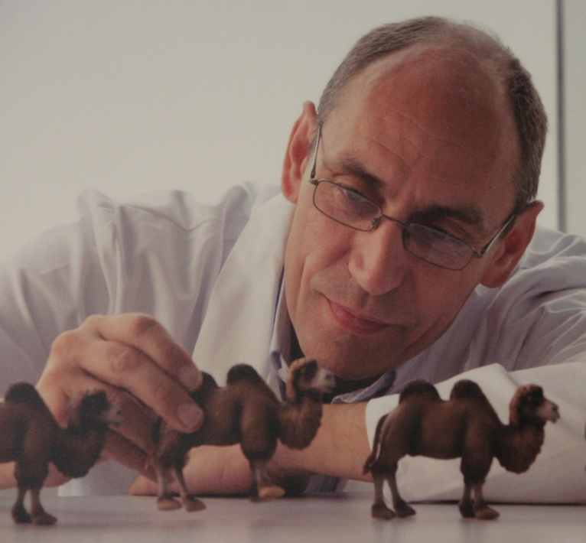
Nanobody Project
Ph.D in Cancer and Immunology
  2005
Article in 2006
From dromedary to drug
  Antibodies
  Nanobodies
    Derived from camels
    Low cost
    Wider range of diseases
Pioneers
  Prof. Raymond Hamers
  Prof. Serge Muyldermans
    VIB Group Leader
Visit exchange
  2006 & 2007

Slide 13
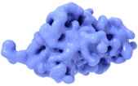
Human Growth Hormone
and its Specific Nanobodies
hGH

Slide 14
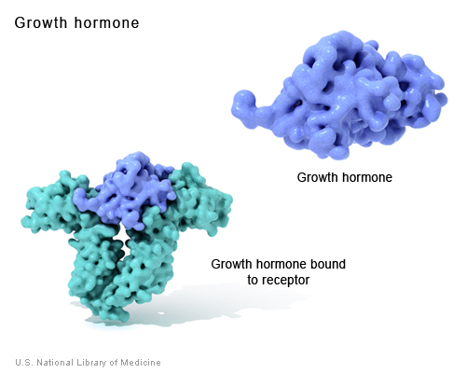
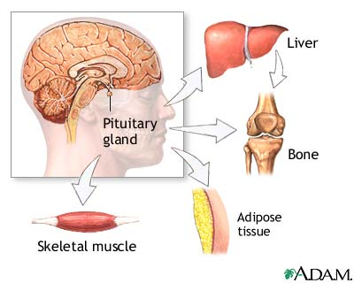
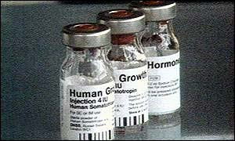

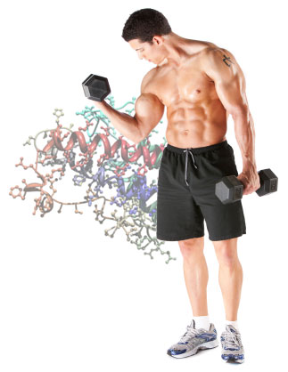
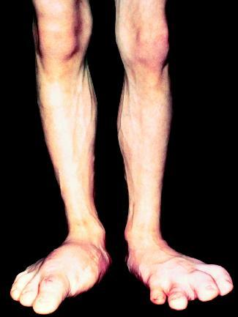
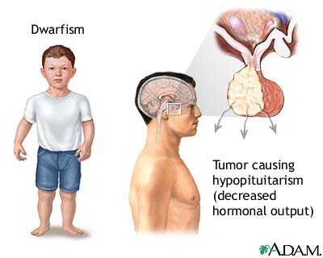
Anti-Growth Hormone Nanobodies
Growth Hormone
  Secreted protein (22 kDa)
  Pituitary gland
  Muscles and bones
GH over-production
  Acromegaly & gigantism
GH deficiency
  Dwarfism and Obesity
  Treatment
    rhGH
Body building
Animal rGH
  Fish, cows, etc..
  Feed
Somatropine
Acromegay
And gigantism
Dwarfism

Slide 15
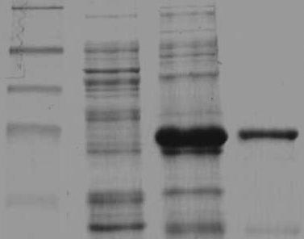


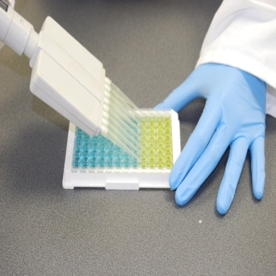
Anti-Growth Hormone Nanobodies
rhGH protein expression
  Purification
    His Tag
  Rabbit Anti-rGH
    ELISA
    WB
Anti-GH Nanobodies
  Characterization
  Applications
    Diagnosis
    Purification
      Immunochromatography
kDa
M
1
2
3
40
35
25
10
Paper
IF
2.5
H. Murad, B. Ali, R. Makeya and A. Q. Abbady, (2013). Prokaryotic overexpression of recombinant human Growth hormone and characterization of its polyclonal antibody. Gene.
Absorbance (450nm)
Paper
IF
3
A.Q. Abbady, R. Al‒Shemali, J. Mir Assaad and H. Murad, (2014). Generation and characterization of nanobodies against rhGH expressed as sfGFP fusion protein. General and Comparative Endocrinology.

Slide 16
GH-phage ELISA
M13 ELISA
  Ease of production
  Stable structure
  Signal amplification
M13 Sandwich ELISA
  NbGH04-captured GH
  NbGH07
  ~0.5ng/ml
A
B
Y
M-a-M13-HRP
Y
M13
M13
C
HA
GIII
His
Nb
HA
His
HA
GH
6xHis
Biotin
Nb
Nb
Nb
GH
GH
III
I
II
Paper
IF
4
H. Murad, J. Mir Assaad, R. Al‒Shemali and A.Q. Abbady, (2017). Exploiting Nanobodies in the Detection and Quantification of Human Growth Hormone via Phage-Sandwich Enzyme-Linked Immunosorbent Assay. Front Endocrinol.

Slide 17
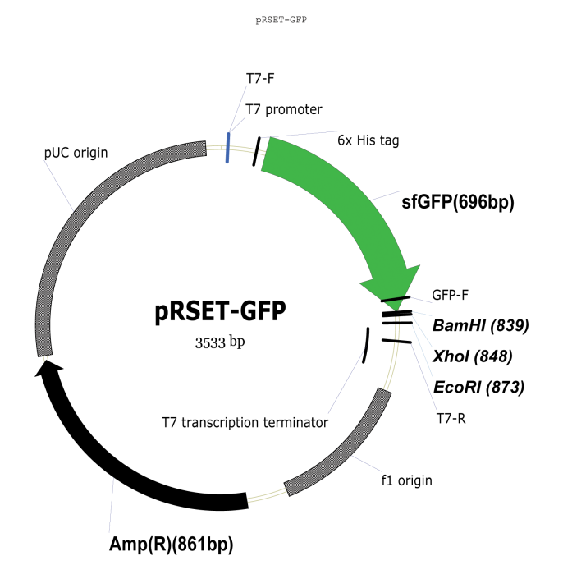
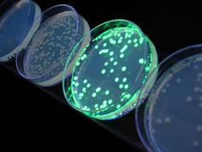
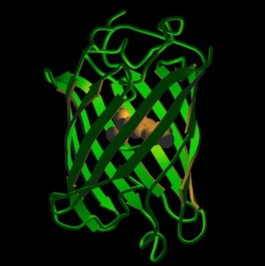
sfGFP as Fusion Protein
Aequorea victoria jellyfish
Visible green color
  High level protein production (super-folder)
  High solubility and stability
  Easy purification by adding affinity tag (6xHis)
  Removable by adding protease cleavage site
His
Paper
IF
2
Twair A, Al-Okla S, Zarkawi M, Abbady AQ: Characterization of camel nanobodies specific for superfolder GFP fusion proteins. Molecular Biology Reports 2014, 41(10), 6887-98.
TEV
GFP-GH

Slide 18
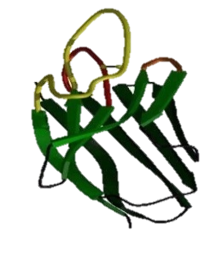


Nanobody Fusion Proteins
Anti-GH GFP fusion Nanobodies
  Expression in E. coli
  NbGH01-04, 06
  GH direct detection
    Detection R-a-GFP
Sandwich ELISA
  Captor Nb
  Detector GFP-Nb
GFP
Nb07
Nanobody
GH
sfGFP
sfGFP-NbGH
Nb04

Slide 19
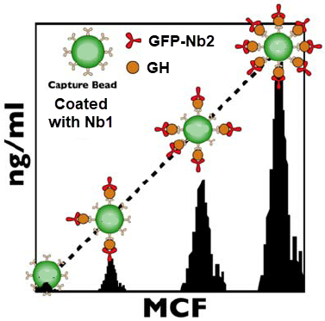
Nanobody Beads Array
GH quantification
  Direct, Fast & Scalable
  Detection limit:
    0.1ng/mL
GFP
Nb
Ag
Nb
Nb
Nb
Agarose Bead
Nb
Nb
Nb

Slide 20
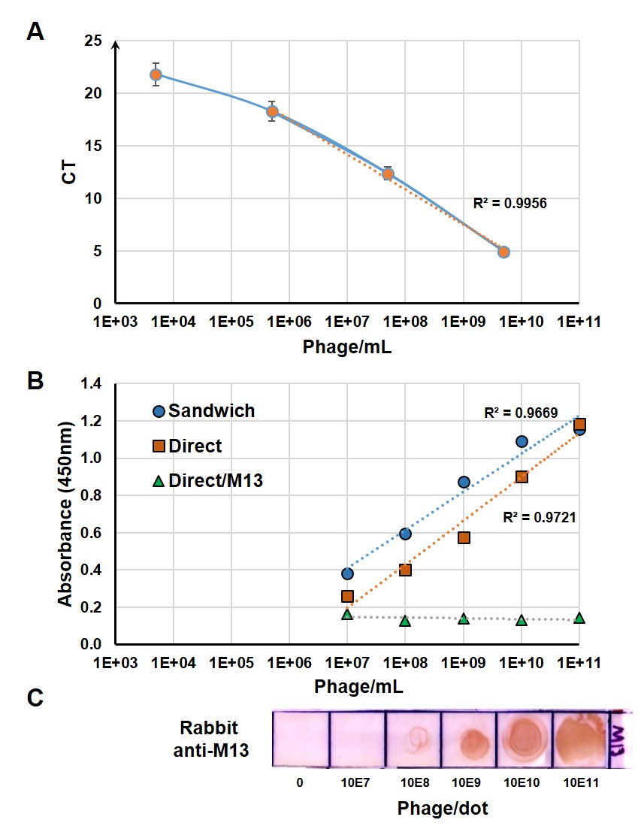

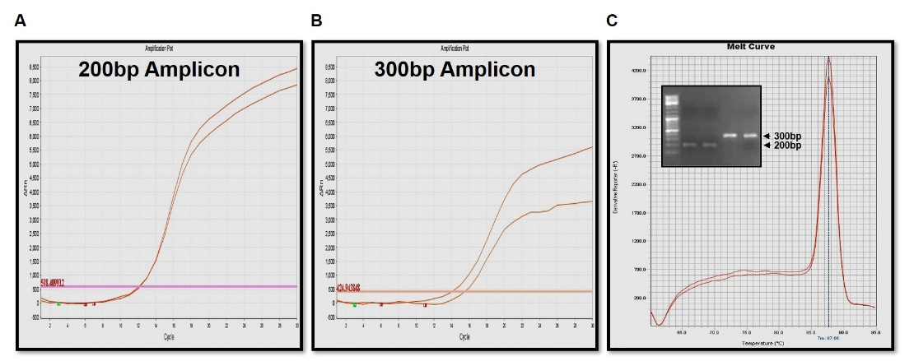
Nanobody-Phage iPCR
Immuno-PCR
  is an extremely powerful method of immunodetection which combines the specificity of an ELISA with the signal amplification of PCR.
Y
M13
RT-PCR
A) RT-PCR
B) ELISA
C) DOT BLOT
ssDNA
HA
His
Nb
GH
Nb
ELISA

Slide 21
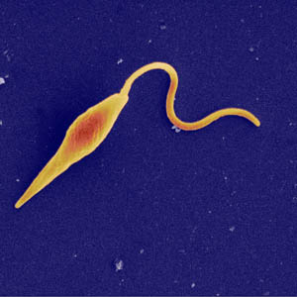
Nanobodies Against Leishmania

Slide 22








Anti-Leishmania Nanobodies
Leishmania
  Protozoan parasite
  23 different species
  Obligate intracellular
    Macrophages
  Life cycle
    Insect vector
      Sandfly
  Manifestations
    Cutaneous lesions
    Mucocutaneous ulcers
    Visceral
  In Syria
    Among refugees
Detection of Leishmania
  Collaboration
    Faculty of Science
  Species specific Nbs
    L. tropica & L. major
Ph.D. Degree
Inas Abo-Ashamat
Generation and characterization of specific Nanobodies against leishmania tropica

Slide 23
Production of anti-Leishmania Nbs
Camel immunization
  AECS
  L. tropica
Nb library
  L. tropica
    10⁷ transformants
Phage Display
  L. major
  L. tropica

Slide 24
Detection of Leishmania by ELISA
Anti-L. tropica Nanobodies
  NbLt05, 06, 14, 24 & 36
  Detected Species
    L. tropica
    L. major
    L. trantolae
  Immobilized Antigens
    Intact parasites
    Lysate
    No Ag
Detection of different local isolates
  L. tropica

Slide 25
Neutralizing Leishmania Infectivity
Preincubation with anti-L. tropica Nanobodies
Infection of human macrophages
Cell fixing then coloring
Cell counting
Paper
IF
5.5
E. Abu Alshamat, M. Kweider, C. Soukkarieh, M. Zarkawi, H.E. Khalaf and A.Q. Abbady, (2019). Potential of Camel Nanobodies as Molecular Tools to Understand, Diagnose and Treat Leishmaniasis. Front Immunol

Slide 26


Future Applications
Lateral Flow Immunoassay
  GH detection
  Leishmania Detection
    L. tropica
    L. major

Slide 27

Laboratories & Equipments

Slide 28



Techniques
Antibody Engineering
Phage Display
Creation of
Genetic Library
Immune Techniques
Gene Cloning
Protein Expression
&
Purification

Slide 29

Recombinant DNA Laboratory
Target Gene
  Protein of interest (Ag)
Vector (Plasmid)
  Bacteria
  Plant cells
  Mammalian cells
Cloning
Applications
  Genetic modification
    Transfected Cells
    Transgenic plants
  Protein Expression
    Nanobody
    Medical proteins
Nanobody

Slide 30


Laboratory of Genetic Libraries
Genetic Variation
Several Genes
  PCR
  Digestion
  Ligation
  Transformation
    In E. coli
10 libraries
  5x10⁶ to 5x10⁸

Slide 31

Phage Display Laboratory
Bacteriophages
Definition:
  Random displaying peptides or proteins on the surface of bacteriophage
  Direct physical link between the phenotype and the genotype
Applications:
  Isolation of high-affinity antibodies
  Studying protein-protein
Laboratory

Slide 32




Immune Proteomics Laboratory
SDS-PAGE Immunoblotting
  Protein Electrophoresis
  Immunodetection by antibodies
ELISA
  Enzyme-linked immunosorbent assay
FPLC
  Fast Protein Liquid Chromatography
  Purification of antibodies
  Purification of recombinant proteins
SPR
  Surface Plasmon Resonance
  Protein/protein interaction

Slide 33


Cell Culture Laboratory
Cell Lines
  Transfection
  New set of plasmids
    ICGEB course 2016
    Local courses
Leishmania
  Infection
  Effect of nanobodies
    Secreted
    Labeled

Slide 34
Acknowledgments
AECS
DMBB
DMBM
Project staff
Aya Twair
Lamis Alhomsi
Enas Abo Alshamat
Jana Mir Assad
Houssam El-Din Khalaf
Bothaina Al-Ali
Amer Maya
Danya Sakhal
Nebal Al-Saleh
Manal Houigah
Rima Makeyah
Zouzefeen Alwaer
Thanaa Doumani
Ola Sbienati
Rasha Al-Shemali
Collaborations
AECS
Dr. Houssam Murad
Dr. Moutaz Zarkawi
National
Dr. Mahmoud Kouaider
Dr. Shady Sukaria
Dr. Hassan Naser Eddin
Dr. Isam Qassem
PhD students
Lamis Alhomsi
Aya Twair
Inas Abo Al-Shamat

Slide 35



Scientific Activities
Commission for Distinction and Creativity
  Academic Programs
    Medical Science
  Syrian Science Olympiad
    Biology
Professor at the IUST
  Biology

Slide 36

Scientific Activities
Frontiers In Immunology (IF:5.5)
  Associate Editor
  www.frontiersin.org/journals/immunology

Slide 37




Slide 38





AECS courses

