Slide 1
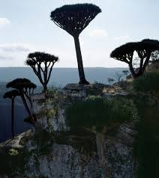

Slide 2
تقييم التاثير الخافض للسكر والدهون للمستخلص الايثانولي لرزين نبات شجرة دم الاخوين في جزير ة سقطرة على حيوانات التجارب The Potential Antidiabetic and Antihyperlipidemic Activity of Dracaena Cinnabari Balf. Resin in experimental animals

Slide 3
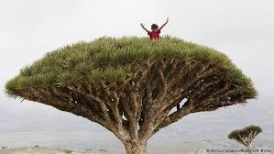
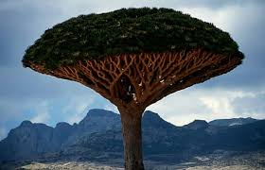
تعرف شجرة أم التنين أو كما يطلق عليها “دم الأخوين” بأنها من أغرب الأشجار الموجودة في العالم ، ويقصد بالأخوين هنا أول أخوين عرفتهما البشرية ، ويعود تاريخ شجرة دم الأخوين إلى حوالي 50 مليون سنة او أكثر ،

Slide 4
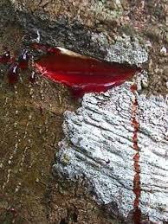
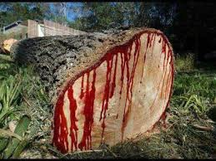
ترجع تسمية هذه الشجرة “دم الأخوين ” إلى أسطورة الأخوين قابيل وهابيل التي تحكى عبر الأجيال ، ويقال أن أو قطرة دم نزفت بينهما أنبتت هذه الشجرة ، كما يزعم أن هذين الأخوين كانا أول من سكن جزيرة سوقطرة ، وعندما سالت دماء أو جريمة قتل بينهما ظهرت هذه الشجرة على الجزيرة .

Slide 5
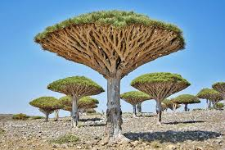
شجرة دم الأخوين من أكثر الأشجار ندرة وجمالا ، بالإضافة إلى ذلك كانت نبتة مقدسة لدى بعض الديانات القديمة مثل الآشوريين ، الحميريين والفراعنة أيضا ، وهذه معلومات موثقة على جدران ونقوش المعابد .

Slide 6
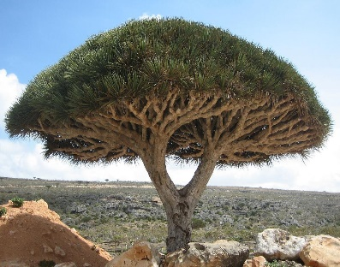
Dracaena Cinnabari
is a species plant in agavaceae family in the Island of Socotra, Yemen (Bellakhdar; 1997).
It has a unique and bizarre appearance, its upturned, densely-packed crown having the shape of an upside-down umbrella (Milburn;1984).

Slide 7
Mabberley (1998) noted that resinous sap produced via incisions in the bark or stem of the Dracaena cinnabari ,which was used by the Ancients in different purposes (Mabberley; 1998).
Tree
Powder
Resin
Trunk

Slide 8
It has been used in Yemeni folk medicine for the treatment of
Gastric sore
Diarrhea , and dysentery,
Antispasmodic , analgesic

Slide 9
Phytochemical screening of aqueous and ethanolic extract of resin contains
Tannin,
Carbohydrate,
Phenol, Alkaloids,
Steroids, and Diterpenes
In addition to the present of
flavonoids which consider the main component of the plant ,
sterols and triterpenoids

Slide 10
There are a lot of researches that have been worked on Dracena cinnabari balf resin and approved its effectiveness as
antimicrobial, antiviral
antitumor and cytotoxic
It is also found that, it is
a potent analgesic
antioxidant
and anti-inflammatory

Slide 11
Aim of study
Evaluating the potential antidiabetic effect of Dracaena cinnabari balf resin extract in alloxan-induced diabetes rats
and on lipid profile in high-cholesterol diet-induced rats through two separate experiments.

Slide 12
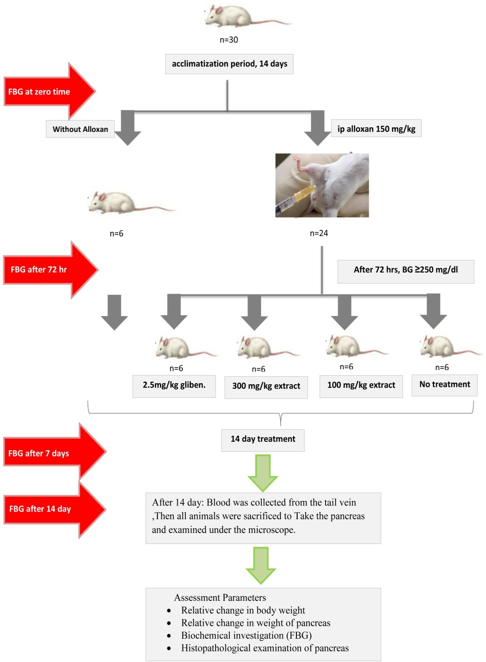

Slide 13
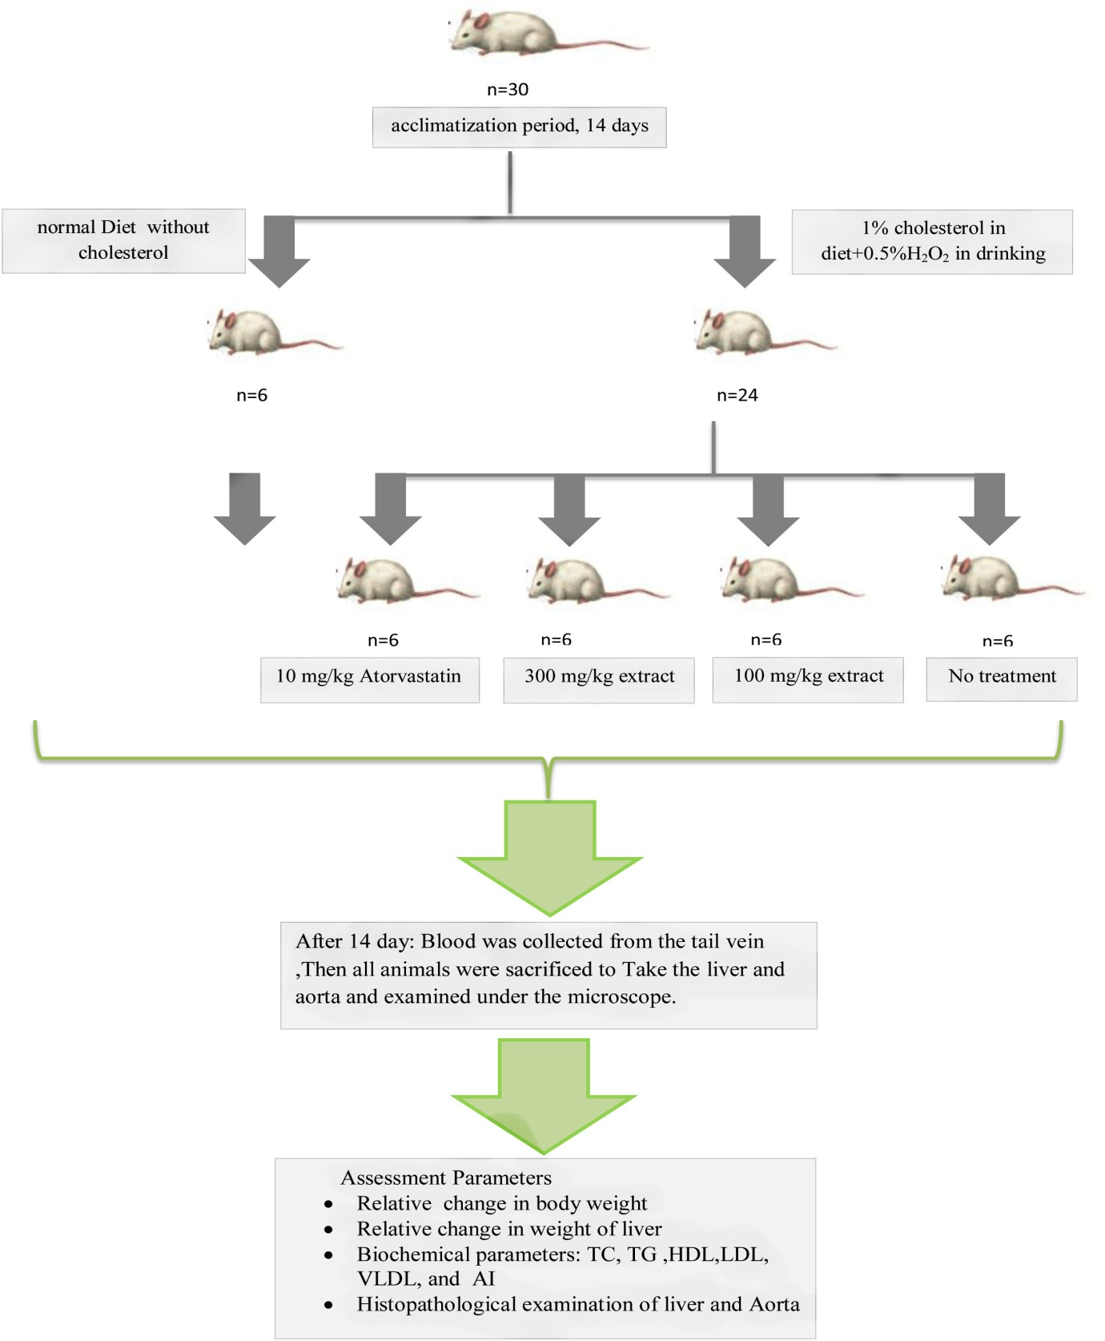

Slide 14
Statistical analysis:
The result were expressed as mean ± SD and differences among the groups of animals were compared using one-way ANOVA with post-hoc LSD's test. Statistical significance was set at P ≤ 0.05. Statistical analysis was performed using Microsoft excel, and SPSS software version 20.

Slide 15
Results of evaluation of antidiabetic potential of DCBR extract:
Relative change in body weight:
Groups | 1st Body weight(g) | 7th day Body weight(g) | 14th day Body weight(g)
Group 1 | 165.41±43.8 | 196.46±32.7 | 219.5±35.7
Group 2 | 178.33±17.4 | 158.66±32.3 | 146.73±36.3*
Group 3 | 175.93±25.7 | 184.48±26.5 | 196.05±27.5
Group 4 | 153.16±43.1 | 172.28±40.5 | 187.73±39.0
Group 5 | 153±14.0 | 150.56±19.9 | 150.03±18.5*
Values are expressed as Mean ±SD; n=6; *P ≤ 0.05 vs. group 1. DCBR: Dracanea cinnabari balf Resin.

Slide 16
Results of evaluation of antidiabetic potential of DCBR extract:
Relative change in weight of pancreas:
The effect of DCBR extract on change in the pancreas weight (g) of Alloxan -induced diabetic rats.
Groups | pancreas weight (g) | % of change vs. group 1
Group 1 | 1.57±0.43
Group 2 | 0.48±0.08* | 69.4 %
Group 3 | 1.03±0.42 | 34.3%
Group 4 | 1.33±0.43** | 15.3%
Group 5 | 0.92±0.21* | 41.4%
Values are expressed as Mean ±SD; n=6; *P ≤ 0.05 vs. group 1, **P ≤ 0.05vs. Group 2. DCBR: Dracanea cinnabari balf Resin.

Slide 17
Results of evaluation of antidiabetic potential of DCBR extract:
Biochemical investigation (FBG):
Effects of DCBR extract on the FBG values (mg/dl) of Alloxan-induced diabetic rats.
Groups | Basal Value(mg/dl) | 7th day(mg/dl) | %of FBG change vs. Basal Value after 7 days | 14th day(mg/dl) | %of FBG change vs. Basal Value after 14 day
Group 1 | 80.16 ±9.7 | 88.16±4.2 |  | 90.3±6.7
Group 2 | 495.0±32.7* | 522.16±31.1 *, ∆ |  | 508.4±34.9*, ∆
Group 3 | 381.6±22.2*,** | 291.8±18.1 *,**, ∆ | 24% | 180.8±14.9*,**, ∆ | 53%
Group 4 | 473.6±14.7* | 186.6±4.4*,**, ∆ | 60.5% | 101.6±3.1** , ∆ | 79%
Group 5 | 481.5±11.4* | 415.0±13.7*,**, ∆ | 14% | 217.0±10.7*,**, ∆ | 55%
Values are expressed as Mean ±SD; n=6 ; *P ≤ 0.05 vs. group 1for each column, **P ≤ 0.05 vs. group 2 for each column. ∆P ≤ 0.05 vs. basal value for each row. DCBR: Dracanea cinnabari balf Resin, FBG: Fasting Blood Glucose.

Slide 18
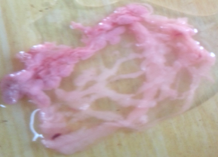
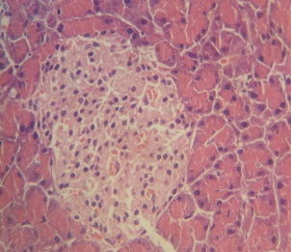
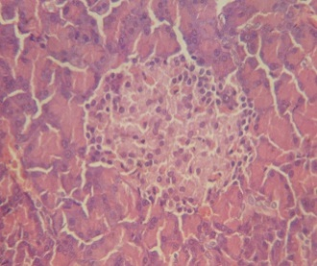
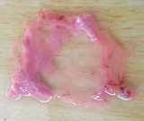
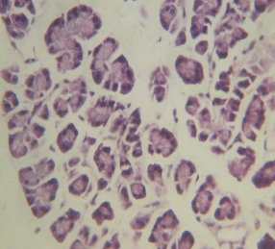
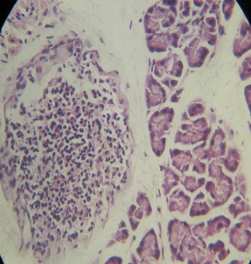
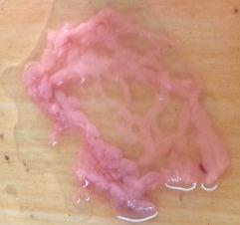
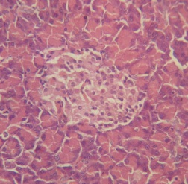
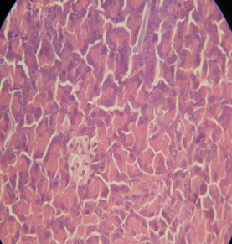
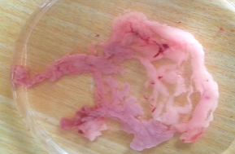
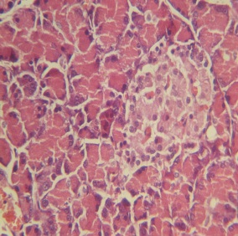
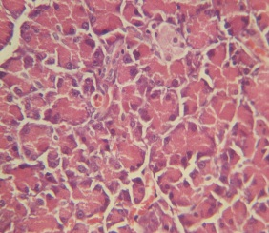
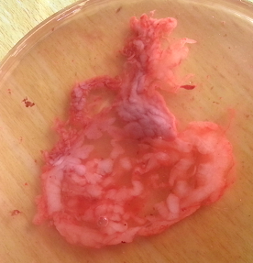
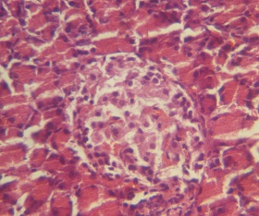
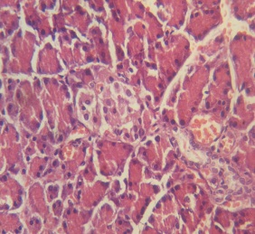
Results of evaluation of antidiabetic potential of DCBR extract:
Histopathological examination of pancreas:
Macroscopic observations
Microscopic observations
Group1
Group2
Group3
Group4
Group5

Slide 19
Results of evaluation of antihyperlipidemic effect of DCBR extract:
Relative change in body weight:
Table (7): The effect of DCBR extract on change in the body weight (g) of hyperlipidemic rats.
Groups | Initial Body weight (g) | 7th day body weight (g) | 14th day Body weight (g)
Group 1 | 251.33±22.5 | 271.48±19.7 | 295.01±15.5
Group 2 | 277.9±6.6 | 279.25±2.1 | 287.3±0.6
Group 3 | 295.4±32.1 | 293.4±34.2 | 305.46±32.6
Group 4 | 321.3±43.3 | 279.41±37.5 | 280.98±42.4
Group 5 | 306.53±35.9 | 300.26±30.4 | 316.38±34.
Values are expressed as Mean ±SD; n=6 ; *P ≤ 0.05 vs. group 1. DCBR: Dracanea cinnabari balf Resin.

Slide 20
Results of evaluation of antihyperlipidemic effect of DCBR extract:
Relative change in weight of liver:
Table (8): The effect of DCBR extract on change in the liver weight (g) of hyperlipidemic rats.
Groups | liver weight (g) | % of change vs. group 1
Group 1 | 9.65±0.25
Group 2 | 16.9±0.91* | 75%
Group 3 | 10.4±1.08** | 7.8%
Group 4 | 11.13±1.09** | 15%
Group 5 | 13.21±2.36*&** | 37%
Values are Mean ±SD; n=6 ; *P ≤ 0.05 vs. group 1, **P ≤ 0.05 vs. group 2. DCBR: Dracanea cinnabari balf Resin

Slide 21
Results of evaluation of antihyperlipidemic effect of DCBR extract:
Biochemical parameters: TC, TG ,HDL,LDL, VLDL, and AI:
Table(9): Effects of DCBR extract on the lipid profile mg/dl of high fat diet hyperlipidemic rats after 14 days.
Groups | TC | TG | HDL | LDL | VLDL
Group 1 | 59.2±13.51 | 103.98±20.5 | 52.48±5.83 | 73.5±14.54 | 20.79±4.1
Group 2 | 111.5±9.31* | 136±2.19* | 28±1.09* | 130.5±7.12* | 27.2±0.43*
Group 3 | 93.46±9.98** | 107±8.19** | 36±3.89** | 119.66±12.2 | 21.4±1.63**
Group 4 | 77.01±8.84** | 96.08±23.61** | 28±0.63 | 102.16±4.75** | 19.21±4.72**
Group 5 | 113.05±11.83 | 134±3.63 | 37.5±3.27** | 121±10.31 | 26.8±0.72
Values are expressed as Mean ±SD; n=6 ; *P ≤ 0.05 vs. group 1, **P ≤ 0.05 vs. group 2. DCBR: Dracanea cinnabari balf Resin, TC: Total Cholesterol, TG: Triglyceride, HDL: High Density Lipoprotein, LDL: Low Density Lipoprotein, VLDL: Very Low Density Lipoprotein

Slide 22
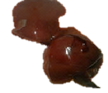
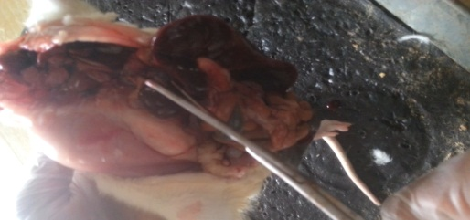
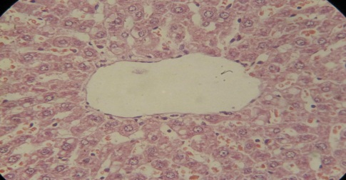
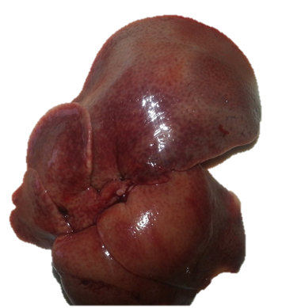
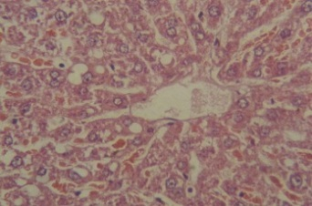
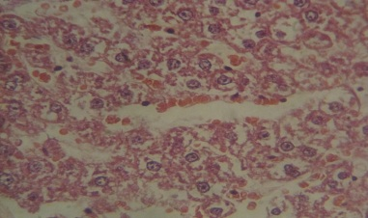
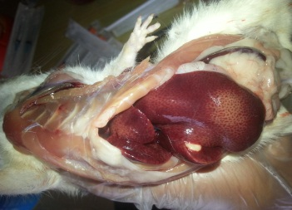
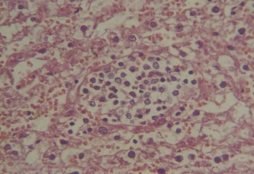
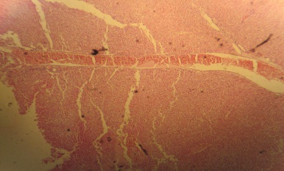
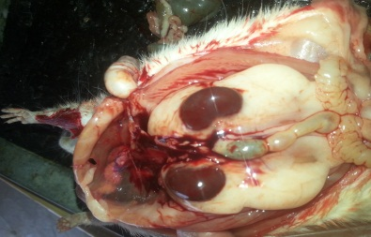
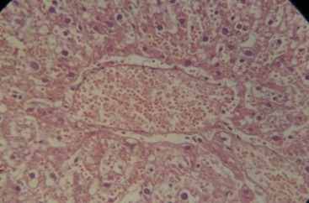
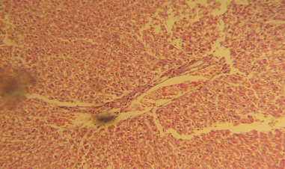
Results of evaluation of antihyperlipidemic effect of DCBR extract:
Histopathological examination of liver
Group 1
Group 2

Slide 23
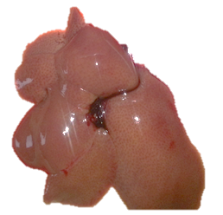
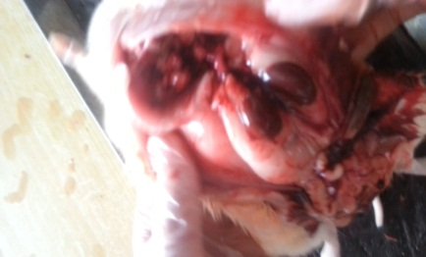
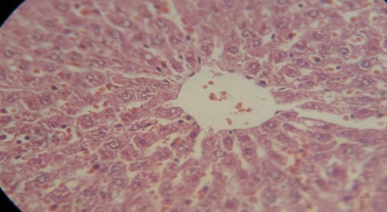
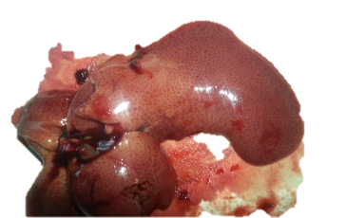
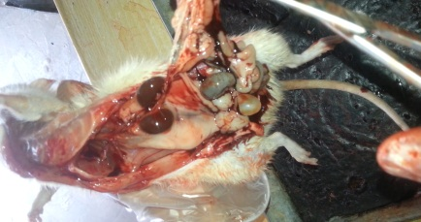
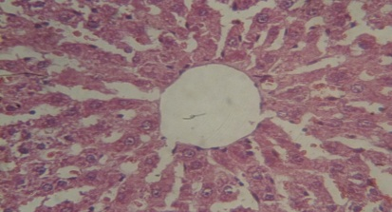
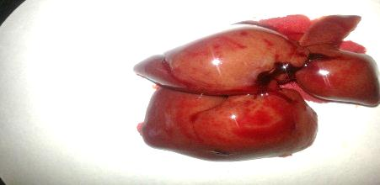
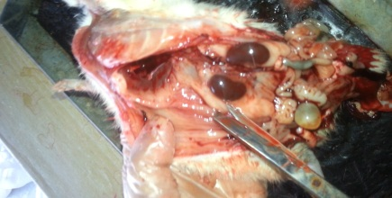
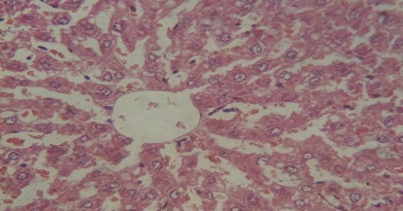
Group 3
Group 4
Group 5

Slide 24
Discussion
In conclusion, ethanolic DCBR extract has demonstrated
significant antidiabetic and antihyperlipidemic activity.
This effect is may be due to the presence of flavonoids in the whole extract which are working by different mechanisms.
However, further studies are recommended to isolate and elucidate the bioactive compound(s) responsible for its antidiabetic and antihyperlipidemic activity and its molecular mechanism of action.

Slide 25
Mechanisms of Antidiabetic of DCBR:
Antioxidants
insulin secretagogues
Mechanisms of Antihyperlipidemic of DCBR:
Antioxidants
bind with bile acids
Inhibit Pancreatic cholesterol esterase enzyme
inhibit α-glucosidase activity
Notes:
Alpha-glucosidase breaks down starch and disaccharides to glucose

