Slide 1
Insulin Resistance
The Silent Killer
Dr Mazen Alyoussef
Diabetologist & Endocrinologist
Hama Scientific Meeting 20/03/2019

Slide 2
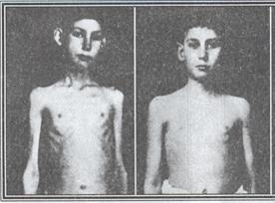

Slide 3
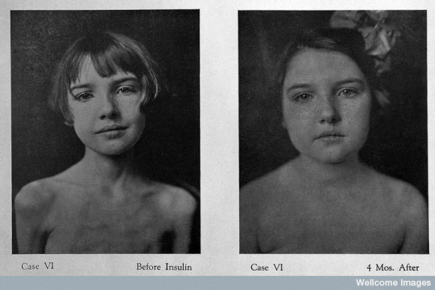
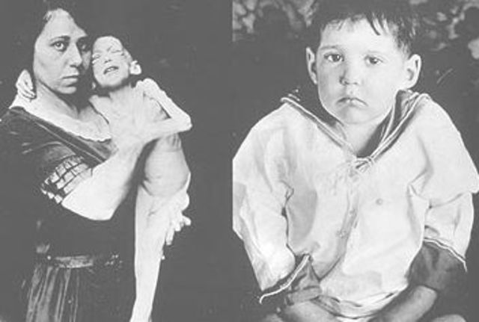
Type 1 DM
SOLVED

Slide 4
What about Type 2 ?
In contrast to T1DM
Insulin
Is the problem, not the solution
Type 2 DM is a hyperinsulinemic state with high blood glucose most of the time.
Insulin resistance: The diminished ability of cells to respond to the action of insulin in transporting glucose (sugar) from the bloodstream into muscle and other tissues.

Slide 5
Evolution Of Type 2 DM
Long Standing Compensatory Hyperinsulinemia
Innocent Victims
PCOs
High Blood Pressure
CVD
High TGs & Low HDL
Primary liver cancer
Alzheimer’s disease
Hypercoagulability
CKD
NAFLD
Beta Cells
Normal
Function
Beta Cells Overproduction
Beta Cell Exhaustion
B-Cell Failure
Insulin
Deficiency
1 Unit Insulin for 10 mg Glucose
10 Units Insulin for 10 mg Glucose
على زعله
<10 Units Insulin for 10 mg Glucose
1 Insulin for>10 mg Glucose
Normoglycemic
Normoinsulinemic
State
Normoglycemic
Hyperinsulinemic
State
Hyperglycemic
Hyperinsulinemic
State
Hyperglycemic
Hypoinsulinemic
State
Insulin required
for Type 2 DM
Hyperinsulinemia
Insulin
Resistance
N Insulin
IFG
Healthy
Individuals
Pre-diabetic State
Type 2 DM
Type 1 & 2
DM
100 mg
126 mg
Fasting Glucose
Over Time

Slide 6
Defects in Insulin Resistance
No Insulin Resistance
Insulin Resistance

Slide 7
To understand insulin resistance
We have to know what insulin normally does.

Slide 9
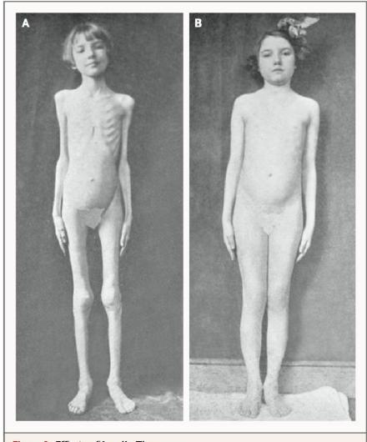
Internal Starvation

Slide 12
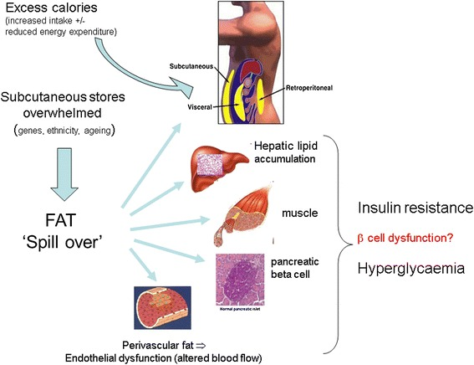

Slide 13
NAFLD
NASH
NAFLD is defined as excess fat in the liver ( > 5 – 10% fat histologically) which is not brought about by excess alcohol use or effects of other toxins, autoimmune, viral or other causes of steatosis.
NAFLD has been shown to predict both T2DM and cardiovascular disease independent of obesity
NASH will become the number one cause of orthotopic liver transplantation by the year 2020

Slide 15
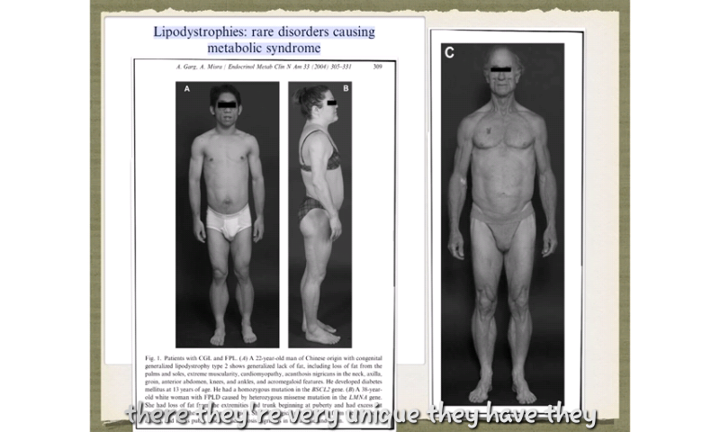
Lipodystrophies cause insulin resistance

Slide 16
Lipodystrophies cause insulin resistance

Slide 18
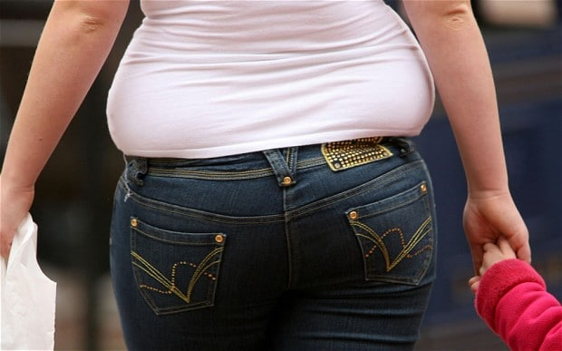
Personal Fat Threshold

Slide 20
Good Luck

